Slide 1
Capacity-building and awareness-raising activities April 2016 -February 2017
Secretariat to the Convention on Long-range Transboundary Air Pollution
EMEP Steering Body and Working Group on Effects bureaux meeting
March 2017
Notes:
This is a sample Title Slide with Picture ideal for including a dark picture with a brief title and subtitle.

Slide 2
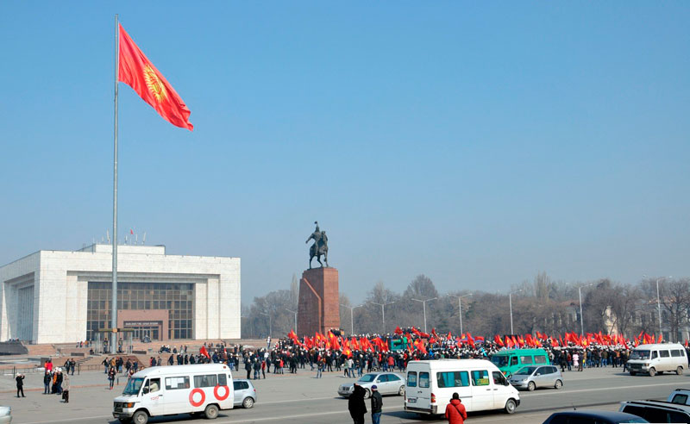
Analysis of the national air quality assessment and management policies and legislation of Kyrgyzstan and recommendations on further steps towards ratification (a roundtable in Bishkek, 12 April 2016)
Workshop on emission inventories (13-15 April 2016)

Slide 3
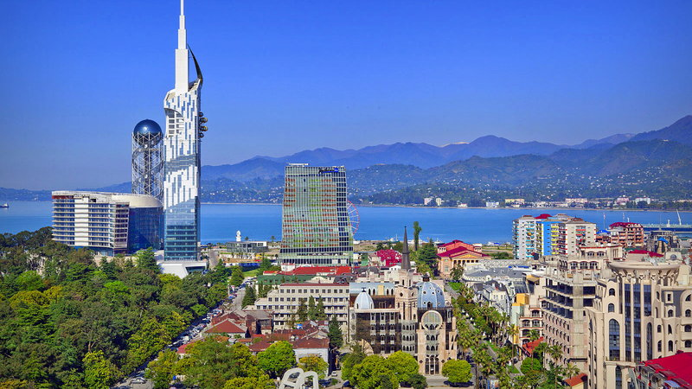

Slide 4
2016: All Parties in Eastern Europe, the Caucasus and Central Asia report their emissions

Slide 5
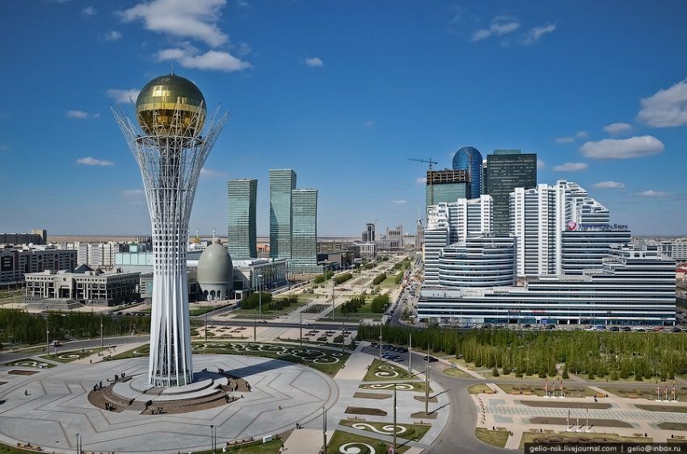
Analysis of the national air quality assessment and management policies and legislation of Kazakhstan and recommendations on further steps towards ratification
Roundtable, Astana, Kazakhstan, September 2016

Slide 6
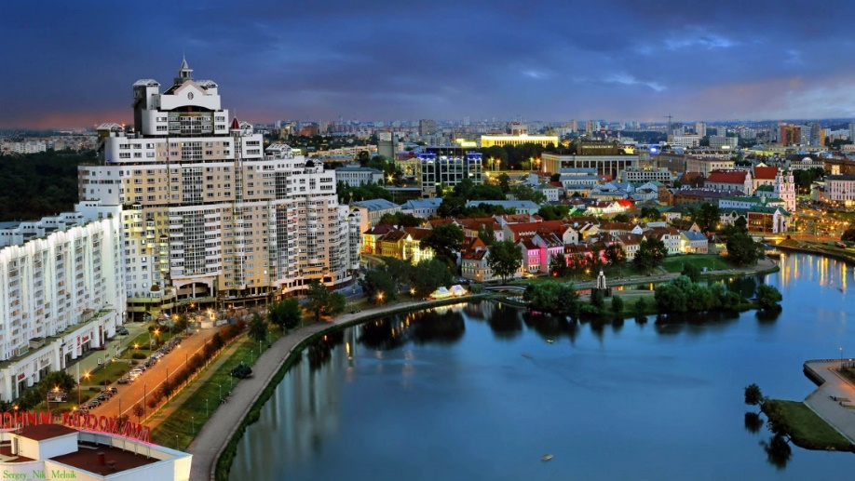
Subregional workshop “Get your right to a healthy community” Minsk, 19-21 September 2016
Organized in cooperation with the secretariat to the Protocol on Pollutant Release and Transfer Registers (PRTR) to the Aarhus Convention and the Ministry of Natural Resources and Environmental Protection of Belarus

Slide 7
Consultation meeting in Yerevan, Armenia
Support in emission reporting under the Convention:
NFR, IIR, gridded data

Slide 8
Other: Support to the organization of the workshop on BATs with a focus on countries in Eastern Europe, the Caucasus and Central Asia (Berlin, April 2016) Organizational support to the meeting of the Coordinating Group on the promotion of actions towards ratification (St-Petersburg, October 2016)

Slide 9
Thank you for your attention! air_meetings@unece.org

