Slide 1

Joint Meeting of the Extended Bureaux of EMEP-Steering Body and the Working Group on Effects
20-23 March, Geneva
Isaura Rábago
Chair WGE
isaura.rabago@ciemat.es

Slide 2
Organizational Issues
Objectives of the meeting
  Inform about last news from EB, WGSR, Secretariat.
  Review ICPs/TF/JEG·DM activities
  Review compliance of Workplan 2016-2017: activities, problems
  Update Mandates for ICPs, TFH and JEG
  Workplan 2018-2019: Define the elements
  Identify and describe future activities
  Prepare the 3rd joint session EMEP/WGE
  Key points to improve links WGE - policy makers (national level)
  WGE cooperation for the implementation of the NEC Directive

Slide 3


Organizational Issues
WGE specific issues Monday, 20 March, 14.00-18.00
1. Organizational issues
2. Update on the Calls for Data |  | ICP M&M, CCE ICP Materials
3. Reports by TFH/ICPs/JEG and common ICP activities | On going activities, 2016-2017 workplan compliance, info about meetings, common activities…. | (All groups)
Tuesday, 21 March, 9.00-13.00
4. Reports by TFH/ICPs/JEG and common ICP activities (continued)
5. Follow-up on ICP review | Web page
6. Outreach and EECCA related activities |  | ICPs? Secretariat
7. Update of mandates for ICPs, TFH and JEG |  | All groups
8. Funding of effects-related activities |  | Secretariat
9. Other business
Workplan discussion moved to EMEP/WGE common issues

Slide 4
Update of Mandates
2016: Started the review of the mandates for EMEP Task Forces and Centres
2017: Starts the review of the WGE ICPs, TF-Health and JEG Dynamic Modelling
Revision and update of Mandates
Consistent with priorities of the Convention
According to
Future Development of Effects-Oriented Activities (EB.AIR/WG.1/2000/4)
Guidelines for reporting on the monitoring and modelling of air pollution effects (ECE/EB.AIR/2008/11; ECE/EB.AIR/WG.1/2008/16/Rev.1)
Long-term Strategy for the Convention on Long-range Transboundary Air Pollution and Action Plan for Its Implementation
Bi-annual workplans for the implementation of the Convention

Slide 5
Update of Mandates
  Including
    a description of the TF/ICP responsabilities to ensure a better understanding of the scope of its activities (…and looking for a political and financial support).
    those activities carried out on a regular and continuous basis (coordination, reporting, meetings…..)
    ………………….

Slide 6
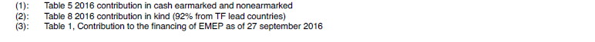
Funding of Effects Related Activities
  ECE/EB.AIR/2016/6
  From 26 Parties to the Convention

Slide 7
Funding of Effects Related Activities
  Need of a sustainable (financial) support:
  for national activities
  for core activities
  Executive Body: clear support to Effects activities
  looking for (sustainable) fundings
  requiring action by Parties (letter from ECE/ENV)
  How to draw attention to action?
  Improving communication tools (updated mandates, new workplan)
  Improving communication channels (national level (NFCs / WGE / EB)
  New requests to Parties: with acompanying information (next summer?)
  Relevance and Usefulness of Monitoring and Modelling tools (NEC)

Slide 8

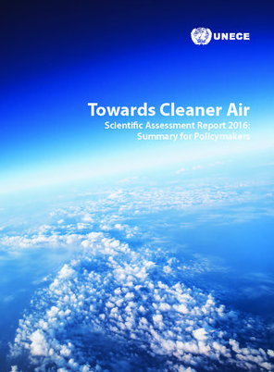
Follow up from the EB, WGSR, Joint EMEP/WGE 2016 meetings
EB & WGSR
Review of the implementation of the workplan 2016-2017
  Launch of the Towards Cleaner Air: Scientific Assessment Report
  Request to elaborate a draft 2018-2019 Workplan
  Adopted the Guidance Document on VOCs
  Recommended further integration of acticvities under EMEP and WGE, and closer cooperation between centres and task forces
  Invited the ad-hoc policy review group to highlight issues regarding LTS
  Encouraged Parties to consider providing resources for the long term financing of the effects oriented (CCE and TFrN)
  Acknowledged the financial contribution by France, Germany, Sweden, Switzerland, Nordic Council of Ministers and Norway to the CCE 2017 activities

Slide 9
Follow up from the EB, WGSR, Joint EMEP/WGE 2016 meetings
Financing:
  WGE: 25% received from earmarked and non-earmarked from approved budget
  TFrN: will begin to cease as of spring 2017 in the absence of funding. Contacts with Denmark for a possible support to this TF
  The Secretariat should write tailored fundraising letters to the Parties taking into
  account the priorities, showing the added value of the Convention
  (contribution to SDG, Synergies with CC)
CCE:
  Financing solution for 2017 activities (170.000 from Sweden, Switzerland, Norway, Nordic Council, Germany (+trust fund +TF leader country (FR)).
  Long term solution requires sustainable fundings
  Looking for a Leader Party to take over the responsibility for the center
  EB Bureau will start with the ToR for the successor of CCE

Slide 10
Follow up from the EB, WGSR, Joint EMEP/WGE 2016 meetings
Workplan 2018-2019
According to recommendations from Policy Review Group
Biannual workplan Biannual deliverables ??
(1st year global report?, 2nd year specific report?)
Workplan: Activities not included in the Mandates
        Linked to concrete objectives and deliverables
Convention activities would be defineb by:
- TF Mandates
- Biannual workplan
- Brief synopsis of activities (integrated, comprehensive, highligthing interlinkages….)

Slide 11

Follow up from the EB, WGSR, Joint EMEP/WGE 2016 meetings
Batumi Action for Cleaner Air (BACA)
Objective: to encourage and support Governments and other actors in their work to improve air quality (to protect public health and ecosystems) during the period 2016–2021.
- Action: invite Governments to voluntarily commit to implementing specific actions
26 Countries have submitted 88 voluntary commitments
Follow-up of commitments within the CLRTAP

Slide 12

Follow up from the EB, WGSR, Joint EMEP/WGE 2016 meetings
SDG: 17 Sustainable Development Goals and 169 targets
  Three dimensions of sustainable development: the economic, social and environmental. Goals and targets will stimulate action over the next 15 years
CLRTAP: contribution to the SDG implementation
  The Executive Body recognized the numerous linkages between the SDGs and the Convention, in particular SDGs 2, 3, 7, 9, 11, 12, 13, 14 and 15, and recommended to increasingly reflect these linkages in the future work of the Convention, including in the workplan.

Slide 13
Follow up from the EB, WGSR, Joint EMEP/WGE 2016 meetings
Clean Air Forum European Union
November 2017
Issues: Air quality in cities
Air Pollution from agricultiral sector
Clean Air bussiness opportunities
Saltsjöbaden Spring 2018
(Gothenburg, Sweden)
(Air pollution)

Slide 14
Follow up from the EB, WGSR, Joint EMEP/WGE 2016 meetings
Policy response to the 2016 Scientific Assessment
i. Enabling sound policy decisions
  1. Human health effects
  2. Integrated environmental policy
      a. Ozone – nitrogen – climate –biodiversity interactions
      b. Nitrogen management
      c. Integrated approach for the development of air pollution and climate change policies and measures
  Cost-effective control measures
ii. Maximizing the impact of the Convention and its protocols
iii. Improving the technical and scientific basis
  1. Emission data
  2. Dispersion modelling
  3. Scope of monitoring and challenges to the existing monitoring system
  4. Improving the functions of WGE and EMEP and their subsidiary bodies
  5. Linked, multipurpose CLRTAP monitoring
  Hemispheric air pollution
iv. Improving communication, outreach and cooperation

Slide 15
NEC Directive 2016/2284
Article 9
Monitoring air pollution impacts
1.Member States shall ensure the monitoring of negative impacts of air pollution upon ecosystems based on a network of monitoring sites that is representative of their freshwater, natural and semi-natural habitats and forest ecosystem types, taking a cost-effective and risk-based approach.
Annex Optional indicators for monitoring air pollution impacts referred to in article 9
European Commission
  February: contactd ICP-Vegetation, ICP Forests, ICP-Waters, ICP Integrated Monitoring
  March: Informed the Executive Body Bureau
  3-4 April : EU Meeting relating to the (new) NEC Directive

Slide 16
NEC Directive 2016/2284
Document on the overview of CLRTAP ecosystem monitoring
  Asses the extent to which current monitoring under the LRTAP ICPs meets the requirements of the Directive (Annex V)
  Available information on historic and current monitoring
  Environmental compartments of interest – freshwater, natural and semi-natural habitats and forest ecosystems (including integrated monitoring)
  Geographical coverage, frequency of sampling, participation by MMSS
Needs to meet the requirements of the Directive:
Increase the monitoring sites to ensure ecosystem representativity
Increase the participation in each of the relevant networks (ICPs)
Maintain the funding of the ICPs and the Coordinating Centre for Effects

Slide 17
NEC Directive 2016/2284
From the WGE to the European Commission:
  Strengths of our WGE Monitoring Network (and modelling)
    Specific for air pollution impacts
    Harmonised methodologies
    Manuals available
    Historical data sets
    Indicators (of Annex V) monitored together with relevant
    complementary data
    …….Others??
  Any specific proposal of collaboration??

Slide 18
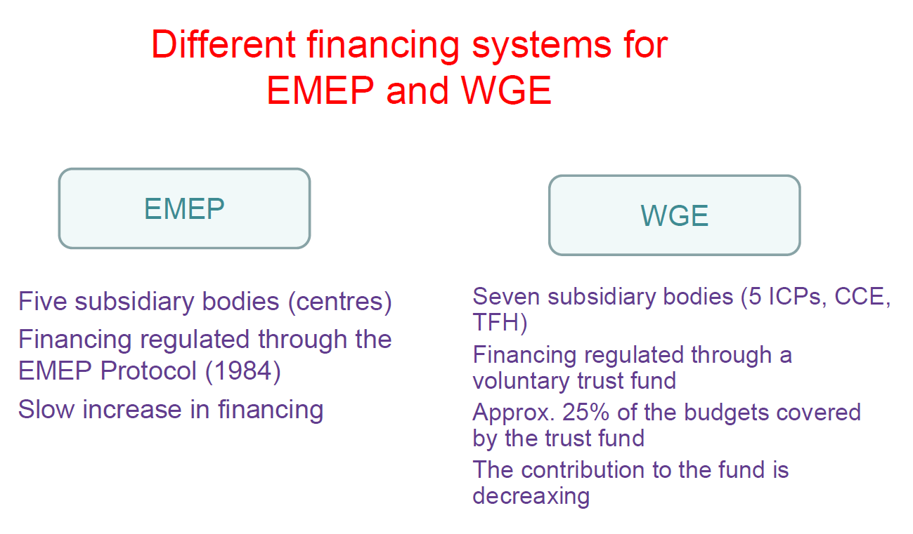
Coordination Centre for Effects
Source: Peringe Grennfelt presentation to the EB, 36th session, 2016
//www.unece.org/fileadmin/DAM/env/documents/2016/AIR/EB/PPT/36th_session_PPT/Item_6/Presentation_on_the_financing_of_CCE.pdf

Slide 19
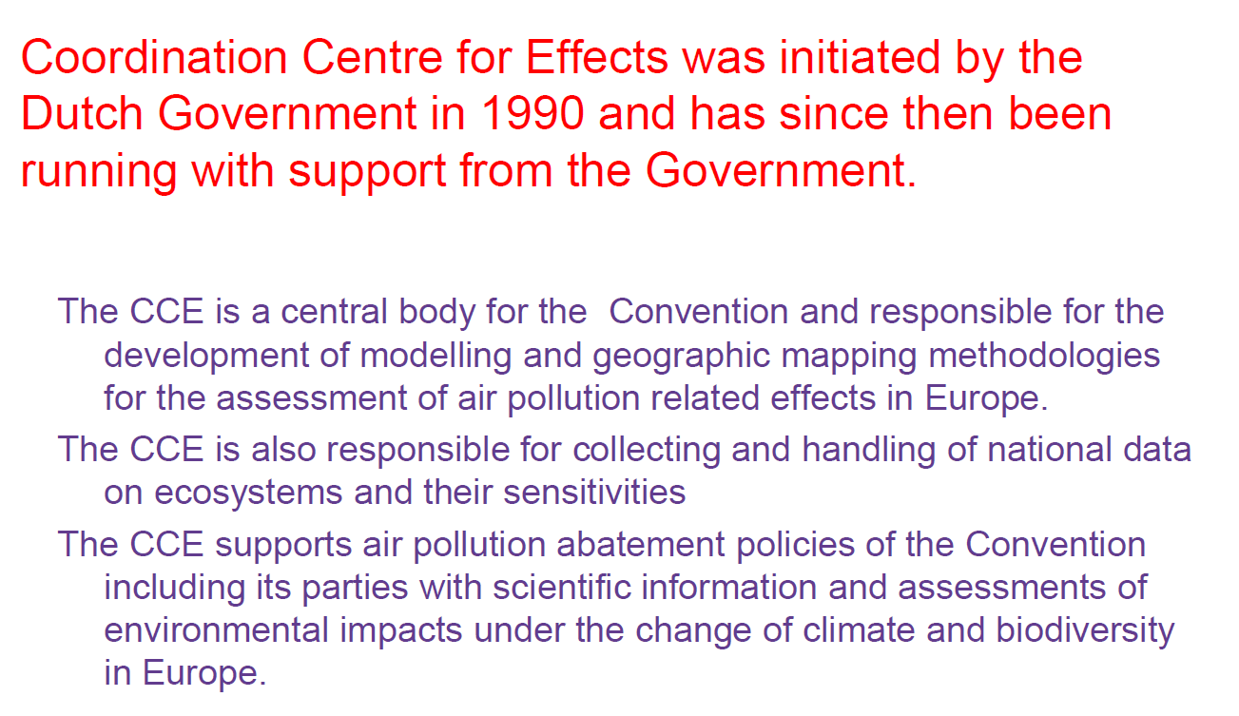
Coordination Centre for Effects
Source: Peringe Grennfelt presentation to the EB, 36th session, 2016
//www.unece.org/fileadmin/DAM/env/documents/2016/AIR/EB/PPT/36th_session_PPT/Item_6/Presentation_on_the_financing_of_CCE.pdf

Slide 20
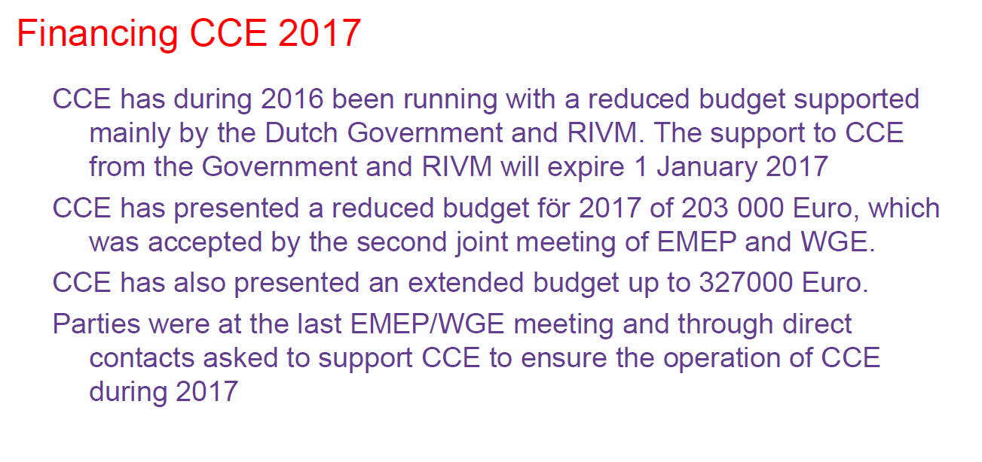
Coordination Centre for Effects
Source: Peringe Grennfelt presentation to the EB, 36th session, 2016
//www.unece.org/fileadmin/DAM/env/documents/2016/AIR/EB/PPT/36th_session_PPT/Item_6/Presentation_on_the_financing_of_CCE.pdf

Slide 21
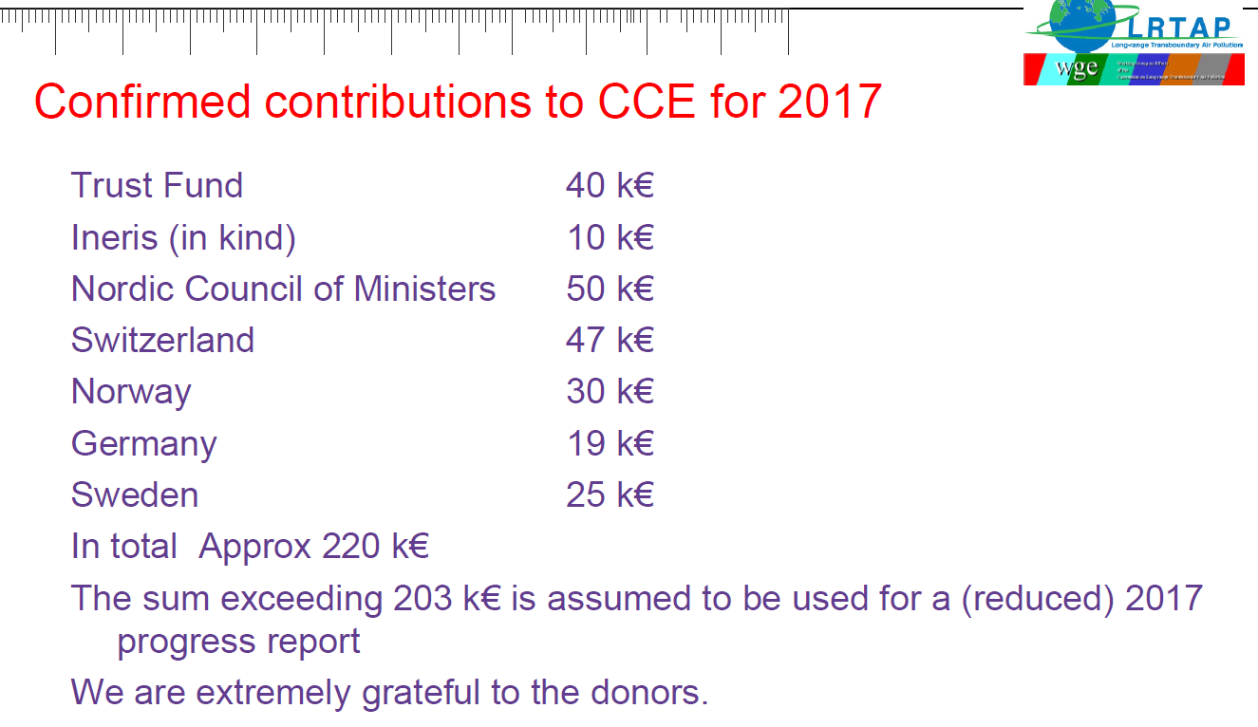
Coordination Centre for Effects
Source: Peringe Grennfelt presentation to the EB, 36th session, 2016
//www.unece.org/fileadmin/DAM/env/documents/2016/AIR/EB/PPT/36th_session_PPT/Item_6/Presentation_on_the_financing_of_CCE.pdf

Slide 22
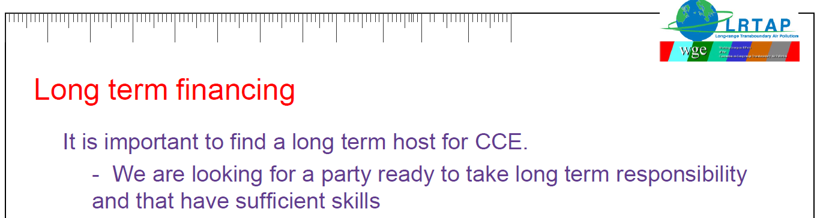

Coordination Centre for Effects
Source: Peringe Grennfelt presentation to the EB, 36th session, 2016
//www.unece.org/fileadmin/DAM/env/documents/2016/AIR/EB/PPT/36th_session_PPT/Item_6/Presentation_on_the_financing_of_CCE.pdf

Slide 23
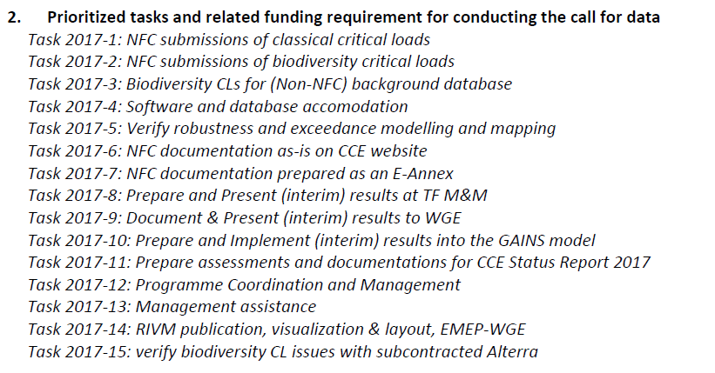
Coordination Centre for Effects
CCE 2017 activities
(Adopted at EB, dec 2016)

Slide 24
Strengthening EMEP-WGE cooperation
  LARGE-SCALE (IAM) OZONE RISK ASSESSMENT
  IN SOIL MOISTURE LIMITED AREAS
  (Draft workplan 2017-2019)
  Main goal:
  Collaboration between ICP-Vegetation and EMEP MSC-W for improving
  current flux-based ozone risk assessment applications for large scales (IAM),
  especially for soil moisture limited areas (Mediterranean, and Central and Eastern Europe)
  and in most of Europe under future scenarios of climate change.

Slide 25
Strengthening EMEP-WGE cooperation
  LARGE-SCALE (IAM) OZONE RISK ASSESSMENT IN SOIL MOISTURE LIMITED AREAS (cont.)
Objective 1. Check Soil Moisture Index (SMI) performance in soil moisture limited areas (2017-2018)
Activity 1.1.- Analyze spatial and temporal variability of the current SMI index across Europe and at field scale for selected sites in Activity 1.2 (EMEP) 2017 (started in 2016)
Activity 1.2. Collate field data with soil moisture measurements for different vegetation covers (CIEMAT, other partners?). 2017 (started in 2016 already)
Activity 1.3. Compare SMI estimates with field data (EMEP). 2017/2018 (started in 2016 already)
Objective 2. Parameterize SMI limitations to ozone flux for common European vegetation species from soil moisture limited areas (2018-2019)
Activity 2.1. Study relationship between SMI and other soil moisture indices with gas exchange and rooting depth for species from soil moisture limited areas (CIEMAT, other partners?). 2017-2018
Activity 2.2. Parameterize SMI (and if appropriate fphen) based on field data of gas exchange and soil water content for common Mediterranean species (CIEMAT, other partners?). 2018
Activity 2.3. Compare ozone flux maps with new/current SMI parameterization (EMEP?). 2019?
Objective 3. Update for parameterizations for large scale ozone flux estimation in European soil moisture limited areas (2018-2019)
Activity 3.1. Adapt/update flux parameterizations available for common European vegetation species from soil moisture limited areas for their use by EMEP in large scale flux estimation (IAM) (CIEMAT/EMEP). 2018
Activity 3.2. Produce ozone flux maps adapted for European vegetation from soil moisture limited areas (EMEP). 2019
Final products (2019):
1. Parameterization of SMI function tested in water limited regions of Europe.
2. Ozone flux maps adapted for soil moisture limited areas including the Mediterranean

Slide 26
Agenda for the 3rd joint session EMEP-SB/WGE
  Mandates
  Thematic Sessions
  Workplan 2016-2017
  Workplan 2018-2019
  Documents:
  Joint report
  ICPs reports
  Minutes of the session

Slide 27
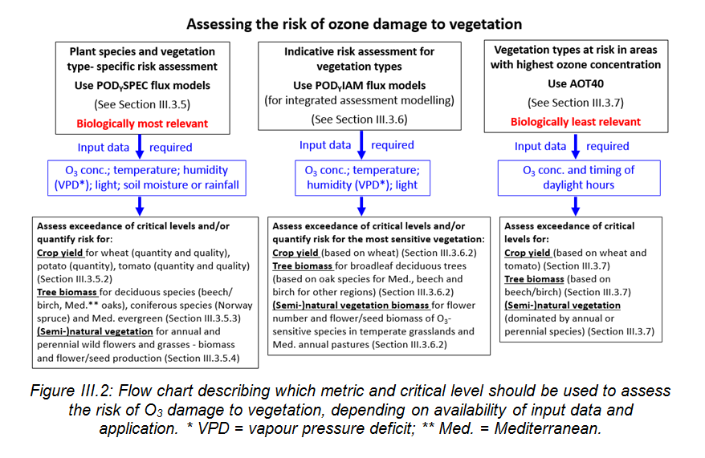

Slide 28
Organizational Issues
Agenda
Tuesday, 21 March, 14.30-18.00; Wednesday, 22 March, 9.00-13.00
Common EMEP and WGE issues
Follow up from the Executive Body and the Working Group on Strategies and Review (December 2016) and the 2nd joint session of the EMEP/WGE (September 2016), EB Bureau meeting March (2017)
Hemispheric transport of air pollution
Coordination Centre for Effects (CCE)
Integrated Assessment Modelling (TFIAM/CIAM)
EECCA activities including capacity building (secretariat)
Cooperation with other bodies (AMAP, WHO, UNEP, Stockholm and Minamata Conventions, CCAC); Information about: UN Environment Assembly (UNEA 3); the WHO Global Platform – 3rd meeting (secretariat)
Elements of the 2018-2019 workplan
Strengthening EMEP-WGE cooperation; future scientific work under the Convention; review of the Long-term Strategy of the Convention
Agenda for the 3rd joint session of the EMEP SB/WGE 11-15 September 2017
Other business

