Slide 1



UNESCO Call for Data
Summary 2015-2016
Outlook 2017-2018
Johan Tidblad & Pasquale Spezzano
EMEP Steering Body and Working Group on Effects bureaux meeting
Geneva, Switzerland
20 - 23 March 2017

Slide 2
UNESCO call for data (1/4)
”Living” Interim report (2016/2017)
Status report (2017)

Slide 3
UNESCO call for data (2/4)
3
Six Parties are participating to the Call for Data
Croatia
Germany
Italy
Norway
Sweden
Switzerland

Slide 4
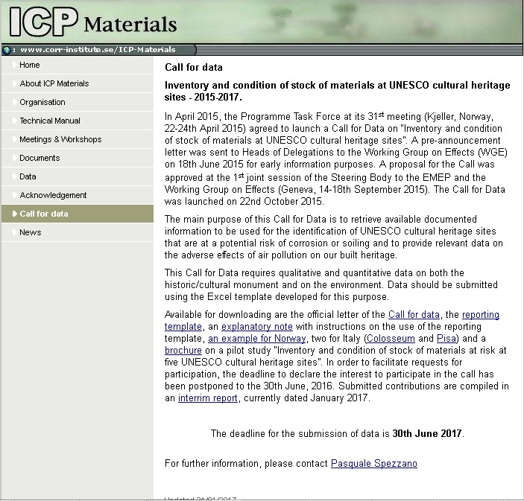
UNESCO call for data (3/4)
A page dedicated to the Call for Data has been added to the ICP Materials website, where all documents and some examples of the reporting template are available for downloading.
Submitted contributions are compiled in an interim report, currently dated January 2017, which is also available on the website.
4

Slide 5
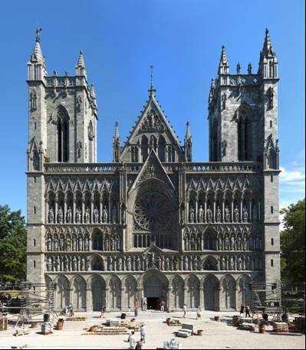
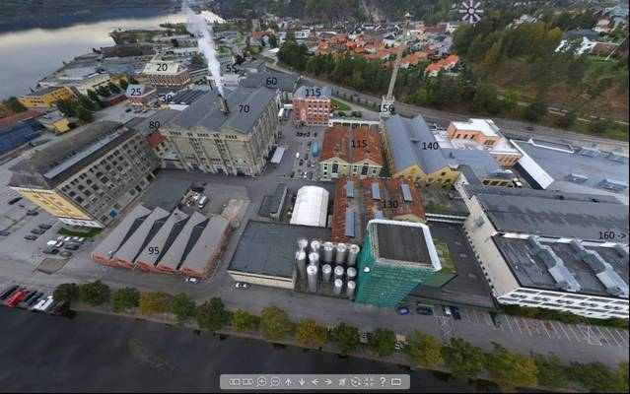

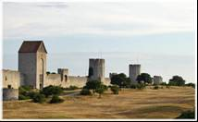
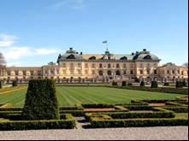

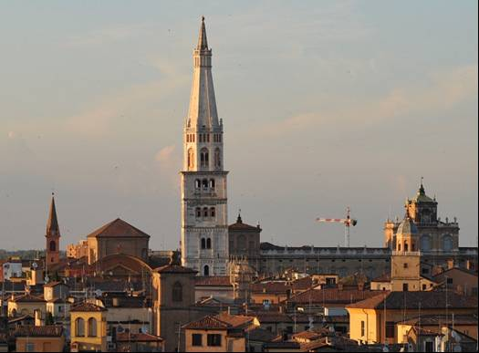
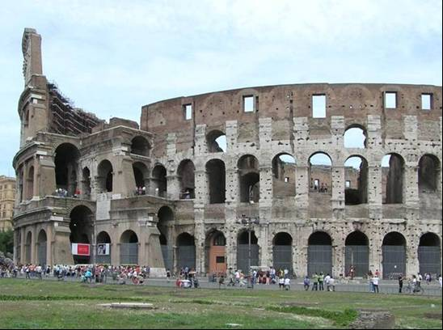
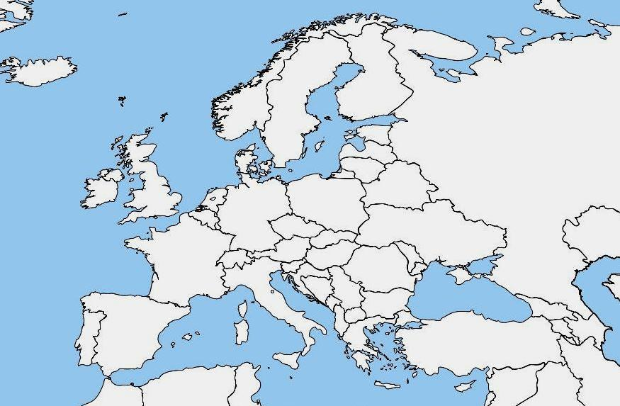
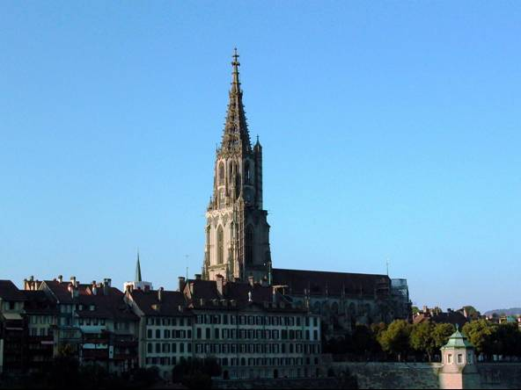
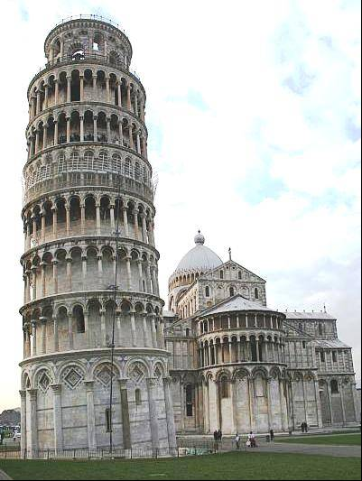
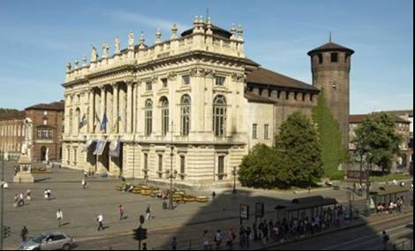
UNESCO call for data (4/4)
5

Slide 6
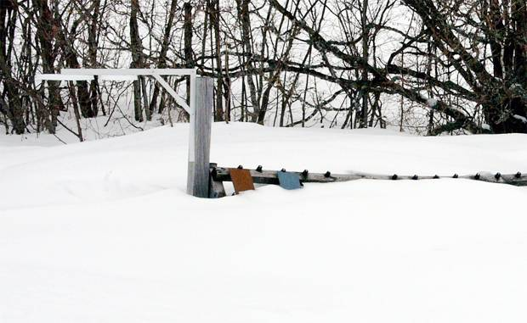
Outlook 2017-2018
Activities
Deliverables
Meetings

Slide 7
Main achievements 2015-2016 (1/5):
Contribution to WGE trend report “Trends in ecosystem and health responses to long-range transported atmospheric pollutants” (2015)
ICP Materials Report No 77: Pilot study on the inventory and condition of stock of materials at risk at UNESCO cultural heritage sites. Part IV: The relationship between the environment and the artifact (2015)
ICP Materials Report No 78: Results of corrosion and soiling from the 2011–2015 exposure programme for trend analysis (2016)
ICP Materials Report No 79: Technical manual for the trend exposure programme 2011-2015 (2016)
Call for Data on Inventory and condition of stock of materials at UNESCO cultural heritage sites 2015-2017 (2015)
Overview of contributions & participation (2016)

Slide 8
Main achievements 2015-2016 (2/5):
2014-2015 exposure for trend analysis
The exposure 2014–2015 included samples of carbon steel, zinc, copper, limestone and modern glass.
Stainless steel was also exposed for the first time at selected sites in the network of test sites.
In addition, samples exposed for four years (2011–2015) of carbon steel, weathering steel, zinc, aluminum and limestone were withdrawn and evaluated.
8

Slide 9
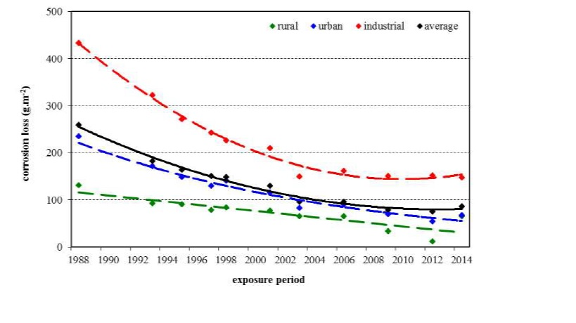
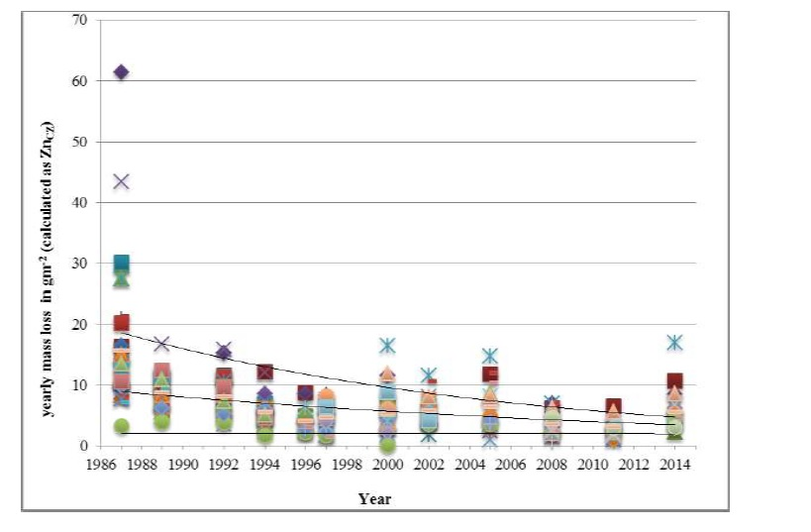
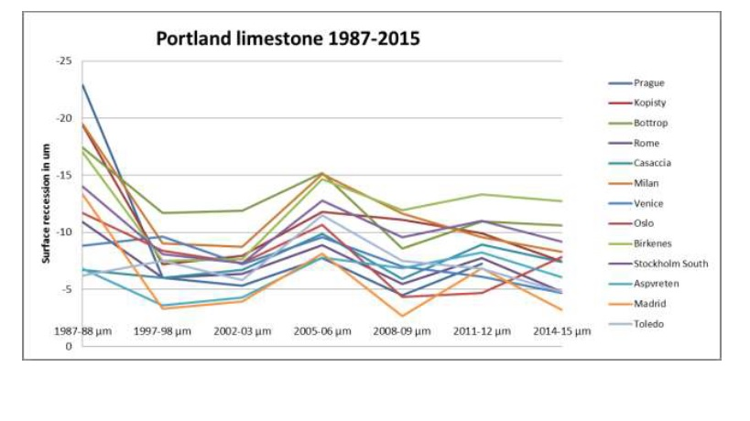
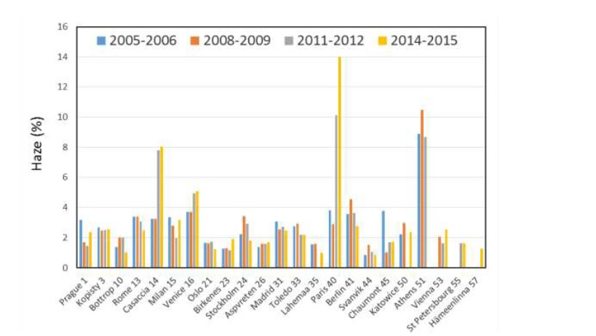
Main achievements 2015-2016 (3/5):
Corrosion loss and soiling remain to high
Trend of yearly corrosion loss of carbon steel
Trend of yearly corrosion loss of zinc
Trend in surface recession rate for Limestone
Soiling of modern glass for the different exposure

Slide 10
Main achievements 2015-2016 (4/5)
32nd Task Force meeting (Rome, Italy, 11 to 13 May 2016)
15 participants from 12 countries: Croatia, Czech Republic, Finland, France, Germany, Greece, Italy, Norway, Spain, Sweden, Switzerland, and the UK.
Croatia has previously not participated in the activities of ICP Materials and the contribution is therefore especially welcomed.
The meeting was also attended by an Italian representative to the Executive Body of the Convention.

Slide 11
Main achievements 2015-2016 (5/5)
Publications & presentations ICP Materials
Kreislova K, Geiplova H, Skorepova I, Skorepa J and Majtas D (2015). Actual maps of atmospheric corrosivity for the Czech Republic. Proceedings of EUROCORR 2015, Graz, Austria
Roots O (2015). ICP materials. Long-term studies at the Lahemaa monitoring station, Estonia. Proceedings of the Estonian Academy of Sciences, 64 (1), 43-52
Kreislova K and Geiplova H (2016). Prediction of the long-term corrosion rate of copper alloy objects. Materials and Corrosion, 67(2), 152-159
Christodoulakis J, Tzanis C, Varotsos C A, Ferm M and Tidblad J (2016). Impacts of air pollution and climate on materials in Athens, Greece. Atmospheric Chemistry and Physics Discussion, doi:10.5194/acp-2016-196
Tidblad J and Thierry D (2016). Evaluation of corrosion products and trends in corrosion rates for aluminium exposed at different atmospheric environments in Europe, EUROCORR 2016, 12-15 September, Montpellier, France
Grøntoft T. (2017) Conservation-restoration costs for limestone facades due to air pollution in Krakow, Poland, meeting European target values and expected climate change, Sustainable Cities and Society 29 (2017) 169-177
11

Slide 12
Exposures for trend analysis (1/2)
Report: Trends in pollution, corrosion and soiling (2017)
Start of new exposure (2017)
Presentation: Air pollution effects during 30 years of research within ICP Materials (1987-2017), Eurocorr 2017, Prague, Czech Republic

Slide 13
Exposures for trend analysis (2/2)
13
The next exposure will start end 2017 and will consist of two sets of samples, exposed for 1 year and 4 years, respectively.
Exposure will be performed in the network of atmospheric corrosion test sites, currently 26 stations in 18 countries.
Croatia is a new country and may join the exposure program by providing test sites.

Slide 14
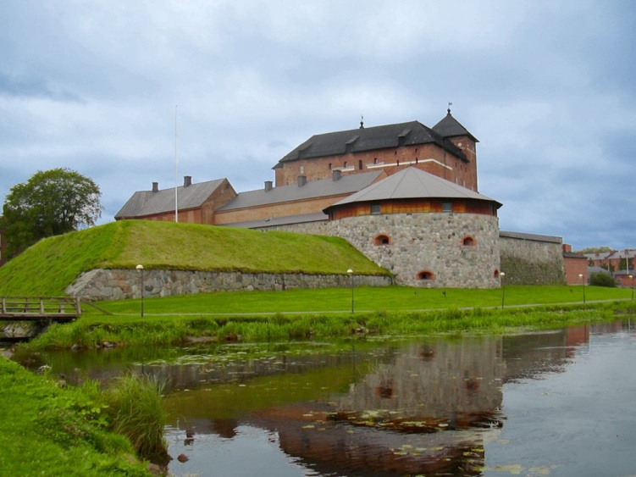
Welcome to ICP Materials 33rd meeting
May 10-12, 2017
Hämeenlinna, Finland
Thank you for your attention!
Any questions?
14

