Slide 1
Development of CBM in India
International workshop “Best Practices in Methane Drainage and Use in Coal Mines”
Directorate General of Hydrocarbons
Ministry of Petroleum and Natural Gas
Government of India
Sunil Kumar Singh
Head – Alternate Energy, PEL/PML

Slide 2
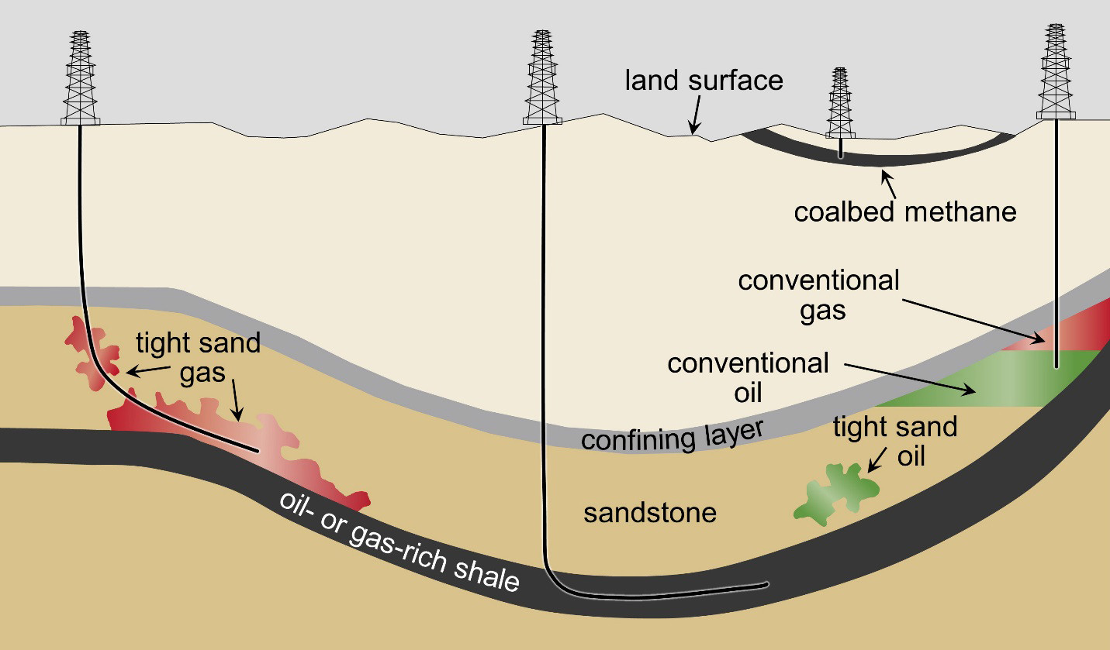
Structure of presentation
Unconventional
CBM in India
Policy Framework

Slide 3
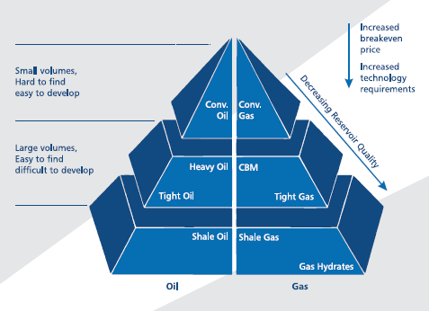
Unconventional Hydrocarbons
Notes:
Resource pyramid of conventional vs. unconventional

Slide 4
Resource Management
MoP&NG
CMM
UCG
CBM
Shale
MOC
Notes:
Resource pyramid of conventional vs. unconventional

Slide 5
“Typical” CBM Well Production Profile
Dewatering
Stage
Stable
Production
Stage
Decline
Stage
Gas
Production Rate
Water
Time
Notes:
Due to the water in the cleats, it usually takes a period of time before gas will be produced. Once enough water is produced the gas perm will become more dominant until a maximum gas rate is achieved. This can take anywhere from 6-18 months depending on the reservoir and the well spacing.
Dewatering requires many wells so that the reservoir can be dewatered, and the methane allowed to desorb from the coal.
The Horseshoe Canyon coals are unique in the fact that they produce gas immediately and very little water production (in the order of L per week has been encountered to date).

Slide 6
Unconventional – Marginal economics
Pricing
Gas grid and Gas Market development
Resource Estimation needs revisit
Simultaneous exploitation
Land Acquisition
Water handling problems
Grant of statutory clearances
Notes:
when fluid pressure is below the desorption pressure gas starts to desorb
cleat density and aperture is going to be a major determinant in gas flow rates – cleat density is going to affect the diffusion rate from matrix
as gas desorbs the coal matrix can shrink opening cleats further and increasing permeability

Slide 7
Chronology of CBM in India
In order to harness CBM resources in the country , CBM Policy was formulated in 1997
MoU was signed on 09.09.1997 between MoP&NG & MoC
Provides framework to act in co-operative manner for development of CBM
MoPNG to administer the CBM projects
Coal/Lignite Resources are divided into areas for CBM development:
Coal deposit up to 300m (with and without Mining leases)
Coal deposit below 300m
DGH was made the implementing agency

Slide 8
CBM Policy: Terms of the Offer
Revenue sharing model
Biddable Production Level payment at rate committed by bidder. (2.5% flat PLP for nomination CBM Blocks)
Free pricing and marketing freedom
Higher revenue realization for producers
Up to 100% FDI allowed
Enables and encourages entry of foreign players
No carried interest by NOCs
Encourages participation of global and Indian private firms
Biddable parameters
Work Program, Technical competence and Revenue share as per biddable PLP
No upfront signature bonus
Commercial bonus payable at declaration of commercialty

Slide 9
CBM & NELP Policy
CBM
NELP
No Cost recovery
Production Level Payments (PLP)
Royalty
BEC
WP
Production Level Payment
Technical competence
Cost Recovery
Profit Petroleum based on IM
Royalty
BEC
WP
Fiscal (IM & Cost recovery)
Technical competence

Slide 10
State-wise distribution of CBM Resources
Sl. No. | State | Prognosticated CBM Resource (in BCM) | Prognosticated CBM Resource (in TCF) | Established CBM Reserves (in TCF)
1 | Jharkhand | 722.08 | 25.5 | 1.916
2 | Rajasthan | 359.62 | 12.7 | 0
3 | Gujarat | 351.13 | 12.4 | 0
4 | Odisha | 243.52 | 8.6 | 0
5 | Chhattisgarh | 240.69 | 8.5 | 0
6 | Madhya Pradesh | 218.04 | 7.7 | 3.65
7 | West Bengal | 218.04 | 7.7 | 4.33
8 | Tamil Nadu | 104.77 | 3.7 | 0
9, 10 | Telangana & Andhra Pradesh | 99.11 | 3.5 | 0
11 | Maharashtra | 33.98 | 1.2 | 0
12 | North East | 8.50 | 0.3 | 0
Total CBM Resource |  | 2599.48 | 91.8 | 9.9

Slide 11
CBM Bidding Rounds

Slide 12
Phases in CBM Contract
Phase-I: Exploration phase
Duration: 2-3 years + 3 extensions of 6 months under CBM extension policy
Major activity: Drilling of Coreholes and Test wells
Phase-II: Pilot Assessment Phase
Duration: 3-4 years + 3 extensions of 6 months under CBM extension policy
Major activity: Drilling of Pilot wells, Environmental studies, Techno-economic Evaluation, Market survey
Phase-III: Development Phase
Duration: 5 years + 1 year extension
Major Activity: Drilling, completion and testing of development wells
Phase-IV: Production Phase
Duration: 20 -25 years
Major Activity: Commercial production from the Block

Slide 13
CBM in India: Current Status
CBM policy formulated in: | 1997
MoU signed between MoP&NG & MoC | 09.09.1997
Total CBM rounds conducted | 4
No. of CBM Blocks awarded in 4 rounds | 33
Coal bearing Area identified for CBM | 26,000 Sq. Km.
Area covered under 33 blocks | 16, 613 Sq. Km. (64%)
CBM Resources in the 26,000 sq km area | 2599 BCM (91.8TCF)
CBM Resources (from 33 Blocks) | 1767.06 BCM (62.4 TCF) ~68% opened up
Established CBM Reserves (GIP) | 280.8 BCM (9.9 TCF)
Commercial Production commenced | July 2007
Total No. of CBM Wells drilled | 927
Investment made (till FY 2014-15) | Around US$ 1.5 Billion
Present Gas Production (June 2016) | 1.56 MMSCMD from 5 CBM blocks
No. of CBM Blocks in Production Phase | 3
No. of CBM Blocks in Development Phase | 5
CBM Blocks in Exploration phase | 4
Blocks awaiting PEL | 2
CBM Block Terminated | 1 (Under arbitration)

Slide 14
Reserves established in CBM blocks
Sl. No. | Block name | Consortium (PI) | Approx area (SQ.KM.) | Current Status | GIIP (in TCF) | Recoverable Reserves (in TCF)
1 | RG(E)-CBM-2001/1 | EOL (100) | 500 | Under Dev. | 2.15 | 0.993
2 | SP(W)-CBM-2001/1 | RIL (100) | 500 | Prodn. Phase | 1.96 | 0.670
3 | Raniganj South | GEECL (100) | 210 | Prodn. Phase | 1.92 | 1.340
4 | SP(E)-CBM-2001/1 | RIL (100) | 495 | Under Dev. | 1.69 | 0.620
5 | BK-CBM-2001/1 | ONGC (80) - IOC (20) | 95 | Under Dev. | 1.06 | 0.130
6 | Jharia | ONGC (90) - CIL (10) | 85 | Under Dev. | 0.52 | 0.107
7 | NK-CBM-2001/1 | ONGC (55) - IOC (20) - PEPL (25) | 340 | Under Dev. | 0.34 | 0.052
8 | Raniganj North | ONGC (74) - CIL (26) | 350 | Under Dev. | 0.26 | 0.066
TOTAL |  |  |  |  | 9.9 | 3.978

Slide 15
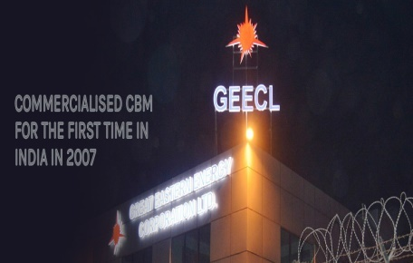
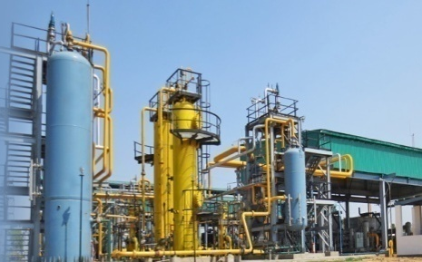
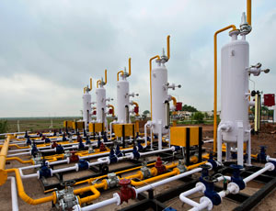
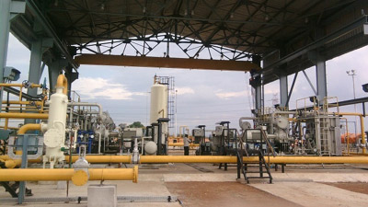
Key Success Stories
Raniganj South - One of the most successful discovery
Pioneer of CBM in India. Commercialized the block in 2007
Block awarded thru FIPB (Foreign Promotion Investment Board)
Produced 817 MMm³, Current prod. @0.5 MMSCMD
Total Investment – US$ 343 Million
Raniganj East - Largest CBM producer in INDIA
One of the most prolific area.
First asset to produce greater than 1 MMSCMD
>300 wells drilled. Current Prod. @1.05 MMSCMD
Total Investment – US$ 434 Million
14
Other Success Stories - Sohagpur West | North Karanpura | Bokaro | Jharia

Slide 16
Exploration and Production Regime in India
State Monopoly
Public Sector Upstream Oil Companies
Liberalization of E&P Sector (1997- 2009)
9 NELP and 4 CBM rounds.
254 exploratory and 33 CBM blocks through competitive bidding
New Domestic Gas Pricing Guidelines
Discovered Small Field Policy
1948
1991
1997
2009
2014
2015
2016
Beginning of
de-regulation
28 producing fields and 28 exploratory blocks offered including private players
Further liberalization of the sector
Discovered small field bid round-2016
HELP - Hydrocarbon Exploration licensing policy
Open acreage licensing
Revenue Sharing Model
Pricing Guidelines for difficult gas fields
Policy intervention for CBM
Nomination Era
Pre-NELP PSCs
NELP/CBM PSCs
Future

Slide 17
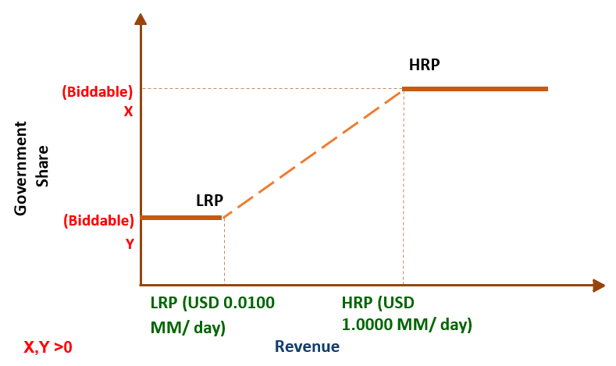
Revenue Sharing : Bid Parameters- DSF
Contractor to bid the Government Share of revenue (%) against
Lower Revenue Point (LRP) ≤ US$ 0.0100 mn/day
Higher Revenue Point (HRP) ≥ US$ 1.000 mn/day
2. Bid yielding highest NPV will get 80 marks and rest bids would be scored on pro-rata basis
Revenue Share
Weights
80%
Biddable Work Program
Bid proposing maximum number of new appraisal / development wells would get 20 marks
Rest bids would be scored on pro-rata basis
20%
13

Slide 18
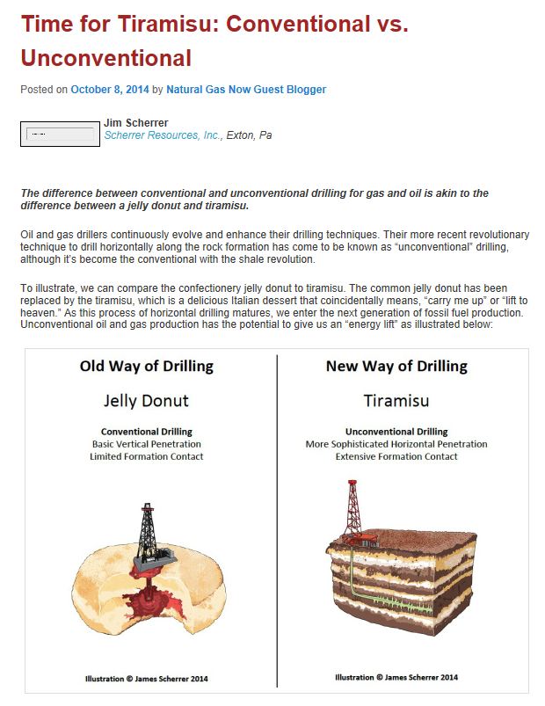

Slide 19
Thank you

