Slide 1
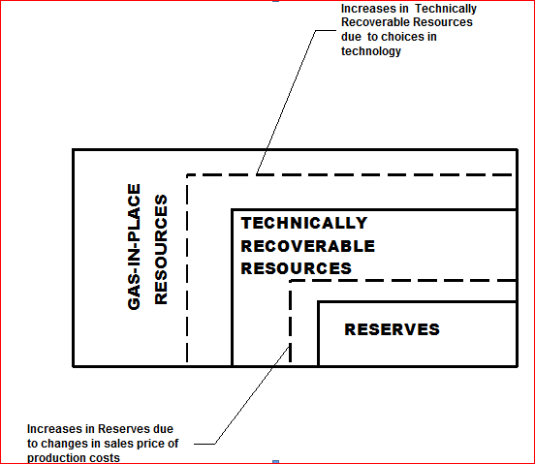
Converting Resources to Reserves

Slide 2
Porter’s Value Concept Applied to Mining
Locate
Valuate
Establish
Transport
Beneficiate
Market
Divest/Sell
After Vorster, 2000

Slide 3
Overview of the value chain analysis for a co-located coal and natural gas deposit
Activity | Definition | Input | Output
Locate | Determine extent and magnitude of coal and gas deposit | Suspected coal and gas resources | Resource estimates for coal and gas
Valuate | Determine profitability of co-located deposits | Coal and gas resource estimate | Bankable feasibility and “Go—No Go decision”
Establish | Implementation of extraction plan | Bankable feasibility and “Go—No Go decision” | Coal and Gas resources prepared for extraction
Transport | Transport of mined coal and produced gas | Coal and gas moved from mine to surface | Stockpiled coal and stored or transported gas
Beneficiate | Coal is washed and gas is treated | Stockpiled coal and stored or transported gas | Saleable products
Market | Maximization of profit | Saleable products | Revenue and profit
Divest/Sell | Curtailment of operations | Revenue and profit | New Economic circumstances

