Slide 1
Innovation & Commercialization
Yigal Erlich
Yozma
Genève, April 2013

Slide 2
Eco-System – Existence of Critical Mass of Success Factors
Entrepreneurial Culture - relevant “DNA” ingredients
High quality Human Resources - academia, defense, immigration
Developed Defense-related Technologies and R&D - civilian commercialization
Global Technology Companies – increased presence and exposure
Capital Availability – VC funds, strategic and financial investors, angels
Proven Global Exit Avenues – M&A is the main avenue, increased activities
Modern Infrastructure – legal, banking, financial, accounting, IP protection
Government Support – financial incentives, OCS grants, tax exemptions
Recognized Leading Global Innovation Center

Slide 3
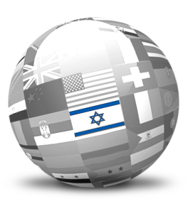
Israel VC “DNA” – Drivers of Innovation
Going global from inception
Tolerance of failure
Must-win attitude
Ability to use limited resources effectively
Solution-driven approach to real problems
Short history – past is not a constraint
“Chutzpah”
Ambitious
Communicative
Innovative
Improvisation
Vision
Creative
Experimental
Forward
Informal
Non-Conventional
Independent-thinking
Notes:
3

Slide 4
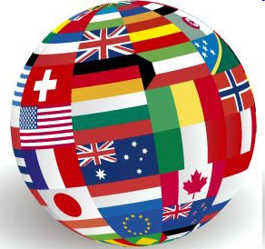
International Collaboration in Industrial R&D
Europe
France Russia (Rusano, Skolkovo) Italy Germany Greece Denmark Hungary Turkey Portugal Finland Sweden Czech Republic Bulgaria(New) Lithuania (New) Slovenia Ireland Belgium (Flandria) Netherlands
North America
New York Massachusetts Maryland Virginia Wisconsin Colorado Illinois Oregon BIRD(Foundation) Ontario CIIRDF(Foundation)
Asia
China( Shanghai, Most) Jiangsu (Foundation) India
SIIRD-Singapore (Foundation) KORIL-RDF-Korea (Foundation)
South America
Argentina Uruguay Brazil
Australia (Victoria)
* Through EUREKA (40 country Multilateral Initiative)
Notes:
4
4

Slide 5
Government vs. VC role
Government Involvement
 Market failure conditions
 Government as a catalyst
 Predetermined exit conditions
 No government control
 Indirect investments (funds)
 Risk sharing
Professional VC funds
 Capable to raise funds
Choosing the right
investments
Managing the investments
Building value for exit

Slide 6
The Government as a Catalyst
Government
Intervention
Establishment
of Yozma
Market
Failure
$100M Investment
1993
1997
Government
Exits
Yozma Privatized
Problem
Solved
Return>$100M
© Yozma Proprietary

Slide 7
New Startups Established, 2003-2012
10 Years Average: 600 per year
2012: 23% decrease compared to 2011
Number
Source: IVC Research Center

Slide 8
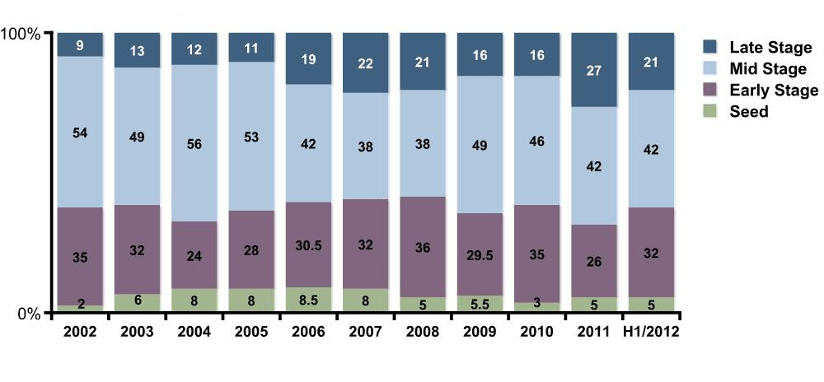
VC Investments by Stage
Source: IVC Research Center

Slide 9
VC Investment and Israeli VC Funds as % of yearly total 2003-2012
10 Years: $15.7 billion
Israeli VC Funds: $5.7 billion, 37% of total
Other Investors: $10 billion, 63% of Total
$b
Source: IVC Research Center

Slide 10
Foreign Investors in Israeli Startups
Increased Activities and Presence
Select Funds/Investors | Source of Capital | Type | Exposure/Mode of Operation
Sequoia Israel, Greylock Israel, Orbimed Israel, DFJ – Tel Aviv, Credit Agricole | Israel-dedicated fund | VC Funds | Domestic team, usually 3+ partners Usually co-invest with Israeli funds Only few lead Round A
Index, Bessemer, Accel, Highland, Battery, Lightspeed, HarbourVest, Canaan, Benchmark, Norwest, USVP, Crescent, SVB, Kima Ventures, Paul Capital, Kreos Capital, Blumberg Capital, Horizon Ventures, Fortrers | General allocation from main fund | VC Funds | Israel is part of investment strategy Few have domestic team, 1-2 prof. Usually co-invest with Israeli funds in Rounds B,C, few invest in Round A
Kleiner Perkins, New Leaf, NEA, Matrix, Mayfield, Opus, MPM, Storm, Charles River, RHO, JK&B, DAG, Globespan, Soffinova, Andresseen Horowitz, Union Square, Atlantic,, Softbank, HP Ventures, Coller Capital, Lexington Partners | General allocation from main fund | VC Funds | Opportunistic approach No domestic presence Usually co-invest with Israeli funds Preferred by some serial Israeli entrepreneurs
Intel Capital, Motorola Ventures, ABB Ventures, Singtel, Siemens, T Ventures, GE, Nielsen, Samsung, J&J, Itouchu, Bosch, EMC, IBM, Cisco, BASF, Google, Microsoft, Qualcomm, Facebook, LG, Mitsui, SAP Ventures, AVG, Ebay, Huawei, Lenovu, Deautche Telekom Ventures | Corporation | CVC - Corporate Venture Capital or arms | Strategic interest Most have domestic team & presence Usually co–invest with Israeli funds
Innovation Endeavors, Tel Aviv Angel Group, Initial Capital, Jeff Pulver, Eric Schmidt, Zeev Oren | Private, Family wealth | Angels, Micro funds | Opportunistic approach Seed investors, co-invest with Israeli funds
Partial list
Source: IVC Research Center

Slide 11
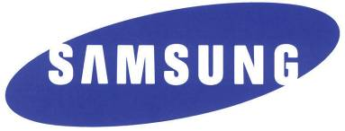
Increased Multinational Presence in Israel
Seeking Technology Innovation and Development
Partial list
Source: IVC Research Center
Notes:
All grow by accusations
US & EU, but also more and more SEA, Japan and now Chinese co’s
11

Slide 12
15 Years of Venture Capital Activity 1997-2012
$24 billion invested in the VC sector
$14 billion raised by Israeli VC funds
More than 6,000 startups established
M&A: $37 billion, IPO: $4 billion raised
NASDAQ: 100 Israeli high-tech companies are listed
Human capital emerged as Israel’s main resource
Global recognition - a leading innovative technology center
VC – the Accelerator of the High-Tech Industry Innovation and Growth
Source: IVC Research Center
Notes:
12
The average time to exit - ~7 years
10.5 B – invested in 10 years
9.5b created 34b = multiple of ~3.7
12

Slide 13
Thank you

