Slide 1


e-BOD(Bill of Delivery) for Logistics
25th
UN/CEFACT Forum
April. 2015
Youngkon Lee

Slide 2
Table of contents
1. Introduction
2. Requirements
3. Process and data
4. Conclusion

Slide 3

1.1 Logistics Problems
1. Introduction
lost freight
invisible freight
incorrect logistics information
fake consignee
High cost delivery
fraud of transporter
Notes:
EDI, ebMS 등 배경 추가

Slide 4
1.2 Major factors for logistics problem
1. Introduction
Person
Technology
information distortion/omission
mistake(inadvertently, unconsciously)
accident, crime
wrong transporter, consignee
On-line and off-line mixed
different communication protocols
weak security
interoperability problem
incorrect delivery place
complex logistics industry structure
distorted logistics market
vehicle problems
loose freight check
order document issued by forwarder
or transporter
delivery without order document
Environment
Practice
Notes:
EDI, ebMS 등 배경 추가

Slide 5




1. Introduction
1.3 Digitalizing logistics information flow by e-BOD(Bill of Delivery)
To digitalize B2B logistics processes by applying e-BOD framework
AS - IS
TO - BE
④ confirm taking over (signature on paper)
transporter
④ confirm taking over (electronic signature)
transporter
② load freight
② load freight
consignor
consignor
③ freight transport
③ freight transport
① allocate freight
on vehicles
transport information
transport information
⑤ paper receipt transfer
paper receipt
print, send
Make and register e-BOD
① allocate freight on vehicles
purchase info transfer
purchase info transfer
consignee
logistics information system
consignee
logistics information system
logistics information process
Input receipt information manually
logistics information process
e-BOD process
※ paper receipt Evidence document for proving freight delivery from consignor to consignee in logistics process, which could be used as payment receipt.
※ e-BOD(electronic bill of delivery) Electronic receipt document which enables on-line process of distribution, peruse, evidence, payment process among transporter, consignor, forwarder, consignee.

Slide 6
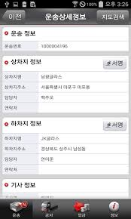
1. Introduction
1.4 Benefit
Payment to transporter within 3 days after transport
Real-time confirmation of transport: visualization
Very simple process and no lost of receipt paper
transfer e-BOD
make e-BOD
e-BOD
Consigner/
forwarder
transporter
Request delivery
❍ request payment
payment previously
Payment company
□payment

Slide 7
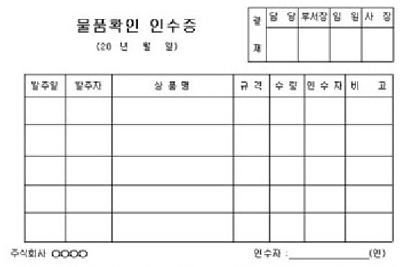
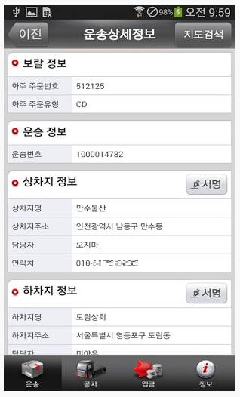
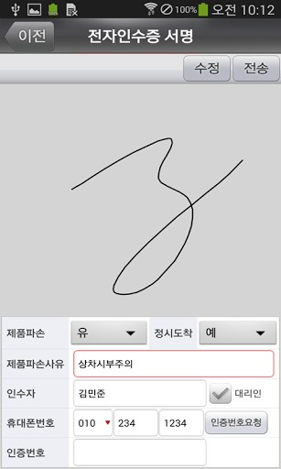
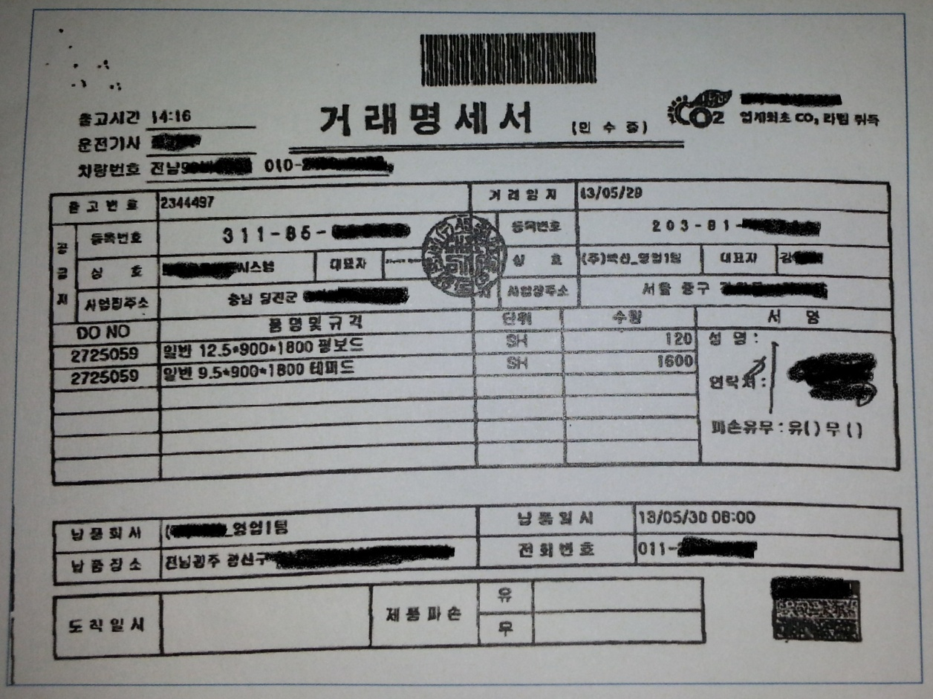
1. Introduction
1.5 Samples of paper receipt and e-BOD
paper receipt
e-BOD

Slide 8




2.1 Visible delivery
2. Requirements
e-BOD: freight info + delivery info + transporter info + consignee/consigner info
logistics information space
merge
merge
merge
merge
merge
synchronize
synchronize
synchronize
synchronize
synchronize
synchronize
real delivery flow
forwarder
mediator
delivery store
consignee
consigner
warehouse

Slide 9

2.2 Data synchronization
2. Requirements
Synchronization between logistics information and real delivery
  Synchronization for time: real-time delivery information creation
  Synchronization for geographic space: position of consignee and destination
  Synchronization for consignee information: authenticated and intended consignee
  Synchronization for freight information: freight information not changed
  Synchronization for delivery information: delivery information not changed
at least
Trusted Mobile
e-BOD

Slide 10
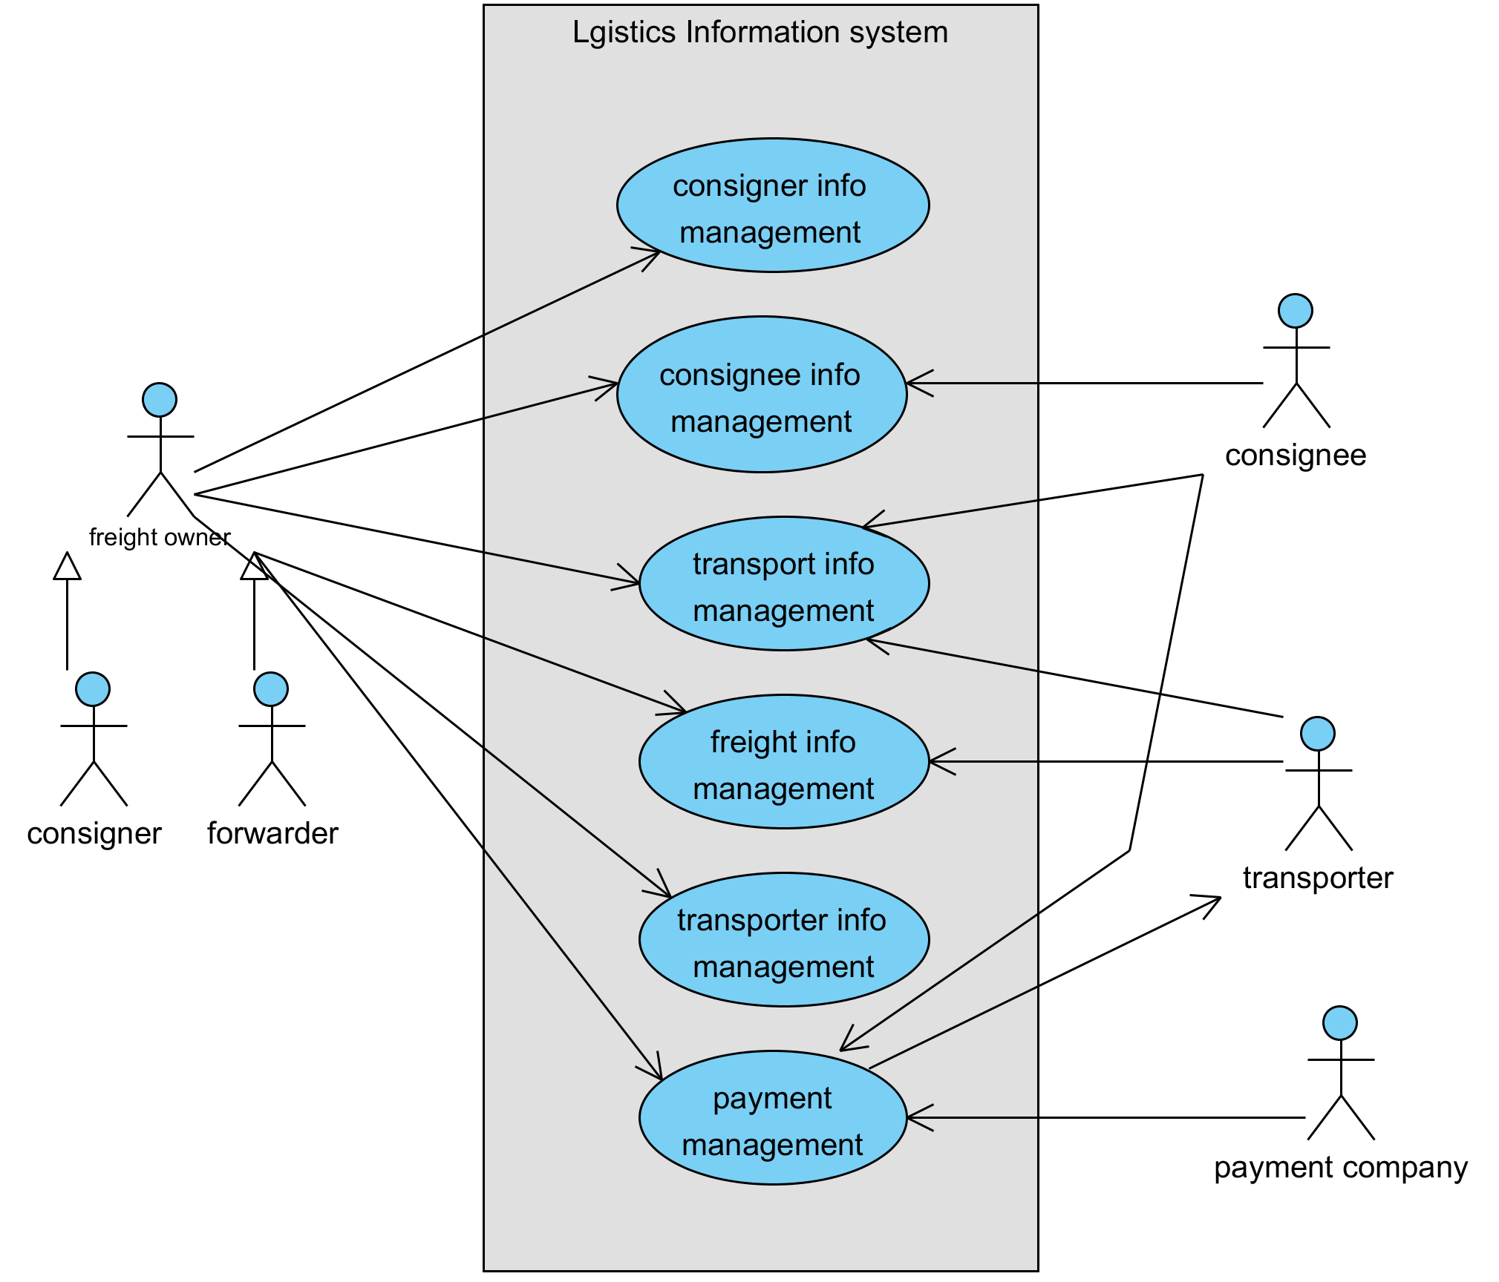
3. Process & data
3.1 e-BOD use cases

Slide 11


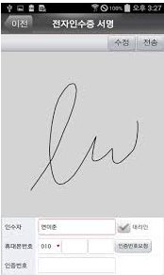
3. Process & data
3.2 e-BOD data
consigner
transporter
consignee
Consigner
data
Transporter
data
Consignee
data
Loading data
Transport data
Unloading data
Freight data
Accepter data
Freight status
data
+
+

Slide 12
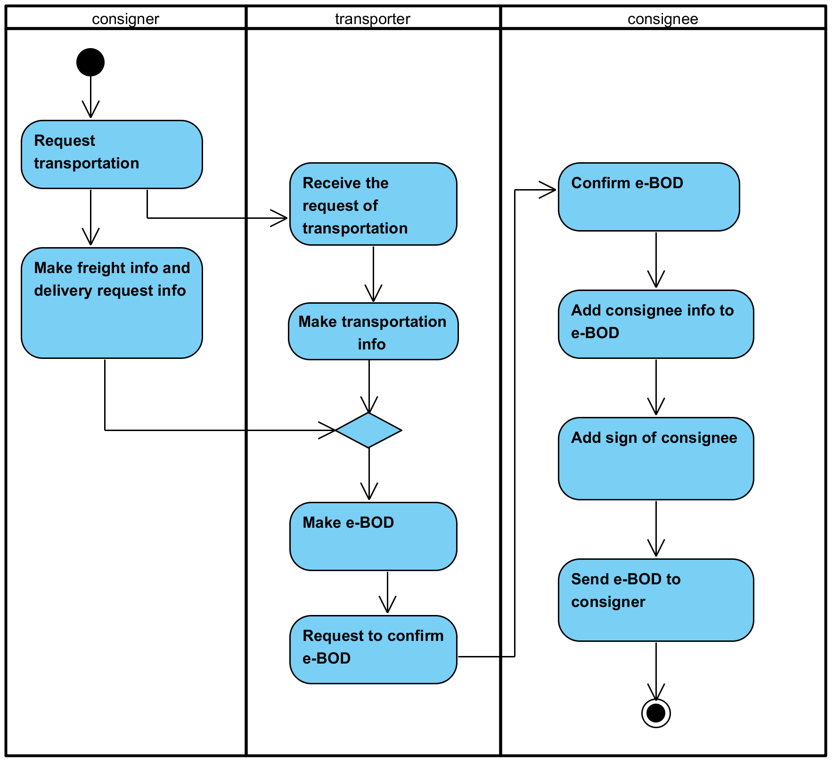
3. Process & data
3.3 e-BOD activity process

Slide 13
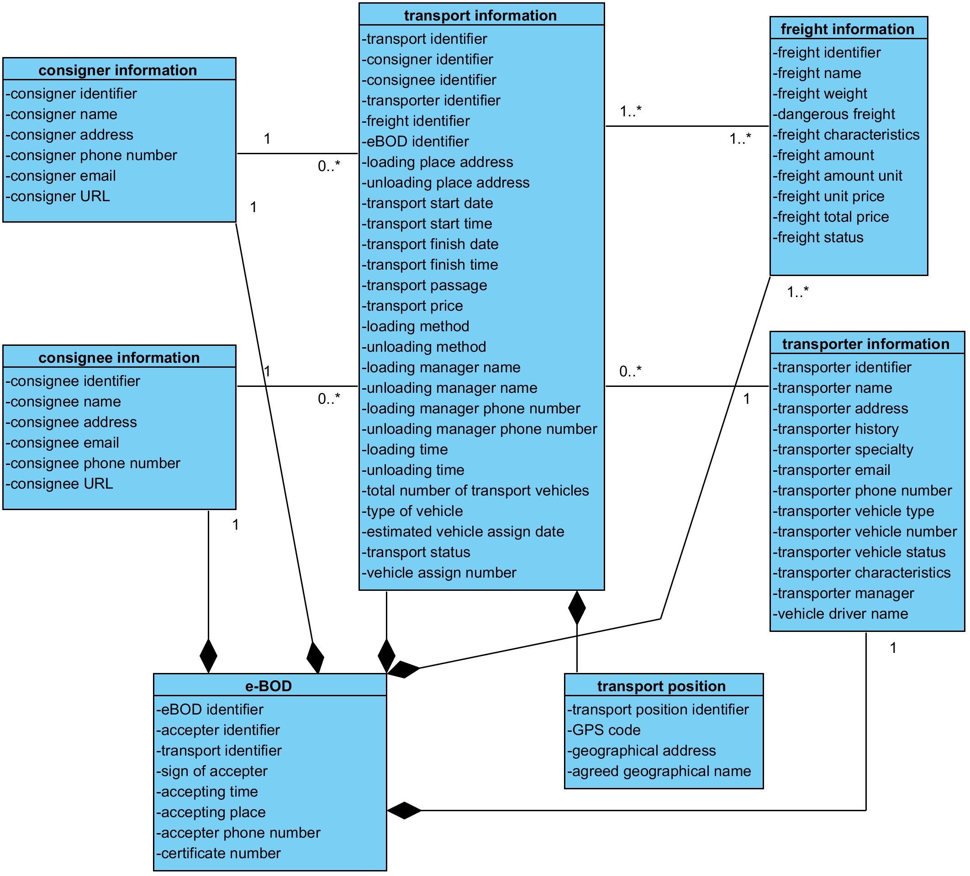
3. Process & data
3.4 e-BOD classes

Slide 14
3. Process & data
3.5 Need more..
Items | Content
Terminology definition | Define terminology used in e-BOD
BIE, ABIE, ASBIE | Define business information entity for e-BOD
XML schema | Make e-BOD XML schema
Layout | Define e-BOD data item layout in mobile device

Slide 15
4. Conclusion
Big consigner requires e-BOD for visualization
Regulation, legalization, platform are now preparing
How do we proceed e-BOD project in UN/CEFACT?
  - Collaboration, joining project, or independently..

Slide 16
- Thank you !! -

