Slide 1
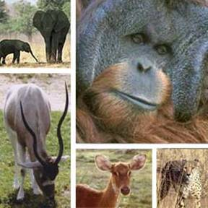
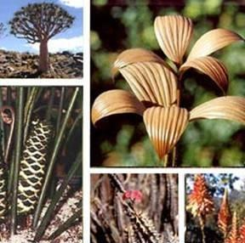
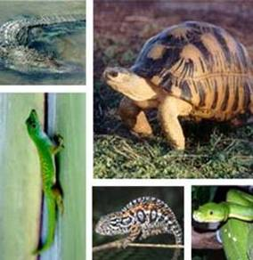
CITES and Track and Trace Systems
Facilitating legal, sustainable and traceable international trade in wildlife
25th UN/CEFACT Forum
20 to 24 April 2015
Palais des Nations, Geneva, Switzerland

Slide 2
CITES: Trade, environment and development
CITES stands at the intersection between trade, environment and development (Rio+20*).
CITES regulated international trade is a multi-billion dollar business with Parties now issuing over 850,000 permits per annum – permits that effectively certify that the trade is both legal and sustainable.
*The future we want (United Nations General Assembly Resolution 66/288 (A/RES/66/288))

Slide 3
CITES: Trade, environment and development
This CITES regulatory system, using permits, certificates, is mature, stable and universally recognized and adopted.
However, a number of developments are impacting on this environment…

Slide 4
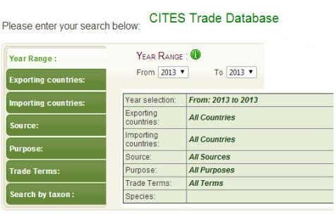
CITES DATA
CITES: One of the few MEAs to produce primary data which offers policy makers a valuable tool to assist with more effective decisions
The CITES Trade Database holds over 12 million records

Slide 5
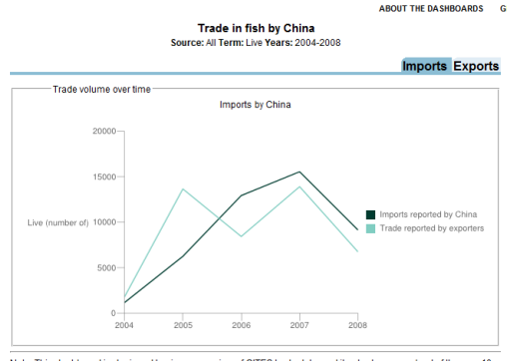
CITES DATA
These 12 million records are created using data from CITES permits and certificates

Slide 6
What this means for CITES
Dematerialization of trade related documentation is moving faster than expected
ASIA and the Amazon region are leaders in this area

Slide 7
What this means for CITES
What is important is for CITES documents to conform to international standards for e-trade and protocols for electronic data exchange
Parties have adopted a standard permit form, and guidance has been provided in Resolution Conf. 12.3 (Rev. CoP16) on CITES permits and certificates

Slide 8
CITES Electronic Permits
Trends: Need to ensure harmonization with other initiatives
United Nations Centre for Trade Facilitation and Electronic Business (UN/CEFACT) standards
UNCTAD ASYCUDA
World Customs Organization (WCO) data model

Slide 9
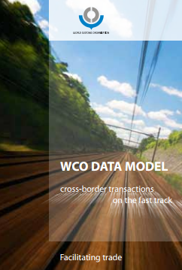
Current situation
UN/CEFACT CCL and the WCO Customs Data Model provide opportunities for CITES e-permits to become aligned with Single Window environments

Slide 10
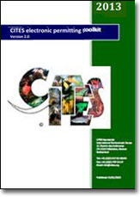
Current situation
CITES e-permitting toolkit is integrated in the WCO Data Model v 3.3
It is based on UN/CEFACT’s Core Component Library
Established MoU with UNCTAD of inclusion of ASYCUDA standards

Slide 11
Why do we need traceability standard(s)
Decisions by Parties to CITES related to sturgeons, shark fins, Queen conch, timber, reptile skins, ivory, among others.
The challenge is that CITES is adopting many decisions on traceability targeting individual species.
This may result in many different systems using different standards.
Why would this be a problem?

Slide 12
Why do we need traceability standard(s)
The question can be answered with a question:
Why are Parties requesting traceability systems for CITES-listed species?
The Secretariat could provide different reasons. But the overall vision should be the same: Ensure that the trade is Legal and Sustainable.

Slide 13
Why do we need traceability standard(s)
Would be possible to develop a general/meta umbrella standard? The standard then could be extended to meet the requirements under a business chain for any species.
Would it be possible to maintain a core set of standards for every species, facilitate development of new track and trace systems for additional species, and be harmonized with international standards and norms.

Slide 14
Current work
Discussions with UNECE (UN/CEFACT), UNESCAP (UNNext), World Bank, GS1, Governments of Switzerland, France and the Netherlands (Chair of PDA Agriculture) on extension of traceability systems for agriculture (including fisheries and timber) for wildlife.
There is agreement that such a meta-standard [could] be developed for use by CITES.

Slide 15
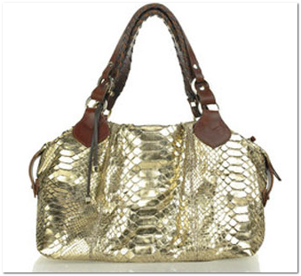
Current work
Feasibility project between Switzerland and GS1 on a track and trace standard for python skins
It builds on the T&T standards developed by UN/CEFACT and GS1

Slide 16
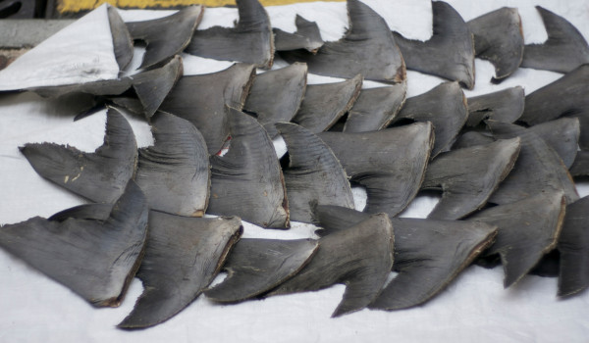
Current work
Currently working with a consultant on a project on shark fins: … the chain of custody, including where in the trade chain it is considered essential to be able to identify the products in trade

Slide 17
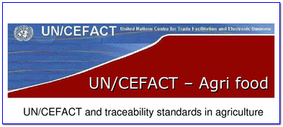
Traceability and sustainable/legal trade
Work to increase the “traceability” of CITES species from harvest to consumer (many parallels to the work of the PDA on Agriculture)
Need advice by UN/CEFACT, and WCO on lessons learned

Slide 18
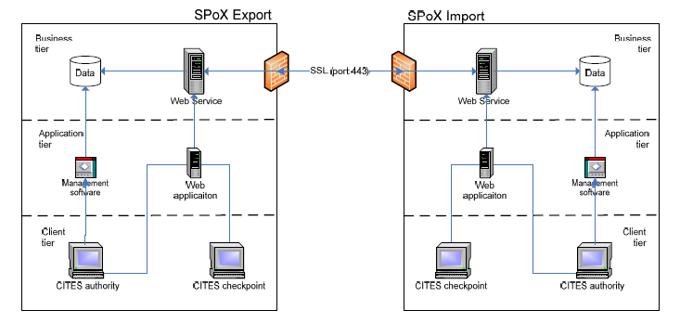
Traceability and sustainable/legal trade
This would allow for business processes to be optimized and the “goods” in transit to be traced, providing for legal, sustainable international trade

Slide 19
Traceability and sustainable/legal trade
In summary, adhering to UN/CEFACT standards and the WCO data model provides CITES with:
Decrease in opportunities for fraud
Real-time data and easier reporting
Decreases in the rate of error
Ensure legal acquisition and sustainability (requirements under CITES)

Slide 20
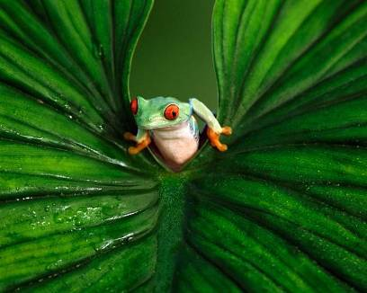
CITES and traceability
To ensure that international trade in CITES-listed species is legal, sustainable and traceable

Slide 21
Marcos Regis Silva CITES Secretariat Geneva www.cites.org

