Slide 1
23rd UN/CEFACT Forum
UN/CEFACT Project Recommendation for ensuring legally significant trusted trans-boundary electronic interaction
Aleksandr Sazonov 7th April 2014

Slide 2
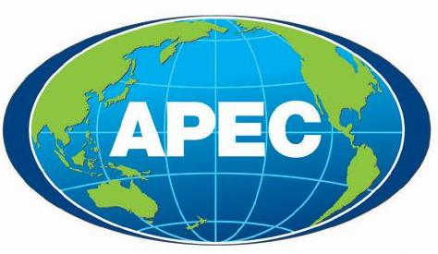
Political Context Global task statement
2012 APEC Leaders' Declaration «…necessary to be more active in promoting confidence and trust in electronic environments globally by encouraging secure cross border flows of information, including electronic documents.»
Agreement on trade facilitation WT/MIN(13)/36 • WT/L/911 of 11 December 2013
ARTICLE 1: PUBLICATION AND AVAILABILITY OF INFORMATION
2. Information Available Through Internet
ARTICLE 10: FORMALITIES CONNECTED WITH IMPORTATION AND EXPORTATION AND TRANSIT
2. Acceptance of Copies
3. Use of International Standards
4. Single Window
17 January 2014 Russia ratified the United Nations Convention on the use of electronic communications in international contracts
«The Electronic Communications Convention is an enabling treaty whose effect is to remove those formal obstacles by establishing equivalence between electronic and written form.»
United Nations Commission on International Trade Law (UNCITRAL)

Slide 3
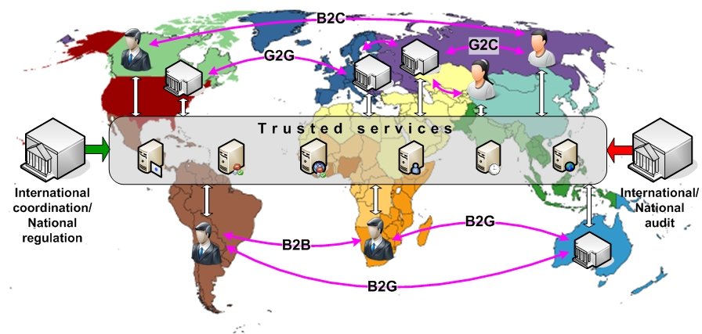
Common approach to ensuring trans-boundary trusted electronic interaction
Use of trusted services
Interaction participants: natural/legal persons, registry systems, trust service providers

Slide 4
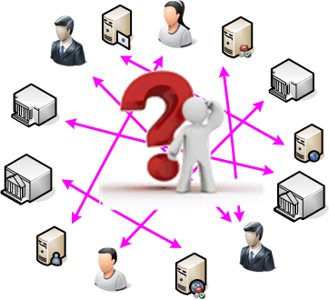
How to achieve interoperability?

Slide 5
European Interoperability Framework 2.0 (EIF 2.0)
Cooperating partners with compatible visions,
aligned priorities, and focused objectives
Political Context
Политический контекст
Политический контекст
Политический контекст
Политический контекст
Политический контекст
Политический контекст
Политический контекст
Политический контекст
Legal Interoperability
Aligned legislation so that exchanged data is
accorded proper legal weight
Coordinated processes in which different
organisations achieve a previously
agreed and mutually beneficial goal
Organisational Interoperability
Semantic Interoperability
Precise meaning of exchanged information
which is preserved and understood by all parties
Technical Interoperability
Planning of technical issues involved in linking
computer systems and services

Slide 6
Coordinated work
Legal level
(UNCITRAL)
ensure
legally significant trusted
trans-boundary electronic interaction
Technical level
(ISO/ETSI)
Organisational &
Semantic levels
(UN/CEFACT)

Slide 7
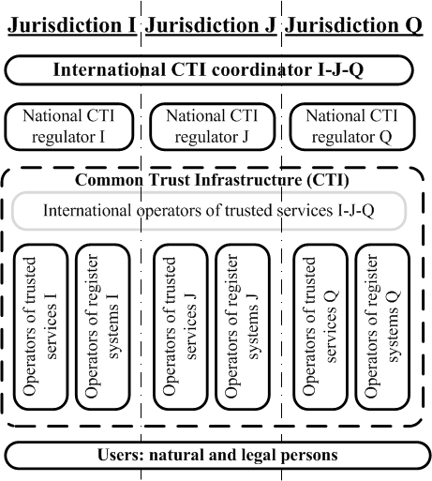
UN/CEFACT role
Complicated bonds
Governance model (example)
UN/CEFCT
recommends
How to build and manage national Trust Infrastructures in a best way so they would be interoperable with each other
for e-Trade facilitation

Slide 8
Welcome you to join the Project!
Lets ensure trusted trans-boundary electronic interaction!
Aleksandr Sazonov
deputy general director on development
“National Certification Authority Rus” CJSC
sazonov@nucrf.ru

