Slide 1
WTO Agreement on Trade Facilitation The WCO’s Role
8 April 2014

Slide 2
What is the WCO?
The WCO represents 179 Customs Administrations across the globe that collectively process approximately 98% of world trade.
3 Main Strengths of WCO
Capability and responsibility for global standard setting for Customs
Standard Setting
Cooperation
Capacity Building
Capacity Building / Technical Assistance delivery
Network of accredited experts from Customs Administrations
Cooperation with other international organizations and other agencies
Notes:
The WCO welcomes the WTO Agreement on Trade Facilitation (ATF) adopted at the WTO’s Ninth Ministerial Conference in Bali (Indonesia) held from 3 to 7 December 2013, under the framework of the Doha Development Agenda.
Full implementation of the Trade Facilitation Agreement will contribute to economic growth and recovery, improved revenue collection and alleviation of poverty.
The World Customs Organization (WCO), as one of the Annex D organizations, has long supported the conclusion of a WTO Agreement.
Furthermore, the ATF highlights the role of the WCO in implementation and administration of the ATF. It is essential to ensure smooth and effective implementation of the ATF.
WCO immediately started with the WTO in respect of the governance and future implementation of the ATF, in particular in the framework of the WTO Trade Facilitation Committee to be established.

Slide 3
What is the ATF?
The WTO Agreement on Trade Facilitation (ATF) contains 13 Articles regarding Trade Facilitation in Section I and special and differential (S&D) treatment for developing countries and Least-Developed Countries in Section II. It deals almost entirely with Customs-related topics but foresees cooperation with other agencies (CBM).
Section I
Art.1 Publication and availability of information
Art.2 Consultation
Art.3 Advance ruling
Art.4 Appeal/Review procedures
Art.5 Other measures for transparency etc.
Art.6 Fee and Charges
Art.7 Release and Clearance of goods
Art.8 Border Agency Cooperation
Art.9 Movement of goods intended for import
Art.10 Formalities
Art.11 Transit
Art.12 Customs cooperation
Art.13 Institutional Arrangement
(TF Committee)
Section II
Special and Differential Treatment
for Developing Countries and Least Developed Countries
Rules about Categories A, B and C
Assistance for Capacity Building
Information to be submitted to the TF Committee
Final provision

Slide 4
ATF - Key Principles ATF?
Section I
Art.1 Publication and availability of information
Art.2 Consultation
Art.3 Advance ruling
Art.4 Appeal/Review procedures
Art.5 Other measures for transparency etc.
Art.6 Fee and Charges
Art.7 Release and Clearance of goods
Art.8 Border Agency Cooperation
Art.9 Movement of goods intended for import
Art.10 Formalities
Art.11 Transit
Art.12 Customs cooperation
Art.13 Institutional Arrangement
(TF Committee)
Transparency
Predictability
Efficiency

Slide 5
Lead role at the border
Customs should take a leading role to implement the ATF as a central government agency at the border.
National Committee
On Trade Facilitation
Coordinated Border Management

Slide 6
Range of WCO Activities
WCO activities cover a wide range of Customs matters, including economic competitiveness, compliance and enforcement, revenue collection and organizational development.
WTO ATF
RKC
ECP
WCO
Activities

Slide 7
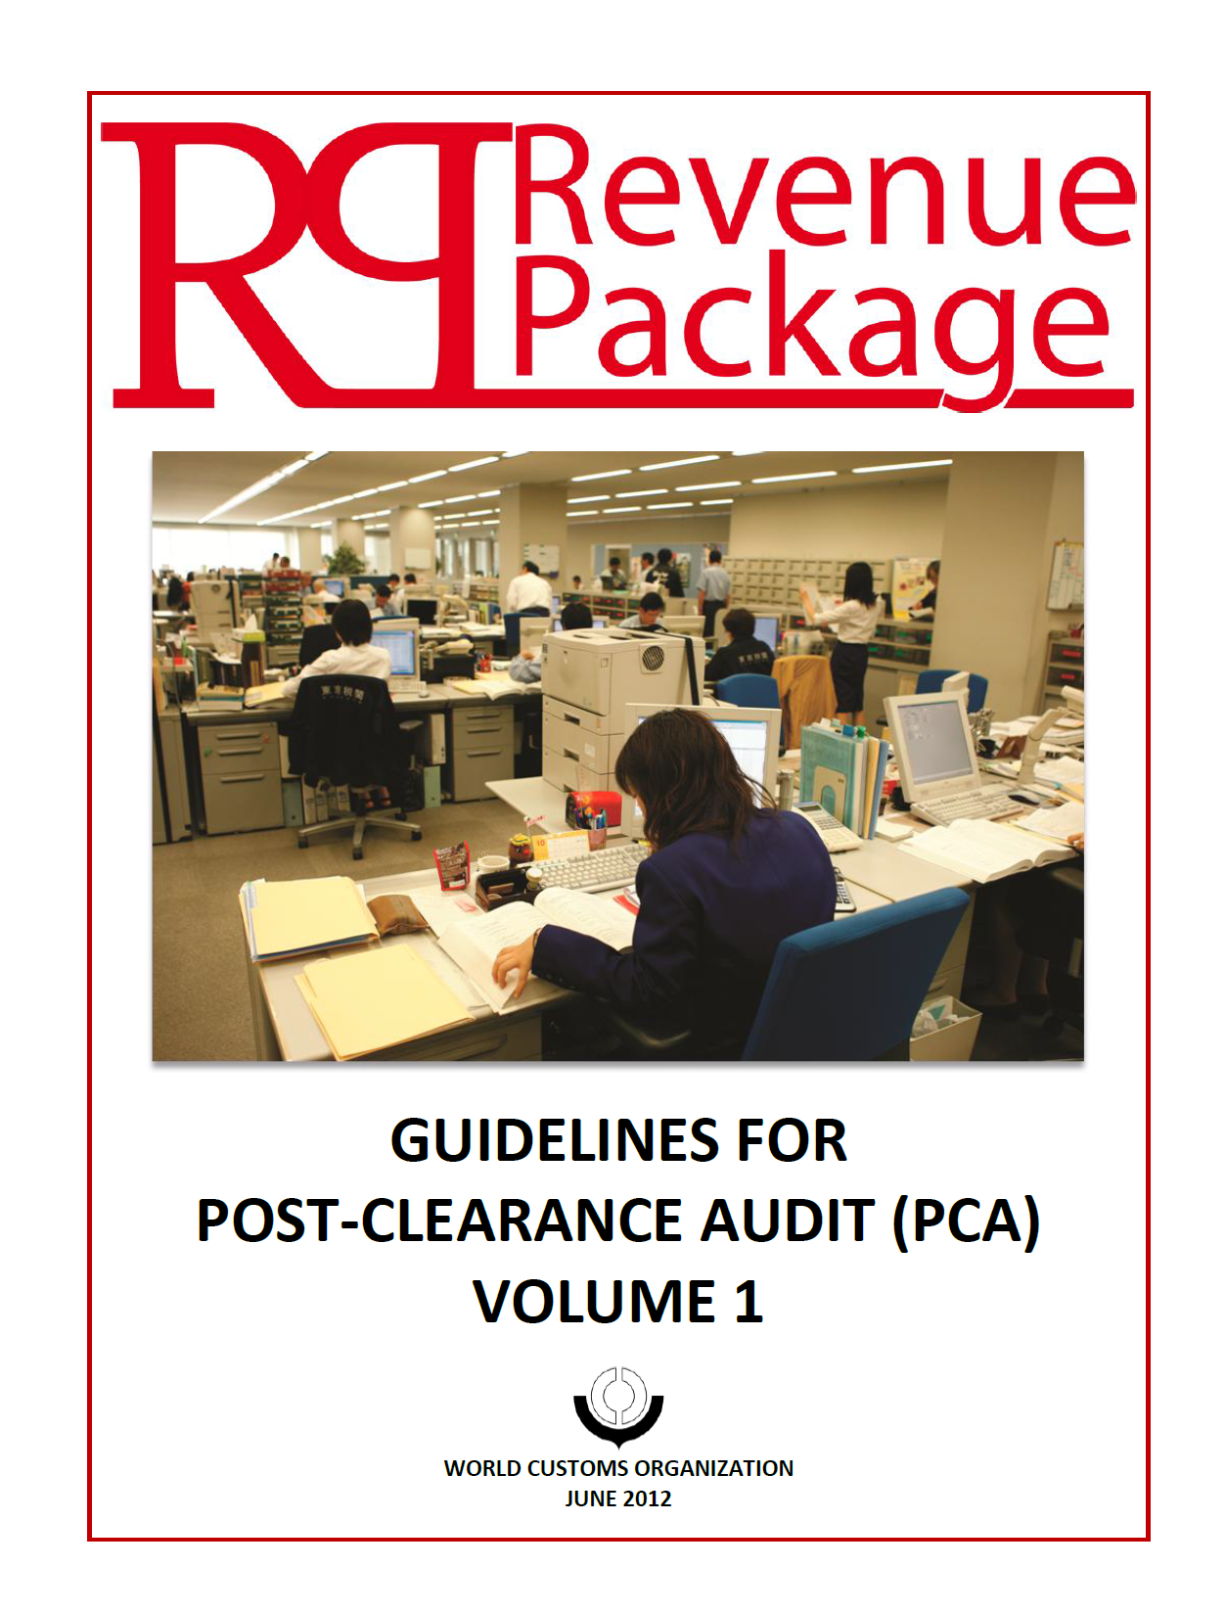
WCO tools to support ATF
The WCO has developed a number of instruments and tools, which respond to Members’ needs as regards ATF implementation. The WCO is continuing to develop and fine-tune an inter-active guidance tool designed to help Customs implement the ATF.
Examples of WCO tools
Revised Kyoto Convention
SAFE
Framework of Standards
Time Release Study Guide
Single Window
Compendium
Data Model
Risk Management
Compendium
Globally
Networked Customs
Post Clearance Audit Guidelines
Upcoming
Coordinated Border Management
Compendium
Transit
Handbook
Customs/ Business Partnership
Guidelines
…
CLiKC
Project Map
Database
Capacity Building
Development
Compendium

Slide 8
Example – Risk Management
The ATF obliges Members, to the extent possible, to adopt or maintain a risk management system for Customs control.
The RKC sets out principles of Customs risk management and the RKC Guidelines cover technical aspects of risk management and Customs control.
The Risk Management Compendium introduces detailed and technical information on risk management, based on practices and experiences of WCO Members.

Slide 9
WCO implementation guidance for the ATF
The WCO will provide implementation guidance for the ATF. The guidance is a web tool or USB which contains valuable information to assist WCO Members to implement each provision of the ATF.
Overview
ATF provisions
Standards and Guidelines of RKC
Other relevant WCO tools
Members’ practices
Performance indicators

Slide 10
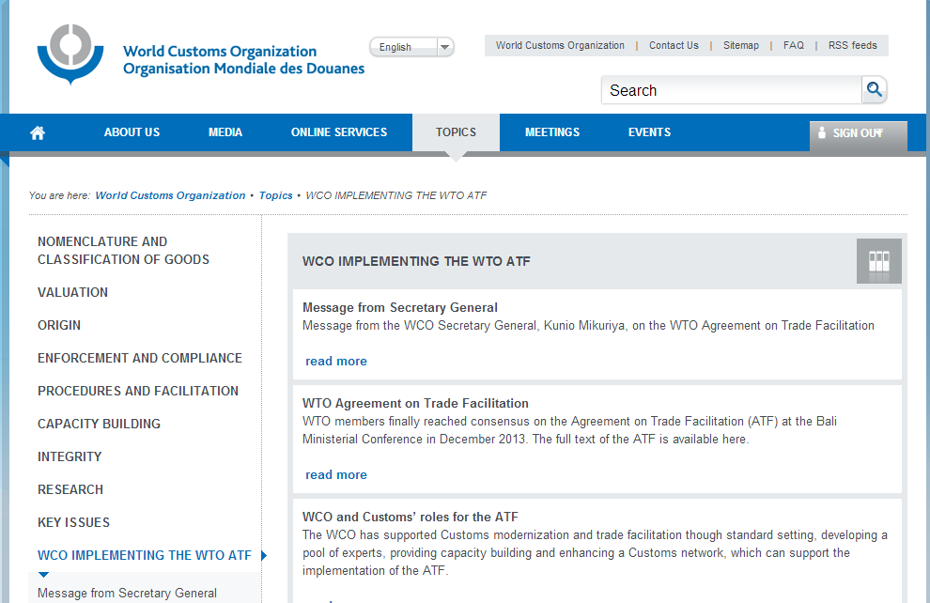
http://www.wcoomd.org/en/topics/wco-implementing-the-wto-atf.aspx

Slide 11
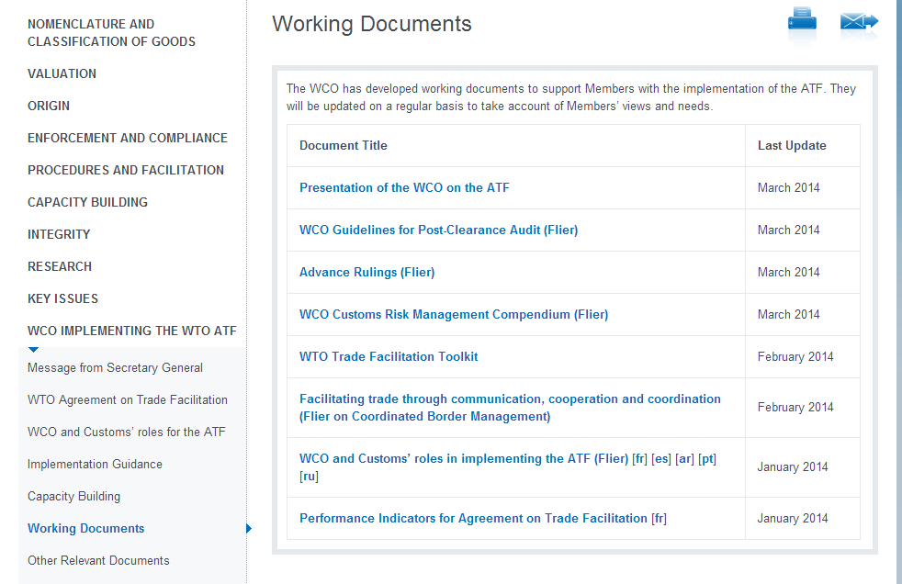
http://www.wcoomd.org/en/topics/wco-implementing-the-wto-atf/working-documents.aspx

Slide 12
WCO Working Group on the ATF
The Working Group (WG) will be the focal point for standard setting, capacity building and other issues relating to ATF implementation. The WG will take up the practical aspects inherent in meeting expectations arising from the ATF.
Analyse ATF and prepare relevant actions
Set new standards or modify existing tools
Discuss technical assistance activities
Donor information
Report to PTC/CBC/Policy Commission/Council

Slide 13
Capacity Building and Technical Assistance
The WCO will provide Members with practical assistance to implement the ATF through its network of Customs experts.
The Project Map Database supports donor and project coordination.
The WCO Database has more than 400 accredited experts from Members.

Slide 14
Roadmap - 2014
 | 2013 Dec | Feb | March | June | July | Autumn | December
WTO ATF
WTO Meetings
WCO Meetings
Supporting Tools
Capacity Building
Legal review
Conclusion of ATF
Adoption of
ATF
Preparatory
Committee
Donor
meeting
WG
Working Group
PC (Dublin Resolution)
PTC
PC &
Council
PTC
PC
CBC
CBM Compendium
Transit Handbook
etc.
Implementation Guide
Needs identification for 2014/2015
(requirements from Members)
Capacity building delivery for Trade Facilitation

Slide 15
The WCO is ready to support the implementation of the ATF!
MORE INFORMATION
Ms. Susanne Aigner
Head of the WTO Trade Facilitation Taskforce at the WCO
Susanne.Aigner@wcoomd.org

