Slide 1
PUBLIC PRIVATE PARTNERSHIP (PPP)
CONTRACT MANAGEMENT
Muhammad A Ingratubun
Senior Procurement Specialist
Asian Development Bank
Geneva, Switzerland - 22 February 2012

Slide 2
Defining PPP (Is it Possible?)
There many definitions of PPP!
One thing in common “ … legally binding contract …” or “ ... contractual arrangement …” or “… relationships …”
PPP as a procurement model/method)
PPP is a “marriage” or “relationship” between public - private entities to produce output)

Slide 3
What is PPP Contract Management?
What is PPP Contract Management?
... The process that enables both parties to a contract
… Delivering the PPP Agreement objectives (World Bank, Vickram Cuttaree, 2008)
PPP Contract Management is the entire process in getting PPP project prepared, procured, delivered (operated) maintained and handed over.

Slide 4
What is PPP Contract Management?
PPP contract management starts here
PPP Market testing
Contract Administration and Monitoring
PPP Market study / sounding
PPP contract management covers the entire process
Adopted (modified) from http://toolkit.pppinindia.com/

Slide 5
Fuel Supply Agreements
O & M Agreements
Loan & Financing Agreement
Concession Agreements
PPP Model/ Method
Other Contracts/ Agreements
Tariff vs Subsidy Agreement & Decree
Statutory Agreements/ Decrees
Central vs Local Government Agreements
PPP Identification
Decision to Enter PPP
PPP Contract (Types)
Guarantee vs counter Guarantees
Consultant Contracts (FS, Transaction Advisors, etc)
EA’s staff engagement contract/ decree
Service providers Contracts
PPP Development
PPP Contract Award
Contract Administration & Performance
Management of Construction
& Operation
PPP Operation

Slide 6
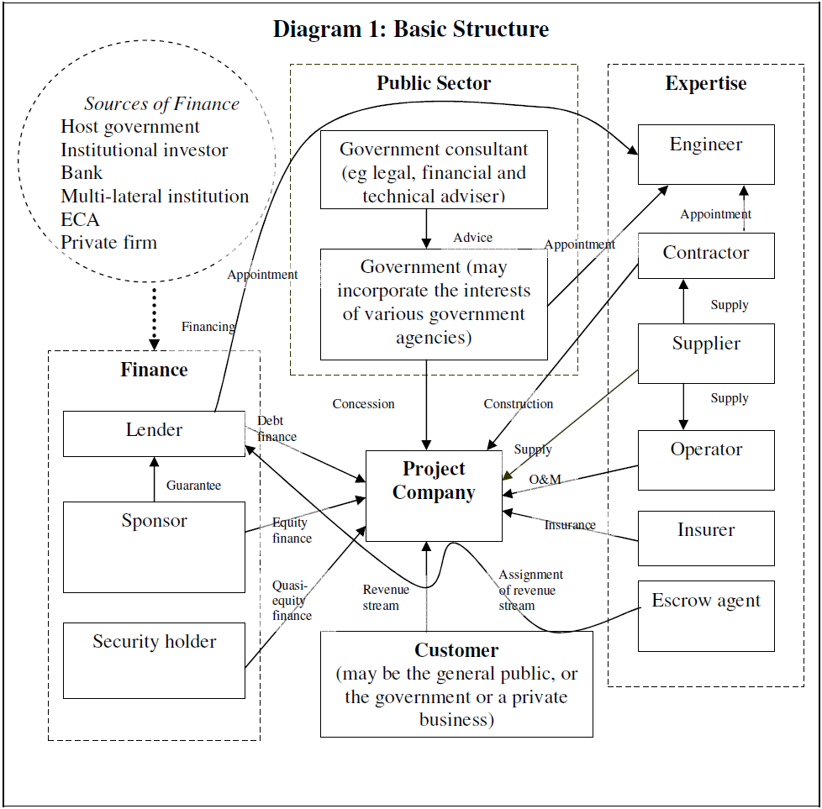
PPP (Concession ) Basic Structure
Source:UNESCAP, A Legal Perspective of Public Private Partnerships (Internet Feb 2012)

Slide 7
Contract Management (Private – Public)
Core Team
PPP Identification
Amount of Works
PPP Development
Resources Allocated
PPP Operation

Slide 8
Planning
Preparation
Evaluation
Award
Administration
PPP Identification
Contract Management
PPP Development
PPP Operation

Slide 9
Private vs Public – Entering Contract
Public Sector
Which PPP model?
Alliance or risk transfer?
Cash or In-kind (assets)?
Existing vs New Regulatory Framework?
Subsidy vs New Tariff vs Adjustment?
Funding sources vs method?
National Security?

Slide 10
Private vs Public – Entering Contract
Private Sector
Open bidding or sole source? (Solicited vs Unsolicited)
Profit vs Market Penetration?
Joint venture vs Sole Bidder?
Risks taken - shared – passed?
Limited vs unlimited liability
Equity or contracting role only?

Slide 11
Typical Issues in
PPP Contract Management
Resources
Feasibility Study – Credibility!
Risk Sharing and Management
Changing Laws and Regulations
Procurement
Contract Administration

Slide 12
Typical Issues After PPP Contract Award
Lack of Capacity vs Loss Institutional Memory
Delay (New Law, Procurement, etc)
Change in Law and Regulations
Performance Management (QA/QC)
Handling Disputes
Managing Contract Changes and Variations
Early Termination and Compensation
Renegotiations

Slide 13
Effective PPP Contract Management
Begins when decision to enter PPP is made not when PPP Contract is awarded
Keep core team from PPP Identification to Operation
Adequate financial resources for contract monitoring with right skilled staff - TrAdv
Win-Win & Smile-Smile = No Losers No Stewing
Important - Good attitude among partners
Sound preparation & fairness minimizes re-negotiations & variations risks
Contract Management Plan

Slide 14
MDBs Recommendation
Every Jurisdiction & PPP project is different
Structuring Challenges - Existing vs New PPP Regulatory Frameworks
Capacity Building
Project Development Facility (PDF)
Early Engagement of Private Sector – Market Study/Sounding vs Testing
PPP Procurement vs MDBs Procurement
Customized Standardized Contract Forms.
Early Engagement – PPL (Public-Private-Lender)

Slide 15
Thank You

