Slide 1
The Role of Indonesia Infrastructure Guarantee Fund for
PPP Projects Development in Indonesia
A Presentation on PPP Days 2012
Geneva, 21-24 February 2012

Slide 2
Indonesia Infrastructure Needs and
PPP Context

Slide 3
Strong economic growth is projected, thus requires more development of basic infrastructure
In the next 15 years, Indonesian economy is estimated to be more than 5 times of 2010
In 2045
GDP: ~USD 15.0 – 17. 5 trill
Income per capita would be around ~USD 44,500 – 49,000
In 2025
GDP: ~USD 4.0 – 4.5 trill
Income per capita is predicted to be around ~US$ 14,250 – 15,500 (classified as a high income country)
2010
GDP: ~USD 700 billion
Income per capita USD 3,000
Source: MP3EI

Slide 4
Infrastructure investment estimate shows huge needs of contribution from the private sector
Government estimates investment needs for infrastructure within 2010-2014 reach ~ USD 214 billion
Funding Gap is about USD 74 billion: expected to come from Private Sector
Indonesia Infrastructure Investment Requirement 2010-2014
(in US$ billion)
$ 214
$ 140
It is expected that part of this will be under PPP scheme
$ 74
$ 74
Investment
Needs
State Budget / SOE
Funding
Gap
Private
Source: Bappenas

Slide 5
Some of Key Challenges to Accelerate Indonesia’s PPP - which are not unique to Indonesia only
Sectors
  Public Sector Capacity & Commitment
      Comprehension of PPP concept & process
      Execution capacity
          Project Preparation
          Transaction management
  Government Support
      Direct
          Land Acquisition
          Investment / Operations Subsidy / Viability Gap Funding (VGF)
      Contingent
  Regulatory Framework
  Institutional Issue / Coordination
Key Challenges
Transport
Toll Road
Various measures have been taken by GoI, one of which is establishing IIGF
Electricity
Water Supply
Waste
Selected Oil & Gas
Selected Telco
Irrigation

Slide 6
IIGF Profile and Business Model

Slide 7
IIGF Profile
Date of Establishment
30 December 2009
Capital Structure
Paid-in Capital: Rp. 3.5 trillion (~USD 390 mio)
Additional Rp 1 trillion (~USD 119 mio) in 2012 has been approved by Parliament) → total capital by end of 2012 ~USD 500 mio
Ownership
100% Government of Indonesia
Legal Basis
Presidential Regulation (PR) No.67/2005, j.o. PR No. 56/2011 and PR No.13/2010.
PR No. 78/2010.
MOF Regulation No. 260/PMK.011/2010.
Government Regulation No. 35/2009.
Government Regulation No. 88/2010.
Core Business
Provide guarantees for Government Contracting Agencies’ (Ministries, Regional Governments, SOEs) contractual obligations under Cooperation Agreement of PPP infrastructure projects

Slide 8

GOI establishes IIGF to provide guarantees to accelerate PPP infrastructure projects development
Presidential Regulation 67/2005*
Presidential Regulation 78/2010
MOF Regulation 260/2010
Single Window Mechanism for Guarantee Provision
Primary Objective of IIGF
1. Improve creditworthiness – bankability of PPP projects
2. Provide guarantees to well structured PPPs
3. Improve governance, transparency and consistency of guarantee provision process
4. Ring-fence GOI Contingent Liabilities and minimize Sudden Shock to RoI State Budget
*as has been ammended by Presidential Regulatian No. 13/2010 and No. 56/2011

Slide 9
IIGF serves as Government’s Single Window for
Appraising, Structuring of Guarantees & Processing Claims
Project
Appraising, Structuring of
Guarantees & Processing Claims
Project
Project
Project
Project
A single window is important for:
A consistent policy on appraising guarantees
A single process for claims
Introducing transparency and consistency to the process

Slide 10
As a Single Window Processor, IIGF is aimed to be a credible guarantee provider
Capital
Management/Resources
System
Consistent, robust, transparent process
Leapfrog set up by utilizing international experience
Independency
Corporate structure & governance
Market/industry watchdog
GoI capital injection (Rp 3.5 T by 2011)
MDA/Others credit/guarantee facilities
Private sector background
Best-in-class appraisal consultant
Capacity

Slide 11

IIGF’s Business Model is designed to make the Government Guarantees provision Consistent, Transparent, and Efficient
Minister of Finance
Note:
will exist only if exist, i.e. when become part of guarantee structure provided to investor
B
A
A
Equity Injection & Guarantee Policy
1
MOF
Proposal for Guarantee
Contracting Agency
(Ministries, Regional Governments, SOEs)
B
Counter Guarantee for MDA Guarantee Facility
Recourse Agreement
3a
PPP Agreement
2
Credit & Guarantee Facility
Guarantee Agreement
3b
Investor
Multilateral
Development
Agency / Others
Co-Guarantee Agreement
A

Slide 12
Project eligibility criteria for IIGF Guarantees
Sector
Eight economic infrastructure sectors: water, power, transportation (railway, ports), toll road, waste, irrigation, telecommunication, oil & gas
PPP Contract
Awarded through a competitive bidding process
Project Viability
Economically, financially, technically & environmentally viable, socially desirable
Regulations
Comply with related sector regulations
Feasibility Study
Prepared by credible experts/consultants
Arbitration Clause
Binding arbitration provision in the Concession/PPP Agreement

Slide 13
How can IIGF improve guarantee capacity to cover more Indonesia’s infrastructure projects ?
Project Contract
Government
Balance Sheet
G
F
I I
1
2
3
Contracting
Agency
Project
Appraisal
IIGF Balance Sheet
IIGF
Private
Sector
MDA/Other Credit
Facility
Submission
MDA/Other Guarantee
Facility
Guarantee
Recourse
Can cover more deal flow, utilizing:
IIGF capital
Support from Government
Partnership with Multilateral Development Agencies or other relevant institutions

Slide 14

IIGF may provide coverage of various CA’s Obligations which have been allocated to CA under PPP Agreement
Allocation of Risks in a PPP Agreement
– an Illustration
Transport
PC | Shared | CA
A
B*
C
 | D
 | E *
 |  | F
 |  | G *
 |  | H *
Toll Roads
Examples :
CA Payment Obligations
Early Termination / Other Payment Obligations due to Government Actions / Inactions, such as:
Change in Law
Expropriation
Currency Inconvertibility / Non Transfer
Force Majeure Affecting CA
Electricity
Water Supply
Sectors: As per Presidential Regulation No. 67/2005 **
Waste Water
*) Risk that leads to certain financial obligation of the bearer
Selected Telecom
Possible IIGF Guarantee Coverage
Irrigation
Selected
Oil & Gas
PC : Project Company
CA : Contracting Agency
**) as has been ammended by Presidential Regulatian No. 13/2010 and No. 56/2011

Slide 15
Sample of
IIGF Business Model Implementation

Slide 16


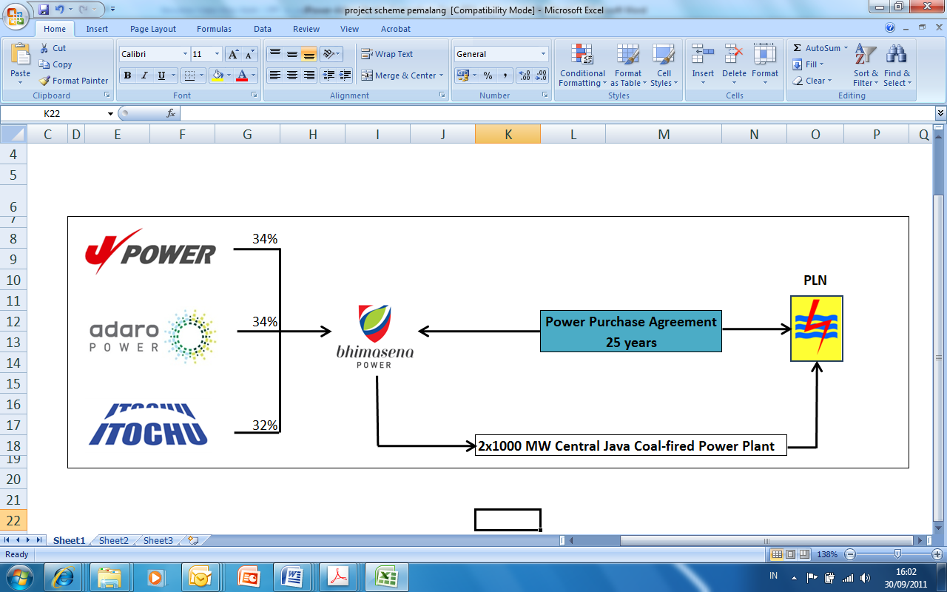
Sample of IIGF business model in power sector
Project
Ultra super critical coal fired power plant
Location
Batang Regency, Central Java Province, Indonesia
Gurarantee Agreement
ofIDR 300 Bio
6 October 2011
COD
End of 2016
PPA Tenor
25 years
Guarantee Agreement
for
Central Java Power Project
2x1000 MW; ~US$ 4 bio
PPP Structure
Build, Operate, Transfer (BOT)
Developer
PT Bhimasena Power Indonesia , an SPV of consortium:
J-POWER: 34%
ADARO: 34%
ITOCHU: 32%
Guarantee Structure
Guarantee Agreement : Project Company with IIGF and GOI
Coverage: political risk, force majeure affecting PLN and PLN EOD
Guarantee Tenor:
  Equity : 16 years
  Debt : 21 years

Slide 17
PPP Structure with Guarantee in CJPP
Skema Penjaminan dalam Proyek CJPP
PPA
Recourse Agreement 1
Recourse Agreement 2
First loss basis
up to IDR 300 bio
Guarantee Agreement (GA)
Remaining balance
after IIGF portion

Slide 18
CJPP Overall Transaction Scheme
State-owned electric utility
3
Recourse Agreement
Guarantors
1
2
PPA
Guarantee Agreement
Project Company
Sponsors
Equity
Project-Finance Debt
Lenders
4
Sponsor Agreement
5
Loan Agreement
Profit Distribution
Debt Service
6
EPC, O&M, Fuel Supply Agreements
Engineering, Procurement and Construction Contract
Fuel Supply Contract
Operation and Maintenance Contract
EPC Contractor
Fuel Supplier
O&M Contractor

Slide 19
Key Terms and Conditions of CJPP Guarantee Agreement
No | Item | Position
1 | Guarantee Coverage | Itemized and detailed clauses of PLN’s financial obligation in the PPA
2 | Guarantee Tenor | - Equity : 16 years post COD - Debt : 21 years post COD
3 | Guarantee Fee | Applicable to IIGF, and also to Government once the necessary regulation is in place
4 | Structure of Guarantee | Co- guarantee structure between IIGF and GOI with ‘Amount Sharing’ concept.
5 | Back-up on IIGF Amount | No back- up ; Except when IIGF’s insolvency is a result of Government action/inaction.
6 | Commercial Structure of Co-Guarantee | ‘First Loss’ basis on IIGF Amount
7 | Legal Structure of Co-Guarantee | One Guarantee Agreement . However, the two guarantees are several, and not joint

Slide 20
Guarantee Cover for CJPP
  Obligation to purchase electricity
      Monthly payment (Capacity and Energy payment)
  Deemed Dispatch
      Due to PLN not being able to receive Sellers output
  Buyout obligation due to PPA Termination triggered by PFM, NFM
  Obligation to pay due to PLN Event of Default (EOD):
      Non payment
      Material Breach
      Merger, Consolidation
      GOI EOD under GA
Covered:
PLN Financial Obligation as per PPA
Not covered:
Sellers EOD
Tax for Special Facilites
Indemnity

Slide 21
Policy shifting towards a Better Guarantee Framework in power sector
 |  | Support Letter | Confirmation Note | Letter of Guarantee | Guarantee Agreement
1 | Period / Project | Early 1990s / 27 IPP (1st Gen) | Mid 2000 / Cirebon (2nd Gen) | 2009 / 10,000 MW Fast Track I (PLN EPC) | 2011
2 | Addressee | Project Company | Lender (JBIC)* Insurer (NEXI)* | Chinese Lenders | Project Company
3 | Issuer | Ministry of Finance | Ministry of Finance | Ministry of Finance | IIGF (and MOF)
4 | Coverage | Blanket | Blanket | Installment (Principal + Interest) | Detailed as per covered financial obligations of CA as stated in the PPP Agreement
5 | Terms of Payment and Claims | Not stated | Not stated | 45 days | Definite number of days to each payment type, eg. regular availability and termination payment ; Detailed claim and payment mechanism
*) Under Umbrella Note of Mutual Understanding between the Ministry of Finance of the Government of Republic of Indonesia and Japan Bank for International Cooperation (JBIC), and with Nippon Export and Investment Insurance (NEXI);

Slide 22
Lessons learned from CJPP as the 1st PPP Project in Indonesia
ofIDR 300 Bio
6 October 2011
Integrity of the process: fair, transparent and competitive
Negotiation process prior to bid submission
Strong commitment from PLN as Contracting Agency
Strong Leadership of PLN Procurement Team
Strong commitment of the implementation schedule
Positive cooperation from qualified Sponsors, Lenders and other key Stakeholders
The largest & the 1st PPP Project in Indonesia
Central Java Power Project
2x1000 MW; ~US$ 4 bio
Comparing the process with other countries from RfQ to Financial Close:
CJPP: 39 months
Canada: 18 months
UK: 30 months
CJPP case can be used as a model for other infrastructure projects in promoting more fair, transparent & competitive process which brings value for money for the society as a whole

Slide 23



Sample of IIGF business model in water sector
IIGF is currently working on a Water Project in Bandar Lampung with the support of MoPW, MoF and the World Bank
IIGF’s business model is consistent with international practice on sub-sovereign credit enhancements
IIGF provides comfort to investors/lenders through Guarantee Agreement & ensures its financial sustainability through Recourse Agreement
Minister of Finance
Counter guarantee
The World Bank
Partial Risk Guarantee
Lenders
PDAM WAY RILAU
City Government of Bandar Lampung
Concession Agreement
Private Investors
Recourse Agreement
Guarantee Agreement

Slide 24
IIGF Role in Helping
to Encourage PPP Pipeline

Slide 25
How does IIGF encourage pipeline development process ?
1
CAs Capacity Building through Workshops
  Build understanding on PPP project preparation and execution
  Knowledge sharing of actual cases by International insitutions
2
CA’s Project Preparations Stage, guided by IIGF
Projects
Ready for Market
Overall Process Objective is to ensure Guaranteed Projects are:
  Feasible
  Fair in Risk Allocation
  Robust in Risk Mitigation Plan
  Well Structured
3
Involve Key Stakeholders
  To better understand the challenges and opportunities
  To help develop necessary regulation and concensus, e.g. Risk Allocations Guide, Cooprt’n Agts
4
Show concept workability through project delivery
  Real case examples speak louder
  Work on selected potential projects

Slide 26
How does IIGF facilitate and manage necessary resources ?
1
Engage CA Commitment and Team
  Get the trust of CA on IIGF guidance in execution
  Request CA’s full time working team in place
2
Acquire Professional Consultants
  Build clear Terms of Reference
  Involve international parties with local content
  Competitively procured
Mobilize financing support from various parties
  Line Ministries and MOF for Viability Gap Fund (Government Direct Contribution)
  Other donors who are unbiased and have aligned interests in developing Indonesia infrastructure
  Can also work on reimbursement (success fee) basis as a last resort, to help CA execute PPP
3

Slide 27
Thank You

