Slide 1
Knowledge-based Development: Progress & Plan
4-5 July 2018 Information and Communications Technology and Disaster Risk Reduction Division

Slide 2
Outline
Progress of WG KBD 2017-2018
Plan of Programme WG KBD 2018-2019

Slide 3
1. Progress of KBD 2017-2018

Slide 4
Asia-Pacific Information Superhighway (AP-IS) initiative
The Asia-Pacific Information Superhighway initiative aims to increase the availability and affordability of broadband Internet across Asia and the Pacific, by strengthening the underlying Internet infrastructure in the region.
A study titled “Building a resilient digital economy; fostering SMEs in Central Asia”
A study titled “The Belt and Road Initiative and the Role of ESCAP”
AP-IS 1st Steering Committee Meeting, 1-2 November 2017, Dhaka, Bangladesh

Slide 6
New Asia Pacific Plan of Action on Space Applications for SDGs 2018-2030
Under Regional Space Applications Programme for SD (RESAP) since 1994
Asia-Pacific Plan of Action for Applications of Space Technology and GIS for DRR and SD 2012-2017
Define six priority areas; Identify means and modes of implementation; formalize obligations of member States, UN agencies and donors
First drafting committee, in Bangkok, late May 2018
Turkmenistan and Uzbekistan attended this meeting

Slide 7
Targets and Priority Thematic Areas
48 SDG and SFDRR targets were identified as being HIGH priority in new Regional Plan of Action 2018-2030.
6 priority themes
disaster risk reduction and resilience
climate change
management of natural resources
seamless connectivity
Energy, and
social development

Slide 8
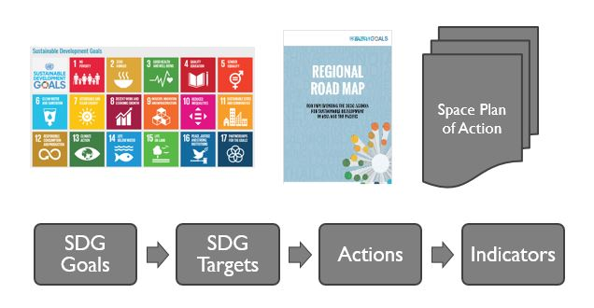
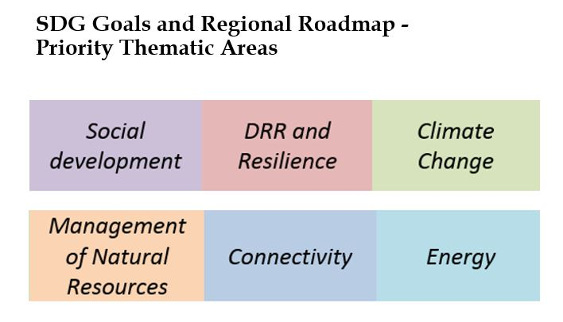

Slide 9
Statistical Geospatial Data for Monitoring the Implementation of the SDGs
Developing statistical geospatial framework and indicators as analytical tools to monitor the implementation of disaster-related SDGs.
Activities
First expert meeting (EGM) in Bangkok, 10 October 2017
Second expert meeting in Almaty, Kazakhstan on 31 January - 1 February 2018.
Plan to organize the third event late 2018
ESCAP-KOICA Fellowship Programme 2017
Capacity building on urban planning and disaster management for Central Asia” in the Republic of Korea from 28 August to 8 September 2017.
Kazakhstan, Kyrgyzstan, Tajikistan and Uzbekistan

Slide 10
2. Plan of KBD 2018-2019

Slide 11
ICT and STI Committee in August 2018
2nd Committee of Information and Communication Technology, Science, Technology and Innovation, 27-31 August 2018, Bangkok, Thailand;
AP-IS Meetings
2nd AP-IS Steering Committee Meeting, 27-28 August 2018, Bangkok, Thailand;
AP-IS Subregional Meeting for Central Asia, October 2018, Almaty, Kazakhstan.
Intergovernmental Consultative Committee on RESAP
Bangkok, 27-29 August 2018
Regional Space Applications Programme for Sustainable Development (RESAP)
Will discuss New Asia Pacific Plan of Action on Space Applications for SDGs 2018-2030

Slide 12
Ministerial Conference on Space Applications for SDGs in Bangkok, 8-10 October 2018
2nd Drafting Committee: Bangkok, Thailand, 27-29 August 2018
Senior official meeting: Bangkok, Thailand, 8-9 October 2018
ESCAP-KOICA Fellowship Programme late October 2018
Capacity building on urban planning and urban disaster for SPECA countries, Republic of Korea, from 30 October to 8 November 2018.
Invite SPECA countries

Slide 13
APDIM
Asia and Pacific Centre for the Development of Disaster Information Management (APDIM) established in Tehran, Islamic Republic of Iran
Key thematic areas

Slide 14
Key Programme APDIM
Regional disaster cloud-based metadata platform (Knowledge and information repository)
Capacity development at regional disaster information management
Regional slow-onset hazards network and alert system (with a focus on sand and dust storm)
The regional sand and dust storms alert network and regional disaster information platform are planned to be launched in 2018.

Slide 15
Thank you very much! IDD/ ESCAP Tae Hyung KIM kimt@un.org

