Slide 1
UNECE
The importance of adopting a Strategic Approach to Regional Cooperation in Innovation for the Sustainable Development
Mario Apostolov, Regional Adviser, Economic Cooperation and Trade Division, UNECE, mario.Apostolov@un.org
Notes:
Data is essential for effective and transparent monitoring and this is an area where UN work, at different levels, is particularly significant.
The importance of disaggregation has been mentioned by the R-UNDG chair.
Joint UN statistical work can help to assess the readiness of countries and provide guidance and capacity-building (-> CES Road Map)

Slide 2
"Our future prosperity depends on us being innovative"
Angela Merkel, at the inauguration ceremony of the Bosch Technology and Development Center in Braga, Portugal,
31 May 2018

Slide 3
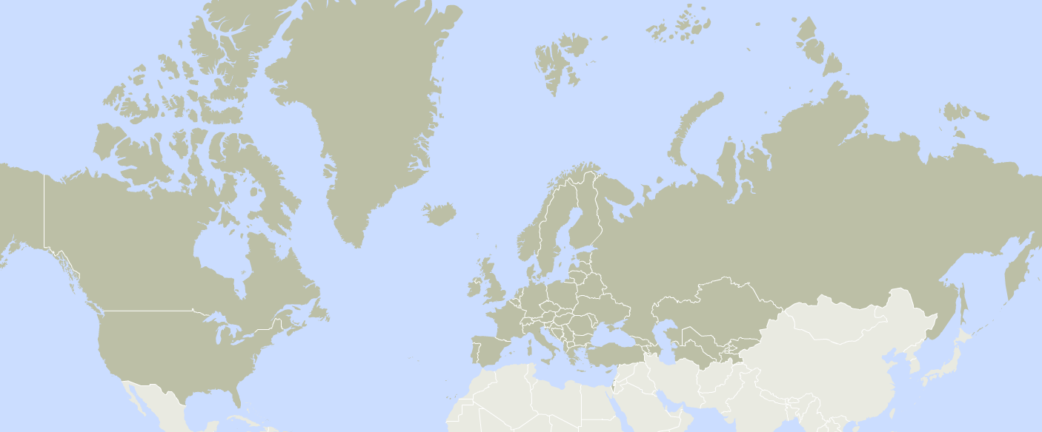
UNECE
Slogan Connecting Countries, Driving Progress, Improving Lives
Mission To help countries convene, connect and cooperate on developing norms, standards and tools to ensure the implementation of the 2030 Agenda for Sustainable Development
Notes:
Data is essential for effective and transparent monitoring and this is an area where UN work, at different levels, is particularly significant.
The importance of disaggregation has been mentioned by the R-UNDG chair.
Joint UN statistical work can help to assess the readiness of countries and provide guidance and capacity-building (-> CES Road Map)

Slide 4
UNECE and the 2030 Agenda
ENVIRONMENT
TRANSPORT
TRADE
INNOVATION AND COMPETITIVENESS
SUSTAINABLE ENERGY
HOUSING AND LAND MANAGEMENT
FORESTS
POPULATION
STATISTICS

Slide 5
Benefits of adopting and implementing a strategic plan
Gives an overall vision for a number of countries and organizations on their innovation policies, institutions and objectives
Sets framework for cooperation in R&D; technology transfer; and innovative tools (e.g. business incubators) with focus on Sustainable development
Defines concrete points to include in national sustainable development plans
Help implement “regional” SDGs through innovation
Based on a formulated vision of Innovation for Sustainable development
Supports national innovation institutions
Uses indicators of achievement of SDGs as a driver for sustainable development
International donors can use it to plan their assistance
Encourages implementation of existing best practices
⇨ Establish vision, baseline and customized objectives for sustainable development

Slide 6
Developing and implementing a strategy
Continuous change management – Prepare organizational, technical, methodological, competencies, regulatory change throughout a modernization effort for innovation
As-Is situation
To-Be situation
Current indicators
e.g. data from an innovation index or the SDG indicators (DESA) + a future ECE index
Carry out studies on the readiness for innovation
Desired indicators (in 1-5 years)
Improved national innovation-support systems
Regional R&D cooperation institutions, etc.
Analysis of needs
Existing good practices
National institutions supporting innovation
National plans for innovation
Research institutions on environmental protection
Social protection, etc.
Objectives for development
Upgrade knowledge and skills to address SDGs with innovative solutions;
Strengthen the regional policy dialogue;
Identify together regional challenges;
Enhance the institutional framework for regional cooperation, etc.
Projects on regional cooperation in innovation for the SDGs
Consultative process – Engage the business community in all steps of the modernization effort
Notes:
Needs assessment is the first step that policy makers/managers, which approach a trade facilitation reform, will have to undertake. It consists of a comprehensive analysis of key obstacles to timely and cost effective cross border trade of goods and services.
The analysis should be conducted on the basis of performance indicators, which take into account factors such as the time required to clear goods through customs, import prices, international transport costs, the productivity of a particular transport mode (air, maritime, road). It should be based on available methodologies, such as the UNNexT Business Process Analysis, the WB Toolkit for Audit, Analysis and Remedial Action, the WB/WCO Time Release Study Software, etc.
Measurement should cover most elements of the supply chain including banking requirements, custom procedures, controls, payment systems, geographical position, IT and physical infrastructure, transport systems.
The analysis requires wide consultation with key players for trade facilitation, i.e. through interviews/questionnaires/ad-hoc meetings. Such players include 1) forwarders/agents/brokers/transport operators, 2) exporters and importers, 3) shipping lines and shipping agents, 4) road carriers, 5) airlines, 6) express operators, 7) railways, 8) ports, 9) airports, 10) border crossing points, 11) customs, 12) commercial banks, 13) exchange control agencies, 14) pre-shipment inspection agencies, 15) chambers of commerce, 16) departments of trade.
Finally, it should take into account third party assessments performed for instance by donors or international cooperation agencies working in the field of trade and transport facilitation (e.g. WB, WCO)

Slide 7
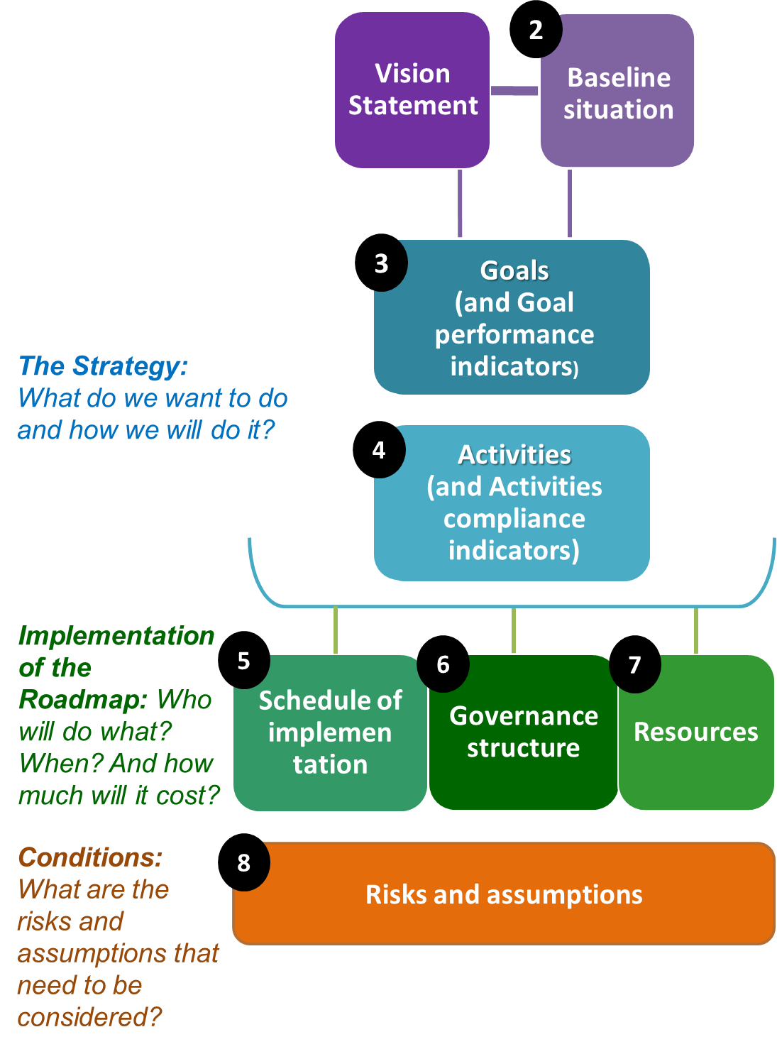
National/regional strategy
Structure of the Strategy Document | Structure of the logical framework

Slide 8
Identify Activities
Capacity development
regional capacity-building seminars for policy-makers
regional hands-on skill-building workshops for practitioners
study tours/exchanges for policymakers to share best practices
develop a network of research institutions dealing with innovation
Policy development and dialogue
Identify existing weaknesses in national innovation systems
Organise regional seminars to share good policies/practices
technical assistance missions by leading international experts
Establish regional cooperation mechanisms for regulatory coordination and harmonization related to innovation.
Identify obstacles to regional cooperation in innovation policies
Report periodically on progress against relevant SDGs, targets
Cooperate in using a sub-regional innovation policy index to measure progress
Agree on a set of priority innovation policy issues
Undertake regular national Innovation for Sustainable Development Reviews
Regional networking and cooperation
Establish a SPECA Network for Innovation Policies for Sustainable Development, etc.
Technology transfer and support to innovative entrepreneurs
support linkages with global technological value chains & FDI
propose options for a joint regional technology transfer office
cooperate with the UN Technology Facilitation Mechanism
create a joint SPECA Sustainable Development Innovation Fund
agree on a set of joint regional projects on innovation activities for sustainable development
Global cooperation
Support cooperation with existing global initiatives such as the UN Technology Facilitation Mechanism, the UN Forum on Science, Technology and Innovation for the Sustainable Development Goals and the Inter-Agency Task Team for Science, Technology and Innovation for SDG
Liaise with peer international structures for expert dialogue and mobilising expertise and resources
Awareness raising
Organise promotional campaigns for the broad public
Implementation schedule:
Start-up phase:
Delivery phase: 3-7 years.
Review phase: evaluating whether the Goals have been achieved + drafting a new Roadmap for 3-5 years. Should start 6-12 months before the deadline.

Slide 9
Drafting a strategy
Initiation Phase, draft the concept; nominate Lead Editor or Drafting Team (involve the key stakeholder agencies in the countries).
Drafting Phase of the document itself: 1) engage countries and stakeholders, 2) discuss with them existing issues and possible activities plan, and 3) define the performance indicators. Outcome – a consolidated draft strategy document. Gradually involve all key stakeholder agencies in all the countries. Good communication is a must. Support for some countries. Should not be an activity imposed from abroad.
Multi-stakeholder process – needs identification of issues and activities; resolving arguments (good moderator is needed) – encouraging dialogue, helping conciliate positions, summarizing and pointing to a solution. Workshops and brainstormings are necessary.
Review: the Drafting Team needs to assess whether the proposed activities of the Roadmap stand a chance to be supported by the key stakeholders.
Validation Phase, the document is presented to the Member States. This phase may include a high-level regional meeting to endorse the strategy and start the implementation of the Activities.

Slide 10
Measure progress in implementing the Strategy
SDG indicator |  | Central Asia |  |  |  | Europe
 |  | 2000 | 2005 | 2010 | 2016 | 2000 | 2005 | 2010 | 2016
9.4.1 | CO₂ emission per unit GDP (kg of CO₂ per constant 2010 USD GDP PPP) | 1.11 | 0.88 | 0.75 | 0.60 | 0.33 | 0.30 | 0.27 | 0.23
9.5.1 | R&D expenditure as a proportion of GDP (%) | 0.18 | 0.25 | 0.16 | 0.18 | 1.62 | 1.60 | 1.75 | 1.83
9.5.2 | Researchers (in full-time equivalent) per million inhabitants | 337.4 | 363.2 | 391.2 | 500.0 | 2458.0 | 2730.3 | 2985.7 | 3181.1
9.c.1 | Proportion of the population covered by at least a 2G mobile network (%) | 30.0 | 60.2 | 86.7 | 97.5 | 94.3 | 98.5 | 98.3 | 97.2

Slide 11
Group Work
Split into groups:
Pls discuss and prepare responses to the following questions:
Please define in one or two sentences the vision (overall objective) of a strategy on Innovation for the SDGs?
What would be the main indicators to measure progress?
40 minutes
Plenary – Presentation of Country experiences

Slide 12
Thanks !
Mario Apostolov Regional Adviser UNECE Economic Cooperation and Trade Division Palais des Nations, Room 431 CH-1211 Geneva 10, Switzerland tel.: +41 22 9171134 e-mail: mario.apostolov@un.org
www.unece.org/trade & www.unece.org/cefact

