Slide 1
Task Force on Electro-Magnetic Compatibility (TF-EMC) Status report to GRSG-117 Proposal for updated R116 EMC annexes Thursday, 8th of October 2018
Submitted by the expert of TF-EMC
Informal document GRSG-117-11
(117th GRSG, 8-11 October 2019, agenda item 13)

Slide 2
GRE TF-EMC Status Report – UN R116 Development
GRE TF-EMC has been asked by WP29 to support GRSG work on new UN R116 draft Regulations for the EMC topic.
TF-EMC has analyzed the EMC annex 9 of previous UN R116 and issued some proposals for revision of EMC annexes of :
ECE/TRANS/WP.29/GRSG/2019/20 - (OICA) Proposal for a draft new UN Regulation on Devices Against Unauthorized Use
ECE/TRANS/WP.29/GRSG/2019/21 - (OICA) Proposal for a new UN Regulation on uniform technical prescriptions concerning approval of immobilizers and approval of a vehicle with regard to its immobilizer
ECE/TRANS/WP.29/GRSG/2019/22 - (OICA) Proposal for a draft new UN Regulation on Uniform provisions concerning the approval of vehicle alarm system and approval of a vehicle with regard to its vehicle alarm system.

Slide 3
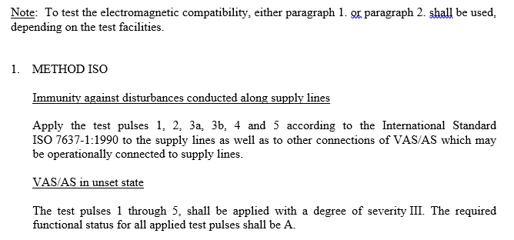
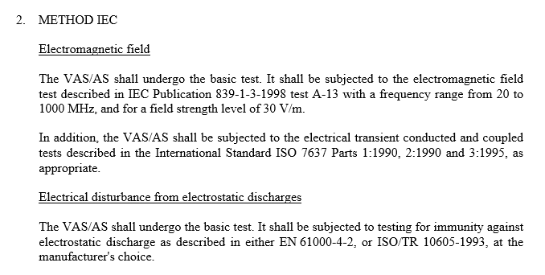
GRE TF-EMC Status Report – UN R116 Development
UN R116 EMC annex 9 included two alternatives methods :
“Method ISO”
“Method IEC”
Proposal that EMC annexes of the 3 new regulations include a single method (based on previous Method ISO)
Justification : Deletion of the alternative « Method IEC » due to the fact that test described in this part were either a duplication of those in “Method ISO” or reference to test which are no more state of the art.

Slide 4
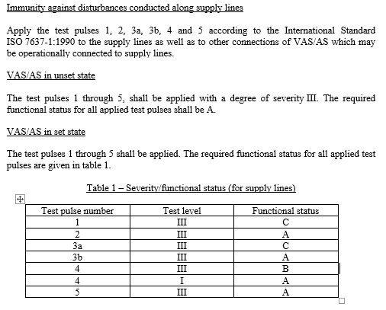
GRE TF-EMC Status Report – UN R116 Development
UN R116 EMC : “Immunity against disturbances conducted along supply lines”
Proposal to simplify wording (reference to UN R10.06) and to be up-to-date (suppression of pulse 5)
Justification : same test is described in UN R10 annex 10 and in UN R10 which is considered as the EMC state of the art pulse 5 is not required.

Slide 5
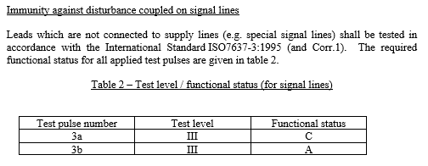
GRE TF-EMC Status Report – UN R116 Development
UN R116 EMC : “Immunity against disturbances coupled on signal lines”
Proposal to suppress this test which is not required in UN R10
Justification : this test of immunity against disturbance coupled on signal lines is not representative of a real misuse-case (in terms of coupling device used in vehicle and/or discrimination of signal lines in whole vehicle harnesses).

Slide 6
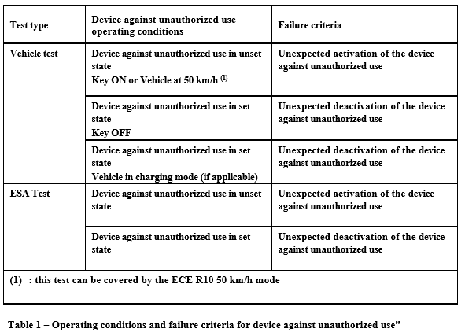
GRE TF-EMC Status Report – UN R116 Development
UN R116 EMC : “Immunity against radiated high frequency disturbances”
Proposal to update UN R10 reference (to UN R10.06) and to add a table with precision on operating conditions and failure criteria (both for vehicle and bench test).
Justification : to be in line with last UN R10 and to allow more consistency between the technical services regarding test conditions and failure criteria.

Slide 7
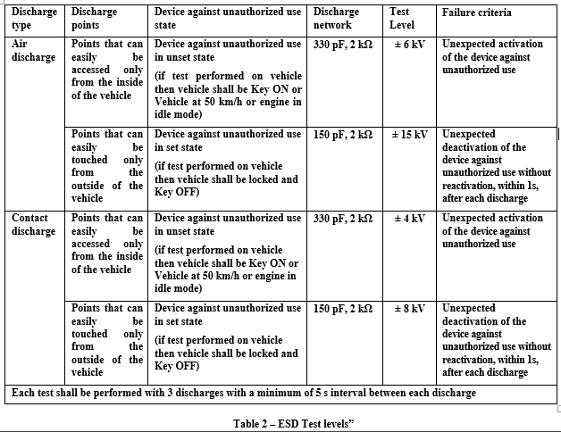
GRE TF-EMC Status Report – UN R116 Development
UN R116 EMC : “Electrical disturbance from electrostatic discharges”
Proposal to update to last version of ISO 10605 (2008) and to add a table with precision on test conditions, test levels and operating conditions and failure criteria (both for vehicle and bench test).
Justification : to be in line with last ISO standard and to allow more consistency between the technical services regarding test conditions (levels and criteria).

Slide 8
GRE TF-EMC Status Report – UN R116 Development
R116 EMC : “Radiated emissions”
Proposal to update UN R10 reference (to UN R10.06) and to add a sentence with precision on operating conditions.
Justification : to be in line with last ISO standard and to allow more consistency between the technical services regarding test levels and test conditions.

Slide 9
Thank you for your attention

