Slide 1
Status of the French legislation on shuttles
Informal document GRSG-117-07
(117th GRSG, 08-11 October 2019, agenda item 2
117th session Geneva
2029 October 8th-11th
Item 2 of the agenda

Slide 2
Status of the French legislation on shuttles
Genesis :
New vehicle concept emerges trough different french manufacturers = the “shuttles”
Concept does not meet the criteria of international vehicle categories (M1/M2/M3)
Concept is autonomous (from early development phases or at term)
French government sees the development of autonomous vehicle as one axis of industrial competiveness.

Slide 3
Status of the French legislation on shuttles
Major concern : Non-adequacy to criteria of international vehicle categories
Vehicles belonging to category M1 shall have no space for standing passengers
+
Vehicles belonging to category M2 and M3 shall comprise more than eight seating positions in addition to the driver’s seating.
VS
Shuttles have 4 to 5 seating positions and standing passengers.

Slide 4
Status of the French legislation on shuttles
Shuttles are not regulated in EU or UNECE vehicle regulations.
France saw the opportunity to establish a national regulation without violating European or internatiolal law.
First step : Define the shuttle in the French « Code de la route ».
(To do so, the legislative vector is a decree of « Conseil d’Etat »)

Slide 5
Status of the French legislation on shuttles
First step : Define the shuttle in the French « Code de la route ».
Before promulgation, the decree was notified to the European Commission. The statu quo period of 3 months was respected, without remark.
Decree N°2018-1045 of November 28, 2018 relating to urban transport vehicles of persons. (https://www.legifrance.gouv.fr/affichTexte.do?cidTexte=JORFTEXT000037662059&categorieLien=id)
Introduction of definition 6.13 in article R311-1 of « Code de la route » :
Urban shuttle: a motor vehicle designed and built for the transport of persons in urban areas, not meeting the definitions of international categories M1, M2 or M3 and having the capacity to carry, in addition to the driver, at least nine passengers and sixteen passengers at the most , four or five of whom can be seated
;

Slide 6
Status of the French legislation on shuttles
Second step : addition of prescriptions for national approvals of urban shuttles (either individual or small series*)
« Arrêté » of May 6, 2019 defining the conditions of approval, operation and circulation of urban shuttles (https://www.legifrance.gouv.fr/affichTexte.do?cidTexte=JORFTEXT000038599098&categorieLien=id )
Subject: Definitions of the conditions of approval, operation and circulation of urban shuttles + obligation of PTI (periodical technical inspections).
In this first version, urban shuttle are not autonomous. The prescriptions related to driving automatisation should be added by revision procedure.
* which does not fall under 2007/46/EC

Slide 7
Status of the French legislation on shuttles
Second step : addition of prescriptions for national approvals of urban shuttles
« Arreté » of May 6, 2019 defining the conditions of approval, operation and circulation of urban shuttles
General construction requirements :
An urban shuttle is designed and constructed exclusively for the transport of seated or standing passengers
An urban shuttle is a single-level vehicle with a flat, low floor, without any steps;
An urban shuttle consists of a single rigid section;
The urban shuttle, as defined, has the capacity to carry, in addition to the driver, at least nine passengers and sixteen passengers at most. It has four or five seats of which two at most can be liftable.
The urban shuttle has a seat reserved for people with reduced mobility, and a place reserved for a wheelchair user.
The urban shuttle is limited by construction at a maximum speed of 50 km / h.

Slide 8
Status of the French legislation on shuttles
Second step : addition of prescriptions for national approvals of urban shuttles
« Arreté » of May 6, 2019 defining the conditions of approval, operation and circulation of urban shuttles
SPECIAL FOCUS ON UNECE Reg 107 / Interior design and accessibility of urban shuttles
Urban shuttles should comply to the provisions of UNECE Regulation No 107 applicable to vehicles of categories M2 or M3 / Class A, with the exception of 7.2.2.3 (minimum number of seated position)
In addition, by way of derogation from point 1.1 of Annex 7, the minimum width of a double service door may be reduced to 1100 mm.

Slide 9
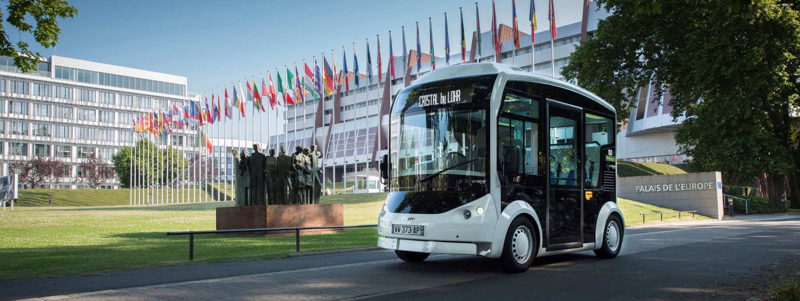
Status of the French legislation on shuttles
Third step : Enforcement
Pending approval : Q4 2019

Slide 10
Status of the French legislation on shuttles
Actions on going : Research and evaluations on autonomous shuttles
How to validate autonomous shuttles ?
Study objectives :
Work on the regulatory framework for autonomous shuttles : how to type approved vehicles ?
To achieve a “state of the art” of autonomous shuttles : performance & safety levels

Slide 11
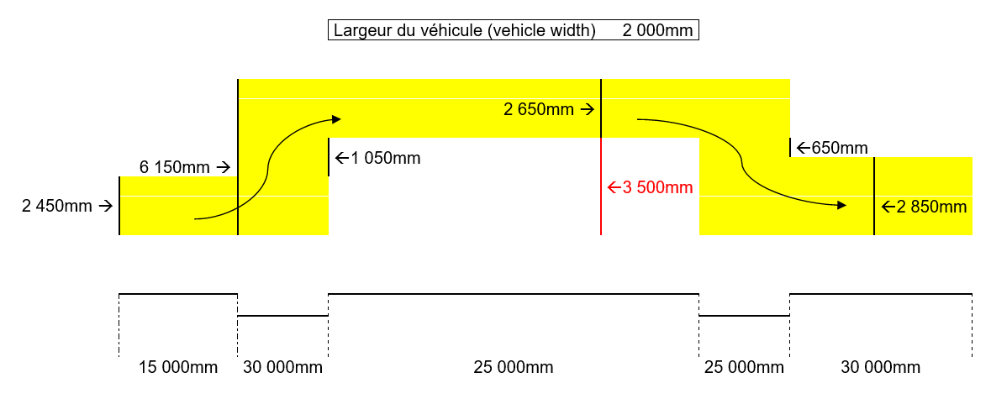
Status of the French legislation on shuttles
Actions on going : Research and evaluations on autonomous shuttles
Focus on the following specific items :
“Classical tests” : Braking systems, Speed limiters, Hill start, Steering control, Stability control (UNECE n. 13/13 H, n. 79, n. 39, n. 89 and UE 1230/2012)
➔ Amendments seems to be needed especially with new definitions of the breaking systems and adapted test protocols for streeing control and stability evaluations.
Rayon 20 m
Rayon 12 m

Slide 12
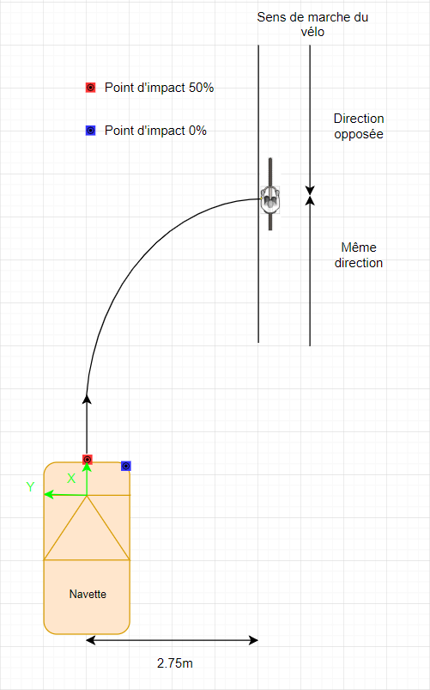
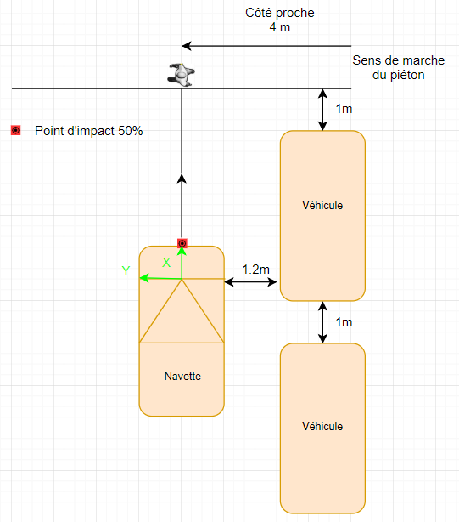
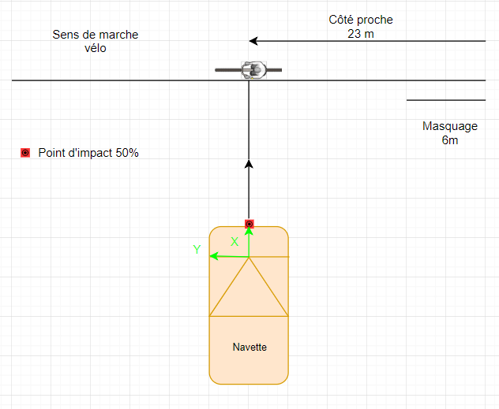
Status of the French legislation on shuttles
Actions on going : Research and evaluations on autonomous shuttles
Focus on the following specific items :
“Automated driving” : Lane keeping, lane departure, Automatic emergency braking (C2C, C2P, C2B under various conditions) using EuroNCAP protocols and Regulation UNECE n. 151.
➔ Testing scenarios and adapted protocols based on the future environment of the autonomous shuttle have to be integrated.

Slide 13
Status of the French legislation on shuttles
Actions on going : Research and evaluations on autonomous shuttles
Next steps in addition to the physical evaluations
Safety concept assessment based on design process audits, risks analysis and risks management system
Introduction of connectivity and cybersecurity to evaluate flows with supervision centers
National procedure to frame exploitation introduction will be defined

Slide 14
Thanks for your attention

