Slide 1
DEVELOPMENT OF END-TO-END DIGITAL SERVICES AND ELECTRONIC DOCUMENT FLOW ON THE ROUTES OF INTERNATIONAL TRANSPORT CORRIDORS IN THE CONDITIONS OF COVID-19
Alevtina Kirillova,
Head of the export logistics development project
JSC "Russian Export Center",
Doctor of technical sciences, professor
Natalia Ignatieva
Deputy division chief of the Department of analysis and statistics JSC «Russian Railways»
Alexey Volodin,
Ph.D., Associate Professor, Director of the Academy of Water Transport
Russian University of Transport (RUT-MIIT)
Pyotr Kurenkov,
Doctor of Economics, Professor of the Department «Transport Management and Intelligent Systems»
Russian University of Transport (RUT-MIIT)
Sergey Filipchenko,
Ph.D. - head of the scientific and technical complex OJSC «NIIAS»
Moscow, Russia

Slide 2
Murmansk
MAIN EXPORT CORRIDORS OF THE RUSSIAN FEDERATION
S-N Direction: European part of Russia - Eastern, Central Europe and Scandinavia (sea)
Arkhangelsk
Part of the Pan-European Transport Corridor No. 1: Kaliningrad - Riga, Gdansk - Sweden, Denmark
FINLAND
Vysotsk
St. Petersburg
TCM branch: Krasnoyarsk, Khabarovsk -
Vladivostok / Nakhodka –Grodekovo –Harbin (China); Posyet / Zarubino -
Kraskino - Hunchun (China) (sea, railway, car)
Helsinki
Vologda
Tallinn
Kirov
ESTONIA
Permian
Yekaterinburg
Tyumen
Riga
LATVIA
Tver
N. Novgorod
Izhevsk
Krasnoyarsk
Moscow
Chelyabinsk
Kurgan
Novosibirsk
Kaliningrad
LITHUANIA
Kazan
Ufa
Petropavlovsk
Omsk
Taishet
Gdansk
Minsk
Kaluga
Ryazan
Penza
Samara
Berlin
Warsaw
Brest
BELARUS
Tambov
Irkutsk
Bryansk
Ozinki
Ulan-Ude
Chita
GERMANY
POLAND
Kiev
Kharkov
Liski
Saratov
Nur Sultan
Part of the Pan-European Transport Corridor No. 2: Yekaterinburg -
Nizhny Novgorod - Moscow - Smolensk - Brest,
Minsk (Belarus) - EU
UKRAINE
Naushki
Zabaikalsk
Shahty
Volgograd
KAZAKHSTAN
Khabarovsk
Kishinev
Rostov-on-Don
MONGOLIA
Ulaanbaatar
Harbin
ROMANIA
Olya
Astrakhan
Khorgos
Urumqi
Suifenhe
Bucharest
Novorossiysk
Pyatigorsk
Pogranichniy
Vladikavkaz
Direction S-N:
European part of Russia - Caspian Sea - Iran (sea)
Hunchun
Ussuriysk
GEORGIA
Makhachkala
Zarubino
Vladivostok
Part of the Pan-European Transport Corridor No. 9: Istanbul (Turkey) - Bryansk-Moscow-St. Petersburg-Vyborg - Helsinki (Finland)
Stambul
Tbilisi
Baku
CHINA
Beijing
TURKEY
AZERBAIJAN
Branch of TSM: Moscow - Samara, Ufa, Chelyabinsk-Kazakhstan (railway)
Corridors passing through Russia:
North-South - Countries of Eastern, Central Europe and Scandinavia - European part of Russia - Caspian Sea - Iran - India, Pakistan, etc.
Transsib - Central Europe - Moscow - Yekaterinburg - Krasnoyarsk - Khabarovsk - Vladivostok / Nakhodka. Branch system: to St. Petersburg, Kiev, Novorossiysk, Kazakhstan, Mongolia, China and Korea. Interfacing with pan-European transport corridors № 2,3, 9
Primorye 1 Primorye 2 Pan-European TC No. 1
TCM branch:
Moscow - Kiev (railway, car)
Tehran
TCM branch: Krasnoyarsk, Novosibirsk, Ulan-Ude - Mongolia, China (railway)
ИРАН
TCM branch: Moscow - Moscow-Novorossiysk-Middle East, Africa, Asia, Europe, America (sea)
Direction S-N: European part of Russia - Sea of Azov - Vladikavkaz, Georgia (railway and car)
INDIA
Pan-European TC No. 2 Pan-European TC No. 9
Mumbai
Foreign hubs

Slide 3
LIST OF EXPORT CORRIDORS OF THE RUSSIAN FEDERATION
№ | Large corridor | Large corridor route | Export corridor | Checkpoints
1. | North-South | Countries of Eastern, Central Europe and Scandinavia - European part of the Russian Federation - Caspian Sea - Iran - India, Pakistan and others | Part of the North-South corridor: the European part of Russia - Eastern, Central Europe and Scandinavia | Ust-Luga
2. |  |  | Part of the North-South Corridor: European part of Russia - Caspian Sea - Iran | Astrakhan
3. |  |  | Part of the North-South corridor: European part of Russia - Caspian Sea - Azerbaijan, Georgia | Derbent, Upper Lars
4. |  |  | Branch of the North-South corridor: Murmansk - Arkhangelsk - EU countries, America, Africa | Murmansk (marine), Arkhangelsk
5. | Trans-Siberian Railway (East-West) | Central Europe - Moscow - Yekaterinburg - Krasnoyarsk - Khabarovsk - Vladivostok / Nakhodka. Branch system: to St. Petersburg, Kiev, Novorossiysk, Kazakhstan, Mongolia, China and Korea. Interfacing with pan-European transport corridors Nos. 2,3, 9 | Trans-Siberian Part: Moscow - Baltic States - Central Europe | Posin, Skangali, Pskov Pechora
6. |  |  | Branch of the Trans-Siberian Railway: St. Petersburg - Central Europe | Ivangorod, St. Petersburg, Vysotsk
7. |  |  | Continuation of the Trans-Siberian branch: St. Petersburg - China, other Asia, America, the Middle East and Africa | St. Petersburg
8. |  |  | Transsib branch: Moscow - Kiev (Ukraine) | Suzemka, Valuyki (railway), Triple-breasted, Nekhoteevka
9.1. |  |  | Transsib branch: Moscow - Novorossiysk - Middle East and Africa | Novorossiysk, Caucasus, Taman, Tuapse, Rostov-on-Don (marine), Azov, Yeysk, Taganrog, Sevastopol
9.2. |  |  | Transsib branch: Moscow - Novorossiysk - Asia | Caucasus, Novorossiysk, Tuapse, Taman
9.3. |  |  | Transsib branch: Moscow - Novorossiysk - Europe | Novorossiysk, Tuapse, Taman, Rostov-on-Don (marine), Yeysk, the Caucasus, Azov
9.4. |  |  | Branch of the Trans-Siberian Railway: Moscow - Novorossiysk - America | Tuapse, Novorossiysk
10. |  |  | Branches of the Trans-Siberian Railway: Moscow - Samara, Ufa, Chelyabinsk - Kazakhstan; Krasnoyarsk - Novosibirsk - Kazakhstan | External (border of Kazakhstan): Saryagash, Beineu
11. |  |  | Trans-Siberian Branch: Ulan-Ude - Mongolia, China | Nayshki (railway)
12. | Trans-Siberian Railway (East-West), Primorye-1, Primorye-2 | Central Europe - Moscow - Ekaterinburg - Krasnoyarsk - Khabarovsk - Vladivostok/Nakhodka, Grodekovo - Harbin; Posiet/Zarubino - Kraskino - Hunchun | An Offshoot Of The TRANS-Siberian, Primorye, Krasnoyarsk - Khabarovsk - Vladivostok/Nakhodka, Grodekovo - Harbin (China); Posiet/Zarubino - Kraskino - Hunchun (China) | Zabaykalsk (railway), Vladivostok, Nakhodka, Vostochny (Primorsky Krai), Pogranichniy (railway, Primorsky Krai), Pogranichniy (a / m, Primorsky Krai)
13. | Pan-European Transport Corridor No. 1 | Helsinki - Tallinn - Riga - Kaunas and Klaipeda - Warsaw and Gdansk. Branch Riga - Kaliningrad - Gdansk | Part of the Pan-European Transport Corridor No. 1: Kaliningrad - Riga, Gdansk - Sweden, Denmark | Kaliningrad (marine)
14. | Pan-European Transport Corridor No. 2 | Berlin - Poznan - Warsaw - Brest - Minsk - Smolensk - Moscow - Nizhny Novgorod - Yekaterinburg | Part of the Pan-European Transport Corridor No. 2: Yekaterinburg - Nizhny Novgorod - Moscow - Smolensk - Brest, Minsk (Belarus) - EU | xternal (border of Belarus): Molodechno (transfer station), Kozlovichi, Bruzgi, Kamenny Log
15. | Pan-European Transport Corridor No. 9 | Helsinki - Vyborg - St. Petersburg - Pskov - Moscow - Kaliningrad - Kiev - Lyubashevka / Rozdilna (Ukraine) - Chisinau - Bucharest - Dimitrovgrad - Alexandropolis. Branches: Helsinki - St. Petersburg - Moscow (branch A); Kaliningrad - Kiev (branch B); Kaliningrad - Vilnius - Minsk (branch B). The section of the Pan-European transport corridor No. 9, the Finnish border - St. Petersburg - Moscow, is included in the North-South corridor. | Part of the Pan-European Transport Corridor No. 9: Vyborg - Helsinki (Finland) | Buslovskaya
3

Slide 4
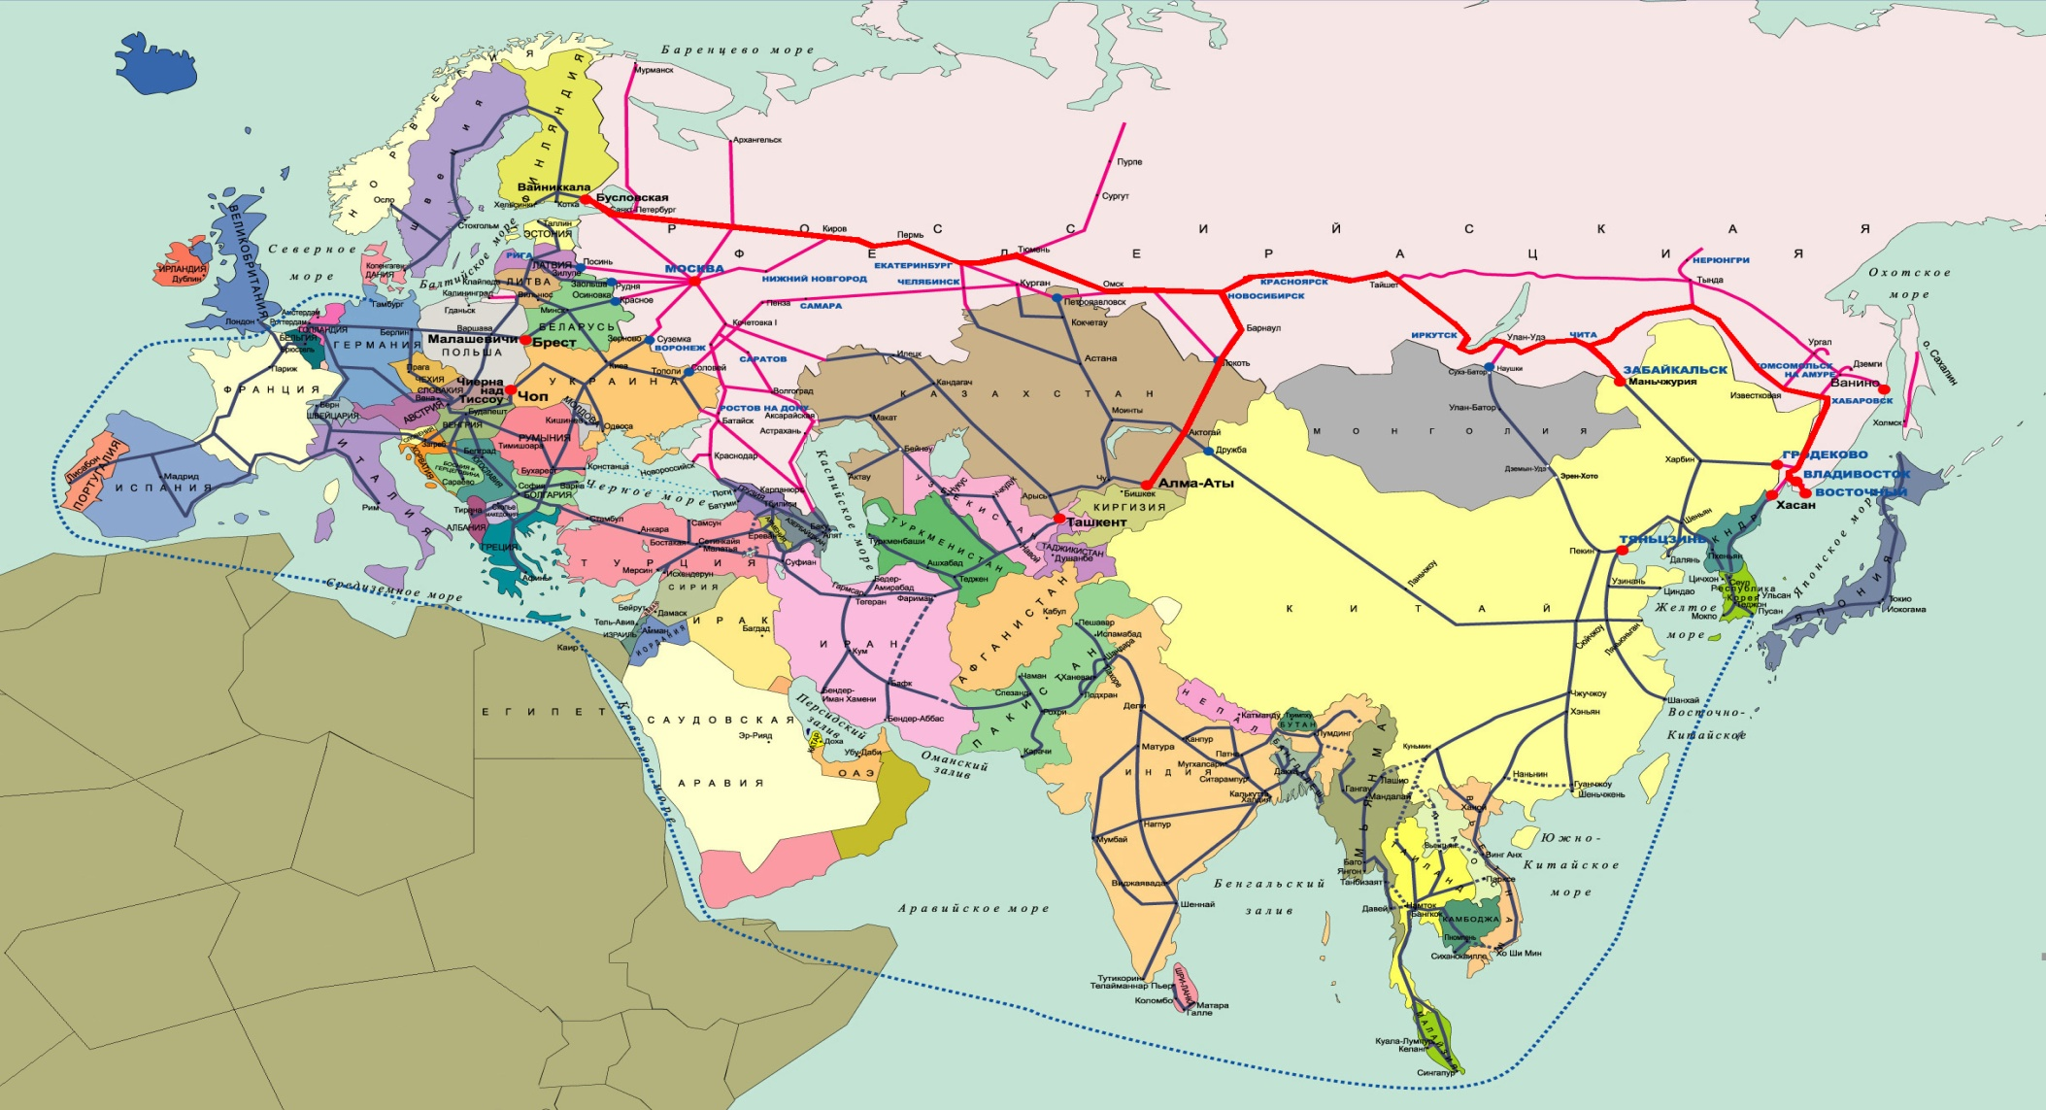
Area of freight East-West on a single transportation document CIM / SMGS - need an electronic invoice in the format of CIM-SMGS
CIM/SMGS consignment note shall be issued for carriage by Railways applying different transport law

Slide 5
The main question is how do we work tomorrow?
Now the transport market has a very difficult and unusual situation, in which we all find ourselves, and much now depends on our joint coordinated work, cooperation and mutual assistance. We are now in a difficult period of the pandemic, we have seen problems in most delivery cases - where people are involved. Therefore, for the future, you need to: - strive for the most contactless delivery methods, - activate cargo containerization, - use rail transport for container and contrailer transport. Logistics terminals and warehouses must also be fully automated. Loading/unloading facilities and reach stackers must also be unmanned. More applied sectors of the information economy are actively developing: - collecting and processing commercial information, user services, creating content, - new automated production and logistics algorithms. - new intelligent solutions for supply chain management and transportation efficiency. Logistics companies need to: - joining forces to survive in a crisis, - new tools to support teamwork in quarantine and beyond mechanisms for supporting cargo owners (exporters, importers, traders and economic operators) in the context of changes in sales markets and logistics chains.

Slide 6
Thank you for your attention! Merci pour votre l'attention! Danke fur Ihre Aufmerksamkeit!
Dank u voor uw aandacht! Tack för er uppmärksamhet! Takk for oppmerksomheten!
Tak for din opmærksomhed! Obrigado pela vossa atenção! Grazie di attenzione!
Gracias por su la atención! Kiitos huomiota! Tänan teid tähelepanu eest!
Paldies par uzmanību! Таны анхаарлын төвд баярлалаа! Назарларыңызға рахмет!
Ташаккур барои таваҷҷӯҳатон! Dėkojame už Jūsų dėmesį! Dziękuję za uwagę!
Дякуємо за увагу! Дзякуем за ўвагу! Ďakujem vám za pozornosť! Dankie vir die aandag!
Hvala za vašo pozornost! Vă mulțumesc pentru atenție! Благодаря за вниманието!
Хвала вам на пажњи! Hvala na pažnji! Ви благодариме за вашето внимание!
Σας ευχαριστώ για την προσοχή σας! Игътибарыгызга рәхмәт! İlginiz için teşekkür ederiz!
תודה על תשומת הלב שלך! דאנק איר פֿאַר אייער אכטונג! Terima kasih atas perhatian Anda!
感謝您的關注！ أشكركم على اهتمامكم! ご清聴ありがとうございました! आपका ध्यान के लिए धन्यवाद! 당신의주의를 당신을 감사하십시오! ขอบคุณสำหรับความสนใจของคุณ! ا تشکر از توجه شما! Շնորհակալություն ուշադրության համար! მადლობას გიხდით ყურადღებისთვის!
E'tiboringiz uchun tashakkur! Diqqət üçün təşəkkür edirik! Terimakasih atas perhatiannya!
Конул бурганын учун рахмат! আপনার মনোযোগের জন্য আপনাকে ধন্যবাদ!
ဂရုစိုက်တဲ့အတွက်ကျေးဇူးတင်ပါတယ်! Üns bereniňiz üçin sag boluň! دىققەت قىلغىنىڭىزغا رەھمەت!
Eskerrik asko arretarengatik! Gràcies per l’atenció! Salamat sa atensyon!

