Slide 1
COVID-19: The Statistics Canada Response
Centre for Tourism and Transportation Statistics
UNECE WP.6
Transport and COVID-19: Responses and Resources
June 2020

Slide 2
A rapidly evolving situation:
On January 25, a man quarantined in a Toronto hospital was confirmed as Canada's first case of the coronavirus.
On February 14, the agency set up a COVID-19 Working Group to assess impacts vis-à-vis its data programs.
On March 15, the agency focussed on mission critical data (LFS, CPI, Trade) with all employees working from home.
Confirmed COVID-19 Cases in Canada:

Slide 3
A multi-faceted response:
In early March, Project 22 Steering Committee formed to oversee the COVID-19 related work of the Economic, Geomatics, Social and Modeling Working Groups.
Since February, the COVID-19 Economic WG has initiated:
COVID-19 related-text in all economic data releases
“Fast Tract” modules on manufacturing, wholesale & retail
Weekly indicators of aviation, rail and international travel
“Flash estimates” of prices and “Nowcasting” of GDP
On March 25, the COVID-19 & Economy Dashboard was launched with 16 indicators (8 transport and travel-related) as well as analytical commentary updated weekly.

Slide 4
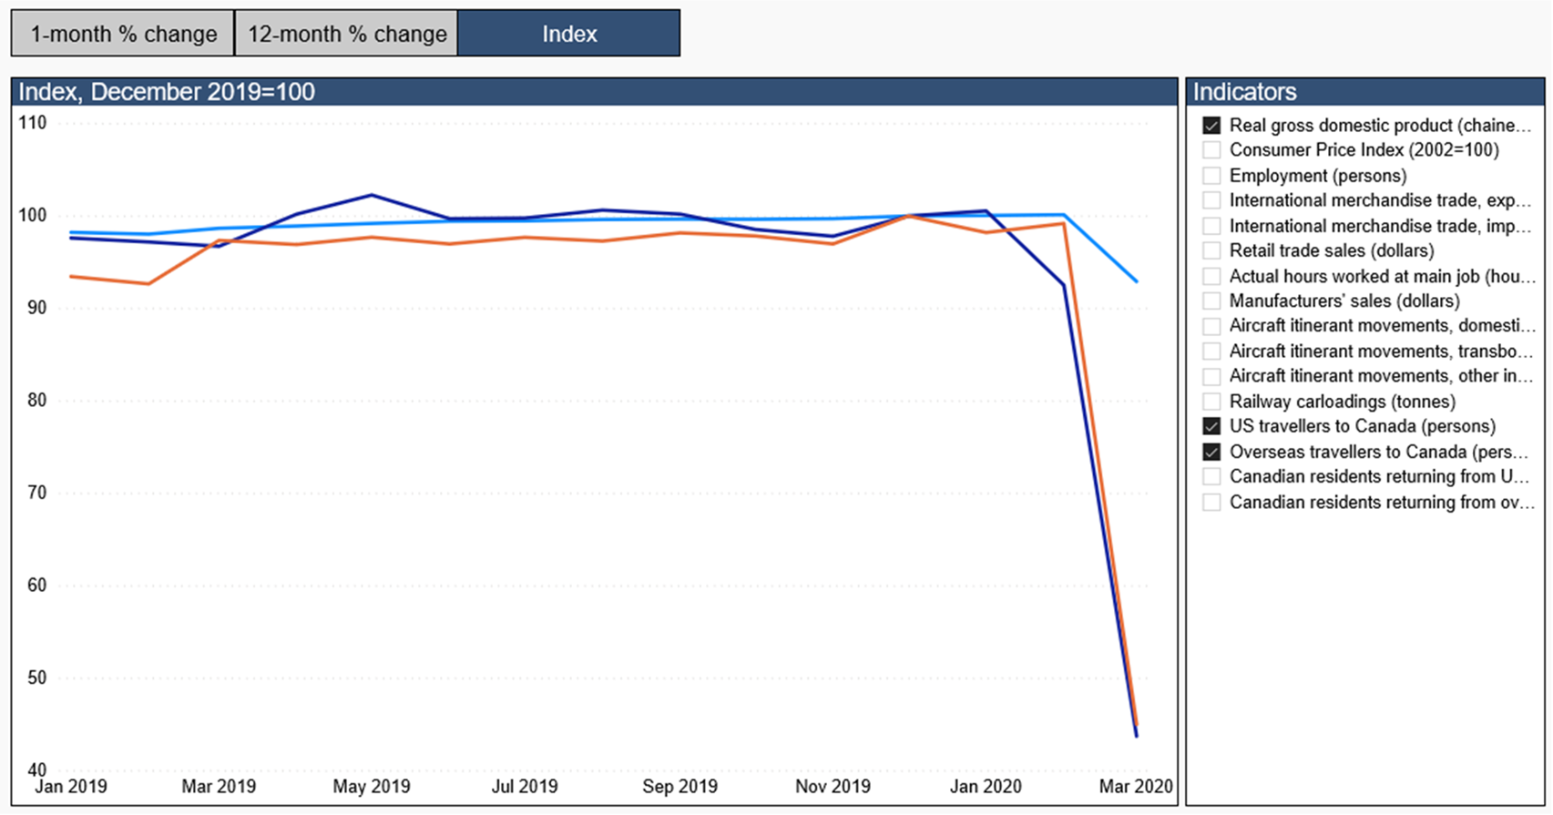
Economic Dashboard and COVID-19

Slide 6
Summary
Statistics Canada has responded to the virus in many ways ranging from providing geomatics data to first responders and creating weekly indicators to continuing its key data programs and increasing the use of modeling; and
In addition, as IT and HR resources allow the agency is now gradually re-introducing its regular programs including travel and transport-related data (e.g. Urban Transit, National Travel Survey, Canadian Freight Analysis Framework).
For more information, please contact:
Michael Scrim michael.scrim@canada.ca
Lawrence McKeown larry.mckeown@canada.ca

