Slide 1
COVID19 Transport Data
Please keep your microphone muted
Veuillez désactiver votre microphone
Пожалуйста, отключите микрофон
“Need data? Can you wait until Autumn 2021?”
http://etc.ch/UMyg

Slide 2
Questions to Participants
How is your statistics work evolving to track covid? COVID data hubs, prioritizing short-term data, new releases of monthly/weekly/daily data, new indicators?
How is COVID affecting your regular statistics production activities? Resource management issues? Coping strategies for 2020 surveys/censuses?
How are you balancing timeliness versus accuracy?
Has it made you rethink your publication timelines? Many countries publish provisional monthly road fatality numbers a few weeks after the reference month, can you?
What should UNECE/other international organisations do? Is it desirable to try to publish a few top-level, easy-to-produce indicators with a shorter time-lag?

Slide 3
DirectPoll
http://etc.ch/UMyg
DirectPoll Results
https://directpoll.com/r?XDbzPBd3ixYqg8zrQInEiYTQV4kPv6eAxP3GfLfM

Slide 4
UNECE Actions
Much internal and external interest in short-term statistics.
We did not think that a new short-term questionnaire would have been welcomed(!)
So we trawled national sites.
https://wiki.unece.org/display/DSOCIOT/Data+Sources+on+Coronavirus+impact+on+transport

Slide 5
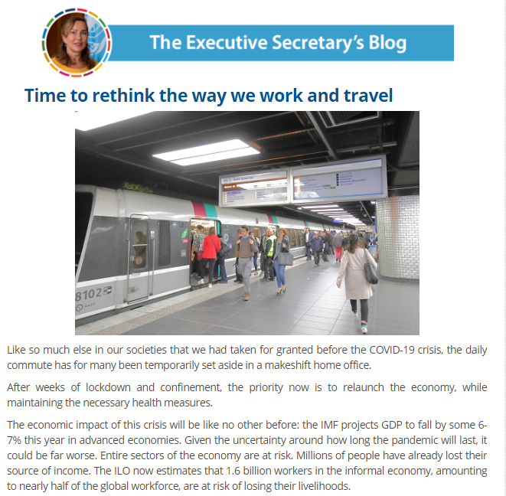
En France, celle-ci a chuté de 40%. 40% seulement si j'ose dire, car je m'attendais à ce que les chiffres soient encore meilleurs tant les déplacements en véhicule individuel ont été très réduits.
https://www.unece.org/info/media/executive-secretary-blog/2020/time-to-rethink-the-way-we-work-and-travel/doc.html

Slide 6
The Available Data were often:
Vehicle registrations (admin data)
Road safety (provisional, top-level data often directly from police databases)
Interesting proxies, like traffic camera fine data indicating increased speeding
Traffic (at specific points, rather than vehicle-km)
Indexes of different modes
New flash/experimental short-term indicators

Slide 7
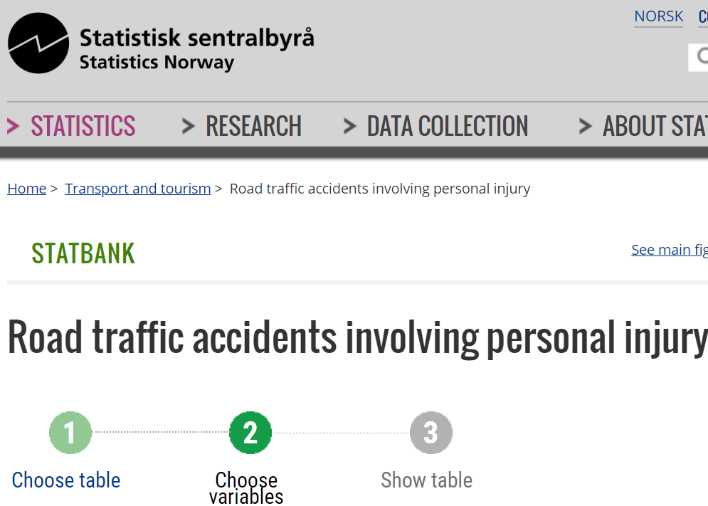
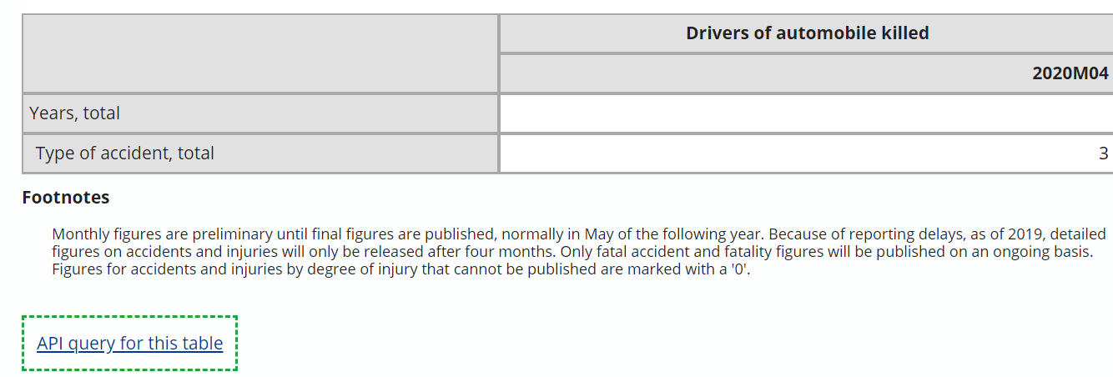

Slide 8
Questions to Consider
Without burdening countries with further data requests, is there any way to increase timeliness of international road safety data? Very basic top-level data only, e.g. fatalities (not necessarily following international guidelines).
What possibilities exist (other than web trawling) for automated collation?
Do countries object to having a provisional, separate dataset published, possibly sourced from a non-official statistics source (like police data)?

Slide 9
DirectPoll
http://etc.ch/UMyg

Slide 10
Road accidents: What’s Happening in 2020?

Slide 11
How can we monitor transport changes in post-COVID world?
SDG indicators are a great place to start
3.6.1 Road safety
11.2.1: public transport access. Perhaps it is more relevant than ever to track use in the short term?
9.1.2: ideal instrument for tracking change in transport habits. How can we integrate walking and cycling into this? What additional indicators might be useful?

