Slide 1
Proposals from the
Informal Working Group on AEBS to amend UN R. No. 152
Informal Working Group on AEBS for Light Vehicles
Informal document GRVA-05-55
5th GRVA, 10-14 February 2020, Agenda item 7
00 and 01 Series amendments of UN Regulation
GRVA-2020-17 (Robustness of the system)
GRVA-05-35 (Amendment of corrigendum)
Chair and Secretary IWG AEBS – GRVA 05

Slide 2
Informal Working Group on AEBS for Light Vehicles
4th GRVA in September 2019:
Requirement for 2nd step of C2P → GRVA-2019-16
Amendments to existing regulation → GRVA-2019-17
GRVA agreed to continue the discussions about
“Repeatability of test runs” and “Car to Bicycle scenario”
IWG meetings 10th meeting in Brussels (28-29 November 2019)
11th meeting in Paris (6-7 February 2020)
5th GRVA in February 2020:
Robustness of the system → GRVA-2020-17
GRVA-05-35（Corrigendum)
Chair and Secretary IWG AEBS – GRVA 05

Slide 3
Informal Working Group on AEBS for Light Vehicles
This presentation shows the proposal for
“Robustness of the system”
and the status report for
“Car to Bicycle scenario”
00 and 01 Series amendment of R152
GRVA-2020-17 (Robustness of the system)
Chair and Secretary IWG AEBS – GRVA 05

Slide 4
Informal Working Group on AEBS for Light Vehicles
New amendments to UN R152 (00 and 01 series)
(GRVA-2020-17)
Chair and Secretary IWG AEBS – GRVA 05

Slide 5
Informal Working Group on AEBS for Light Vehicles
Supplement amendment of regulation
Last GRVA (4th)
[6.10. Repeatability of test runs
6.10.1. [Any of the above test scenarios [,where a scenario describes one test setup at one subject vehicle speed at one load condition] shall be performed two times. If one of the two test runs fails to meet the required performance, the test may be repeated once. A test scenario shall be accounted as passed if the required performance is met in two test runs. [The total number of failed test runs shall not exceed [10%] of all performed test runs of all Car to Car and Car to Pedestrian scenarios in all load conditions.]]
6.10.2. The root cause of any failed test run shall be analysed.
6.10.3. During the assessment per Annex 3, the manufacturer shall demonstrate via appropriate documentation that the system is capable of reliably delivering the required performances.]
OICA proposed “Repeatability of test runs” at last GRVA session (GRVA-04-11)
GRVA ask to discuss further in the AEBS IWG.
Chair and Secretary IWG AEBS – GRVA 05

Slide 6
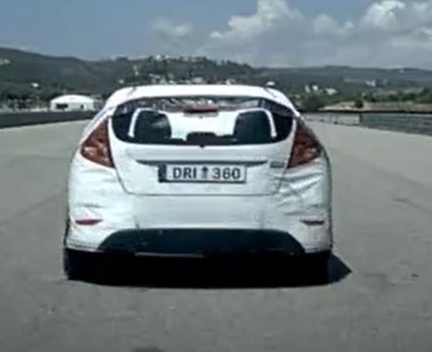
Informal Working Group on AEBS for Light Vehicles
Supplement amendment of regulation
AEBS-10-02
If the vehicle collides,
the target will fall apart.
〇Before rebuild
〇After rebuild
Radar reflectivity
DRI 3D target
Effect of target rebuild
Due to external influences it is difficult to ensure that every test run is performed under the same conditions.
Chair and Secretary IWG AEBS – GRVA 05

Slide 7
Informal Working Group on AEBS for Light Vehicles
Supplement amendment of regulation
GRVA-2020-17
Title:
“Repeatability of test runs”
“Robustness of the system”
Para. 6.10.1
Example of Detail:
Number of tests: Two times in each test conditions
No | First test | Second test | One more test (Either is NG) | Requirement
1 | 〇 | 〇 | - | Pass
2 | 〇 | × | 〇 | Pass
3 | 〇 | × | × | Fail
4 | × | × | ‐ | Fail
Chair and Secretary IWG AEBS – GRVA 05

Slide 8
Informal Working Group on AEBS for Light Vehicles
Supplement amendment of regulation
GRVA-2020-17
Percentage of failed tests:
Para. 6.10.1
The number of failed tests shall not exceed 10.0 % in each scenario
(Car to Car, Car to Pedestrian and [Car to Bicycle]).
Investigation of the failure cause:
Para. 6.10.2
The root cause of any failed test run shall be analyzed together with the Technical Service and annexed to the test report.
Chair and Secretary IWG AEBS – GRVA 05

Slide 9
Informal Working Group on AEBS for Light Vehicles
Supplement amendment of regulation
GRVA-2020-17
GRVA-05-35 (Corrigendum)
Investigation of the failure cause:
Para. 6.10.2
If the root cause cannot be linked to a deviation in the test setup, the technical service may test any other speeds for subject vehicle and target vehicle within the speed range as defined in paragraph 5.2.1.3., 5.2.1.4., 5.2.2.3. or 5.2.2.4. as relevant.
Para. 5.2.1.4. Requirement for M1 vehicle
Relative Speed (km/h) | Stationary/ Moving
 | Maximum mass | Mass in running order
10 | 0.00 | 0.00
15 | 0.00 | 0.00
20 | 0.00 | 0.00
25 | 0.00 | 0.00
30 | 0.00 | 0.00
35 | 0.00 | 0.00
40 | 0.00 | 0.00
42 | 10.00 | 0.00
45 | 15.00 | 15.00
50 | 25.00 | 25.00
55 | 30.00 | 30.00
60 | 35.00 | 35.00
Technical service may re-test within the required speed range
Para. 5.2.1.3.
Test vehicle speed range:
Between 10 km/h and 60 km/h
Chair and Secretary IWG AEBS – GRVA 05

Slide 10
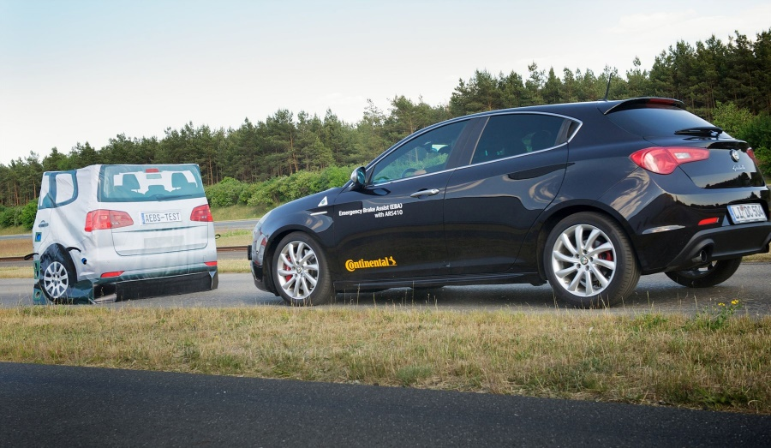
Informal Working Group on AEBS for Light Vehicles
Supplement amendment of regulation
GRVA-2020-17
Demonstration of system:
Para. 6.10.3
During the assessment per Annex 3 (CEL), the manufacturer shall demonstrate via appropriate documentation that the system is capable of reliably delivering the required performances.
Chair and Secretary IWG AEBS – GRVA 05

Slide 11
Informal Working Group on AEBS for Light Vehicles
Car to Bicycle scenario
Chair and Secretary IWG AEBS – GRVA 05

Slide 12
Informal Working Group on AEBS for Light Vehicles
Specifications - Car to Bicycle scenario
Last GRVA (4th)
The group still faces difficulty in agreeing on performance requirements for the car to bicycle collision given the lack of vehicles with this technology on the market. Consequently, the informal working group agreed to consider car-to-bicycle at a later stage, when more data is available.
Proposal to GRVA
“GRVA agreed the extension of mandate to adequately address Car to Bicycle scenario (e.g. 7th GRVA - September 2020), when more data is available.”
Chair and Secretary IWG AEBS – GRVA 05

Slide 13
Informal Working Group on AEBS for Light Vehicles
Specifications - Car to Bicycle scenario
Last IWG
Margin
(Proposed by J)
=3.65m
Scenario of C2B
Accident data
Euro NCAP
Lower Speed (LS) of Ego vehicle
LS = 20 km/h, LS = 35 km/h
Reference point for requirements
Example scenario
Further work still needed
1m
0.75m
Stopping distance
TTC
Vehicle edge
15km/h
Target:
Proposal of working document for Car to Bicycle in Sep. session of GRVA (7th GRVA)
Bicycle_{deceleration} = 5.5 [m/s²]
TTC = 0.888 [s]
V_{avoidance} = 39.5 [km/h]
Lane edge
Proposed by Germany
Chair and Secretary IWG AEBS – GRVA 05

Slide 14
Informal Working Group on AEBS for Light Vehicles
Thank you
for your attention
IWG meetings 12th meeting in Tokyo
(14-15 May 2020)
IWG meetings 13th meeting in [Brussels]
(25-26 June 2020)
Chair and Secretary IWG AEBS – GRVA 05

