Slide 1
Who is in control?
Informal document GRVA-05-49 5th GRVA, 10-14 February 2020
Agenda item 3
Submitted by expert from the Netherlands
Automation in road traffic
10 February 2020
Working party on Automated and connected vehicles (GRVA)

Slide 2
Dutch Safety Board
Purpose:
✓
To learn from incidents
✓
To make recommendations in order to improve safety
X
Criminal investigations and prosecution

Slide 3
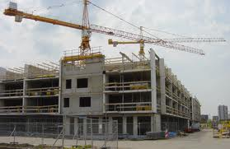
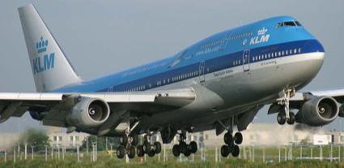
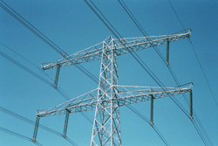
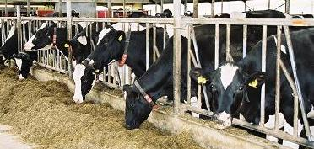
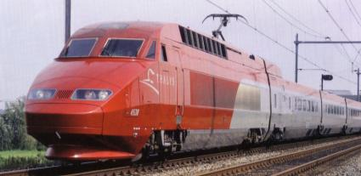
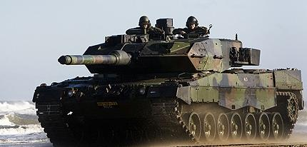
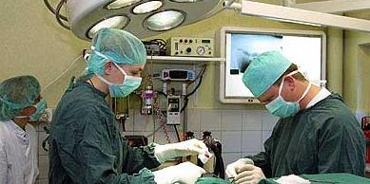
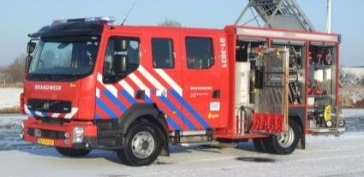
Dutch Safety Board
Notes:
Ellen
De foto’s op deze sheet symboliseren werkterrein
Werkterrein is heel breed + eigenlijk alle maatschappelijke sectoren + in feite maar twee zaken uitgesloten: militair optreden krijgsmacht en openbare orde.
Mogelijk ook digitale veiligheid en openbare orde in de toekomst.
Binnenvaart
Bouw en dienstverlening
Crisisbeheersing en hulpverlening
Defensie
Gezondheid
Industrie, buisleidingen en netwerken
Luchtvaart
Railverkeer
Water
Wegverkeer
Zeescheepvaart
11 sectoren, eigen onderzoekers, gemengde teams, onderzoeksmethodes uitwisselen

Slide 4
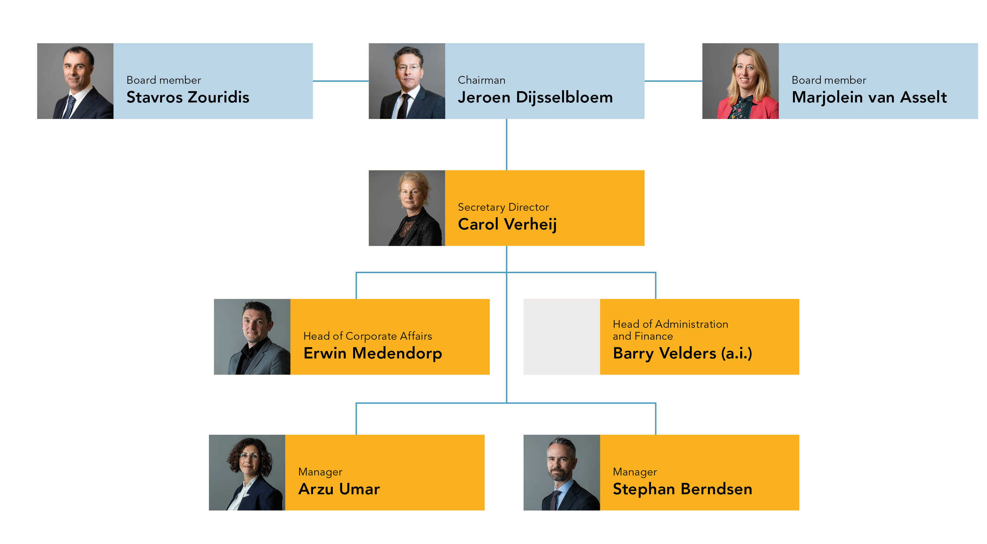

Slide 5
Animation

Slide 6
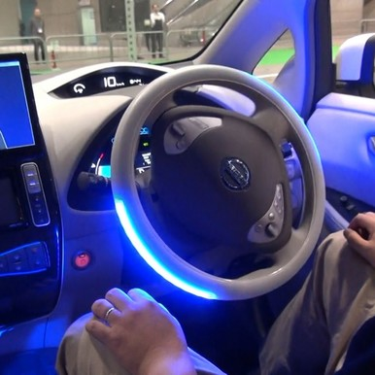
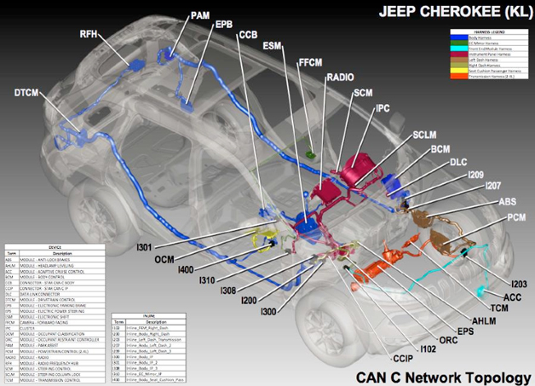
Why did the DSB start this investigation?
New risks
Appeal to parties
Accidents
Due to technological developments:
• driving computer
• new role of driver and
new type of interactions
Responding to new risks by manufacturers and the government
Revelation of new risks through the use of automation

Slide 7
Focus
Management of the risks
Introduction and use of ADAS
by manufacturers, suppliers, supervisors, legislators, interest groups.

Slide 8
Research questions
✓
How do users, the automotive industry, sector parties and the government manage the risks associated with the introduction and deployment of advanced driver assistance systems (ADAS)?
✓
To what extent can this risk management be improved?

Slide 9
Examples of risks that aren’t managed well
Accidents
Hacks

Slide 10
Set up investigation
Accident investigation
Ethical hacks
Types of risks related to ADAS
Literature / experts
Interviews and internal documents
Risk management

Slide 11
New types of risks
Immaturity of systems
Drivers as operators
Interaction between vehicles and drivers
Dynamic development of automation (updates)
Cybersecurity

Slide 12
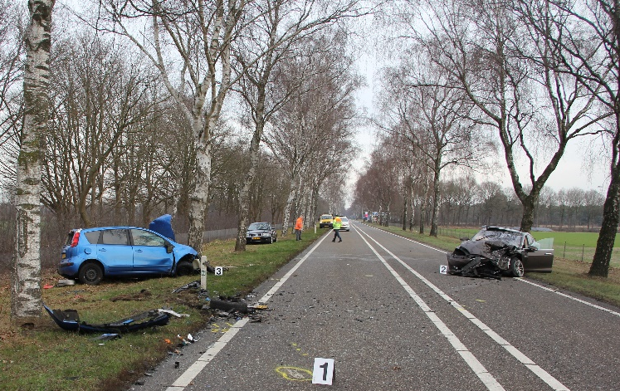
New role of the driver
Longer response times
Reduced alertness
Operating errors of ADAS:
Foolproof design
Clarity who is in control

Slide 13
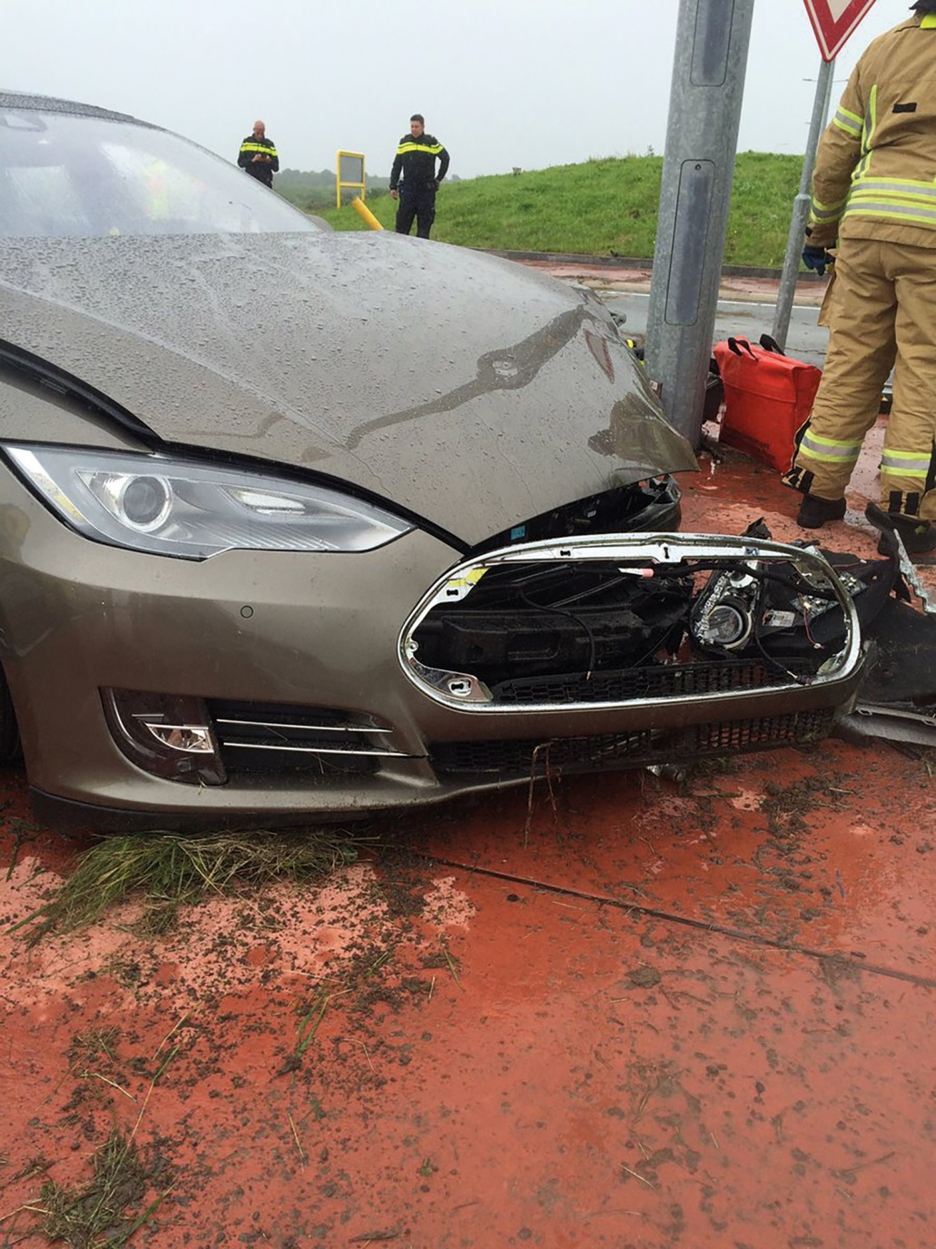
Lack of knowledge driver
Users have only limited insight into the operation and limitations of ADAS
Communication in advertisements and media is inadequate
Provision of information and instruction is often lacking
Driving test does not include ADAS
Diversity of ADAS
Users rely on ADAS

Slide 14
Conclusion: Driver not the central point of focus
New role driver
Lack of knowledge driver
Driver legally responsible
Notes:
Functionality unclear:
What can the system do?
And why does it make certain decisions?
Sometime unclear ‘who is in control?’
Dealing with updates which may change functionality
New role as operator: longer reaction times and reduced alertness
Not trained
Inadequate communication
Being a subject in a living lab without realizing that

Slide 15
Improving ADAS
Design
Approval
Monitoring
Adjustment

Slide 16
Conclusion: more improvement of safety ADAS possible
Continuous development of systems
Improvement during lifetime or only for newly produced cars
No transparency about improvements based on monitoring and evaluation
Manufacturers do not learn to the same degree of accidents
Most manufacturers do not share the results of their accident investigations
Notes:
Continuous development of systems in inherent to the current technology
Some manufacturers modify their ADAS during lifetime, while others do so only for newly produced cars.
No transparency about whether and how manufacturers improve their products based on monitoring and evaluation.
Manufacturers do not learn to the same degree of accidents
Over the air data
Incident response team
Complaints of drivers
Data of spare parts
Scientific research
Most manufacturers do not share the results of their accident investigations

Slide 17
Regulation
Technological changes are going faster while the legislative process is slow
No improvement of safety level required for new ADAS
Unclear how the level of safety must be assessed
Manufacturers are not obliged to learn from accidents
Legislation has little focus on interaction with users
Oversight not set up for changes during lifetime
Legislation in development only for SAE3+:
Validation (including a risk analysis and risk assessment)
Data storage
Human factors (no working group)
Instruction of drivers (no working group)

Slide 18
No responsible innovation
Reference framework: Principles for safe introduction of new technology
Manufacturers
Driven by technical possibilities
Safety and security during the life cycle
Do not ensure that drivers (can) understand what the technology is doing
Accident investigation is limited
Do not provide insight into technology and accident rates
Government
Accessing the safety level is insufficiently operationalized (Directive 2007/46/EC, Article 20)
No policy adjustment based on monitoring and evaluation

Slide 19
@Onderzoeksraad
Dutch Safety Board
https://www.onderzoeksraad.nl
https://www.safetyboard.nl
info@safetyboard.nl

Slide 20
Extra’s

Slide 21
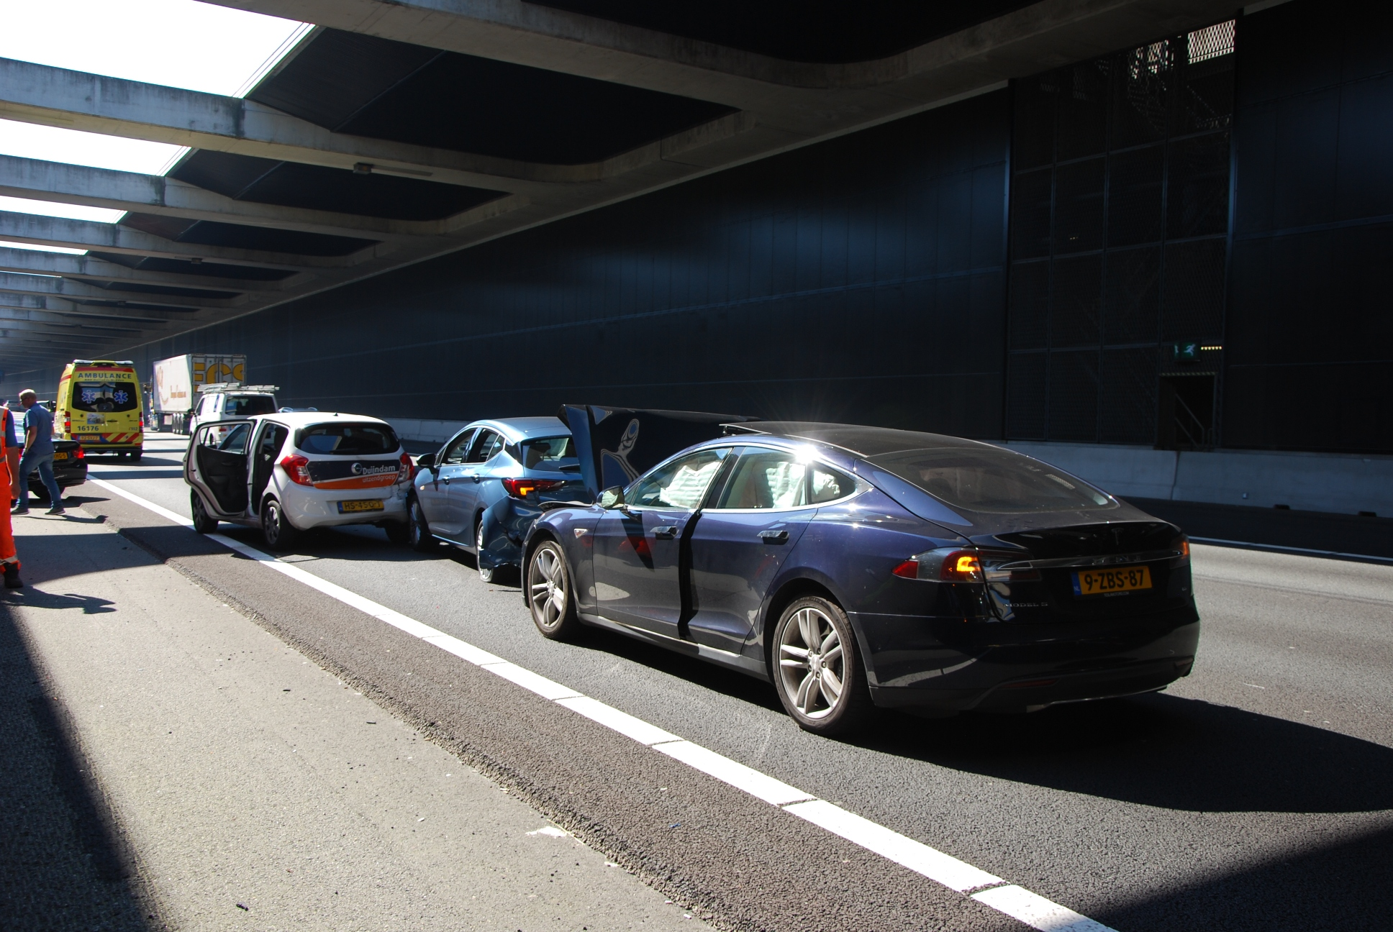
Learning from accidents
Lack of information:
No insight into the number of cars with ADAS
No insight into usage of ADAS
Lack of empirical data about accidents (data not saved or hard to read-out)
Severe accidents not (always) investigated
Consequence: Evaluation and adjustment do not take place

Slide 22
Conclusion: Driver not the central point of focus
Functionality unclear
Sometime unclear ‘who is in control?’
Updates which may change functionality
New role as operator: longer reaction times and reduced alertness
Not trained
Inadequate communication
Subject in a living lab without realizing
Driver legally responsible
Notes:
Functionality unclear:
What can the system do?
And why does it make certain decisions?
Sometime unclear ‘who is in control?’
Dealing with updates which may change functionality
New role as operator: longer reaction times and reduced alertness
Not trained
Inadequate communication
Being a subject in a living lab without realizing that

