Slide 1
Modular Vehicle Combinations Informal Working Group (MVC IWG)
Submitted by the experts from the IWG on MVC
Informal document GRVA-05-43 5th GRVA, 10-14 February 2020
Agenda item 8(b)
Presentation of draft amendment to UN R13
as per informal document GRVA-05-03r1
Version 1.0

Slide 2
Content
Introduction
History of the MVC IWG
Executive summary
Expectations from GRVA

Slide 3
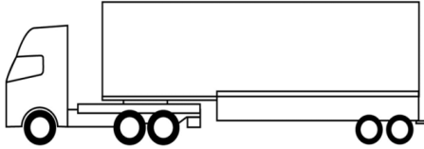
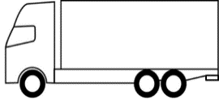
Introduction
Current UN R13
Current UN R13 mainly addresses the approval of single vehicles involved in single-trailers combinations.
The objective of the MVC IWG is to add missing definitions and requirements in UN R13 for approving single vehicles involved in Modular Vehicle Combinations, e.g. towing trailers.
MVC
3
1
4
2

Slide 4
History of the MVC IWG
In 2014, GRRF started a new Informal Group on Modular Vehicle Combinations (MVC).
Objectives:
Enable the approval of vehicles, with regards to braking, steering, stability and mechanical couplings, which are a part of a modular vehicle combination.
Avoid individual approval according to non harmonized national requirements (which is limiting market competition and operation of these vehicles)
Around 20 to 25 experts were involved in the group: Sweden, NL, Denmark, Finland, Norway, Spain, motor vehicle, trailer and system manufacturers
The work was put on hold in 2016 after 6 meetings, due to resource issues (same experts involved in several groups like e.g. ACSF).
The informal group on mechanical coupling delivered 2 years ago a supplement to UN R55 series 01 to cover MVCs.
Decision at WP29 of March 2019 to prolong the mandate by one year until February 2020.
GRVA-04 supported IWG’s proposal to concentrate on the delivery of the MVC step 1.

Slide 5
Executive summary
The IWG has developed a draft proposal amending UN R13 (GRVA-05-03r1).
The proposal covers the same (five) combinations as in R55-01 supplement 7 (ISO 18868).
Only dollies with rigid drawbars are covered (hinged drawbars should be dealt in a second step).
The proposal is built on version 2014 of ISO 11992 standard (digital link between vehicles).
The objective of the IWG is to get the amendment adopted at GRVA session of September 2020.
Relevance, content and prioritization of a 2nd step should be decided at GRVA of September 2020.
The mandate of the IWG is coming to an end, GRVA is expected to advise on the way forward.

Slide 6
Expectations from GRVA
Principle agreement on the main concept of the proposal.
Detailed comments to the draft text by March 31st, 2020.
Make GRVA-05-03r1e a formal document, for possible adoption in September 2020
Endorse ISO 11992-2:2014 (or comment by March 31st, 2020)
Get guidance on how to proceed to finalize the work:
Option 1: finalize MVC-step 1 for September GRVA in an ad-hoc group led by industry
Option 2: prolong mandate by [1 year] to complete MVC-step 1 (we then need a new chairman)
Decide at GRVA of September 2020 (or February 2021) about the step 2 (relevance, content, level of urgency, deadline)

Slide 7
Work program and Scope

Slide 8
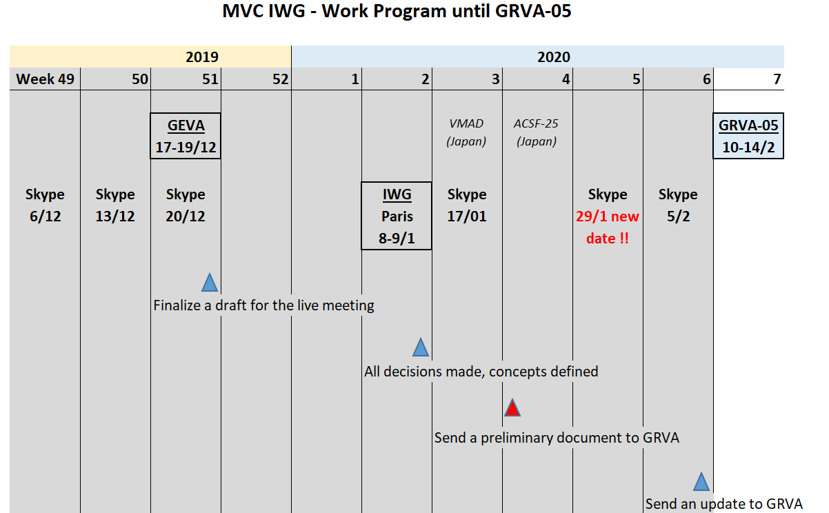
Work program

Slide 9
Scope
Step 1 – Feb 2020
Deliver amendments to UN R13, to cover:
The same combinations as the five covered in R55-01 supplement 7 (ISO 18868)
Dollies with rigid drawbars
Step 2 – Content & lead-time tbd
UN R13
Dollies with hinged drawbar
Other combinations and/or other vehicle type
UN R79: e.g. to cover steered dollies
UN R55: Coordinate further steps with GRSG

Slide 10
Technical principles

Slide 11
Definitions
A “towing trailer” is a trailer which is equipped to tow another trailer.
A “Dolly” is a towing trailer designed for the sole purpose to tow a semi-trailer. A dolly may have a rigid or a hinged drawbar.
A “Link-trailer” is a semitrailer equipped with a fifth wheel in its rear end enabling a second semitrailer to be towed. (Definition from R55-01 supplement 7).

Slide 12
Structure of the proposal
5.1. General
5.2.1.34.
5.2.2.24.
5.2.2.25.
5.2.1. Motor vehicle
5.2.1.1. Applicable to all motor vehicles
…
5.2.1.33.
5.2.1.34. Motor vehicles authorized to tow more than one trailer
5.2.2. Trailers
5.2.1.1. Applicable to all Trailers
…
5.2.1.23.
5.2.2.24. Towing trailers
5.2.2.25. Non towing trailers authorized to be coupled to a towing trailer

Slide 13
General
Same braking reference for all vehicles of the combination (Same pressure in the pneumatic control line and in the equivalent electronic message for all vehicles of the combination)
Electric control line mandatory on all vehicles of the combination
ISO 7638 7-pins connector or automated connector
ISO 11992 digital link between vehicles
In-use and construction requirements
The motor vehicles are authorized to tow multiple trailers only when fulfilling the requirements in 5.2.1.34.
The trailers -other than towing trailers- are authorized to be coupled to a towing trailer only when fulfilling the requirements in 5.2.2.25.
It is an in-use requirement for the user to ensure the motor vehicle and the last non-towing trailer are compatible with the use in a multiple-trailer combination.

Slide 14
Communication between vehicles
Use of ISO 11992 standard for the communication between vehicles.
Update of the ISO 11992 standard: use version 2014
Requirement for a point-to-point connection between vehicles is kept
The use of repeaters and message routing function is regulated. See further information in the backup slides at the end of this presentation.
Each towing trailer shall gateways the hard-wired warning signal (pin 5 of ISO 7638) from following trailers, while electrically isolating the signal. See further information in the backup slides at the end of this presentation.

Slide 15
Braking of motor vehicles
The parking brake of the motor vehicle shall be able to maintain the combination stationary in a 12% slope (same requirement as for a motor vehicle for a single trailer).
Air supply: Current formula in R13 Annex 7 paragraph 2.3.3 considers the towable mass for the dimensioning of the energy source. This formula is valid for multiple trailer combinations. No need for change. Same conclusion for the electric supply.
Warning and information to driver
From a safety standpoint, the driver only needs to know when one of the trailer EVSC is intervening, no need to know which trailer(s) is intervening
Same conclusion when a trailer fails

Slide 16
Braking of trailers
Spring brakes mandatory on all trailers
Type-0 and compatibility bands
A rigid drawbar dolly shall be considered to be a centre axle trailer with respect to the requirements of Annex 4 (Type-0) and Annex 10 (compatibility bands).
A link-trailer shall be considered to be a semi-trailer with respect to the requirements of Annex 4 (Type-0) and Annex 10 (compatibility bands).
This is the state-of-the-art on multiple trailer combinations for more the past 10-20 years. Experience shows it works.
Simulations done by the Technical university of Eindhoven shows the load transfer during braking are very similar on a dolly vs centre axle trailer and on a link-trailer vs semi-trailer.

Slide 17
Vehicle Stability Control
Vehicle Stability Control mandatory on all vehicles of the combination, including dollies.
EVSC on the motor vehicle
Roll Stability Control on the trailers
Every trailer of the combination can generate automatically commanded braking.
Automatically commanded braking shall be transmitted to the towed trailers via the pneumatic and the electric control lines (the towed trailers cannot differentiate braking generated by the driver and braking generated by Stability control)
A towing trailer may brake towed trailer(s) for the purpose of stretching the rear of the combination.

Slide 18
Thanks for your attention

Slide 19
Communication between vehicles Message Routing function
Routing Function
The message routing function shall transmit forward and backward all relevant messages defined in the ISO 11992 standard, e.g. the brake demand is transmitted by the towing vehicles to the towed ones; the failure information of towed trailers is transmitted to the motor vehicle.
EBS
EBS
EBS
Router
ISO 11992 interface
ISO 7638 connector
Braking system of the towing trailer

Slide 20
Communication between vehicles Repeater
Function of the repeater
If more than the 18m allowed by the ISO 11992-1 standard are needed on the trailer, a repeater device can be added on the electric control line.
EBS
EBS
coil
Max 18m
Max 40m

Slide 21
Communication between vehicles Repeater
Function of the repeater
If more than the 18m allowed by the ISO 11992-1 standard are needed on the trailer, a repeater device can be added on the electric control line.
The repeater then provides an extra 40m for the wiring.
EBS
Repeater
EBS
coil
Max
18m
Max 40m
Max
40m

Slide 22
Communication between vehicles Transmission of “pin 5” warning signal
Principles
Every towing trailer shall read the “pin 5” input from the following trailer and gateway it on its own “pin 5” information to the towing vehicle, and on the ISO 11992 relevant message.
The pin 5 of the rear electric connector shall be electrically isolated from the pin 5 of the front electric connector.
YES !
EBS
EBS
EBS
Router
!
NO !
EBS
EBS
EBS
!

