Slide 1
Transmitted by the Co-Chairs of the IWG on EDR/DSSAD
Informal document GRSG-119-27 119th GRSG, 6-9 October 2020
Agenda item 13
IWG on EDR/DSSAD
Status Report October 2020
Notes:
1

Slide 2
Background IWG on EDR/DSSAD
In accordance with the ‘Framework Document’ as adopted by WP.29-178, June 2019:
GRSG
GRVA
IWG on EDR/DSSAD
TASKS:
Define the scope and specific objectives of, and differences between, EDR (Event Data Recorder) and DSSAD (Data Storage System for Automated Driving)
Define EDR and DSSAD technical requirements
DELIVERABLES:
WP.29 Nov. 2019 Identification of differences between DSSAD and EDR
WP.29 Mar. 2020 Requirements for DSSAD for Automated Lane Keeping Systems
WP.29 Mar. 2020 Review of the existing national/regional actives & a proposed way forward for EDR/DSSAD
WP.29 Nov. 2020 Requirements for EDR

Slide 3
PREVIOUSLY – two-step approach & two deliverables
Step 1: for WP.29 November 2020 basic requirements for EDR. (based on existing well-known standard)
Step 2: from WP.29 November 2020 new, advanced requirements for EDR. (based on new national legislation, safety benefits, technological progress, etc. – to be identified)
Deliverables for Step 1 to GRSG July session:
GRSG-118-13 EDR Common Technical Requirements appropriate for adoption in the 1958 and 1998 Agreements.
GRSG-118-14 UN Regulation on EDR, containing the same technical requirements as doc. -118-13.

Slide 4
PREVIOUSLY – GRSG-118 decisions
GRSG-118-13 & -118-14 contained outstanding issues on definitions, overwriting, testing and data elements.
GRSG agreed in July to submit these documents with an official symbol for consideration and vote to November 2020 WP.29/AC.1, subject to a final review at the GRSG in October.
(GRSG-118-13 at WP.29 as ECE/TRANS/WP.29/2020/100) (GRSG-118-14 at WP.29 as ECE/TRANS/WP.29/2020/123)
The IWG on EDR/DSSAD was entrusted to resolve the outstanding issues for the GRSG October session.

Slide 5
IWG Activities - since GRSG-118
Activities during July & September:
Two sessions of the IWG on EDR/DSSAD
Three session of the Sub-Group on EDR
Eight sessions of Task-Forces on: - definitions, - ‘overwriting’ specifications, - data elements.
In additional many other activities in smaller groups
Participation by up to 70 people (representatives from many contracting parties to the 1958 and 1998 Agreements and experts from Industry and organizations for PTI, insurance, accident analysis, etc.).

Slide 6
EDR Requirements
Results for GRSG-119, two new informal documents:
GRSG-119-02 rev1 amending ECE/TRANS/WP.29/2020/100:
EDR Common Technical Requirements appropriate for adoption in the 1958 and 1998 Agreements
GRSG-119-03 rev1 amending ECE/TRANS/WP.29/2020/123:
UN Regulation on EDR

Slide 7
EDR Requirements
Both GRSG-119-02 rev1 and GRSG-119-03 rev1:
Capturing, recording and locking of data,
Data elements and format,
Survivability testing.
Data retrieval is excluded.
Only GRSG-119-03 rev1 (UN Regulation format):
Type-Approval elements,
The EDR shall record the captured data in the vehicle,
Deactivation of the EDR shall not be possible,
Without prejudice to national requirements on privacy, data protection and personal data processing.

Slide 8
EDR Requirements
Outstanding issues on definitions, overwriting, additional testing and others are resolved (for consideration ‘EDR Step 2’).
Still outstanding issues on:
data elements: - existing Part 563 data elements: · mandatory recording of roll angle or roll rate, · normal acceleration, · dependency between acceleration and Delta-V. - additional data elements: for several CP’s many additional elements are essential in EDR Step 1,
EDR non-volatile memory buffer to accommodate the data related to at least [two/three] different events.

Slide 9
Considerations for GRSG
The IWG will continue its work on the data elements, until the end of this calendar year.
GRSG may already consider the current documents GRSG-119-02 rev1 and GRSG-119-03 rev1, (without the current annex on data elements).
Consideration and vote by WP.29/AC.1 in March 2021 of: ECE/TRANS/WP.29/2020/100 amended by GRSG-119-02 rev1 ECE/TRANS/WP.29/2020/123 amended by GRSG-119-03 rev1 (without the current annex on data elements)
together with the final list of data elements as submitted by the IWG on EDR/DSSAD by the end of this year.
AC.2/WP.29 Nov. 2020 requested to extent the IWG mandate.

Slide 10
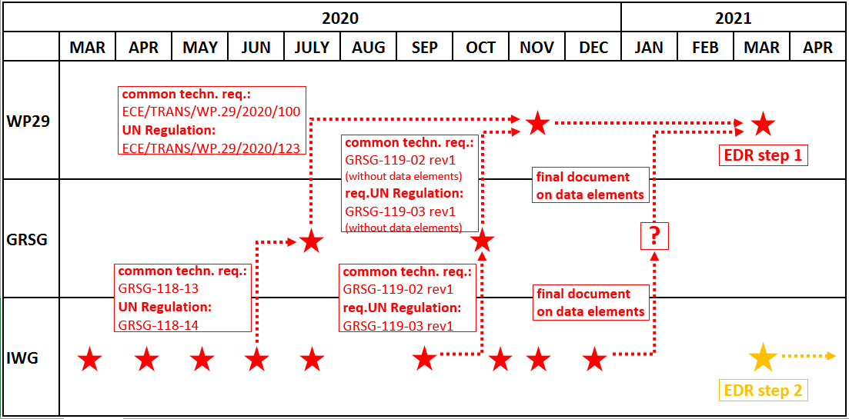
Schedule
Guidance from GRSG to IWG on EDR/DSSAD requested.

Slide 11
Thank you!

