Slide 1
UNECE UN R. 79 - 03 Series Proposed Amendments
Informal document GRVA-04-53 4th GRVA, September 2019 Agenda item 6(a)
Submitted by the expert from AVERE

Slide 2
Technology has caught up with R79.03, and is constraining performance in previously unforeseen or unconsidered environments.
Assistance or automation functions need to be human-like to be safe and functional. Un-humanlike behavior is confusing to the driver and surrounding traffic. Ideal safety case often not compatible with real-world driving
If AV functions are not comfortable, functional or improve safety, they will not be used by drivers. Consumers do not understand the limits of regulations
Developing is an iterative process and requires on-the-road data collection and validation if systems are to properly account for edge cases. We should not expect generational shifts
General comments
General
Comments

Slide 3
Lateral acceleration of 3 m/s2 is insufficient to safely keep the vehicle centered in the lane in high-curvature roads.
Increasing the lateral acceleration to accommodate more road geometries is safer than departing the lane when the limit is reached
We recommend increasing this limit to 4 m/s²
ACSF Category B1
Paragraph 5.6.2.1.3.

Slide 4
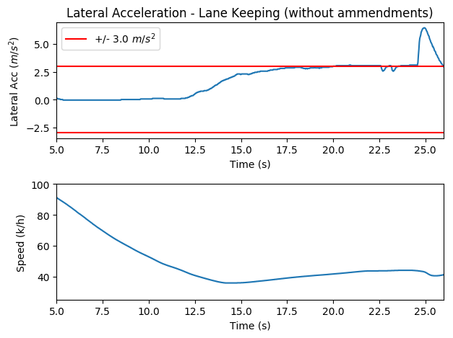
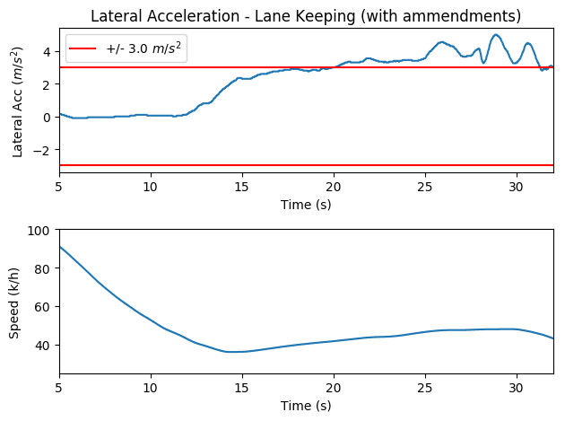
ACSF Cat. B1 Vehicle Simulation

Slide 5
ACSF Cat. B1:
In-Vehicle Video
Autosteer with current ECE R79.03 restrictions
Autosteer with proposed amendments

Slide 6
ACSF Cat. B1 Fleet Data – Manual Driving
Lateral acceleration exceeds 3 m/s2
in 4% of turns
*Data is collected from 100 cars in Tesla’s customer fleet in August
Each ”turn” referenced above begins when steering wheel torsion bar torque exceeds 2 Nm and ends when torque goes back below 2 Nm
Data is filtered for areas where Autosteer is available (to attempt to limit data to areas lane where lines are present and visible) and vehicle speed > 10 kph

Slide 7
ACSF Cat. B1 Fleet Data – Automated Driving
18 times as many steering saturated lane departures per mile in the EU
23 % increase in aborts in the EU
*Data is collected from Tesla’s customer fleet in May and August 2019
~6 million Autosteer miles across Europe in builds prior to R79.03, ~6 million miles since R79.03
~44 million Autosteer miles in the U.S. in builds prior to R79.03, ~2. million miles since R79.03 (though R79.03 restrictions do not apply in the US)

Slide 8
It may take > 5 seconds to begin lane change maneuver in the presence of surrounding traffic
To increase the likelihood of success in a single lane change attempt and reduce the risk of confusing other drivers with erratic indicator lamp behavior, a higher timeout threshold is recommended
A maximum time of 20 seconds is recommended for beginning the lane change maneuver
ACSF Category C
Paragraph 5.6.4.6.4.
and 5.6.4.8.1

Slide 9
ACSF Cat. C: Timeout
Vehicle Simulation

Slide 10
ACSF Cat. C: Timeout
Vehicle Simulation

Slide 11
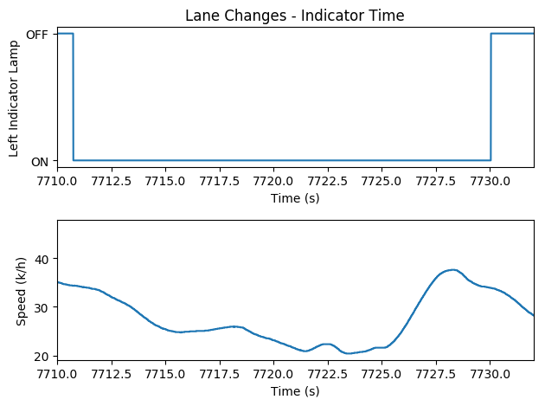
ACSF Cat. C: Timeout
In-Vehicle Example

Slide 12
ACSF Cat. C: Timeout
Fleet Data – Automated Driving
22% reduction in lane changes requested per mile
*Data is collected from Tesla’s customer fleet in May and August 2019
~6 million Autosteer miles across Europe in builds prior to R79.03, ~6 million miles since R79.03
~41 million Autosteer miles in the U.S. in builds prior to R79.03, ~44 million miles since R79.03 (though R79.03 restrictions do not apply in the US)

Slide 13
ACSF Cat. C: Timeout
Fleet Data
*Data is collected from 1000 cars in Tesla’s customer fleet in August 2019
Filtered for vehicle speed > 10 kph

Slide 14
A 3 seconds minimum to start a lane change maneuver can be too long if the driver requests a lane change just when a gap is available in the target lane.
We propose a minimum time of 1.5 seconds to give surrounding traffic enough time to react.
ACSF Category C
Paragraph 5.6.4.6.4.

Slide 15
Requiring the indicator to be automatically turned off by the system restricts the regulation to only vehicles without latching indicator stalks.
For stalks with mechanical latches the intuitive way to trigger a lane change is by latching the turn indicator stalk
ACSF Category C
Paragraph 5.6.4.6.7.

Slide 16
ACSF Cat. C: Latching Stalk
In-Vehicle Video
Auto Lane Change with current ECE R79.03 restrictions – Lane Change is suppressed if user latches the indicator stalk
Auto Lane Change with proposed amendments – A single Lane Change proceeds to completion and user resets stalk

Slide 17
The ”critical distance” calculation prescribed in the regulation is overly conservative
To increase the likelihood of successfully completing a lane change in the presence of a rear vehicle without compromising safety, we recommend a more dynamic approach to critical distance calculation
ACSF Category C
Paragraph 5.6.4.7.

Slide 18
ACSF Cat. C: Critical Distance
Vehicle Simulation
Ego speed = 104 kph Rear vehicle speed = 104 kph
Critical distance per R79.03 = 29 meters
Lane change was requested at 20 meters

Slide 19
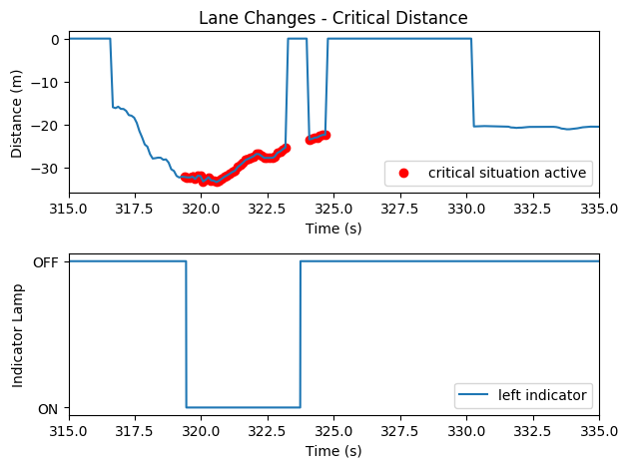
ACSF Cat. C: Critical Distance In-Vehicle – Unassisted driving

Slide 20
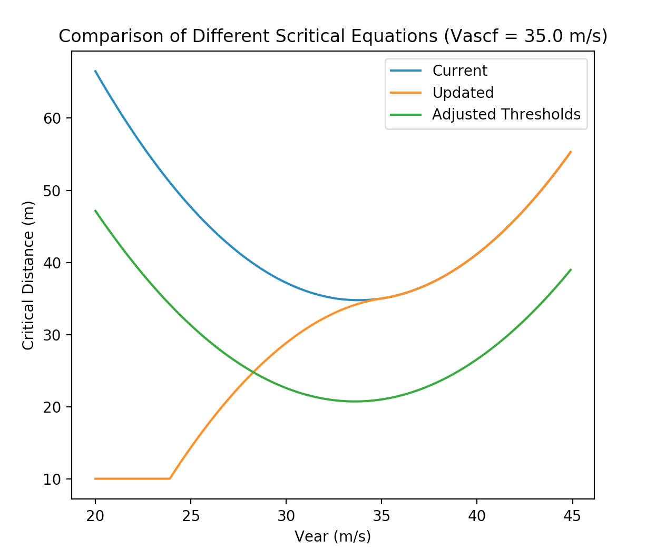
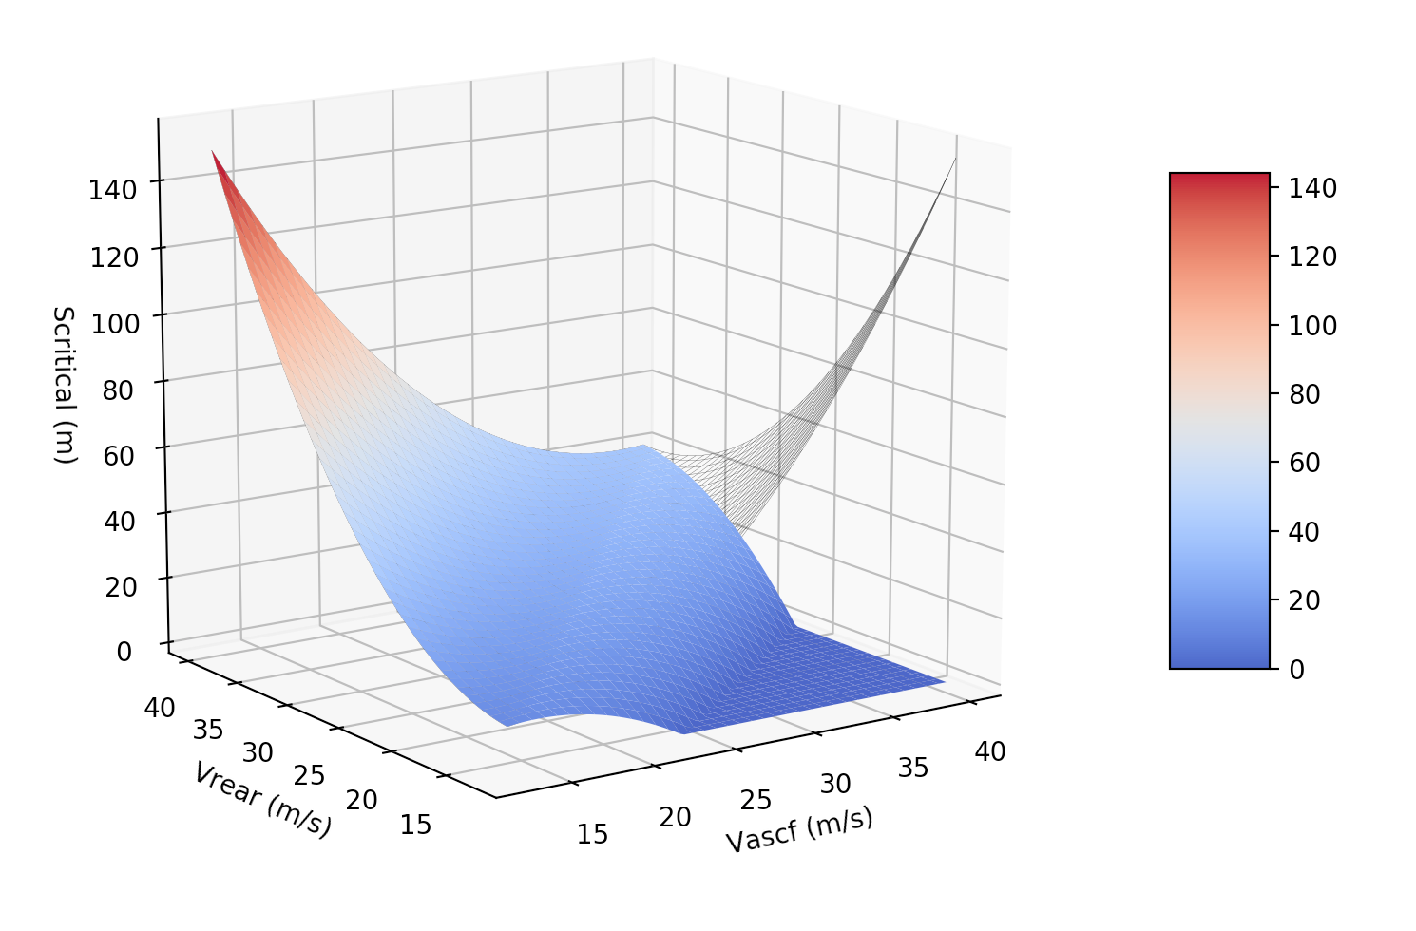
ACSF Cat. C: Critical Distance Equation

Slide 21
Increase the allowed lateral acceleration such that vehicles can safely maintain their lane position
Allow a lane change maneuver to be start more than 5 seconds after the initiation of the lane change to allow the vehicle to adjust the position longitudinally to safety merge with other vehicles
Adjust critical situation thresholds to be more inline with natural driving
Allow natural stalk behavior to prevent mode confusion and unsafe signaling to other vehicles
Amendments
Summary

Slide 22
Questions

