Slide 1
IWG-DPPS
Informal document GRSP-66-23
66th GRSP, 10-13 DEC 2019
Agenda item 3(b)
Objective - to develop the amendment of GTR No.9 & UN R127 w.r.t. DPPS * DPPS: Deployable Pedestrian Protection Systems(e.g. deployable bonnet, external airbag)
Meetings - 4th Meeting (In Paris, France, 12 – 14 Mar. 2019) - 5th Meeting (In London, UK, 3 – 4 Sep. 2019)
- Intermediate Meeting (webmeeting(skype), 28 Nov. 2019)
Discussion Items - Verification Impactor - Defining Head Test Area - Simulation for HIT determination - Sensing Area - Drafting the Amendment

Slide 2
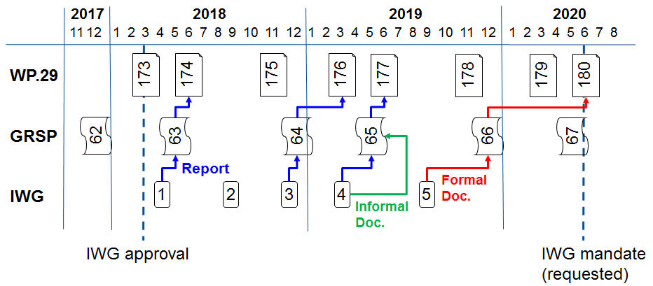
Next meetings & Timeline
Next meetings - In Barcelona, Spain, 4 – 6 Mar. 2020 - more meetings (t.b.d.)
Timeline (TOR)

