Slide 1
Substitute – interlock solutions Fit & function / Fit & non-function by the “Electrical key-system”
Transmitted by the experts from IEC
Informal document GRE-81-07
(81st GRE, 15-18 April 2019
agenda item 5)
Cor Versluijs, IEC
March 7th, 2019
This document visualizes the interlock solutions for the categories C5W/LEDK, W5W/LEDK and WY5W/LED proposed in the documents GRE/2019/9 and GRE/2019/10.

Slide 2
Interchangeability: Electrical key “details cap”
Source
W5W (traditional)
W5W/LEDK (substitute)
Contacts
Contacts
W5W
Holder
W5W/LED
W5W uses cap-holder system W2.1x9.5d
W5W/LEDK uses cap-holder system WX2.1x9.5d
Notes:
The contacts on the light source shall be uni-polar, allocated on both sides of the pinch: For the traditional sources allocated on the wings, and for the LED source allocated on the “exhaust tube”.
(note: uni-polar to enable both the 0° and 180° position insertion and functioning)

Slide 3
Interchangeability: Electrical key “details holder”
Source
W5W (traditional)
W5W/LED (substitute)
Contacts (A)
W5W
Holder
Contacts (B)
Contacts (A)
W5W/LEDK
Contacts (B)
W5W uses cap-holder system W2.1x9.5d
W5W/LEDK uses cap-holder system WX2.1x9.5d
Notes:
The contacts in the traditional holder has to be on the same side of the pinch, but it is allowed that the “holding-spring” on the opposite has the same polarity (presented as dashed lines)
The contacts for the LED-Substitute holder shall have the contact for the traditional source connected to the contact for the LED-Source.

Slide 4
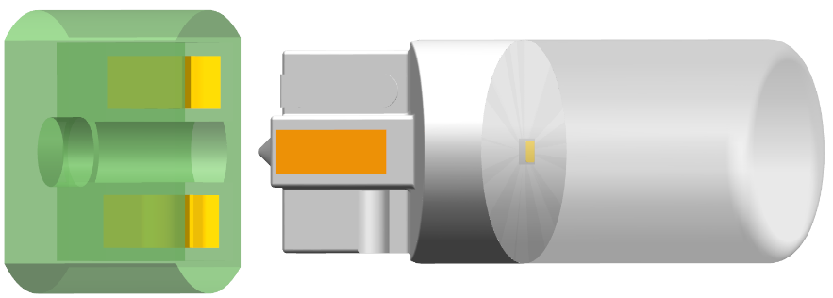
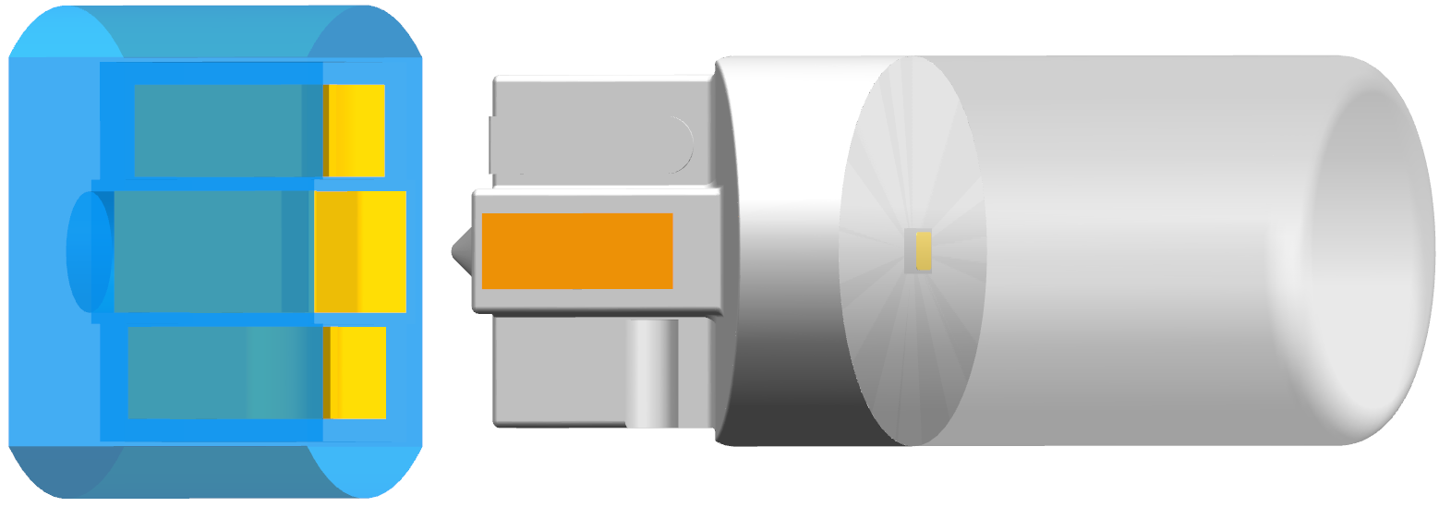
Interchangeability: “Mechanical match”
Source
W5W (traditional)
W5W/LEDK (substitute)
W5W
Holder
W5W/LEDK
W5W uses cap-holder system W2.1x9.5d
W5W/LEDK uses cap-holder system WX2.1x9.5d
Notes:
Pre-insertion - showed

Slide 5
Interchangeability: ”operation / non-operation”
Source
W5W (traditional)
W5W/LEDK (substitute)
W5W
Holder
will light-up
will not light-up
W5W/LEDK
will light-up
will light-up
W5W uses cap-holder system W2.1x9.5d
W5W/LEDK uses cap-holder system WX2.1x9.5d
Notes:
Insertion showed for the 4 possible situations: the source can be inserted without damage, only the LED source will not light up in the traditional holder

Slide 6
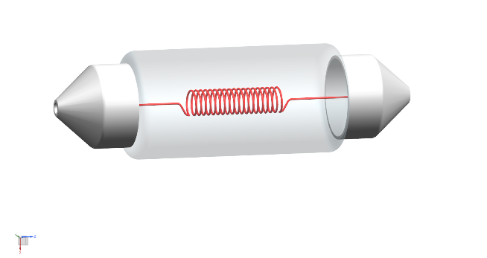
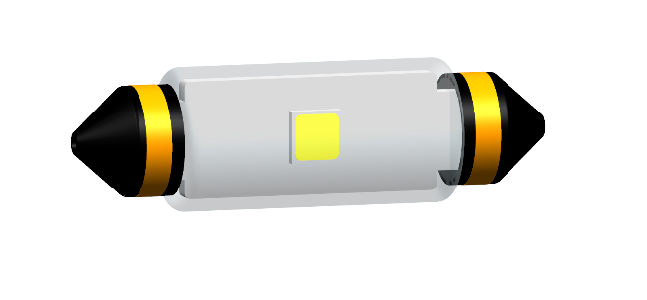
Interchangeability: Electrical key “details cap”
Source
C5W (traditional)
C5W/LEDK (substitute)
Contacts
Contacts
C5W
Holder
C5W/LED
C5W uses cap-holder system SV8.5
C5W/LEDK uses cap-holder system SVX8.5
Notes:
The contacts on the light source shall be uni-polar, allocated on both sides of the pinch: For the traditional sources allocated on the wings, and for the LED source allocated on the “exhaust tube”.
(note: uni-polar to enable both the 0° and 180° position insertion and functioning)

Slide 7
Interchangeability: Electrical key “details cap”
Source
C5W (traditional)
C5W/LED (substitute)
Contacts
C5W
Holder
Contacts
C5W/LEDK
C5W uses cap-holder system SV8.5
C5W/LEDK uses cap-holder system SVX8.5
Notes:
Figure in top left shows one of the possible executions for the contacts for the traditional holder.
Figure in lower right shows the contacts for the LED-Substitute holder: thy shall have the contact for the traditional source connected to the contact for the LED-Source.

Slide 8
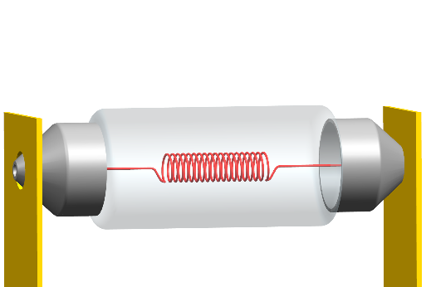
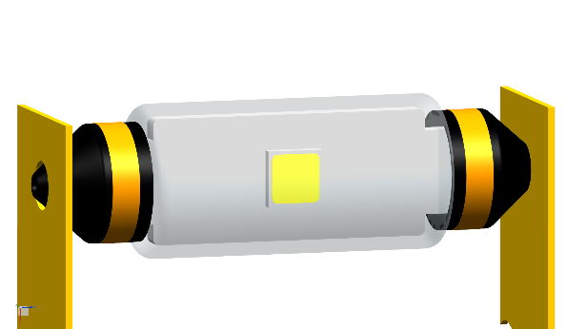
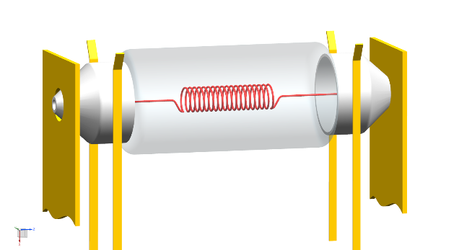
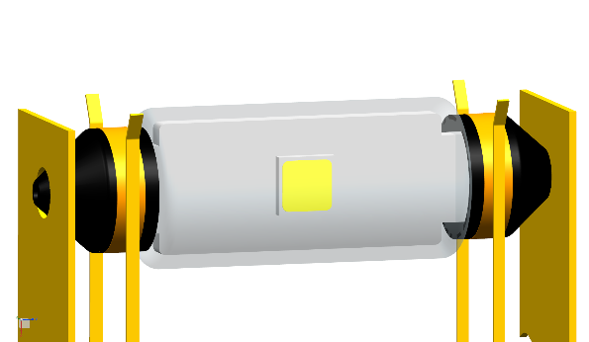
Interchangeability: ”operation / non-operation”
Source
C5W (traditional)
C5W/LEDK (substitute)
C5W
Holder
will light-up
will not light-up
C5W/LEDK
will light-up
will light-up
C5W uses cap-holder system SV8.5
C5W/LEDK uses cap-holder system SVX8.5
Notes:
Insertion showed for the 4 possible situations: the source can be inserted without damage, only the LED source will not light up in the traditional holder

