Slide 1
ISO 16254 Technical Measurement Development
Submitted by the expert of ISO
Informal document GRB-70-09
70th GRBP, 11-13 September 2019,
Agenda item 14
Doug Moore
ISO TC43/SC1/WG42

Slide 2
Overview
Document GRBP-69-26
Observed test variation is significantly greater than assumed and in excess of stated measurement uncertainty in ISO 16254.
Coverage probability at 95% is 1.58 times greater.
Measurement variation observed in testing does not meet the principles of repeatability and reproducibility.

Slide 3
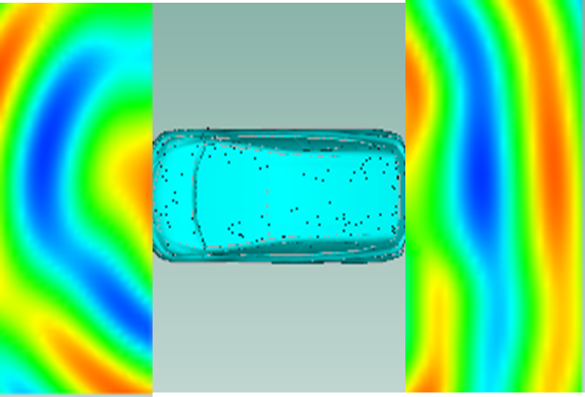
CAE investigations
Evaluate magnitude of spatial variation
Evaluate potential improvement with microphone array
Microphone
Speaker

Slide 5
ISO/CD 16254
Replace single microphone with array microphone.
Report highest 1/3 octave band result within the array.
Use “Max Hold” as 1/3 octave reporting method.
Justification:
Reduce variation and improve repeatability and reproducibility.
Measurement results better correlated to human experience

Slide 6
Key ISO/CD Text
Microphone positions and signal processing
The distance from the microphone positions on the microphone line PP′ to the perpendicular reference line CC′ as specified in Figure 1 on the test track or in an indoor test facility shall be 2,0 m ± 0,05 m.
The microphones shall be located 1,6 m ± 0,02 m, 1,4 m ± 0,02 m, 1,2 m ± 0,02 m, 1,0 m ± 0,02 m, 0,8 m ± 0,02 m above the ground level. The reference direction for free field conditions as specified in IEC 61672–1 shall be horizontal and directed perpendicularly towards the path of the vehicle line CC′.
The vehicle A-weighted sound pressure level for each microphone MicLeft_{i} and MicRight_{i} shall be measured for a duration of 5 s and the maximum value reported.
The one-third-octave frequency spectrum for each microphone MicLeft_{i} and MicRight_{i} corresponding to the maximum hold in each individual one-third-octave band A-weighted sound pressure level shall be reported.

Slide 7
Next Steps
ISO WG42 experts are presently carrying out testing to verify the proposed additional microphone positions and signal processing fulfill the objectives:
Better correlation to real-world experience (detection).
Reduced measurement variation.
ISO/CD 16254 is in process and will be submitted for review and approval by ISO member countries in late 2019.
Pending approval, ISO/DIS 16254 will be prepared to incorporate all comments and findings in 2020.
Pending approval of ISO/DIS 16254, ISO expects to propose amendments to UN R138 in line with the revised ISO 16254 text.
GRBP experts are invited to participate in the ISO 16254 procedure evaluation process.

