Slide 1
Ministry Infrastructure Energy - Albanian Railways IN THE UN Economic Commission for Europe – Inland Transport Committee - Working Party Rail Transport
Workshop: “Making rail freight more competitive and the coordinated development of the rail network with a focus on how to work together at the government and sectoral levels on EATL European – Asian transport links”
Geneva, 25 November 2019 Palais des Nations

Slide 2
”
RWG - RFC working group meeting three main challenges:
Strengthening cooperation between the IMs
1.1. TAC contract main function capacity allocation paths
1.2. Deployment of interoperable systems ERTMS
1.3. Strategy on railway infrastructure development
2. Studying the right balance between F / P modelling
2.1. Freight and passenger traffic database along the RFCs
2.2. Capacity for freight in line with market needs
2.3. REG (EU) No. 913/2010 rail network competitive freight
2.4. the regulation in in relevance with the Economic EEA
2.5. Timetable punctuality targets for freight trains by protocol
3. Promoting inter-modality between rail and combined
3.1. Other transport modes integrating terminals into RFC
3.2. Coordination into the corridor management process

Slide 3
Making Rail Freight more Competitive and the Coordinated Development of the Rail Network with a Focus on how to work together at the Government and Sectoral Levels on EATL European – Asian Transport Links
Albanian in the WB6/EU region and the SEE under the Treaty
The RFC reaching the WB6 in the SERA single EU rail area and Ten-T
RFC 6 Mediterranean starting from south Spain, south France and north Italia, arrives Slovenian and Croatia ports, Interconnects with the TEN-T MED indicative extension to Montenegro-Albania-Greece
RFC 3 reaching Taranto and TEN-T Scandinavian Mediterranean corridor reaching port of Bari ITA by rail/sea meet the TEN-T MED in the WB Region by maritime/rail to port of Durres
Seaport of Durres in the core networks is part of EU indicative extension through Montenegro-Albania-Greece according to the EU REG 2016/758

Slide 4
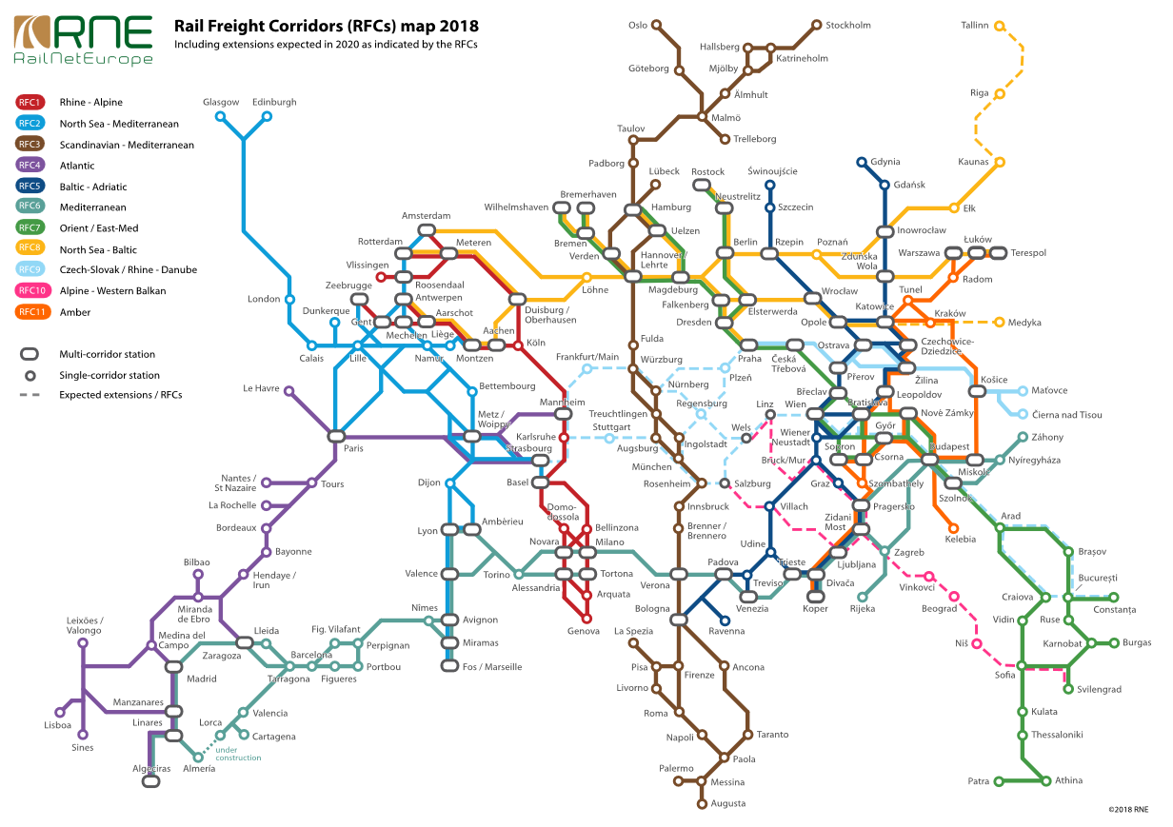

Slide 5
Coordinated Development of the Rail Network with a Focus on how to work together
Thus, RFC 6 and TEN-T Mediterranean coming from ES, FR, north ITA, in SLO and HR meets the indicative extension of TEN-T in the WB6 passing in the multimodality corridors in RFC 5 & RFC 11 in Koper Croatia-BiH-Montenegro-Albania-Greece rail/road
If only by rail RFC6 and TEN-T MED meets the TEN-T OEM and RFC 10 in Belgrade and further to MNE-ALB-GR and sea intermodality for RFC 7 in Sofia and Thessaloniki transports to Turkey, via middle east silk road by rail, and its destination of China in the EEA
In RFC 7 and the trans-european transport network TEN-T OEM in Sofia, in Skopje, Thessaloniki and the entire region meet up with RFC 9 and TEN-T Rhine Danube link CEFTA or downwards from Hungaria to Belgrade to Podgorica to tirana to Durres to Pogradec& preliminary design to reac Piraeus by rail

Slide 6
THE EATL with our IPA countries neighboring in the same corridors, are facilitating interconnectivity between the RFC and trans-European transport networks linking Europe and beyond Europe in rail/road/sea/iww/air IN multimodality Decree no. 7875, dated 26.12.2012, of the President of the Republic of Albania, Law no. 118/2012, "On the transport of dangerous goods
Toward a very efficient approach on intermodality incl. interconnectivity in the WB region and IPA summit in 13-14/11/2019 in Belgrade with the EU Agency for railways and the WB6 where Albania moderates the smart, effective and sustainable rail mobility in TCT

Slide 7
The 1st train from cina comes in the wb6 region in Serbia after 1 month of ROUTing, and if any receiver of goods in Albania the train shall continue, in the connectivity toward THE rfcs through hungaria- Serbia- Montenegro-Albania rail/road multimodality - rail northern Macedonia- Bulgaria and/or Greece rail/sea to turkey to silk road by rail –china-back to Serbian opened rail market and in the wb6/Albanian open market
Decree No. 2700, dated 19.7.2000, of the President of the Republic of Albania, Law No. 8638, dated 13.7.2000, “On accession to the Vilnus Protocol of 3 June 1999 containing the modification of the Convention on International Rail Transport (COTIF) , May 9, 1980 ”
- Decree no. 4398, dated 17.11.2004, of the President of the Republic of Albania, law no. 9299, dated 28.10.2004, "On the accession of the Republic of Albania to Decision III / 1, amending the Basel Convention" On trans-frontier movement of hazardous waste and their disposal ”.

Slide 8
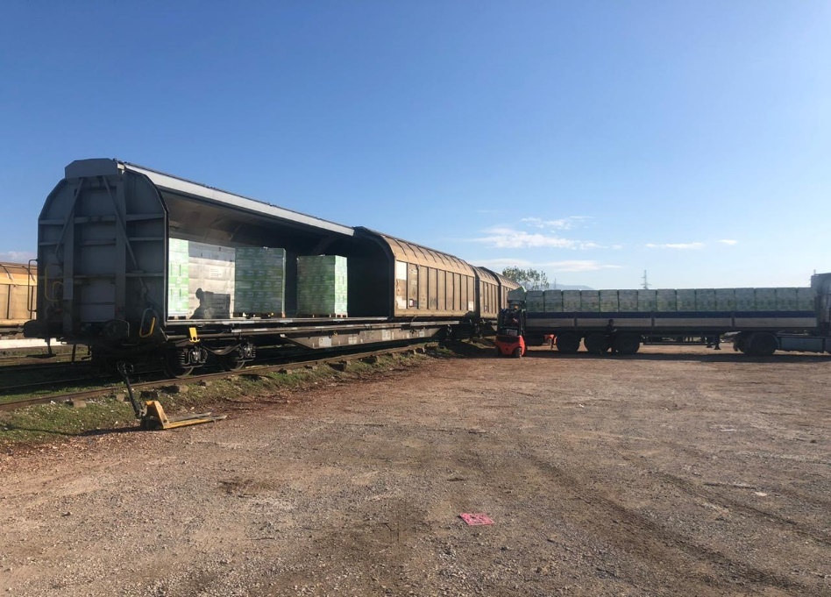
CCB Albania-Montenegro a recent successful model to expand for the other CB railways opened& well-functioning from 10 July 2017 where OSS in 75minute
Decree No. 6845, dated 6.12.1983, of the President "On the Accession of the Republic of Albania to the International Convention on the Transport of Goods by Rail (CIM) and to the Convention on International Rail Transport (COTIF)"
Arriving in the core transport network in Vora strategic pproject area
It is now studying in details with the EU for rehabilitation duration 24M
Decree no. 4399, 17.11.2004, of Republic of Albania, Law No. 9300, 28.10.2004, “On the Accession of the Republic of Albania to Annex A of the Convention on International Rail Transport (COTIF), on uniform rules for the contract of international carriage of passengers and luggage by rail (CIV) ”

Slide 9
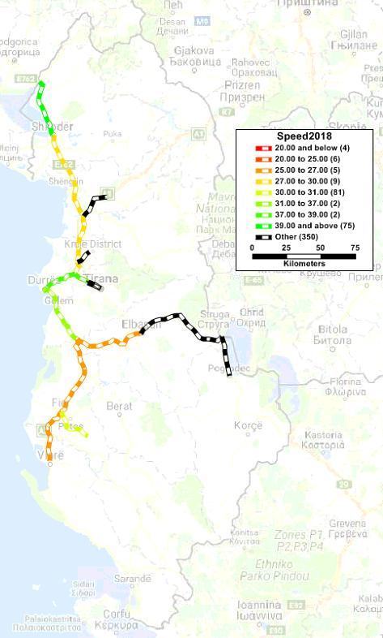
- Decree No. 4125, dated 13.2.2003, of the President of the Republic of Albania, Law No. 9167, dated 22.1.2004, "On the Accession of the Republic of Albania to the International Convention on the Facilitation of Border Crossings for Railway Freight" and Law no. 9168, dated 22.1.2004, UNECE International Convention
- Decree No. 5096, dated 2.11.2006, of the President of the Republic of Albania, Law No. 9620, dated 16.10.2006, "On the Ratification of the Multilateral Agreement for the Establishment of a High Performance Railway Network in South-Eastern Europe"

Slide 10
Albania implements the law on ratification of European Agreement on Main International Railway Lines, where this Ea - a strong legal basis on approval of the 4rth RP and the rail strategy reform in force
Law No. 9689, dated 5.3.2007, "On the European Agreement on the Main Railway Lines"
On Railway financing and Public-Private Partnerships is in the ANTP3
Intensifying efforts to the TEN-T regions and EATL passing through WB6
Implementing legislation for ensuring a high level of security in the WB6/EU

Slide 11
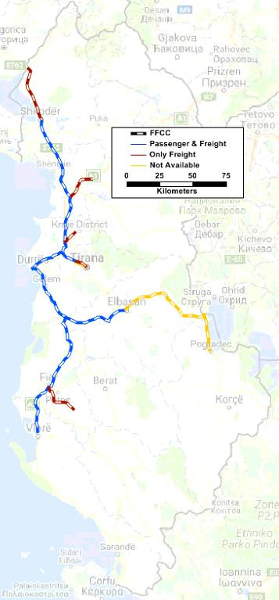
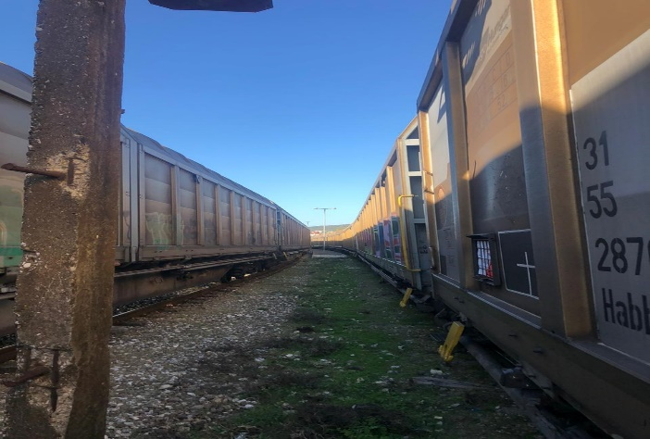
the cooperation on RFC is enhanced from Albanian government's strategic railway transport program
3 railway operators are now licensed in albania
• Decision No. 348, dated 11.5.2016, of the Council of Ministers, “On the approval of the National Strategy for Development and Integration 2015-2020”, on infrastructure and transport, on the modernization of railways to ensure further compliance and integration with countries of the region and trans-European networks

Slide 12
Requiring to increase Rail safety operations-security harmonization with the EU transport regulatory framework for the creation of common market conditions and safety standards, as well as the promoting the liberalization of railway service which is now increased competition among multimodal operators, railway and port operators
Rail operations in Vora st.
22,11,2019 with the HSH

Slide 13
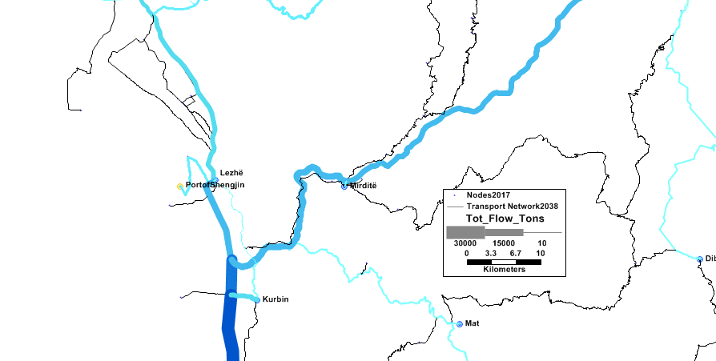
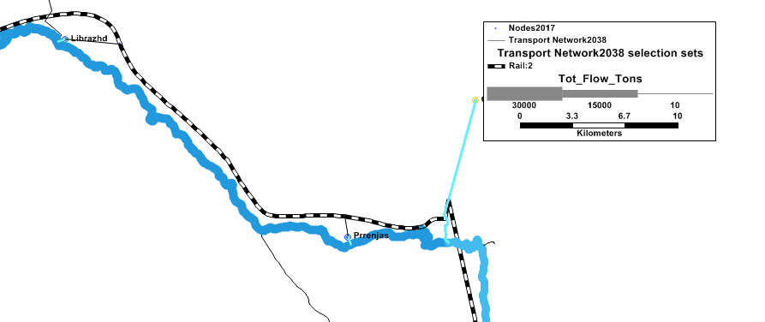
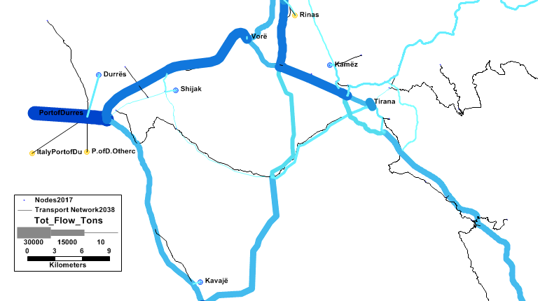
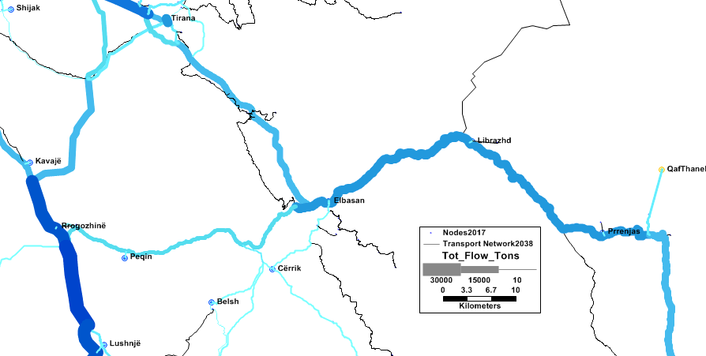
Port of Durres and Vora planned logistic centers
Milor and Kukes logistics
Prrenjas dry port in CVIII
Fieri and Elbasan interports
The Albanian national transport plan 2019-2023 and traffc models to 2038 and basis of Indicative strategic
document for Albania 2014-2020, dated 18.8.2014, on the development of the transport sector papers
• Decision no.201, dated 10.04.2019, of the Council of Ministers, “On the approval of the National Plan for European Integration 2019-2021”, on the drafting of some laws pursuant to the Law “Railway Code” on inland sector rail transport and short-term legal measures

Slide 14
EU comm staff working docs 11/04/2019 on erp rail reform #3
2019-2021 Decision of the council of ministers, “On the approval of the economic reform program (ERP) 2019-2021”, according to which the construction and improvement of the railway network and the railway connection to the ports are planned as international dispatching points the rehabilitation of Dr-PTT-TIA in tendering procedure in the EBRD web
• Decision no. 611, dated 17.9.2014, of the council of ministers, “On the approval of the national action plan for the implementation of the regional strategy for south-east Europe, 2014 - 2020”, dimension i.2 - rail transport

Slide 15
Questions? Thank you
Albanian ministry of infrastructure energy and Albanian railways
Eneida Elezi, foreign affairs the state representative in shift2rail
Eneida.elezi@gmail.com and info@hsh.com.al
Tel . 00355 52 222 037 . Mob. 00355 69 82 20 407

