Slide 1
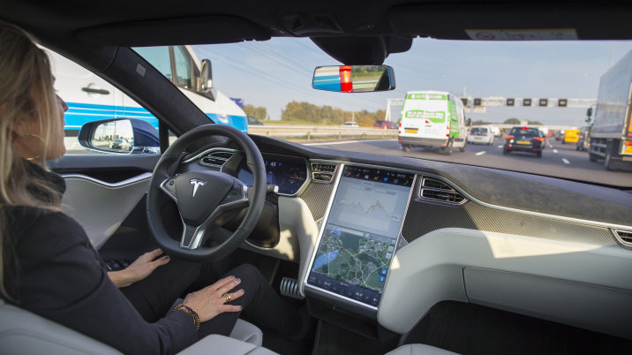
Challenges and Proposals for Modern Vehicles
Submitted by the expert from the Netherlands
Informal document GRVA-01-40
1st GRVA, 25-28 September 2018
Agenda item 5
Geert Pater
Department Manager
Vehicle Standards Development
GRVA, Geneva Sept 2018

Slide 2
The Netherlands Vehicle Authority
Organization
RDW is a non-commercial public body since 1949. It performs its tasks on behalf of the Ministry of Infrastructure and Water Management.
RDW in international context
As the Type-Approval Authority of the Netherlands, RDW tests and inspects new vehicles, their systems and parts of over 1600 manufacturers and importers from all over the world. RDW also makes knowledge available through consultation and supports projects in other countries in the area of traffic safety. In addition, RDW closely cooperates with sister organizations in the area of European regulations.
International consultation
Dutch legislation is based on European Directives. These are increasingly related to agreements that are made in the context of UNECE and EU. RDW participates in various consultation structures in which the international regulations are prepared.
On the road, safely and reliably
Geert Pater, Genéva Sept 2018

Slide 3
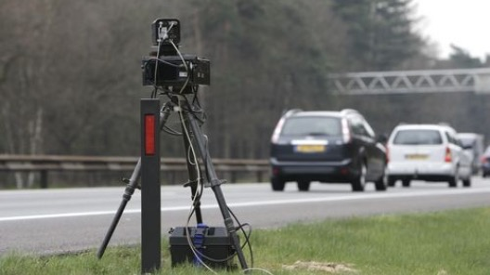
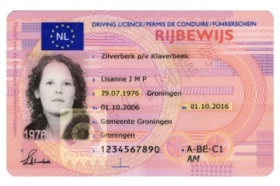
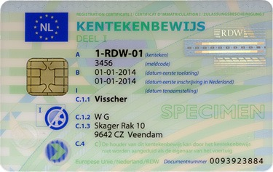
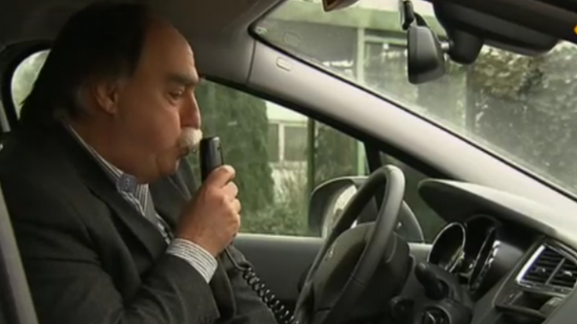
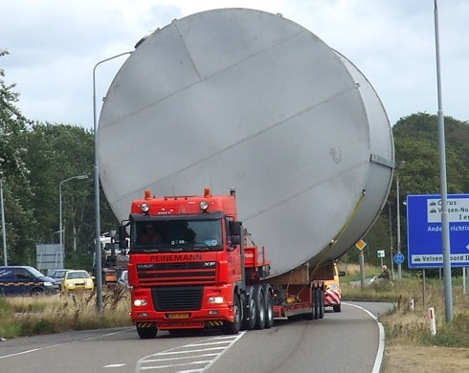
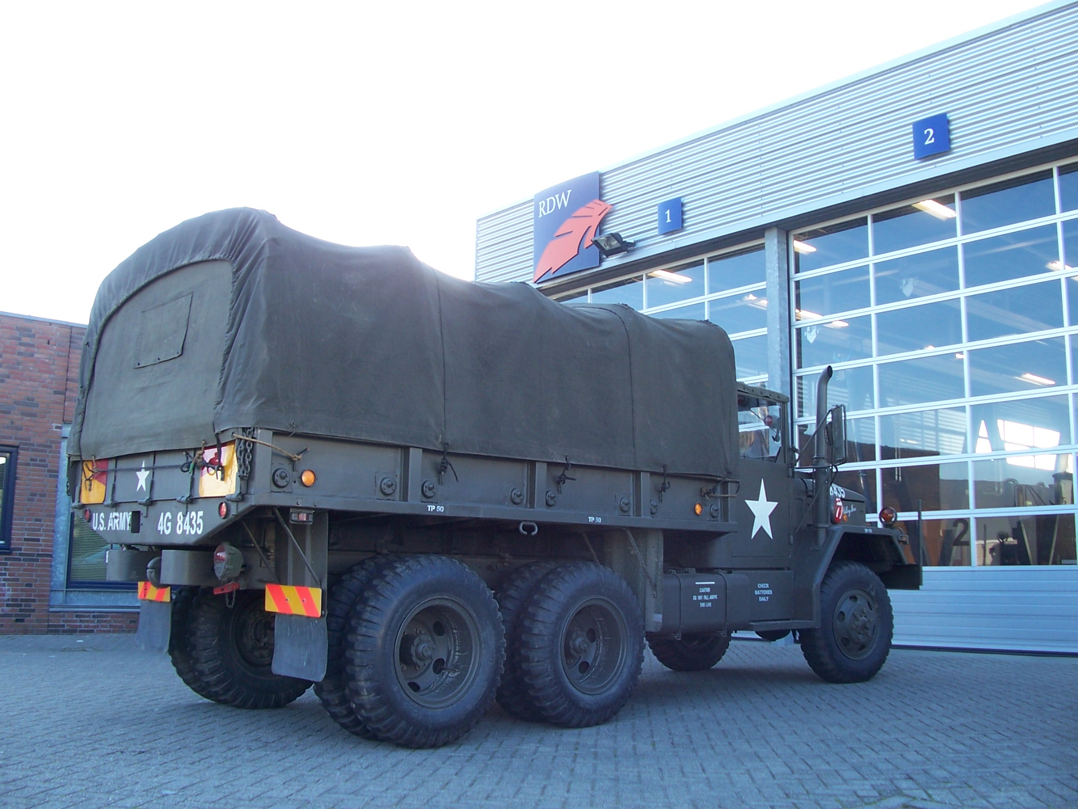
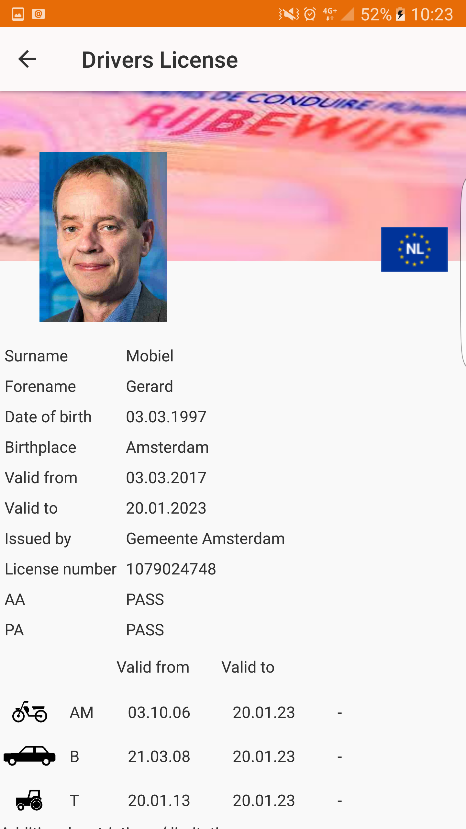
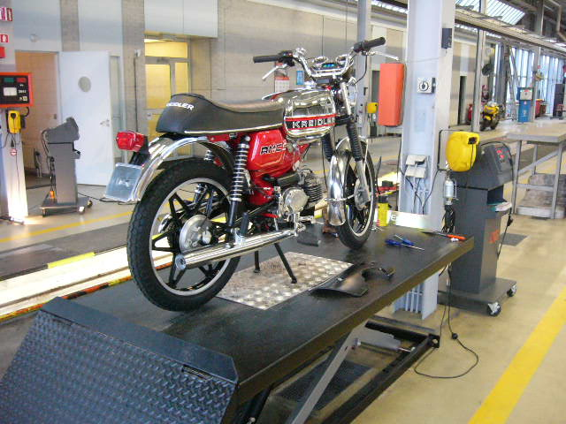
The Netherlands Vehicle Authority
Type Approval
Oversight and Control
Registration and information provisioning
Issuing documents
Veilig en Vertrouwd op Weg
On the road, safely and reliably
Geert Pater, Genéva Sept 2018

Slide 4
The Modern Vehicle as a Data Centre on Wheels
The Challenge

Slide 5
Are we prepared?
Are we prepared?

Slide 6
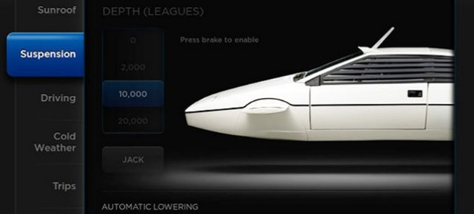
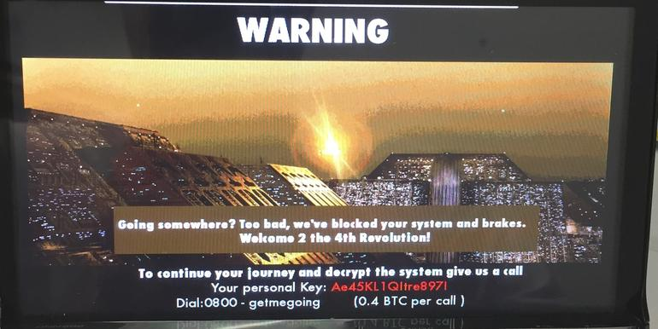
The Challenges
‘The European Type Approval System is not sustainable'
How do you test a car with > 100 million lines of software?
How do you test a car with connections to the outside world?
Software with Easter Eggs and dead code
No formal divide between entertainment and motor management (CAN BUS)
CAN BUS is an open system
'No vehicle is safe'
Testing 18 carkeys of modern cars. They all failed
Ransomware will be in a car within one year
On the road, safely and reliably
Geert Pater, Genéva Sept 2018

Slide 7
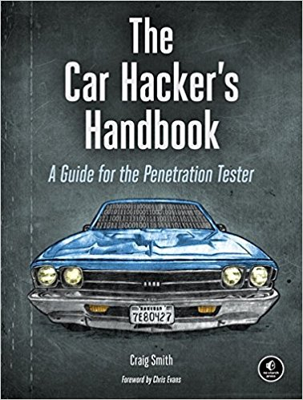
The Challenges
We need a new way of testing, certifying and monitoring
Virtual testing of the car should be possible, or better yet – the software has to get a drivers license.
We need a strong collaboration
between authorities internationally and a natural way to exchange information and learn from each other.
On the road, safely and reliably
Geert Pater, Genéva Sept 2018

Slide 8
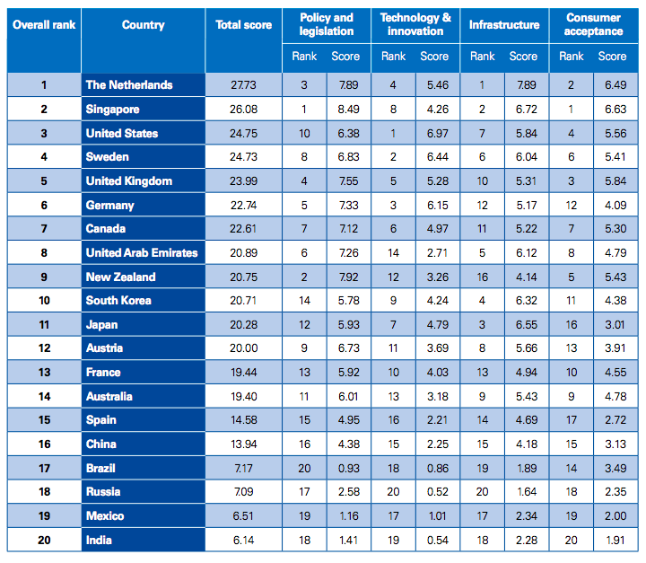
Testing in the Netherlands
KPMG Autonomous Readiness Index 2018
On the road, safely and reliably
Geert Pater, Genéva Sept 2018

Slide 9
Bridging the Gap Between Regulation and Innovation
Assessing Safety and Security
Geert Pater, Genéva Sept 2018

Slide 10
What Is RDW Doing?
Finding Input for New Regulation
Bridging the Gap!
Learning Audit / Learning Experience - VSSF
Vehicle Driving License – vDL
Experimentation Law (January 2019)
On the road, safely and reliably
Geert Pater, Genéva Sept 2018

Slide 11
Vehicle Safety Security Framework (VSSF)
Finding Input New Regulation
An ideation for a smooth co-creation for innovation and legislations
Could be seen as a deeper dive into e.g. Annex 6
Creating maturity by performing Learning Experiences
On the road, safely and reliably
Geert Pater, Genéva Sept 2018

Slide 12
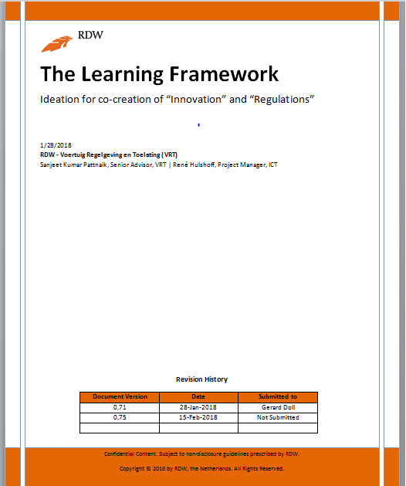
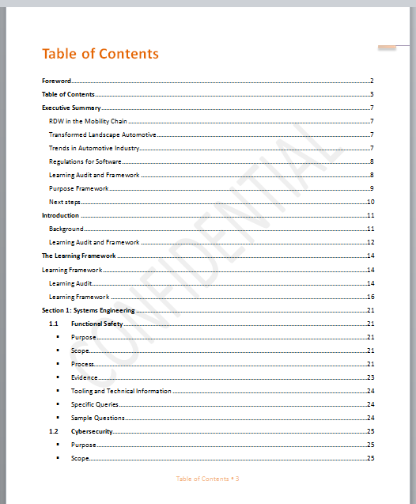
On the road, safely and reliably
Geert Pater, Genéva Sept 2018

Slide 13
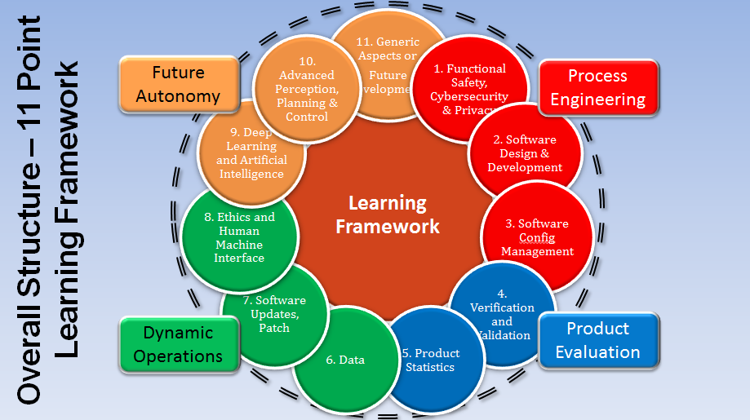
On the road, safely and reliably

Slide 14
Vehicle Safety and Security Framework (VSSF)
Goals
Functionality | Safety | Security | Privacy
Strategy
Process Engineering
Product Evaluation
Dynamic Operations
Future Autonomy
Lifecycle
Development and In-use compliance
Functional Safety, Cybersecurity and Privacy Engineering
Software Verification
Data
Ethics
Software Requirements, Design and Development
Software Updates and/or Patch Management
Learning
Areas
System
Validation
Machine and Deep Learning
Software Configuration Management
Advanced Perception, Planning and Control
Product
Statistics
Human Machine Interaction
Quality
Software Quality Assurance
Notes:
Optie 1: Preferred by Rene, Sanjeet

Slide 15
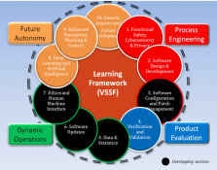
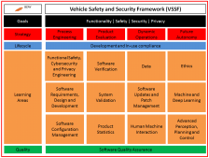
VSSF Process Overview
Learning Session
Learning Framework
Assessment by competent authority
Information Analysis
Information Gathering
Analysis
Product Approval maintenance
Initial / Full Product Assessment
Requirements Development
Best Practice
Standards
Regulations
Type Approval
Process Approval maintenance
Process Assessment
Program Development
New program
Adapt/ modify TA
On the road, safely and reliably

Slide 16
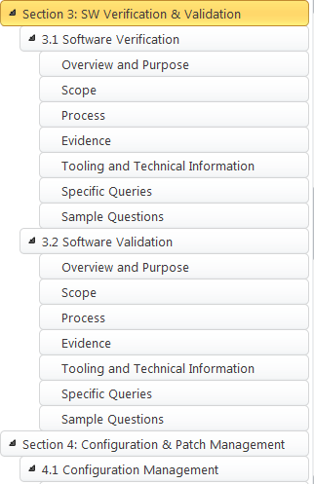
Basic Principles
Overview, Purpose, Scope, Process/Learning aspects, Evidence, Tooling and Tech, Specific Queries, Sample Questions
Question based construction of information gathering
Database of >500 questions dedicated to topics identified
“MOSCOW” based color coding principle – Must, Should, Could and Would be asked questions
Minimum (At least) Learning Set
On the road, safely and reliably
Gerard Doll - Director Vehicle, Regulation & Admission RDW

Slide 17
Basic Principles (Sample Question set)
On the road, safely and reliably
Geert Pater, Genéva Sept 2018

Slide 18
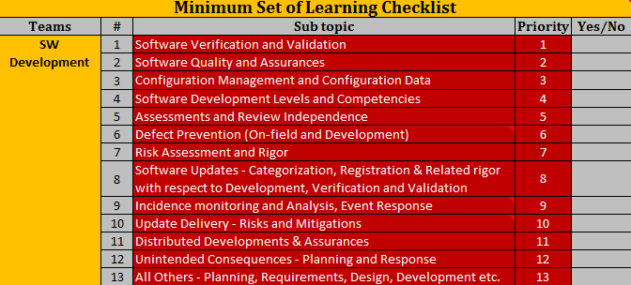
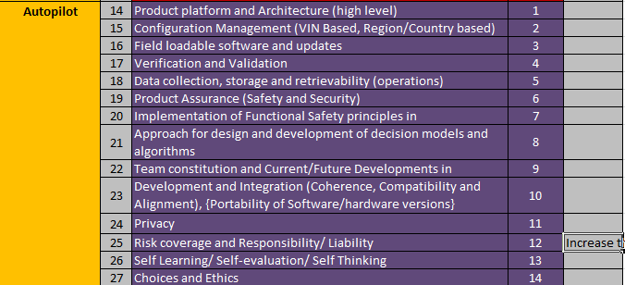
Basic Principles (Minimal learning set)
On the road, safely and reliably
Geert Pater, Genéva Sept 2018

Slide 19
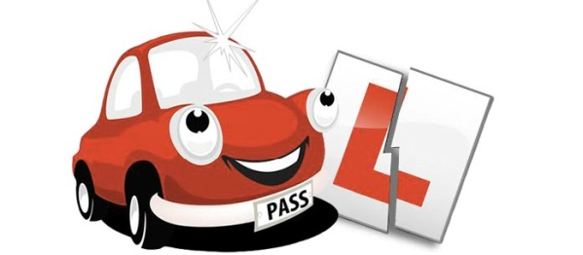
Vehicle Driving License (vDL)
What if technology takes over all driving tasks?
On the road, safely and reliably
Geert Pater, Genéva Sept 2018

Slide 20
Background
Limited knowledge of driving behavior; how to license self driving vehicles?
RDW challenged Green Dino to develop a license for AI-drivers
Green Dino started ‘robotTUNER’ a new company for assessment and training of robot / AI-drivers.
Result: ‘Digital Driving License Project’. A collaboration of stakeholders who want to attribute to an international standard for licensing of intelligent vehicle operating systems, human and AI.
Initial Group
Nvidia, AON Risk Solutions, Ricardo, HAN-Automotive Research, 2getthere, Roborace and initiators robotTUNER and RDW.
robotTUNER
On the road, safely and reliably
Geert Pater, Genéva Sept 2018

Slide 21
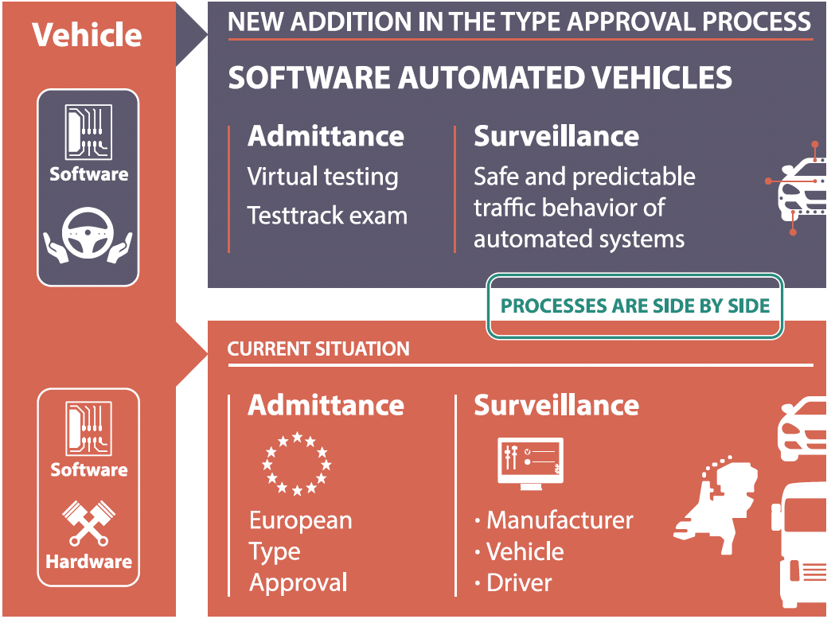
On the road, safely and reliably
Geert Pater, Genéva Sept 2018

Slide 22
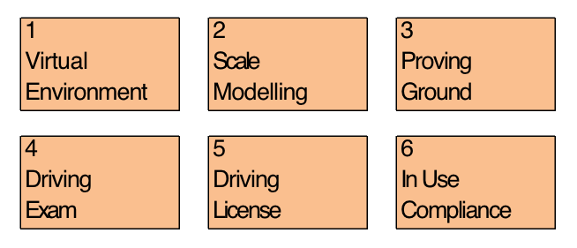
vDL
New work item proposal (ISO)
Safety of Intelligent Vehicle Operating Systems (SIVOS)
Proposed process of testing:
On the road, safely and reliably
Geert Pater, Genéva Sept 2018

Slide 23
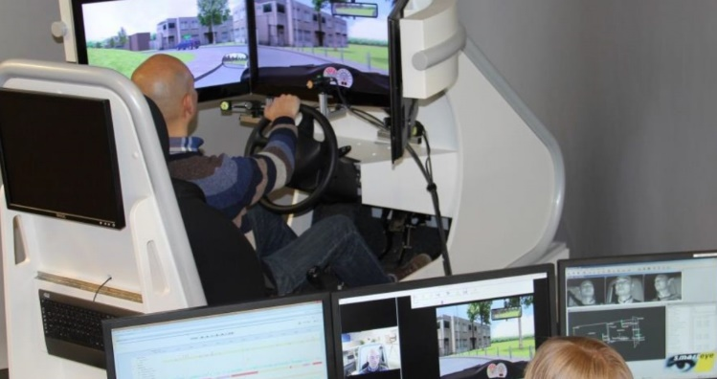
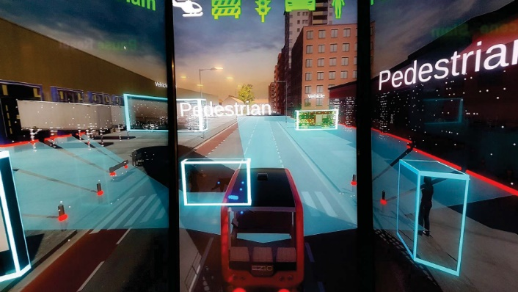
vDL
Virtual Environment
From simulators used for training humans, we know the ‘average human driver’ performance in a broad set of ‘traffic situations’ (use cases, or Operational Design Domain).
The AI-driver ‘competes’ in a virtual environment against this average human driver.
Knowledge (theory) and skills are tested and related to human performances and risk profiles.
The safety manager of a supplier can provide the evidence
On the road, safely and reliably
Geert Pater, Genéva Sept 2018
Notes:
ODD zelfde als incrementeel ontwikkelen?

Slide 24
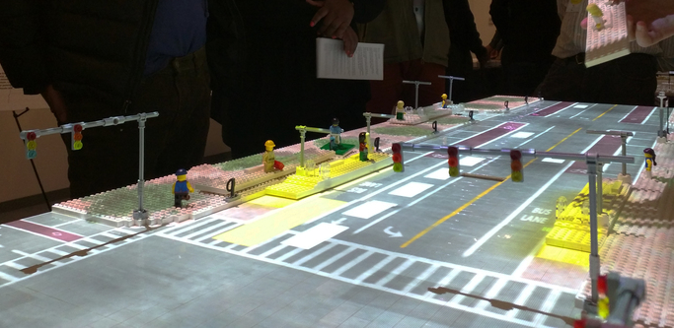
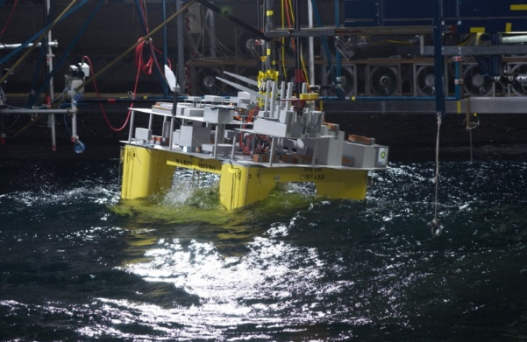
vDL
2. Scale Modelling
The validity of simulation output is not proven yet. Scale modelling is a (traditional) cost effective method for live tests.
The impact on the traffic system can be assessed using scale modelling and augmented reality. Stress testing (e.g. hacking) can show vulnerabilities.
Standard hardware is used. Only the software is tested (sensor testing belongs to vehicle testing).
Under supervision of RDW
On the road, safely and reliably
Geert Pater, Genéva Sept 2018

Slide 25
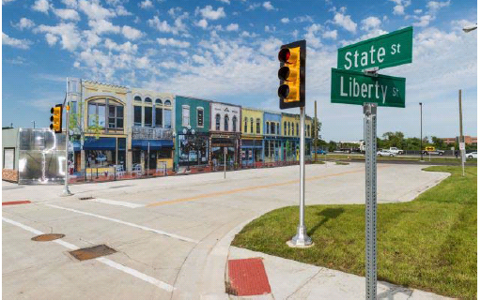
vDL
3. Proving Ground
To make sure the software and hardware are integrated well by the manufacturer, a real life test on a closed proving ground is performed for validation purposes.
Happy flow tests and stress tests (aviation).
Under supervision of RDW
On the road, safely and reliably
Geert Pater, Genéva Sept 2018
Notes:
Wat verstaan we onder happy flow tests en stress tests?

Slide 26
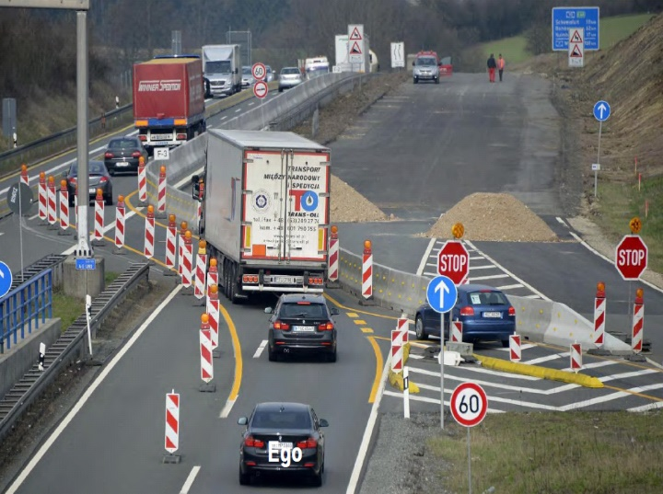
vDL
4. Driving Exam
Just as for humans, the last step is a driving exam on public roads. In this exam (45 – 60 min), some situations from a predetermined list should be negotiated positively.
Validation of safe interaction in complex traffic situations
Under supervision of CBR
On the road, safely and reliably
Geert Pater, Genéva Sept 2018

Slide 27
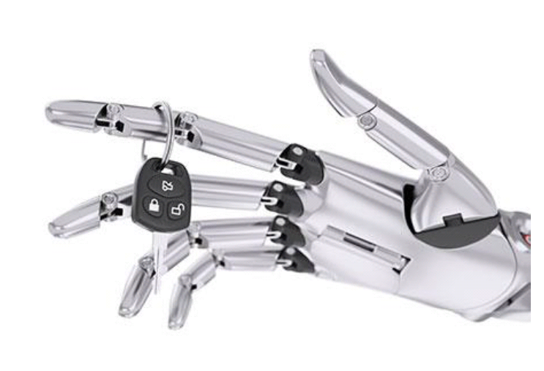
vDL
5. Driving License
For the specific use cases / Operational Design Domain’s, the AI-software obtains the driving license (ISO certificate) = stepped admission.
The innovation strength / reliability of a manufacturer counts.
RDW will give approval after licensing by CBR = compliance with the digital driving license methodology
On the road, safely and reliably
Geert Pater, Genéva Sept 2018

Slide 28
vDL
In Use compliance
Given the ever-changing software, monitoring is needed when the vehicle is used on public roads. Unsafe software updates, hacking or malicious software would otherwise not be noticed.
Traffic flow is monitored for detection of anomalies or abnormal behavior such as ignoring traffic rules or endangering other road users. Those vehicles that are detected as an anomaly need to be rechecked by auditors, or pulled of the roads if necessary.
Software version shows the fitness of the software.
Under supervision of RDW (software PTI)
On the road, safely and reliably
Geert Pater, Genéva Sept 2018

Slide 29
vDL
Next Steps:
ISO proposal ‘SIVOS’ now at NEN: Dutch National Standardization Organization.
Approved by Technical Committee (NC 345042).
Q2 2018: forming working groups.
First pilot driving license in the Netherlands in 2019.
Hopefully: an ISO standard in 2022
Note: The development of a new ISO standard is only possible with international support and resources.
On the road, safely and reliably
Geert Pater, Genéva Sept 2018

Slide 30
Join us
From a regulatory standpoint, the next three years will be an awful big adventure.
Join us to bridge the gap and lets work together to enable automotive innovation
On the road, safely and reliably
Geert Pater, Genéva Sept 2018

Slide 31
Contact
Geert Pater
Department Manager
Vehicle Standards Development
GPater@rdw.nl
On the road, safely and reliably
Geert Pater, Genéva Sept 2018

