Slide 1
Alternative Approach to UN R13 Type-IIA for Battery Electric Vehicles
Submitted by the experts from OICA and CLEPA
Informal document GRVA-01-27
1st GRVA, 25-28 September 2018
Agenda item 8 (c)
OICA – CLEPA
GRVA-01 - September 2018
V1.2

Slide 2
Technical background UN R13 - Type-II and IIA tests
Type-II
Downhill Behaviour Test
Type-IIA
Endurance Braking Performance Test
30km/h
30km/h
6%
6 km
7%
6 km
Scope
M3 and N3
Except vehicles submitted to Type-IIA
Service brake: no restriction
Pass criteria: Hot-stop performance after Type-II
N3: 3.3 m/s²
M3: 3.75m/s²
Scope
M3 class II, III & B
N3 ADR and/or authorized to tow cat. O4
Service brake: prohibited
Pass criteria: Average speed of 30km/h (+/- 5 km/h)

Slide 3
Technical background UN R13 – Definition of SoC *
* State of charge
2.21.4. “Electrical state of charge” means the instantaneous ratio of electric quantity of energy stored in the traction battery relative to the maximum quantity of electric energy which could be stored in this battery;
_
_
_
+
+
+
SoC
0%
50%
100%

Slide 4
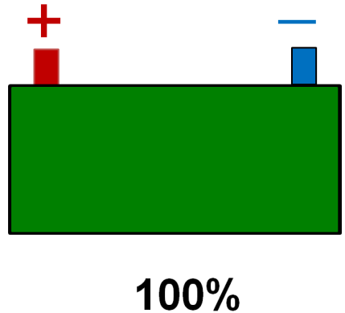
Technical background Description of the issue
BEV
30km/h
General:
UN R13 Type-IIA test is not adapted to Battery Electric vehicles (BEV) technology.
Technical issue:
Technical Services requires Type-IIA to be conducted with a fully charged traction battery (i.e. the worst case).
In these conditions:
The kinetic energy of the vehicle cannot be converted and stored in the traction battery,
No endurance braking is available.
Type-IIA cannot be passed without complex technical solutions highly impacting weight, packaging and cost, e.g. resistors and high-temp cooling system, extra batteries. ➔ Such solutions kill the economical interest of BEV technology.
6 km
7%
Type-IIA not feasible
An alternative approach is needed for BEVs

Slide 5
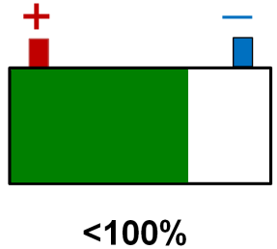
Alternative to Type IIA Principles
No change for vehicles not equipped with an ERB system
BEV & Hybrid vehicles *
* M3 class II, III & B + N3 ADR and/or authorized to tow cat. O4, equipped with an ERB system of cat A or B
Current way
Alternative approach
Type-IIA
Type-II
+
Type-IIA
+
Brake estimator
Warn the driver if performance is below Type-II hot-stop requirements:
N3 = 3.3 m/s²
M3 = 3.75m/s²
30 +/-5km/h
hot-stop requirements:
N3 = 3.3 m/s²
M3 = 3.75m/s²
30 +/-5km/h

