Slide 1
Task Force on Electro-Magnetic Compatibility (TF EMC) Status report to GRE-80 Thursday, 25th of October 2018
Submitted by the expert of TF EMC
Informal document GRE-80-12-Rev.1
(80th GRE, 23-26 October 2018, agenda item 7(a))

Slide 2
TF EMC Status Report
TF EMC had its 16th meeting on Monday, 8th of October 2018.
TF EMC will report on the work, which led to the “GRE/2018/43e - (TF EMC) Proposal for the 06 series of amendments to Regulation No. 10 (Electromagnetic compatibility)” which was submitted by July 27th based on the consensus reached in the TF.
TF EMC will present and explain the informal document No. GRE-80-XX based on the consensus reached in the TF.
TF EMC is asking for the adoption of these proposals including two final decisions to be done by GRE which could not be clarified by the TF EMC.
TF EMC is asking to present the proposal of Regulation No. 10-06 to WP.29 for a publication in 2019.
TF EMC will inform about the status of the proposals prepared by France and India and the topics, discussed at GRE-79 and additional information.

Slide 3
TF EMC Status Report – UN R10.06 Development
Status of the work
Because of the technical changes and the updated TPs, the decision was done to publish a new series of UN R10
An update of the TPs were discusssed and finally agreed by all parties
The proposal, delivered from India about changes of figures of motorcycles, was implemented
Several new proposals were submitted by France and UK and intensively discussed. Most of them were implemented in the document “GRE/2018/43e”.
It was decided to implement updated definitions and figures taken from CISPR12 regarding the test of charging systems
More than 150 modification proposals were discussed
Around 120 modifications were incorporated in the working draft of UN R10.06
28 of the proposals have been included in a roadmap for a UN R10.07 series
2 proposals were not accepted due to a contradiction with international standards

Slide 4
TF EMC Status Report – UN R10.06 Development Topics to be decided by GRE 80 (1):
Introduction of categories of agricultural vehicles
France proposes to introduce the categories T for tractor R for trailers S for interchangeable towed equipment
Justification: Whereas the Commission delegated regulation (EU) 2015/208 « supplementing Regulation (EU) No 167/2013 of the European Parliament and of the Council with regard to vehicle functional safety requirements for the approval of agricultural and forestry vehicles “ Annex 15 part 9 refer to R10.
Discussion in TF EMC: Concerns of Contracting Parties outside Europe because of different national regulations regarding agricultural vehicles (e.g. India, Japan, Russian Federation)

Slide 5
TF EMC Status Report – UN R10.06 Development Topics to be decided by GRE 80 (1):
Introduction of categories of agricultural vehicles
Paragraph 1.1., amend to read:
"1.1. Vehicles of categories L, M, N [and] O, [T, R and S]¹ with regard to electromagnetic compatibility;“
Paragraph 3.1.8., amend to read:
"3.1.8. For vehicles of categories [L], M, N [and] O, [T, R and S], the vehicle manufacturer shall provide a statement of frequency bands, power levels, antenna positions and installation provisions for the installation of radio frequency transmitters (RF-transmitters), even if the vehicle is not equipped with an RF transmitter at time of type approval. This should cover all mobile radio services normally used in vehicles. This information shall be made publicly available following the type approval."
Annex 6, paragraph 3.2., amend to read:
"3.2. For categories M, N, O, [T, R and S] vehicles according to ISO 11451-2."

Slide 6
TF EMC Status Report – UN R10.06 Development Topics to be decided by GRE 80 (2):
The paragraph 3.1.8 should apply for all categories of vehicles, defined in the scope
This means to add the categories L for powered Two Wheelers T for tractor R for trailers S for interchangeable towed equipment
Paragraph 3.1.8., amend to read:
"3.1.8. For vehicles of categories [L], M, N [and] O, [T, R and S], the vehicle manufacturer shall provide a statement of frequency bands, power levels, antenna positions and installation provisions for the installation of radio frequency transmitters (RF-transmitters), even if the vehicle is not equipped with an RF transmitter at time of type approval. This should cover all mobile radio services normally used in vehicles. This information shall be made publicly available following the type approval."

Slide 7
TF EMC Status Report – UN R10.06 Development Topics to be decided by GRE 80 (2): 3.1.8 should apply for all categories of vehicles, defined in the scope
Justification :
France proposes to introduce the L category in clause 3.1.8 because France considers that it is possible to add RF transmitter in aftermarket on L categories

Slide 8
TF EMC Status Report – UN R10.06 Development Topics to be decided by GRE 80 (3)
Informal document submitted by TF EMC
Addition of a definition for OTS (issued from CISPR 12)
2.25. "Outdoor Test Site (OTS)” measurement site similar to an open area test site as specified in CISPR 16, however a ground plane is not required and there are dimensional changes.

Slide 9
TF EMC Status Report – UN R10.06 Development Topics to be decided by GRE 80 (3)
Informal document submitted by TF EMC
Clarification of failure criteria for vehicle in charging mode immunity tests (annexes 6, 15 and 16)

Slide 10
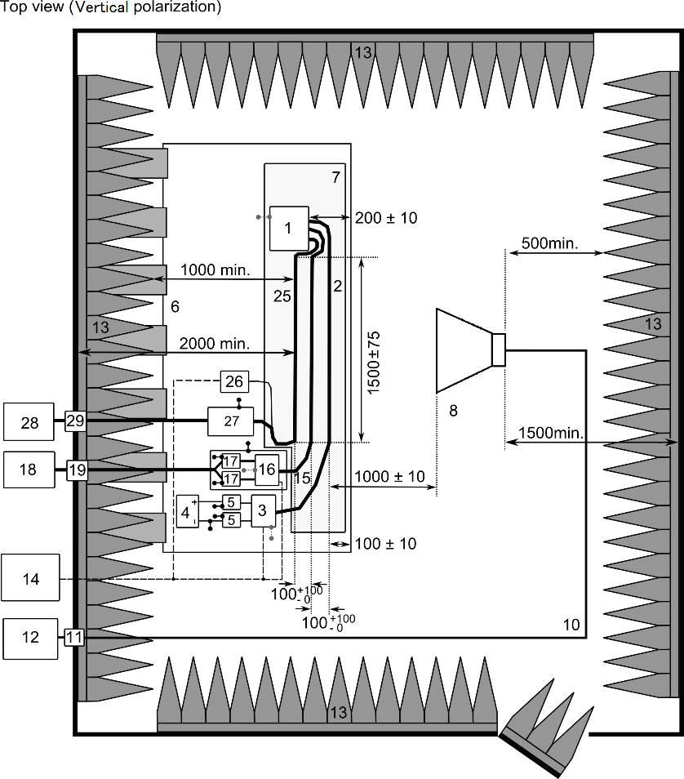
TF EMC Status Report – UN R10.06 Development Topics to be decided by GRE 80 (3)
Informal document submitted by TF EMC
Correction of figure x at Annex 9 – Appendix 3 (part 1/2)
By
…
and

Slide 11
TF EMC Status Report – UN R10.06 Development Topics to be decided by GRE 80 (3)
Informal document submitted by OICA TF EMC
Correction of figure x at Annex 9 – Appendix 3 (part 2/2)
By

Slide 12
TF EMC Status Report – UN R10.06 Development Next Steps
Supporting GRE and WP.29 regarding questions to the contents of the draft of UN R10-06
Goal for the publication of UN R10-06 is September 1st, 2019
The TF EMC will continue it’s work: From beginning of 2019 TF EMC will work on the topics which were not mature for an R10-06 in order to launch either an amendment or a draft of a R10-07

Slide 13
Thank you for your attention

