Slide 1
Indoor pass by noise
France
Presented by Louis-Ferdinand PARDO
Transmitted by the expert of FRANCE
Informal document GRB-67-11
(67th GRB, 24-26 January 2018,
agenda items 4 (a) and 17)
GRB 67th session

Slide 2
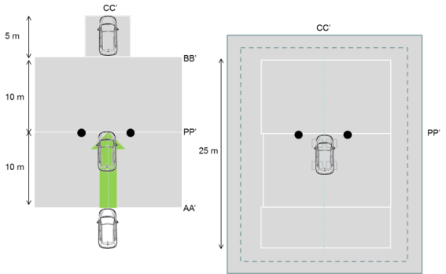
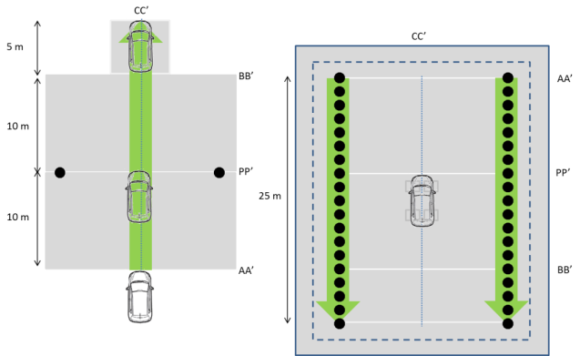
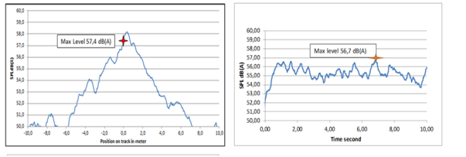
Indoor in standardization
First indoor regulation UN ECE138 for QRTV
Indoor pass-by noise :
ISO 362-3 and proposed in
UN ECE51
Simulated Pass-By

Slide 3
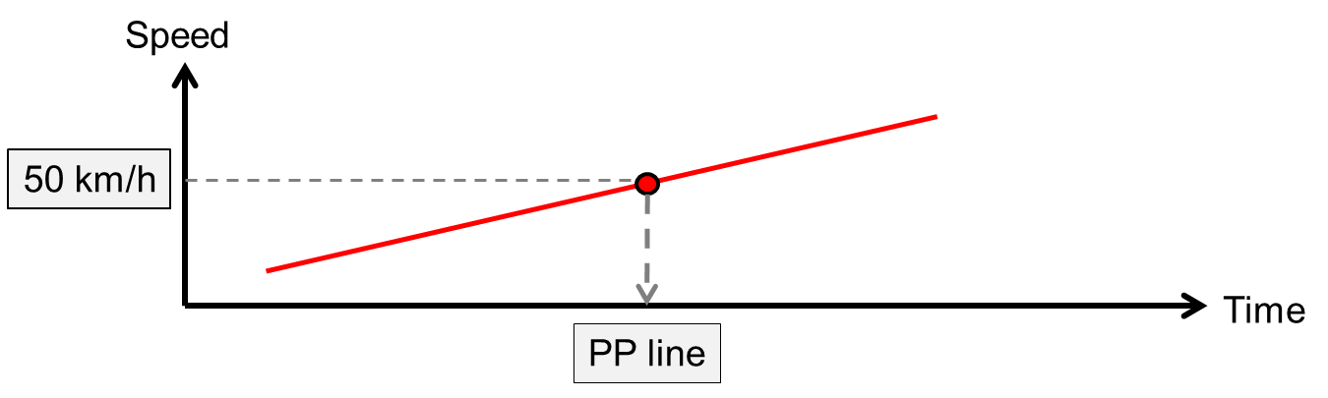
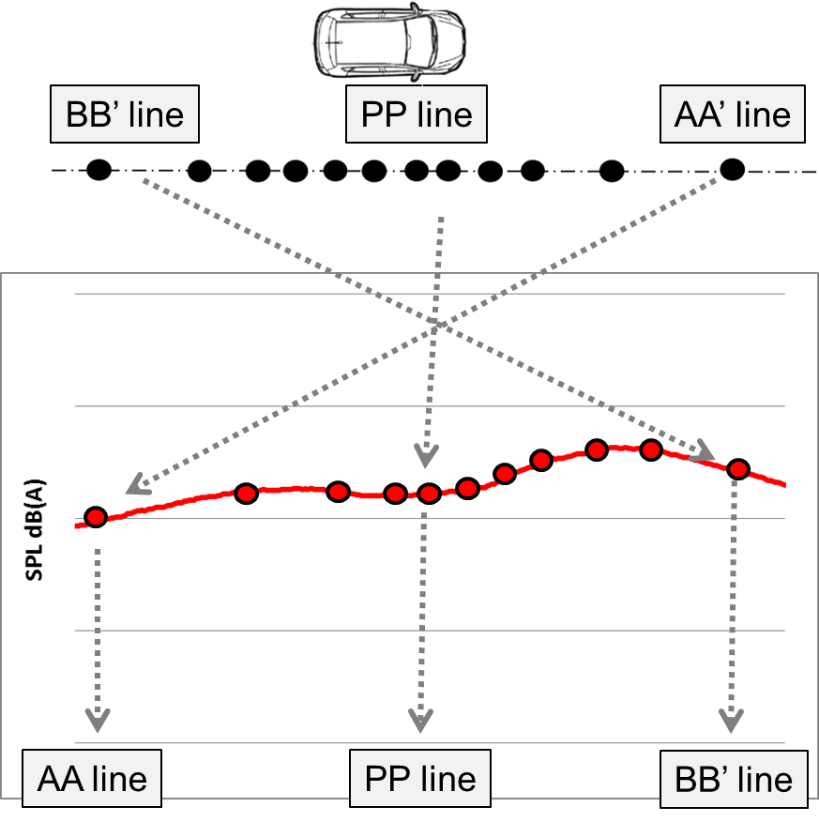
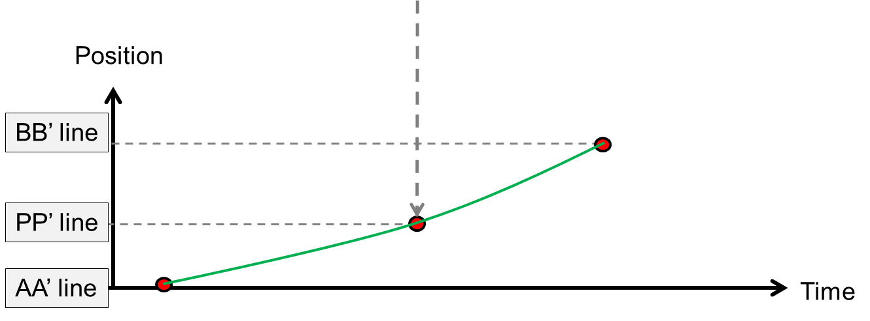
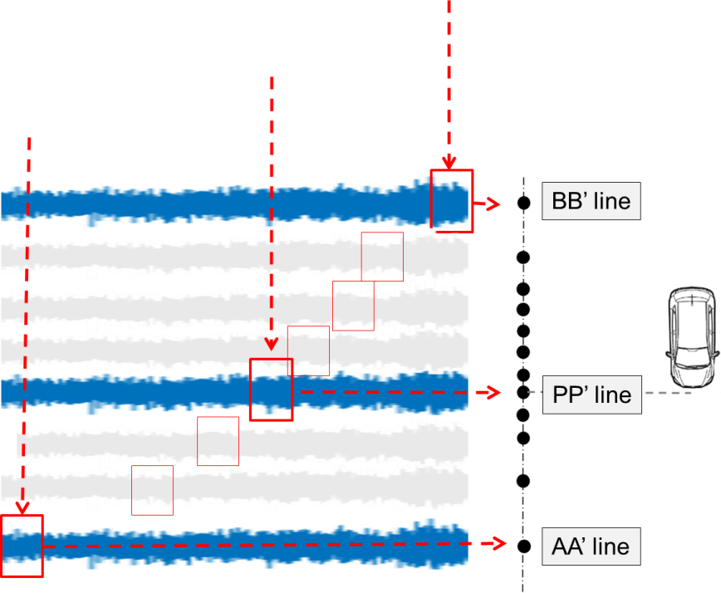
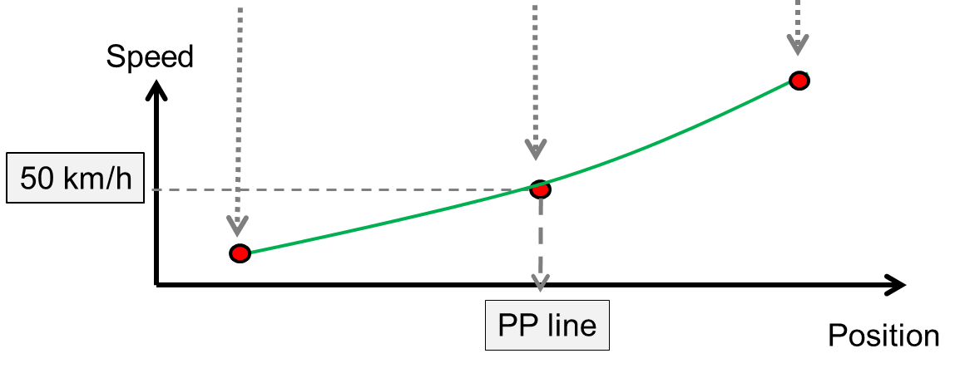
Indoor processing

Slide 4
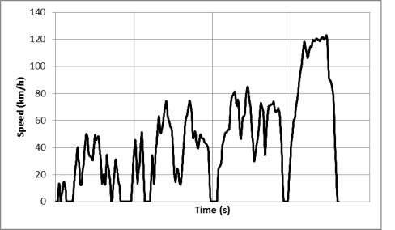
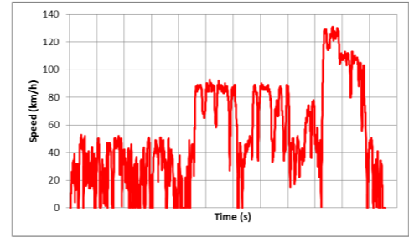
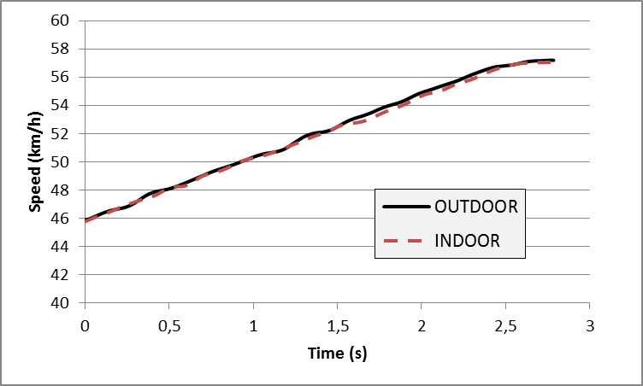
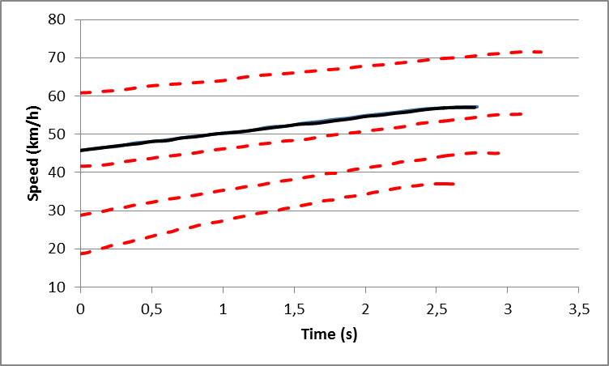
Political questions
Laboratory vs Real Driving
  Indoor test
  WLPC
  Outdoor test
  RDE
  Pollution
Indoor and outdoor cycles are different
  Indoor or outdoor test
  R51.03 Annex 3
  Noise
  Indoor or outdoor test
  R51.03 ASEP
Same cycle for Indoor and outdoor

Slide 5
Political questions
For indoor application, the manufacturer shall provide to the technical service documentation.
Validation of facility e.g. free field propagation, dyno and air handling noise background noise level, dyno dynamic performance, software.
Procedures to be applied for indoor testing, e.g. dyno and software set-up, loading and tie-down, air-handling and vehicle’s temperature management,
Coast down and tyre input sound level data used for calculation of dynamometer load coefficients and tire sound data used for determination of final reported results, e.g. testing, datas management
Testing results on a representative selection of the manufacturer’s production to demonstrate that indoor testing delivers comparable results as outdoor testing within acceptable accuracy.

Slide 6
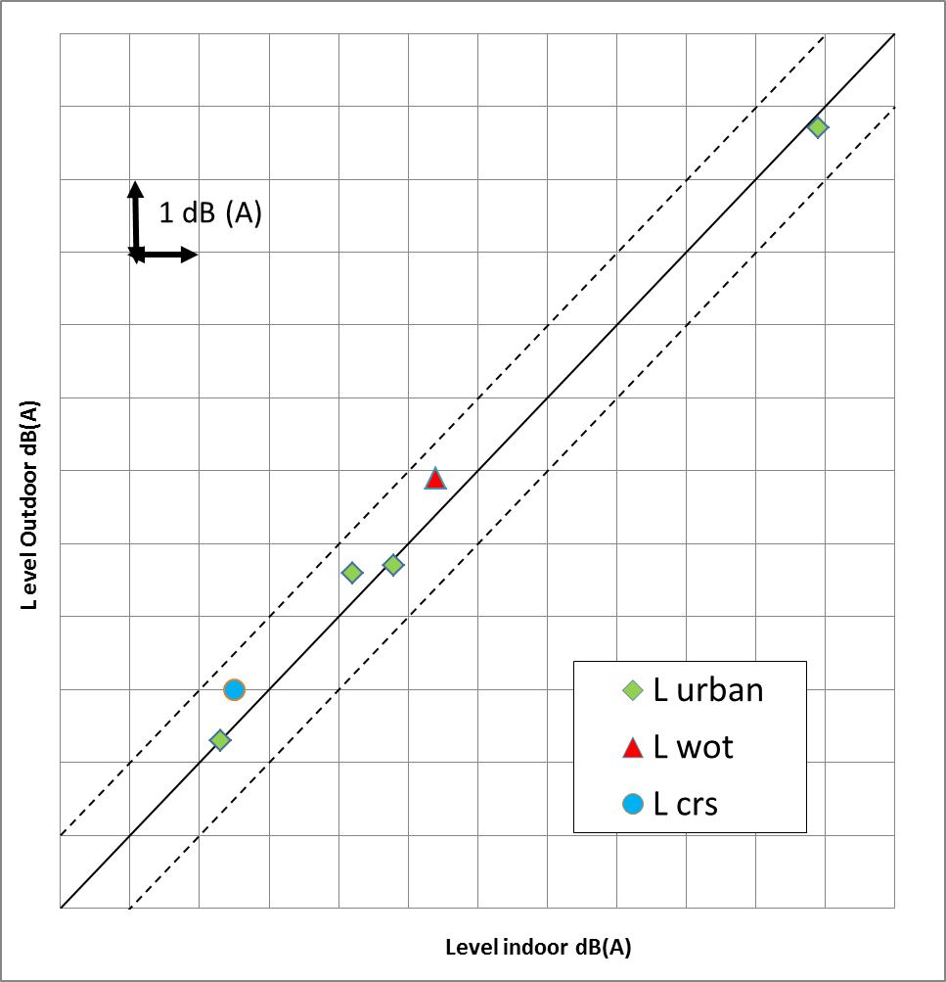
Correlations from states of art
Kramer and ald, Comparison of pass-by noise from real track and simulated mesurement at the roller test bench, internoise, 2016
Development of Pass-by noise Measurement System on a Chassis Dynamometer, Daisuke §Morie, Yoshihiro Shirahashi and Al; SAE 2008

Slide 7
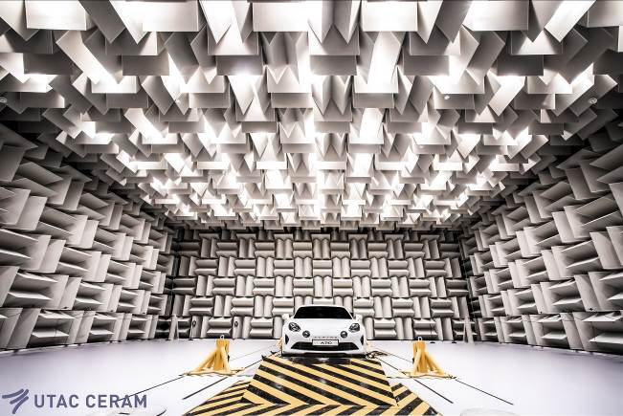
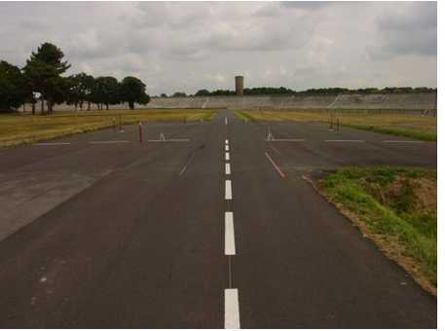
Validation tests
Test programs were performing by UTAC CERAM in its indoor and outdoor facilities
The objective is :
  to valide applicability of the method and
  to estimate potential of correlation indoor/outdoor.

Slide 8
Instrumentation
1. Measuring instruments
All measuring instuments have same or better precision than outdoor.
Indoor uses « virtual sound level meter » with different processing techniques which is able to provide comparable results to a single type 1 sound level meters (sound level meter compliance method for virtual sound level is an application of IEC 61672-1 and 3 type 1).

Slide 9
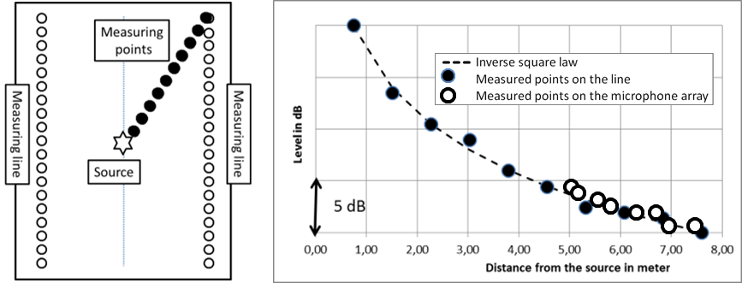
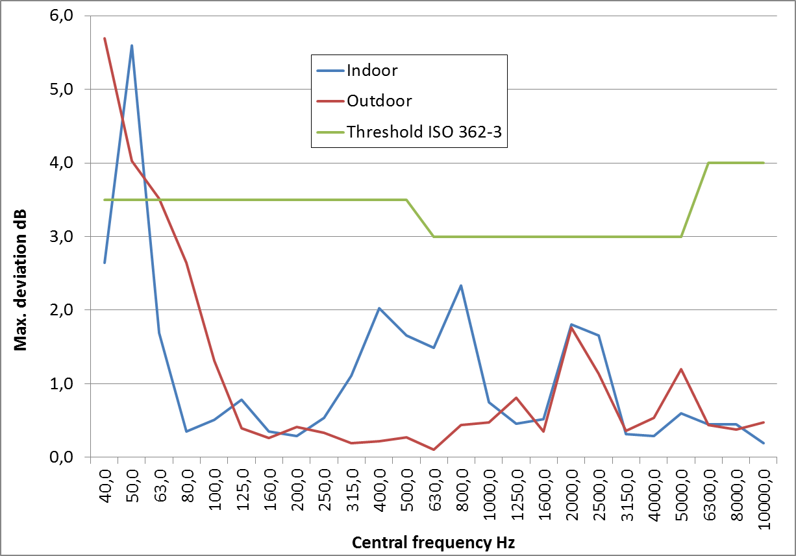
Room acoustic performance
2.1.2. Test Site Indoor
ISO 362-3 requires ISO 26101 for free-field validation.
UN R138 refers also to ISO 26101 requirement.
Indoor acoustic’s propagation is comparable to outdoor acoustic’s propagation. All measurement facilities, either indoor or outdoor have similar deviations.

Slide 10
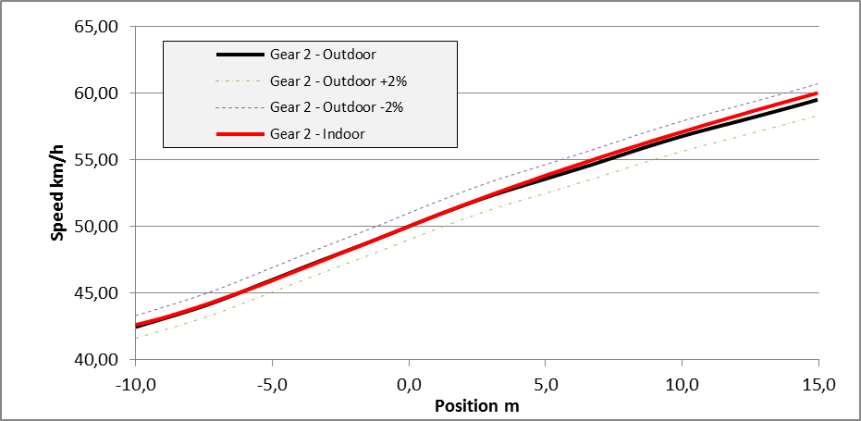
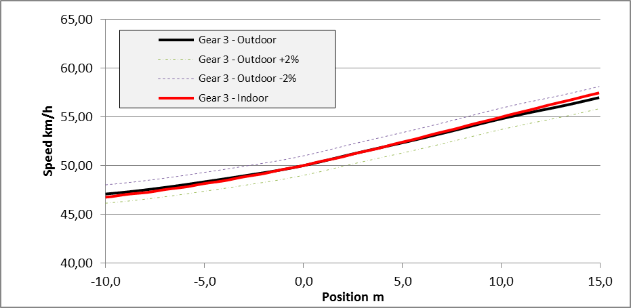
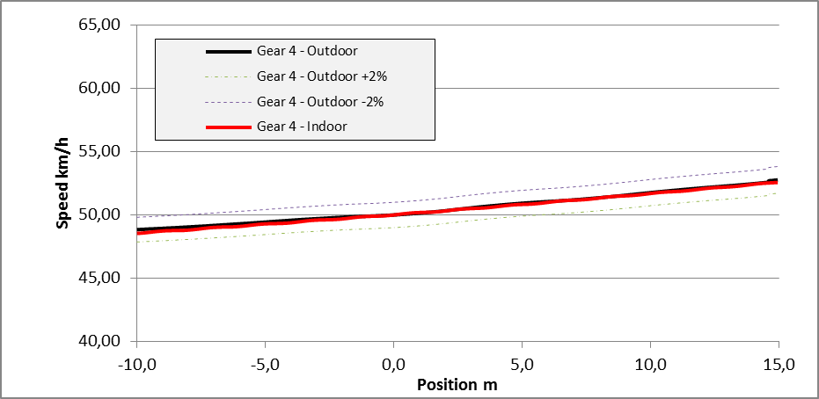
Vehicle dynamic
2.1.2. Test Site Indoor
Using coast-down data from emission/pollution, indoor is able to provide comparable dynamic between indoor and outdoor.

Slide 11
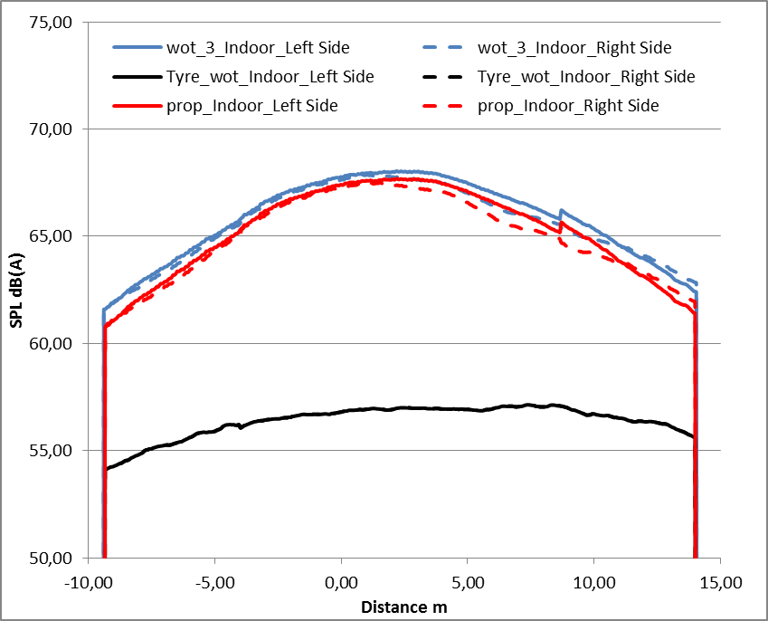
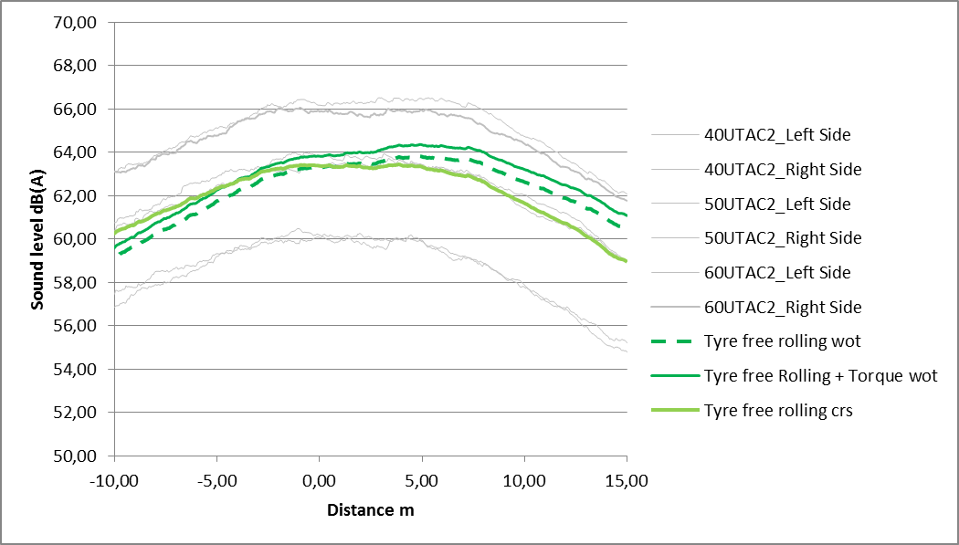
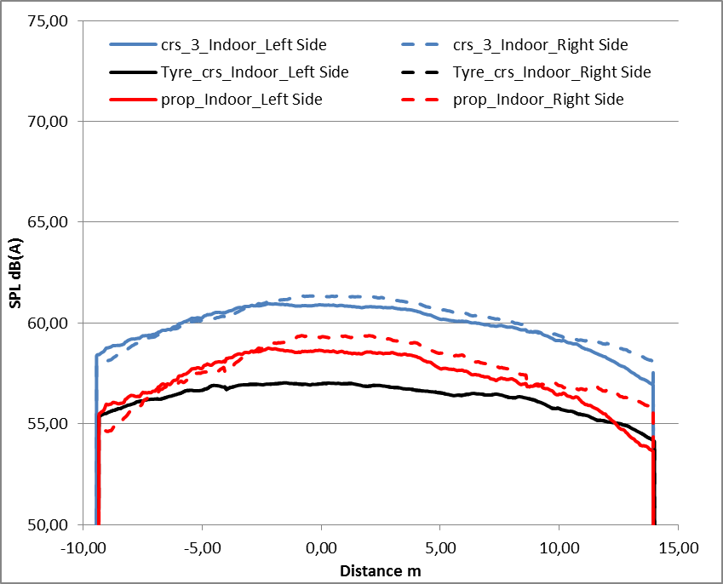
Methods of testing
3.1.3. Interpretation of results
Indoor testing → Propulsion sound level
wot
Outdoor testing → Tyre sound level
+
crs

Slide 12
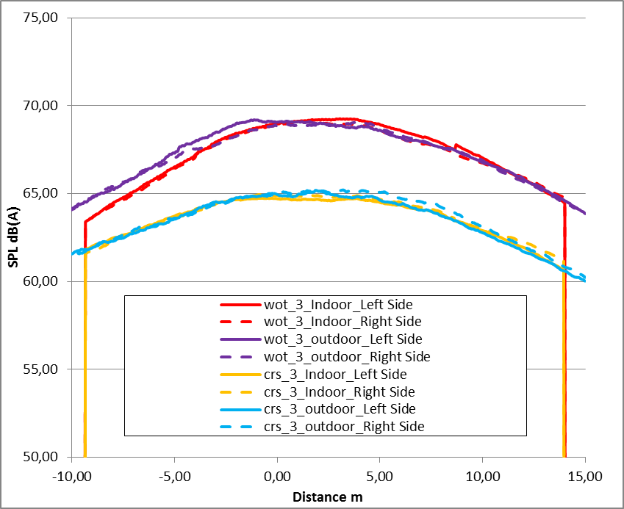
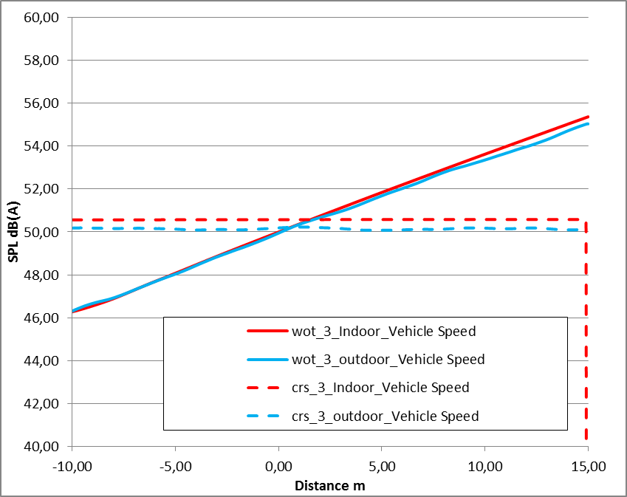
Methods of testing
3.1.3. Interpretation of results
Indoor testing uses and presents results in same format as outdoor (vehicle speed, engine speed and sound level as function of distance).

Slide 13
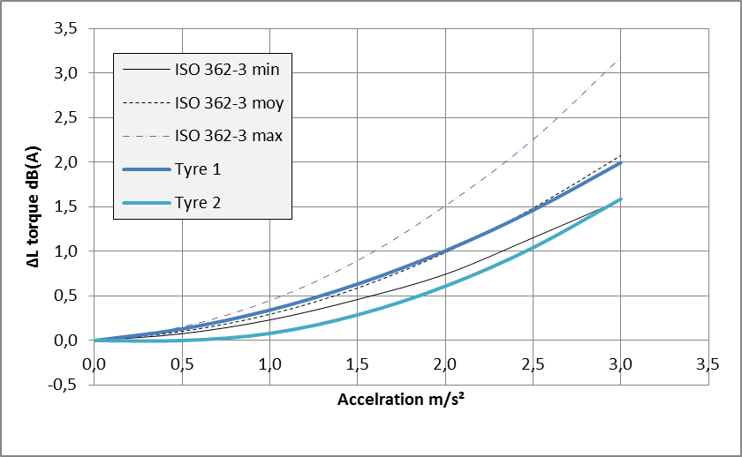
Tyre testing
Annex 8 §2.3. Tyre/road sound
Using silent vehicle (e.g. EV), ISO 362-3 provides method for full tyre sound level evaluation (free rolling + torque).
Tests results on tyres are comparables to default values from ISO 362-3.

Slide 14
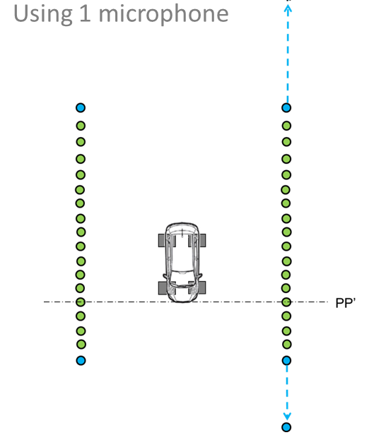
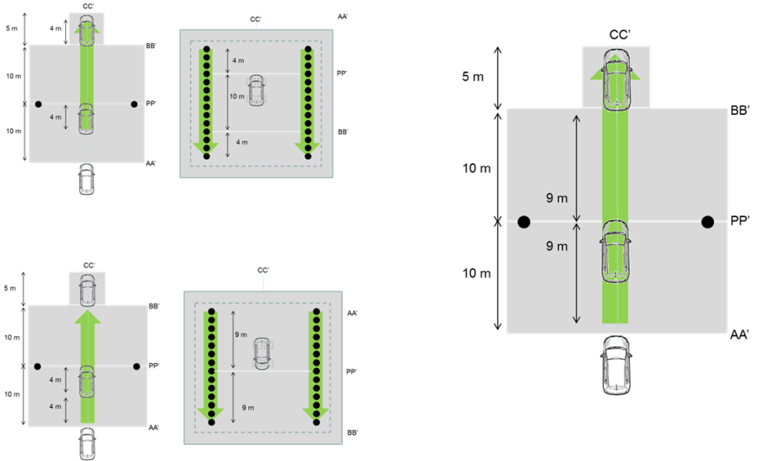
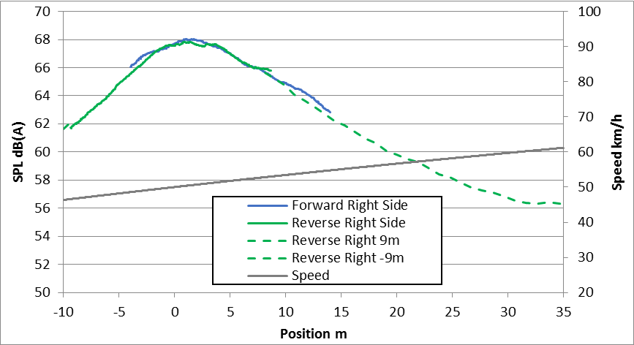
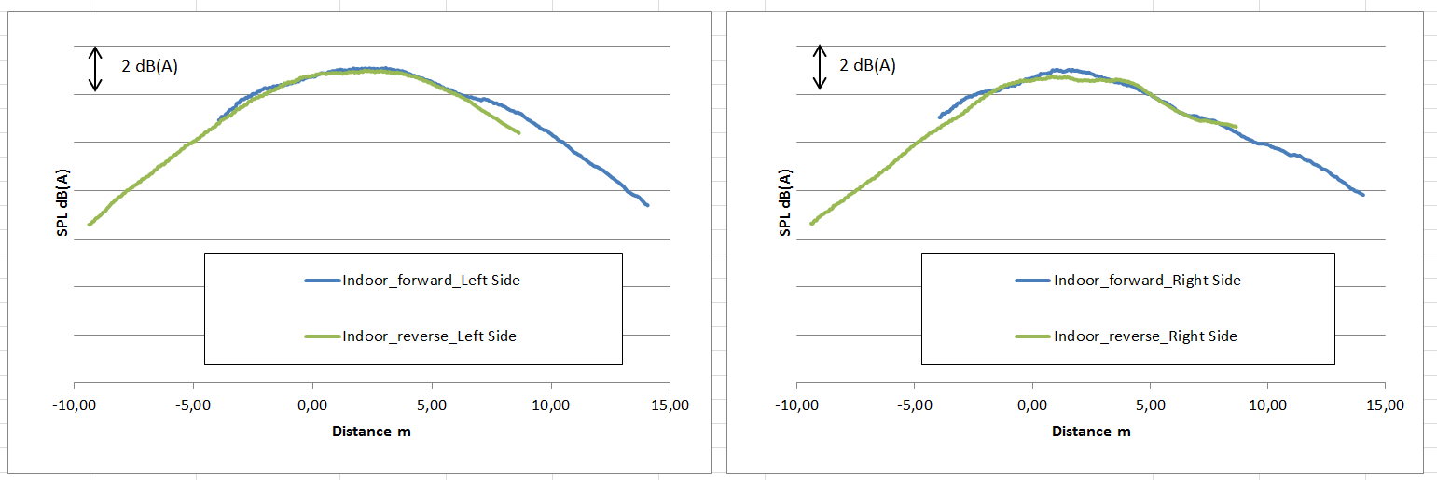
Room extension
Annex 8 §4. Adjustment of room dimensions
Indoor testing in smaller room than 25m length is able to deliver consistent results :
ex. Using both direction
ex. Using acustic’s propgation

Slide 15
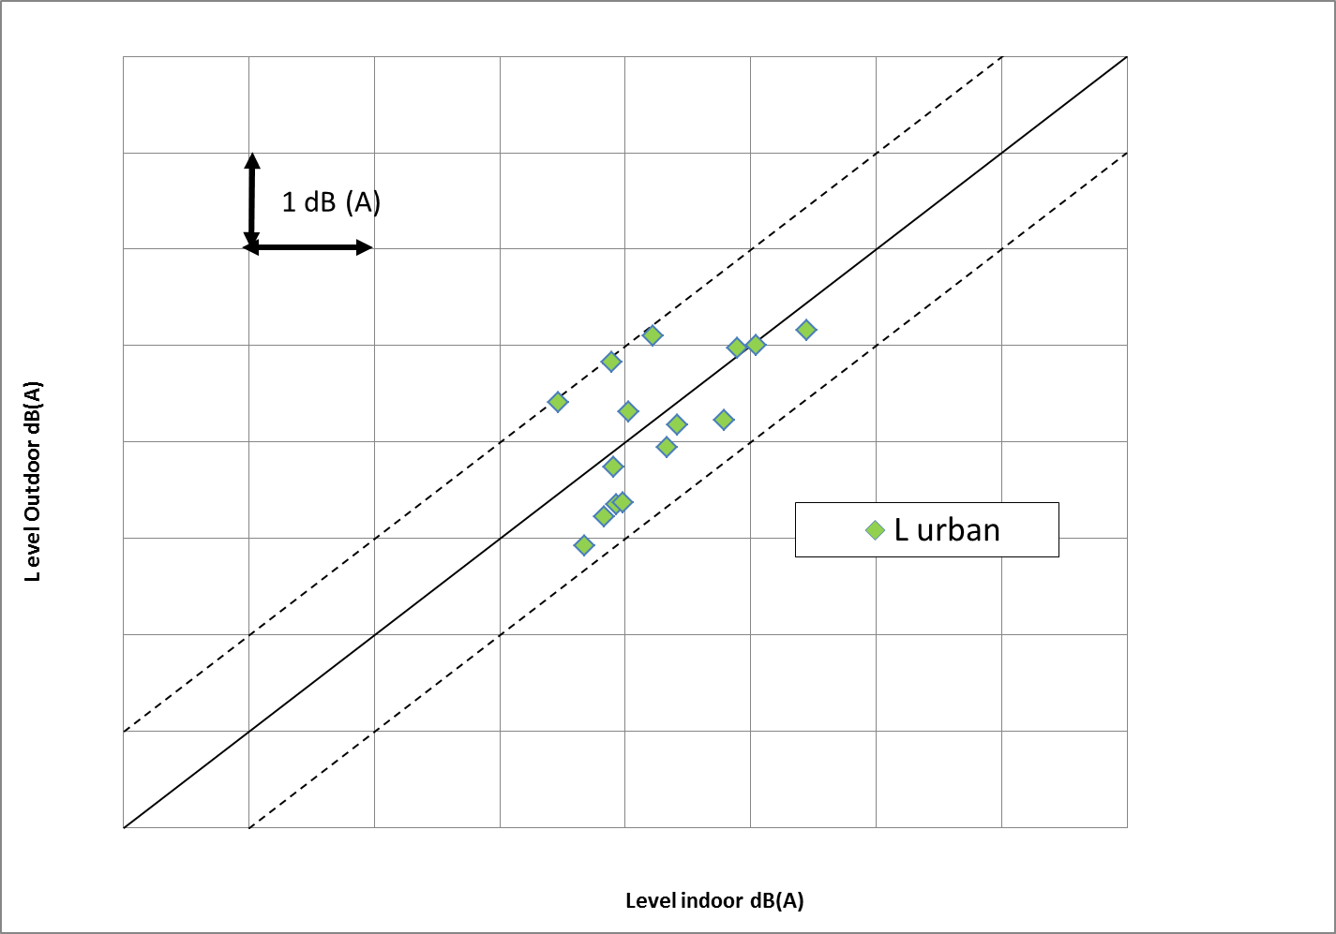
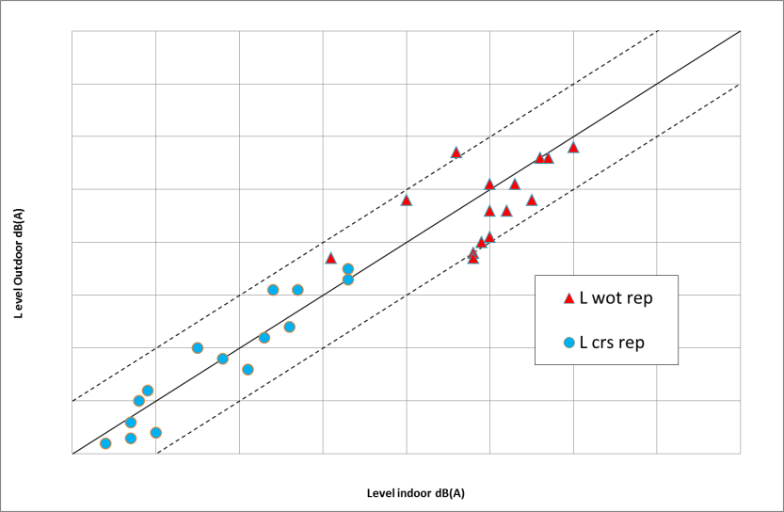
Indoor/outdoor correlations
Tests on 4 vehicles
under different testing conditions (tracks, tyres, day-to-day)
Indoor testing is able to deliver comparable results as outdoor testing within acceptable accuracy.

Slide 16
Conclusions
Indoor testing is applicable.
Specific tools permit to provide comparable behaviour as outdoor (free field, virtual sound level meter, vehicle dynamic, room lenght …).
Indoor testing is able to deliver comparable results as outdoor testing within acceptable accuracy …
… if tests procedures are defined for each facility and manufacturer’s production.
(Technical documentation).

Slide 17
Conclusions
Indoor offers several benefits compared to outdoor :
  Controlled environment conditions to perform tests without weather constraints and dispersion.
  Reproducable cycles for reliable results (several modes and set-up testing, back-to-back tests, …).
Indoor homologation is the first step to virtual homologation.

Slide 18
Thank you for attention

