Slide 1
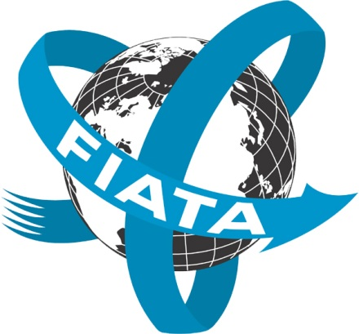
Economic Commission for Europe Inland Transport Committee Working Party on Intermodal Transport and Logistics GENEVA, SWITZERLAND 19 - 21 November 2018 René Zimmermann Manager of the FIATA WG Rail Transport
Notes:
Distinguished Delegates, Colleagues, Ladies and Gentlemen thank you all for the invitation and the opportunity to highlight the challenging role and work of FIATA in relation to rail transport
Thank you, Chairman/ Madam Chairman (choose appropriate) for your kind introduction.
First I will share with you a little of the story of FIATA, then I will spend a few minutes exploring the nature of third party cooperation with international organizations – from the perspective of an international freight forwarders’ Association.

Slide 2
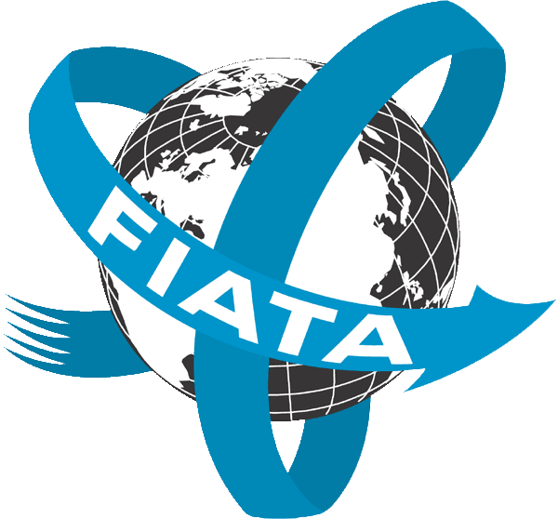
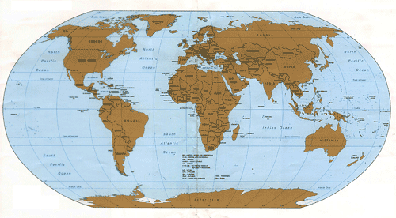
FIATA
108 Association Members in 97 countries
6287 direct Individual Members in 162 countries

Slide 3
Cooperation between FIATA and other railway-related organizations

Slide 4
Collaboration between FIATA and UIC
FIATA’s activity in rail transportation
Market Place Seminar
Concept of the Market Place Seminar
In September 2017 the last Market Place Seminar took place in Duisburg / Germany
Notes:
FIATA is highly committed to rail transport and offers several discussion panels to interested Members and Railway Organisations. Therefore, the FIATA Working Group Rail transport deals with all railway issues and the impact of international organizations, governments, and transport operators thereon, all of which affect the freight forwarding industry.
The Market place was created to get a broader vision about the prospective of railway transportation in order to exchange and discuss the latest trends and developments .
Business: no discussion on prices but on business opportunities
Networking
1 ‘marketplace’ event (first one to take place on 30-31 October 2008 in Prague)
The 8th MPS Seminar took place in Duisburg / Germany in September 2017. It was well attend by Freight Forwarders, Railway, Customers, Terminal operators and other service providers in conjunction to rail transportation. The discussed topics under the title “"Inland Hubs: key towards rail freight corridor development” were:
Transcontinental corridors myth or reality for business development?
Connecting land-locked regions
Accessibility of Freight Corridors
Paperless, on-line and real time
In the meantime this format is one of the most interesting events that FIATA organises.

Slide 5
Collaboration between FIATA and UIC
Eurasian Rail Link
Less customs barriers in Eastern Europe, more corridinated connection between rail and road, sea, air
Reason why FIATA is strengtening its ties with UIC
Next Market Place Seminar will take place in 2019
Notes:
Over the recent years, rail traffic between China and Europe has become more popular. Urumqi has been developed as the Chinese platform for this rail traffic. A maximum of 5% of the Chinese exports to Europe can be transported by this route (capacity, transport prices etc.) therefore it still must be seen as a growing and important niche market. For the time being 0.5% of the goods flowing between Asia and Europe are transported by rail. The available potential is huge.
Slow-steaming exercise by shipping lines , easing of customs barriers in Eastern Europe, and the shift of Chinese production to inland places have all increased the attractiveness of rail solutions from China into Eastern Europe via Russia or the ancient Silk Road through Kazakhstan.
The Eurasian rail connection may attract in additional advisors from the railway side. This situation appears both attractive and complex, with a number of questions that remain open on the table and could become the object of the Rail WG’s deliberations.
There are some reasons why FIATA considered strengthening its ties with the UIC:
• Rail transport is the modality which nowadays is seeing huge investments to increase capacity worldwide.
• It is difficult for Small and Medium-sized Enterprises to approach rail transport.
• Rail Transport has smallest impact on the environment and it is more sustainable
Next Market Place Seminar is under discussion with UIC

Slide 6
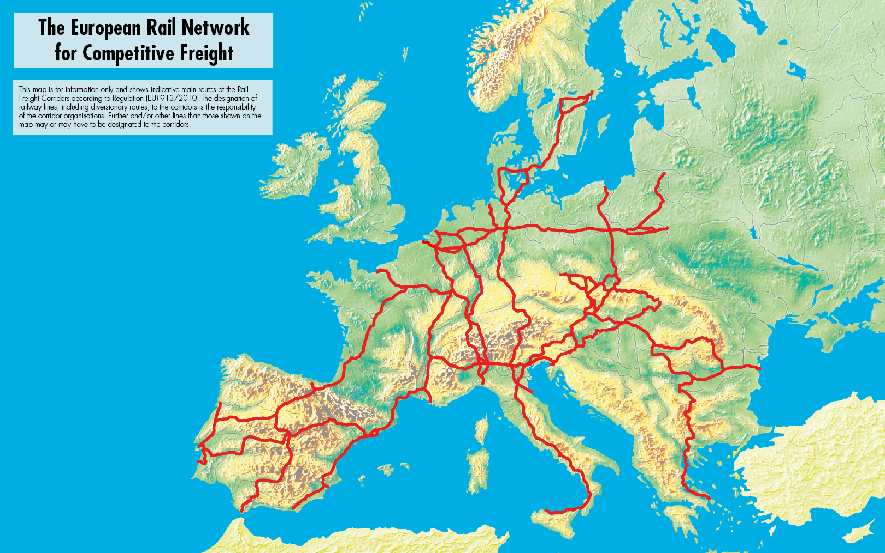
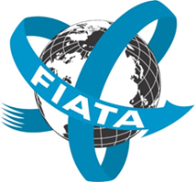
Nine Rail Freight Corridors
Notes:
The European Rail Network for competitive freight is also a important topic which was also a discussing point between FIATA and UIC representatives.

Slide 7
Collaboration between FIATA and OSJD
Organisation for Cooperation of Railways (OSJD) and the International Federation of Freight Forwarders Association (FIATA) have signed a memorandum of cooperation two years ago at the FIATA World Congress in Dublin, Ireland
OSJD and FIATA have agreed to enlarge their cooperation, in particular in the following areas:
*Establishment of a joint working group OSJD/FIATA
*Joint organisation of workshops and conferences

Slide 8
FIATA/OSJD Meetings
FIATA and OSJD held its 2nd joint seminar on Combined Transport on the 11 and 12 July in Istanbul, Turkey
Under the theme “New possibilities of Europe – Asia – Europe multimodal transportation”, delegated discussed the critical aspects for development of Asia-Europe transport corridors, namely political support, unification of trade laws and trade facilitation, challenges and best practices.

Slide 9
FIATA/OSJD Meetings
Oberservations from the meetings:
Bottlenecks on rail transport have been broadly acknowledged, need to increase actions on the remaining bottlenecks by both industry and governments.
Governments should take active actions on rail infrastructure construction, coordination of administrative policies on national, regional and international levels.

Slide 10
FIATA/OSJD Meetings
The meeting was hosted by the UTIKAD the Turkish Association member of FIATA and attracted 55 participants from 18 countries.
OSJD, an inter-government organization, makes great efforts on the development of Europe-Asia international railway and combined transportations.
OSJD plays a critical part in shaping transport policy and strategy, improving documents and managing international railways tariffs among countries.

Slide 11
OSJD Railway Corridors
O
Notes:
There are 13 OSJD corridors linking Europe and Asia, 6 of them overlapping with EU Rail Freight Corridors (RFCs 5 to 9). The recent new initiatives, e.g. from China to Spain, show that there is even potential cooperation possible between corridors that do not necessarily reach external EU borders. The seminar focused on the concept and developments of OSJD corridors, including technical aspects, as well as case studies of existing trains between Europe and China and the related challenges and expectations. The goal of the seminar was to facilitate the establishment of first contacts between EU RFCs and OSJD corridors.

Slide 12
Expectations EU - OSJD Corridors
Short – medium term
Exchange of best practices with all countries/Member States on the corridor
Improving quality and reliability on international freight services
Improved operational performance
Better train handling procedures and reducing red tape, speeding up customs, reduced border constraints
Improved information en-route
Notes:
Improving operational performance: The impact of a delay to a train can often be amplified
when the train moves into successive countries, as it is difficult to incorporate a late train from
another jurisdiction into national timetables.
• Improved information en-route: There is currently a lack of information available to
customers about the whereabouts and expected arrival time of goods being transported by rail
when compared to other modes. Stakeholders have suggested that establishment of a corridor
may improve this.
• Reducing border constraints: Currently there is often a requirement to change drivers and/or
wagons at the borders between countries, therefore imposing both time and cost into the rail
product that is offered to freight customers. Stakeholders have suggested that establishment of
a corridor may reduce the need for this.

Slide 13
Development in railway freight and legislation

Slide 14
Priorities to strengthen rail freight
Improve service quality
Promote competition, by strengthening core competencies
Promote multi-modal transport – strengthening combined transport
Adapt infrastructure to the needs of freight transport
Adapt and increase flexibility of cost structures
Actors of the rail transport system need to co-operate and strengthen their network
Remove operative differentiation of rail freight
Cut back on bureaucracy – simplify language requirements
Promote Innovation
Improve Education

Slide 15
Development in Europe-China block train
A total of 6,300 block trains, westbound and eastbound combined, travelled between the two continents between 2011 and 2017. Of that number 3,200 trains travelled in 2017.
Volume doubled from 2015 to 2017 to more than 317,000 TEU.
Delay caused by border congestion, imbalanced transport for westbound and eastbound, lack of coordinated border management remain challenges.

Slide 16
Development in unification of international railway law
Currently, OTIF-CIM and OSJD-SMGS are the two main legal regimes for international railway law. The two regulations are very different, especially in terms of legal basis for and scope of carrier’s liability.
Some SMGS countries have joined or partially joined CIM, but not all.
Notes:
Asian and European countries could make their cargo transportation through North-South Corridor with double speed compared to Suez channel,
Carriage cost is 30% less, Transit 40% Shorter
A few countries exist along the route therefore (less border crossings and easier for the countries to reach agreements),

Slide 17
Development in unification of international railway law
CIM/SMGS Consignment Note is a practical way to unify the formats of consignment notes under CIM and SMGS, to save operation time and costs
UNECE currently has a Group of Experts towards Unified Railway Law (URL), which has already made a draft URL. Some other railway companies like DB and RZD are trying to conduct some pilots under the URL. But the way to make URL a regional or international convention is not clear yet.

Slide 18
New Developments
International North South Transport Corridor
Notes:
Asian and European countries could make their cargo transportation through North-South Corridor with double speed compared to Suez channel,
Carriage cost is 30% less, Transit 40% Shorter
A few countries exist along the route therefore (less border crossings and easier for the countries to reach agreements),

Slide 19
OPERATIONAL CHALLENGES
LACK OF LOGISTICS PARTNERS PARTICIPATION
AVAILABILITY OF CONTAINERS & RETURN CARGO
RAIL/ TRANSPORT SERVICE PROVIDERS AT RUSSIA CASPIAN SEA
SANCTIONS AGAINST IRAN
MISSING RAIL LINK AT THE IRANIAN BORDER TO AZERBIJAN

Slide 20
FUTURE CONNECTIVITY

Slide 21
Use of FIATA Bills of Lading as multimodal transport document
Negotiable FIATA Multimodal Transport Bill of Lading (FBL) is a carrier-type transport document set up by FIATA for the use of freight forwarders acting as Multimodal Transport Operators.
It can also be issued as a marine bill of lading.
It has been deemed by International Chamber of Commerce to be in conformity with UNCTAD/ICC Rules for Multimodal Transport Documents and therefore bears ICC logo alongside the symbol of relevant freight forwarders association by country or territory.

Slide 22
Use of FIATA Bills of Lading as multimodal transport document
FBL also conforms to “Guide for the Uniform Customs and Practice for Documentary Credits (UCP 600)” of ICC when issued as multimodal transport document in line with Art. 19 or as bills of lading as Art. 20, as an acceptable transport document.
FBL is suitable to be used by freight forwarders for end-to-end transport when they are responsible for the performance of the transport.
Freight forwarders can apply to authorized FIATA Association Members for use of FBL and other FIATA documents. More information can be found on https://fiata.com/about-fiata/fiata-documents.html or info@fiata.com

Slide 23
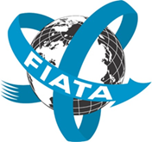
THANK YOU FOR YOUR KIND ATTENTION
Notes:
I kindly encourage you to attend one of our regular meetings and/or to participate in UIC/FIATA Market Place Seminar

