Slide 1
WP24 Intermodal Transport and Logistics 21 November 2018
Proposal for amendment of
Combined Transport Directive
COM(2017)648 final

Slide 2
Importance of multimodal transport
Intra-EU freight transport
Reduce GHG emissions
20% of all EU CO₂ emissions and 73% of all transport CO₂ emissions are from road
Improve safety
Every day, 70 people die and 370 are injured in road accidents
Better air quality
430.000 premature death each year from air pollution
Effective use of the whole transport network
Congestion cost 1,1% of GDP
Notes:
While there has been considerable CT growth since 1992 at 3,5% per annum, road still makes up half of intra-EU freight transport, because the total need for transport has grown faster than intermodal transport.
Road transport makes up ca 20% of total CO2 emissions in EU and 73% of total CO2 emissions from transport.
Every day 70 people die of road accidents and 370 are injured (26000 and 135000 respectivly a year, covers all road transport)
While emissions can be reduces also by other means, accidents and road congestion (and related air problems) can only be reduced by reducing the road transport.
But as intermodal transport grows faster than road, there still has been shift away from road saving in one year on "external cost" €2.1 billion (2011)
This means that by using intermodal transport instead of long distance road only transport, we can save on each container ca 225€ of external costs on average (average full – 25t, length average intermodal operation length - 640km; 35€ per 100 km).
Reduction of negative externalities – major policy aim for Commission
Mix of policy measures
Low-emission vehicles and low emission alternative energy for transport
Increase efficiency of each transport mode and of systems (incl through digitalisation)
Support the modal shift from road to other modes of transport
Combined Transport Directive is the only dedicated legal instrument to support modal shift in freight transport
Policy objective of reducing negative externalities and inter alia making transport more sustainable have been highlighted in series of policy documents, e.g. 2011 White Paper, 2015 Paris Agreement on Climate Change, 2016 Low Emission Mobility Strategy. The Clean Mobility Package of 2017 proposes several measures to support this goal. These measures supplement the already existing measures as the evaluations carried out by the COM show that EU will need to do more to achieve the desired results.
As regards the modal shift, the evaluation shows that EU will not reach its target of shifting 30% of long distance road transport to non-road by 2030 unless more is done and thus will not achieve the targets of reducing negative externalities related to modal shift. A gap of 52 bn tkm is predicted. This is the main objecitve of the amendment of the combined transport directive.
The EP acknowledged already in 2015 that the EU modal shift policy did not yet deliver satisfactory results and reminded that a European sustainable mobility policy needs to build on a broad range of policy tools to shift towards the least polluting and most energy-efficient modes of transport in a cost-efficient manner.
The Parliament also pointed out in 2017 that combined transport needs to be strengthened and asked the Commission for clear, modern and comprehensible rules that can be implemented by the authorities. In the context of reducing interoperability constraints, the Parliament highlighted the need to incentivise the availability of soft, multi-operable infrastructure and rolling stock solutions to support multimodal and combined transport.
Parliament specifically called on the Commission to revise the Combined Transport Directive to increase multimodal transport, eliminate unfair practices and ensure compliance with the social legislation relating to combined transport.

Slide 3
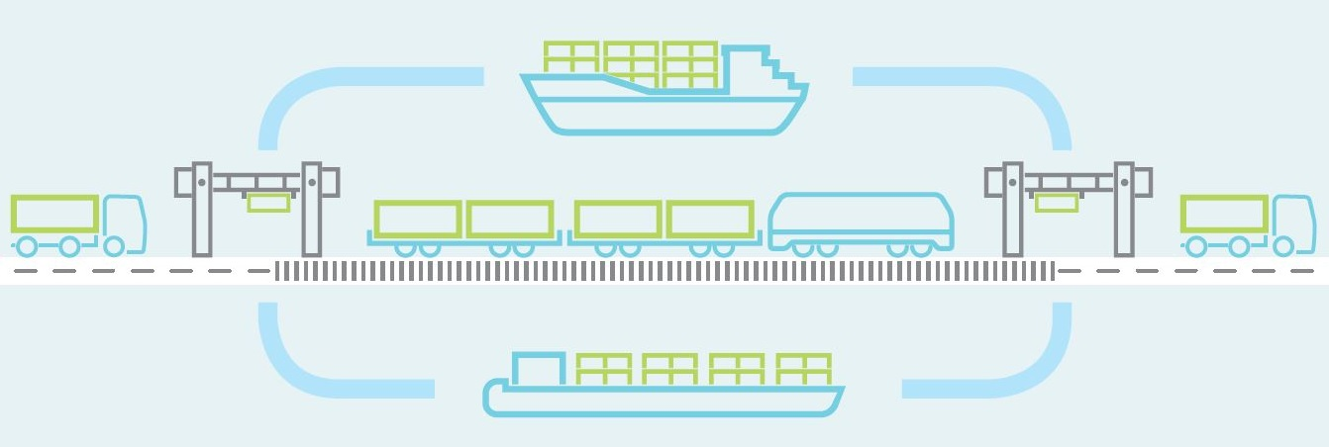
What is combined transport?
A type of intermodal transport of goods with short road leg(s) and the main part by rail, inland waterways or short sea shipping
Notes:
Combined transport is a type of multimodal transport of goods where
the major part of transport is carried out by rail, inland waterways or short sea shipping which
is served (fed) by a short road leg or legs in the beginning and/or end of the transport chain

Slide 4
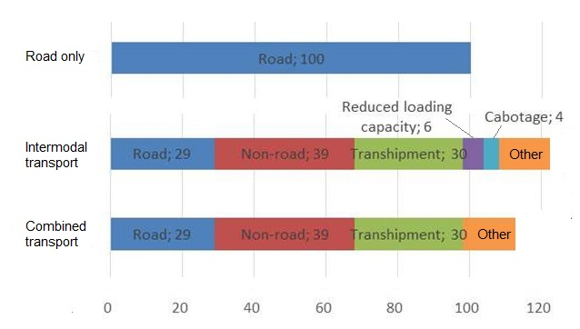
Why has Combined Transport not flourished?
But there cannot be any intermodal transport if no terminals are available!
Notes:
(based on medium to long rail-road transport)
Road transport is simply cheaper, quicker, more flexible and so much easier to arrange. Shifting to intermodal makes today only sense on very long distances or countries with support measures. It takes time and effort to arrange the shift to CT. However, any small negative developemt affecting CT means reverse shift back to road over night.
Without EU law, the cost difference between road only and intermodal transport is 23%
With EU law (CTD, W&D), cost difference is 13% (5-6% benenfit from W&D and 4-5 from CTD (3-4% cabotage and up to 1% from economic support)
It's a miracle it has shifted at all – actually, it only shifts only on long distances, where the cheaper ton-km price of non-road leg weight out the cost of transhipments and delays and additional administrative costs

Slide 5
Main goals of the amendment
Maintain the main benefits
Any removal of benefits may result in reverse modal shift, i.e. shift back to long distance road transport
Clarify the definition
Facilitate enforcement
Enable digitalisation
Update incentives

Slide 6
Clarify the definition
A major aim for amendment was to provide a definition that easier to implement
Current definition causes problems to industry and authorities due to ambiguous language
New definition applies to all combinations same way
New definition covers also national CT
No limit for non-road leg, but connections that do not bring along modal shift are excluded
Road leg is limited to a radius of 150km, or where no terminal exists in this distance and the non-road leg is more than 450 km, to 20% of total operation distance in EU
In certain areas MS may authorise to do longer road legs if no terminals are available in above distances
Notes:
The definition used in current Directive has caused a lot of troubles both for authorities as well for industry due to its ambiguity. The aim is to clarify the definition.
Problematic were "nearest suitable" and number of road legs (1 or 2), as well as different rules for rail and waterborne CT
Current Directive does not foresee any effective measures for proving the eligibility of the special regime applicable for the road legs which creates a loophole for circumvention of cabotage and social rules of road transport. The proposal establishes very detailed conditions proving the eligibility of operations in form of for pre-established documents to be checked at road side on paper or electronically, thus helping to solve the problem of circumvention.

Slide 7
Ensure effective control of eligibility
Establish effective requirements that allow proof of eligibility in order to avoid circumvention
Information required currently does not allow to establish eligibility
Proposal establishes detailed list of data that proves that an operation is a CT operation. This data can be checked at roadside checks to distinguish CT from other road operations
Makes is mandatory for Member States to accept digital proof
ISO/ILU identification ensures that load unit on a truck is the same as in transport documents
Notes:
Current Directive does not foresee any effective measures for proving the eligibility of the special regime applicable for the road legs which creates a loophole for circumvention of cabotage and social rules of road transport. The proposal establishes very detailed conditions proving the eligibility of operations in form of for pre-established documents to be checked at road side on paper or electronically, thus helping to solve the problem of circumvention.
General rules on providing transport data digitally will be established in a proposal to be adopted in May 2018.

Slide 8
Provide adequate incentives
Investment support for transhipment terminals
Obligation for MS to take measures
Goal for terminal density
Allows additional economic support
MS may provide suitable operational support
MS have to review the support given every 4 years and amend as needed
Improves monitoring and review
Notes:
An obligation is foreseen for MS to take measures to support terminal building and capacity increasing where necessary. The long term aim is to have everywhere in EU (where transport demand exists) the possibility to carry out short road leg (max 150km) CT operations.
MS may also use other support measures for CT, but should review these every 4 years and amend as appropirate.
An improved reporting and cooperation is also foreseen to allow for better assessment of success (or lack thereof).

Slide 9
Assessed impact of the proposal
Intermodal operations in EU covered | 72.7%
Increase of price competitiveness vis-a-vis road transport (cost reduction) | 16.6%
Benefit to industry (annual) in EU | 7.18 bn euros
Budgetary implications (annual, all MS combined) | 0.33 bn euros
Increase of modal shift due to CTD amendment (on top of baseline growth) by 2030 | 69.6 bn tkm
 | 8.55 percentage points
2030 modal shift target of 30% achieved | YES
External cost saving through additional modal shift (2022-2030) | 1.63 billion euros
Notes:
Current Directive covers only 42% of intermodal operations. Main increase comes from covering national CT as well as some from shorter IWW and SSS with longer road legs than 150 km acf (up to 20%).
The 16,6% increase in price competitiveness as compared for intermodal operations that currently do not benefit from CTD or are new means that the price difference is instead of 23% now 6,36%
Benefit to industry derives from reduced costs (97,8%) and direct subsidies 2,23%
Budgetary implications come from direct operational support (59,5%) and some direct investment support 40%. These costs are not distributed evenly between years as investment takes time. Some reduction of budgetary costs is also counted in from use of electronic proof.
For modal shift from combined transport in 2030 is expected to be 319 bn tkm (total CT is bigger as road legs are not counted into modal shift). Based on 2005 data (as 2011 White Paper was based on that data), the modal shift target is considered to be by our economists 301 bn tkm

Slide 10
Thank you for your attention
Notes:
Defensive on cabotage:
The CTD amendment is closely coordinated with other proposals including those on road transport in Mobility Package 1.
This proposal does not amend the Article 4 of the CTD and thus the legal relation to cabotage remains the unchanged. The extension of scope of Directive to national CT does not change the scope of Art 4 which itself is clearly limited to on CT between MS. Thus road legs of national CT are subject to cabotage rules.
However, in practical terms, the considerably improved enforcement conditions allow the authorities to control that indeed a truck is doing a pre-established combined transport operation falling under this directive and not trying to circumvent cabotage rules. Most complains as regards received relate to circumvention and not to legal CT operations.
As road legs of CT are by definition short, and the cabotage exemption applies on to international operations, the share of road legs possibily benefiting from the "cabotage exemption" is minor, estimated at 0,3% of road transport (1/3 of CT operations consider using Art 4 in 1/3 of cases)
Defencive on social rules:
The social rules applying to transport apply to the combined transport. The lex specialis for social rules including rules on posted workers are currently separately amended (2006/22/EC).
For purely national CT all rules applicable to cabotage apply.
For international CT rules applying to international road transport apply even if road leg does not cross border. This is because according to the EUCJ, the road legs of a CT operation cannot be considered separate operations.

