Slide 1
Ministero delle Infrastrutture e dei Trasporti
DIREZIONE GENERALE PER IL TRASPORTO STRADALE E L’INTERMODALITA’
Incentives for an intra European modal shift toward a better use of short shipping routes.
An Italian already started experience :
the Marebonus.
Massimo Costa
Geneva 20 November 2018

Slide 2
The Marebonus incentive
With the Decision C(2016) 8459 19 December 2016 - SA.44628 (2016/N), the European Commission approved the ‘Marebonus’ - scheme as an instrument to incentive the supply short sea shipping involving both shipowners and haulers.
Budget
MAREBONUS BUDGET ALLOCATED : 128 M euro

Slide 3
Legal Basis
The legal basis for the measure has been identified in Art. 1, paragraph 647 of Law n. 208/2015 (Italian Financial Act of 2016). The Italian Government provided financial resources in favor of enterprises that use the short sea shipping services, with main aims:
to encourage the freight modal shift from road to sea and short sea shipping transport through public financial support.
to support new maritime services and the upgrade of existing maritime services for combined freight transport connecting ports in Italy or in the Member States of the European Union or in the European Economic Area.

Slide 4
Objectives
Rebalance the freight transportation system by developing multimodal shipping/road transportation, by compensating the obtained difference of external costs avoiding road transportation, as an economic benefit of the final users;
Reduce the social costs of mobility, reduce environmental pollution, decongest the roadway chain and increase safety of circulation;
Encourage the road haulage to make the best possible use of shipping routes;
Stimulate the activation of intermodal services and improve the offer of the existing maritime services, to consolidate and stabilize the results obtained through the previous initiatives (Ecobonus in particular).

Slide 5
Expected Results
According to a conservative estimate an annual saving of externalities goes over 260 million euro, subtracting each year from road network an equivalent in cargo units of more than 800,000 trucks, amounting to nearly 650 million vehicles / km transported, with a total length of more than 16 million linear meters used for freight in the new or improved maritime services.
1.1 Bill. in terms of
potentially subtracted Km from road
9% from new maritime services
5% in terms of increase that can be generated by the improvement of existing services
1.6 Mil. in terms of loaded units
11% from new maritime services
5% in terms of increase that can be generated by the improvement of existing services
52 projects
11 new maritime services
41 improvement of existing services

Slide 6
Beneficiaries
The shipowners companies, also in form of consortia or through special agreement, based in one of the European Union or the European Economic Area, which submit three-year projects for the improvement of new shipping services Ro-Ro and Ro-Pax for multimodal transport of goods or improvement of the services on existing routes, arriving and departing from ports in Italy, connecting ports situated in Italy or in other EU Member States or the European Economic Area.
Mechanism
The incentive may vary until an established maximum of 10 euro cents per embarked units for any kilometer of road avoided.
Eligible routes and distances in kilometers of road avoided are contained in an implementing decree issued after the ministerial decree.

Slide 7
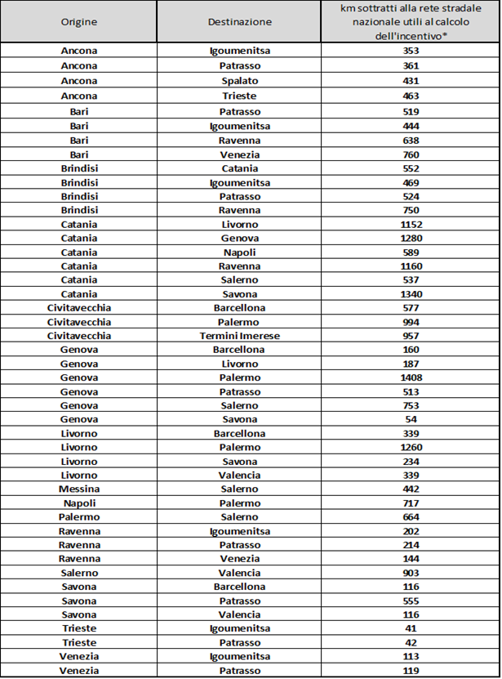
Eligible Routes
The Marebonus decree has identified the eligible routes that contribute for the upgrade of services on existing routes, showing Origin, Destination and Road journeys avoided on national network (in km).
In case of projects related to the creation of combined transport services along new routes, the number of kilometres avoided on the road network for the subsidy calculation has to be quantified by taking into account the road route avoided on the national territory between the port of origin and the port of destination.

Slide 8
Eligible Projects
1) Creation of new maritime services for multimodal freight Transport.
2) Upgrade of existing maritime services for multimodal freight transport.
In this case the aid will be granted for projects that meet at least four initiatives from at least two of the following activities:
Reduction of the shipping line’s environmental impact through the reduction of emissions per load unit;
Sustainable reduction of time frames for the overall intermodal chain;
Improvement of ground services for embarking and disembarking of vehicles;
Greater frequency of shipping line services;
Improvement of on-board services during navigation, including the reception services for the driving personnel;
Implementation of ITS technologies;
Empowerment of safety and security levels;
Offer of increased cargo-hold capacity.

Slide 9
Main Requirements
1) Maritime services have to be regular and frequent and they cannot be seasonal services.
In case of new maritime services, shipowners shall demonstrate that the minimum hold capacity for each year of the subsidy period will be up to 100.000 linear meters;
In case of upgrading of existing maritime services, undertakings shall demonstrate to have had a mininum hold capacity in the last two years up to 100.000 linear meters at the moment of subsimission;
2) Projects should indicate the total hold capacity (per route) destined to freight transport expressed in linear metres and must maintain, on an annual basis and for the whole funding period, at least 70% of said hold capacity.

Slide 10
Eligible costs
The eligible costs under the Marebonus Scheme have been defined as the additional costs indispensable for launching new and upgraded maritime services, thus contributing to the compensation of the difference in negative externalities between road and sea transport.
Aid intensity
The aid will be limited to the 30% of operational costs of the maritime service.
In any case, the aid amount will not exceed 100% of the additional costs related to the upgrade of the service.
Max contribution = x * u * km
X = < 0,10 €
u = embarked unit of transportation
Km = kilometres avoided on the national network

Slide 11
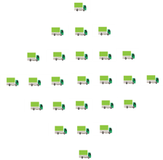
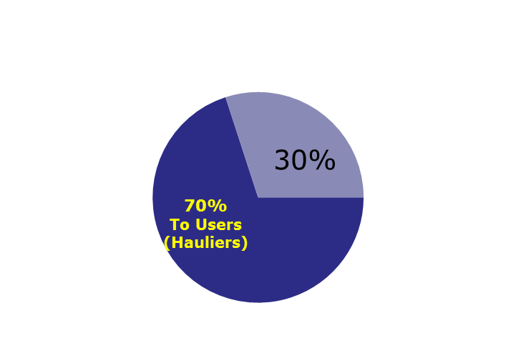
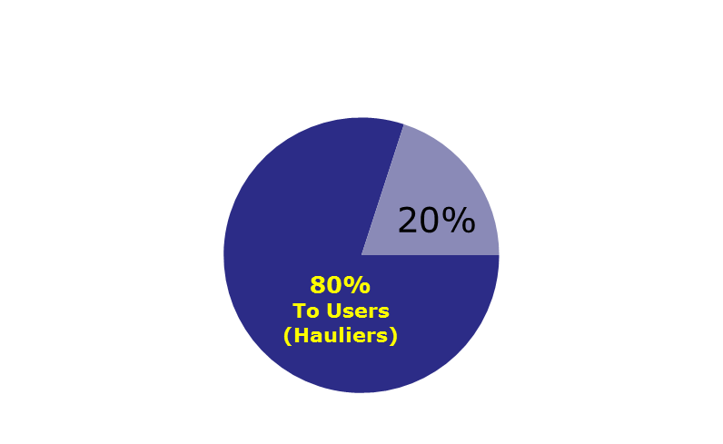
Marebonus indirect contribution sharing system
Commitment to transfer to the user of maritime services at least 70% of the aid received as discount or reimbursement
Beneficiaries (ship-owners) are obliged to allocate at least a certain percentage of the aid received each year to those of their client companies that carried a minimum threshold of vehicles embarkations on the incentivized lines per annum as shown below:
Over 4000 of vehicule embarkations
Over 150 of vehicule embarkations

Slide 12
Ministero delle Infrastrutture e dei Trasporti
DIREZIONE GENERALE PER IL TRASPORTO STRADALE E L’INTERMODALITA’
Thank You!
Geneva 20 November 2018

