Slide 1
Summit on Transport Safety and Security
José Zozaya,
President, General Manager and
Executive Representative of Kansas City Southern de México

Slide 2
Solid Logistics
Network
Skilled Human
Capital
Strategic Geographical
Position
Mexico can become
Northamerica’s logistics plataform
Notes:
Mexico has important competitive advantages that allows the country to improve its participation in international trade markets.
Strategic geographical position, with access to the most important ports and commercial regions in the world and close to the US consumer market.
High human capital that every day is more qualified and specialized.
A solid logistics network based on the high quality and efficiency of its infrastructure, ports and transport services.
The infrastructure’s development is one of the most important areas of a country's economy that directly impacts competitiveness, economic growth and employment.
Mexico has a modern infrastructure in terms of roads, railways, ports, intermodal terminals and border ports, which allows it to expand and consolidate the commercial relationship with the United States in the medium and long term.
The constant investments of the rail service concessionaires in Mexico have permitted the mobilization of goods in an efficient way, at competitive costs and with routes that facilitate the transit between industrial areas and ports or industrial cities with others.
This has allowed the development of certain regions and to improve the standard of living in places where the installation of high value-added goods production industries is encouraged.

Slide 3
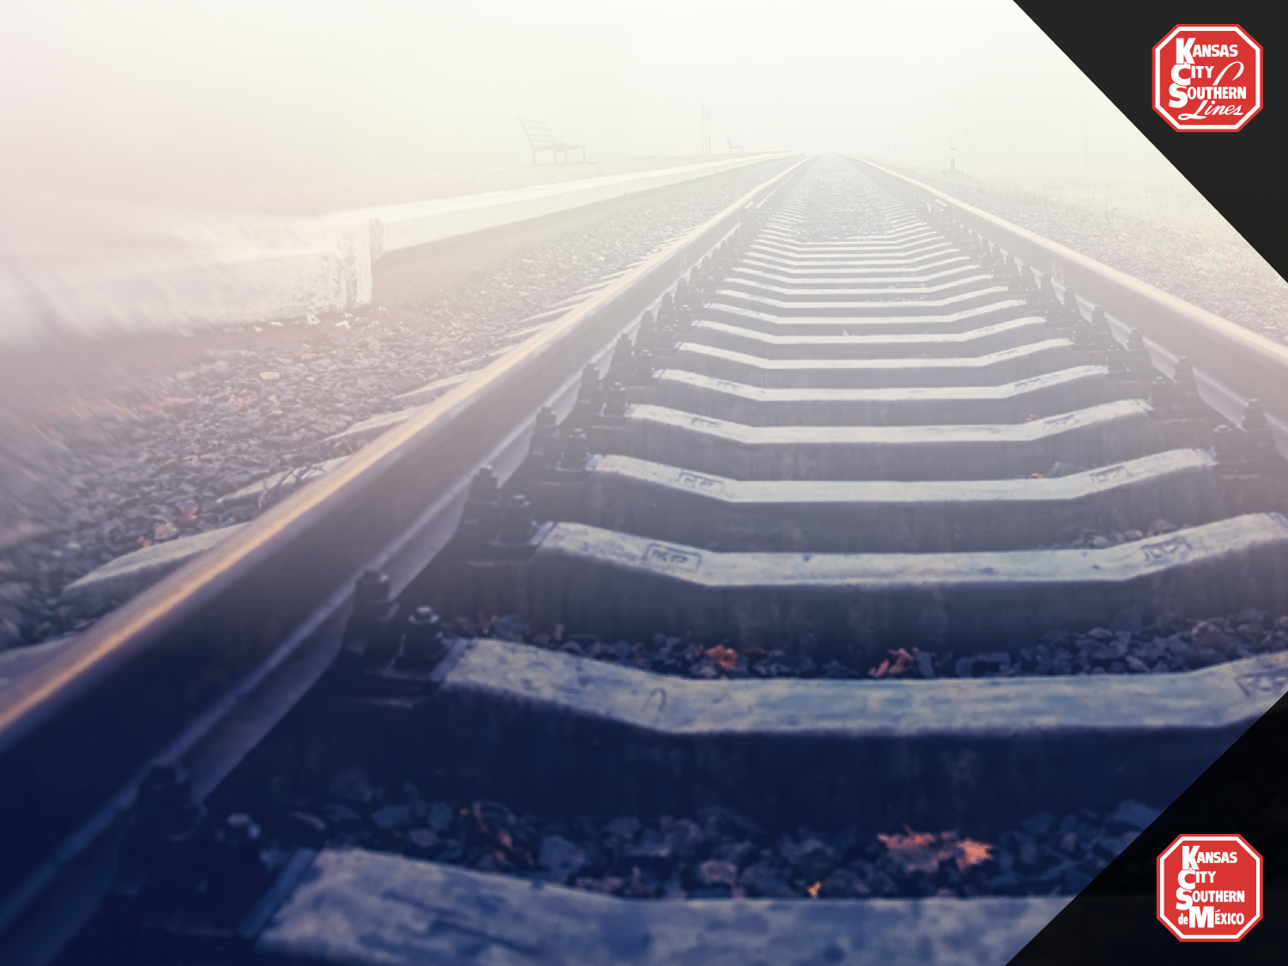
According to the
The Mexican
Rail System
Ranks as the 10th freight rail system worldwide (measured in tons - km)
Is the most productive railway system throughout Latin America
It moves more tons per kilometer than Spain, France, England and Austria’s railways together
Notes:
The railroad is a way of transport that, due to its characteristics, is considered as the ideal medium to transport safely large volume and weight cargo over long distances.
Since 1997, the Mexican Rail System is operated by private concessionaires as part of the Mexican government’s strategy that achieved the rebirth of the freight railways.
This allowed the rail system to promote commercial exchange and to reach more regions in Mexico and abroad, offering logistical advantages such as the reliability of the itineraries and the security of the chain.

Slide 4
Efficient use
of fuel and savings in the emission of greenhouse gases
Ability to transport all types of products
Traffic reduction on federal highways
Consistency in delivery times
Scale economies development
Low risk of accidents
Mexican freight rail system advantages
Notes:
The Mexican freight rail system presents a series of significant advantages and benefits, such as:
Low risk of accidents.
Efficient use of fuel and savings in the emission of greenhouse gases.
Costs’ reduction for society.
Traffic reduction on federal highways.
Consistency in delivery times.
Connection with transfer terminals in the main cities of Mexico, the United States and Canada, which allow to speed up customs procedures.
Ability to transport all types of products and to adapt to the needs of the client.
Cars with a large load capacity.
Scale economies development.
Inventories of goods in movement, which allows to reduce storage costs
The efficiency in the rail system has translated into a reduction of costs for the society and public benefits such as a reduction in traffic on federal highways and reduction in pollution.
An intermodal train can perform the work of 240 (or more) trucks.
A train with bulk cargo can carry the same as 450 (or more) trucks.

Slide 5
Environmentally safe - Reduction of the CO2 emissions
Moving freight by train instead of by truck reduces the CO2 gas emissions by 75% on average
If only 10% of the long-distance freight transported today by road will change to rail, the fuel savings would be approximately of one billion gallons per year and the annual emissions would decrease 10 million tons.
The equivalent of 2 million cars out of circulation.
The equivalent of planting about 240 million trees.

Slide 6
The Mexican Rail
System’s regulation
Notes:
At the beginning of 2017, it was created the Railroad Transport Regulatory Agency (ARTF, by its acronym in Spanish) as a decentralized body form the Ministry of Communications and Transportation.
Its main goal is to promote a safe, efficient and competitive rail system through regulation, monitoring and technical verification of the construction, operation and maintenance of the railway infrastructure.
* The North American Rail Freight Network is fully integrated. It has the same specifications across the three countries: **Infrastructure: AREMA Assoc of Railway Engineers and Maintenance of Way ** Mechanical and operations: AAR Assoc of American Railroads

Slide 7
The agency’s importance
The agency’s main goals
Increase the rail system operation’s safety, reliability and efficiency
Reduce the risks and number of accidents
Prepare railway transit studies
Ensure the effective exchange of railway equipment, interline traffic and movements
Strengthen the legal and technical framework
Notes:
Increase the safety and sustainability of the national rail system, ensure that the operation and rail services are reliable, efficient and competitive, and that they contribute to the integral rail transport system development.
Implement actions and programs to reduce the risks and the number of accidents in the Mexican Rail System.
Strengthen the legal and technical framework of the rail service, in order to give certainty to concessionaires.
Prepare railway transit studies design to evaluate the capacity and efficiency of the railway system, as well as issue norms and guidelines that promote an increase in service standards.
Guarantee the railways’ interconnection when they are general means of communication and regulate the logistics of the railway system and its multimodal operation.
Ensure that the interconnection services established in the Concession Securities, allow the effective exchange of railway equipment, interline traffic and movements.

Slide 8
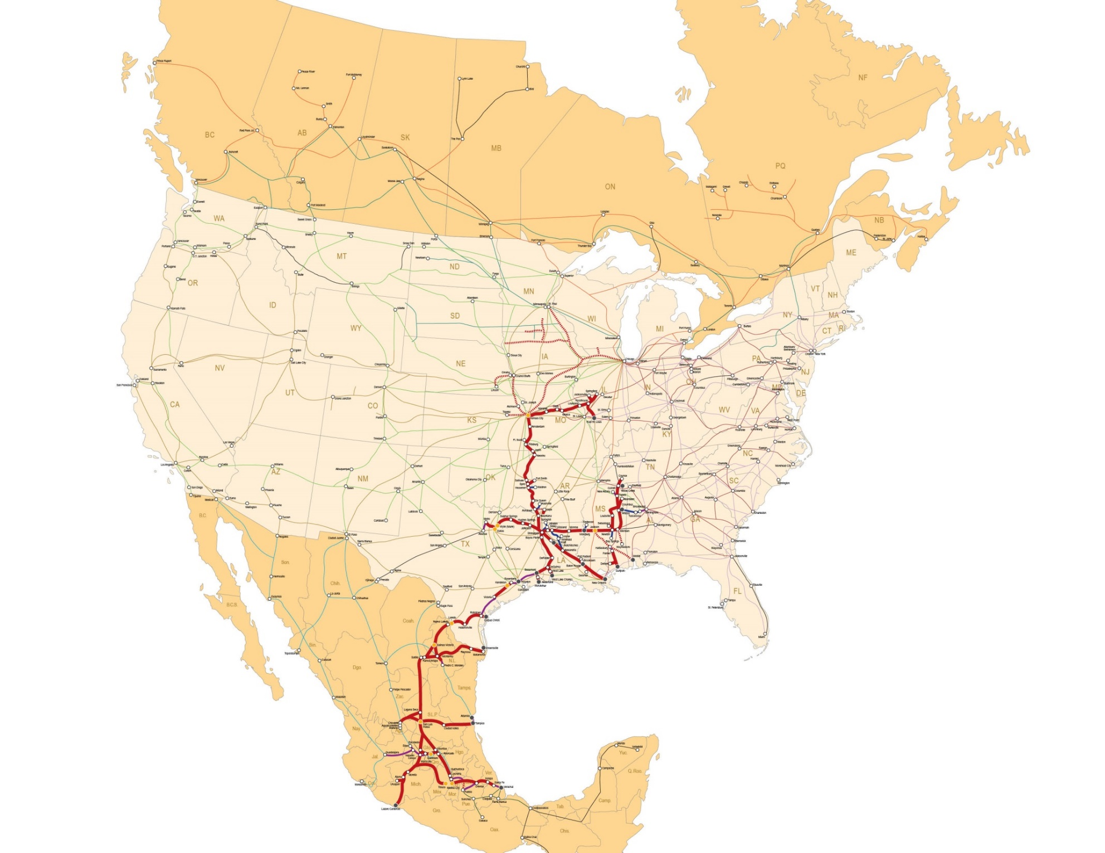
Kansas City Southern de México
©2015 Kansas City Southern
Notes:
KCSM is one of the three trunk lines of the Mexican railway system. It has a 4,251 kilometers net and moves more than 30% of Mexico’s rail freight.
It provides a direct connection between the U.S. and logistics centers in Mexico, crossing the international bridges in Nuevo Laredo / Laredo and Matamoros / Brownsville.
By strengthening the north-south flow of goods and the infrastructure, such as intermodal facilities, the railway system is now in a better position to receive and move the flow of goods between Asia and America.
It is because of this vision that we have established an efficient supply chain based on a well-defined KCS-KCSM railway network that strengthens the north-south scope and at the same time is capable of serving the trade flows coming from Asia.
Furthermore, this commercial flow growth coming from Asia represents a great opportunity for Mexico and we are glad to offer a cost efficient way of taking advantage of this trade.
Our International Intermodal Corridor begins in Lazaro Cardenas and runs throughout 15 States in Central and Northeastern regions of Mexico, connecting the main industrial areas of the country with the rest of North America. It allows us to interconnect the Port of Lazaro Cardenas with the most important cities of both countries. Our railroad crosses, with strategic terminals at the ports of Lazaro Cardenas, Tampico / Altamira and Veracruz.
Thanks to the port’s location, freight can be transported to15 ports in Asia.
It also serves 10 ports in South America, which allows having a very broad international market.

Slide 9
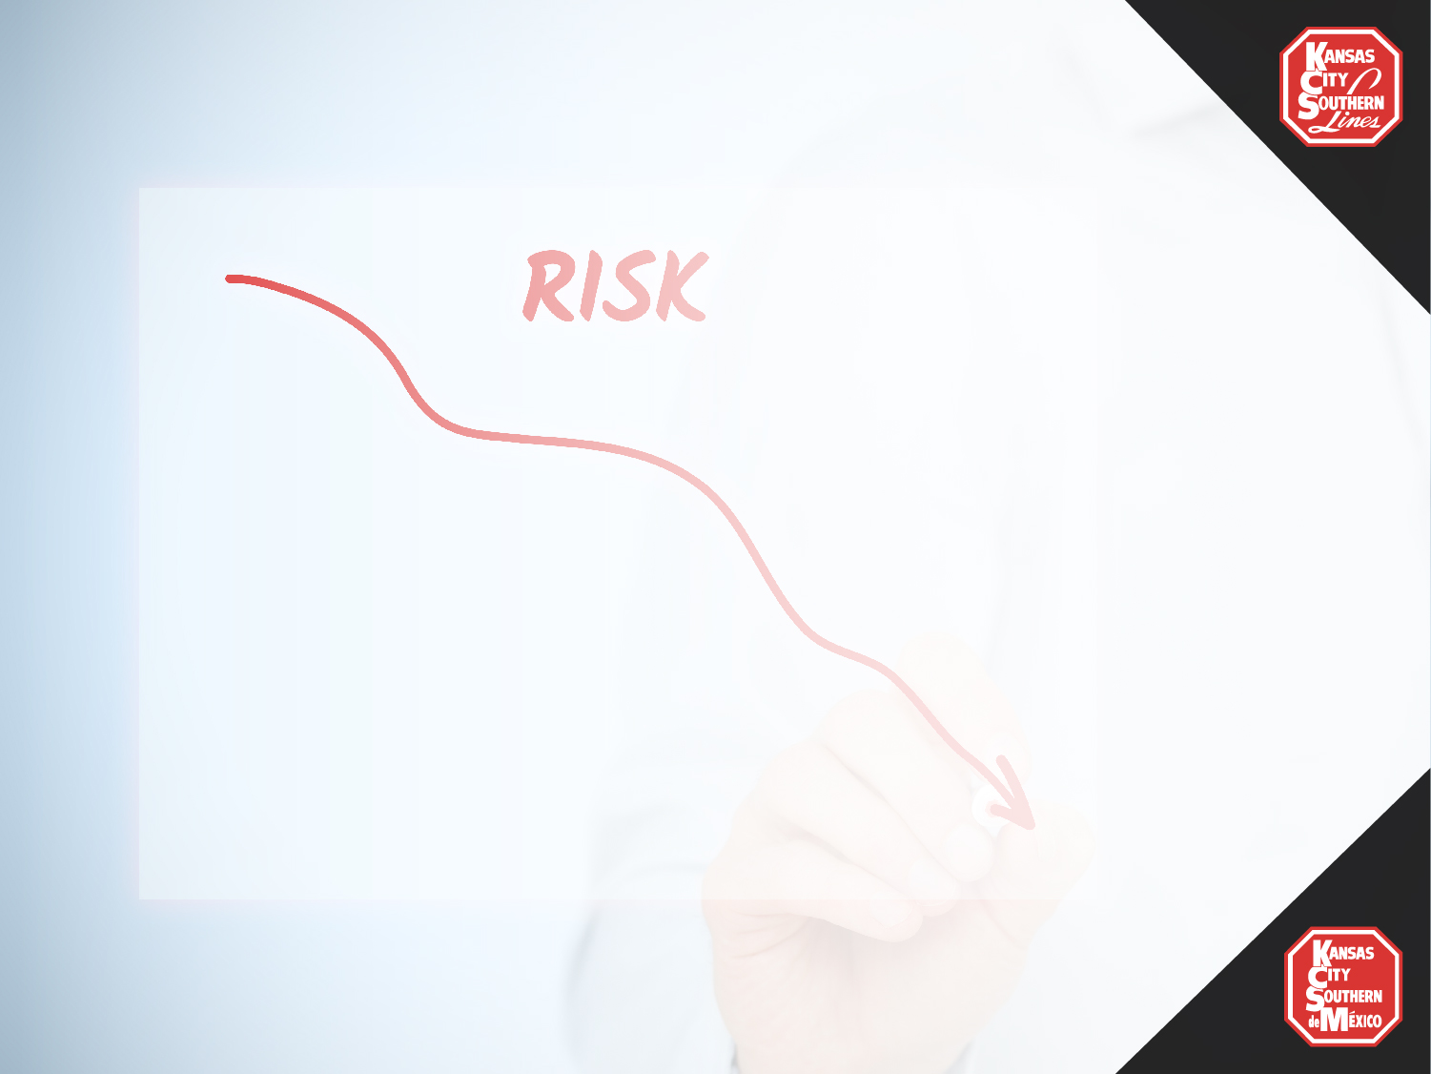
2018 Risks evaluation
Potential threats
Assets in danger
Impact
Drug crossing at border
Inmigrants
Thefts
Vandalisms
Angular closure
Derails
Winding (vehicle - person)
Organized Crime
Rails blockage
Field staff
Infrastructure (buildings and properties of the company)
Systems and technology equipment
Environment
Lowest staffing
Property damage
Business interruption
Loss of clients
Financial loss
Environmental pollution
Lack of trust in the organization
Fines and penalties
Legal discussions
Problems’ identification
Vulnerability
Impact analisys
Notes:
During 2017, the Railroad Transport Regulatory Agency has registered 305 incidents, 720 thefts and 1,245 vandalism incidents throughout the Mexican Rail System.
There were concerns regarding the drugs’ shipment by train, nevertheless the concessionaries of the Mexican rail system have implemented different measures in order to avoid that this way of transportation to be used by the drug cartels.
For KCSM, the safety of the good we ship is a priority, therefore in order to ensure a safe and risk-free shipments in the United States, we work closely with local and state police to eradicate the problems mentioned above.

Slide 10
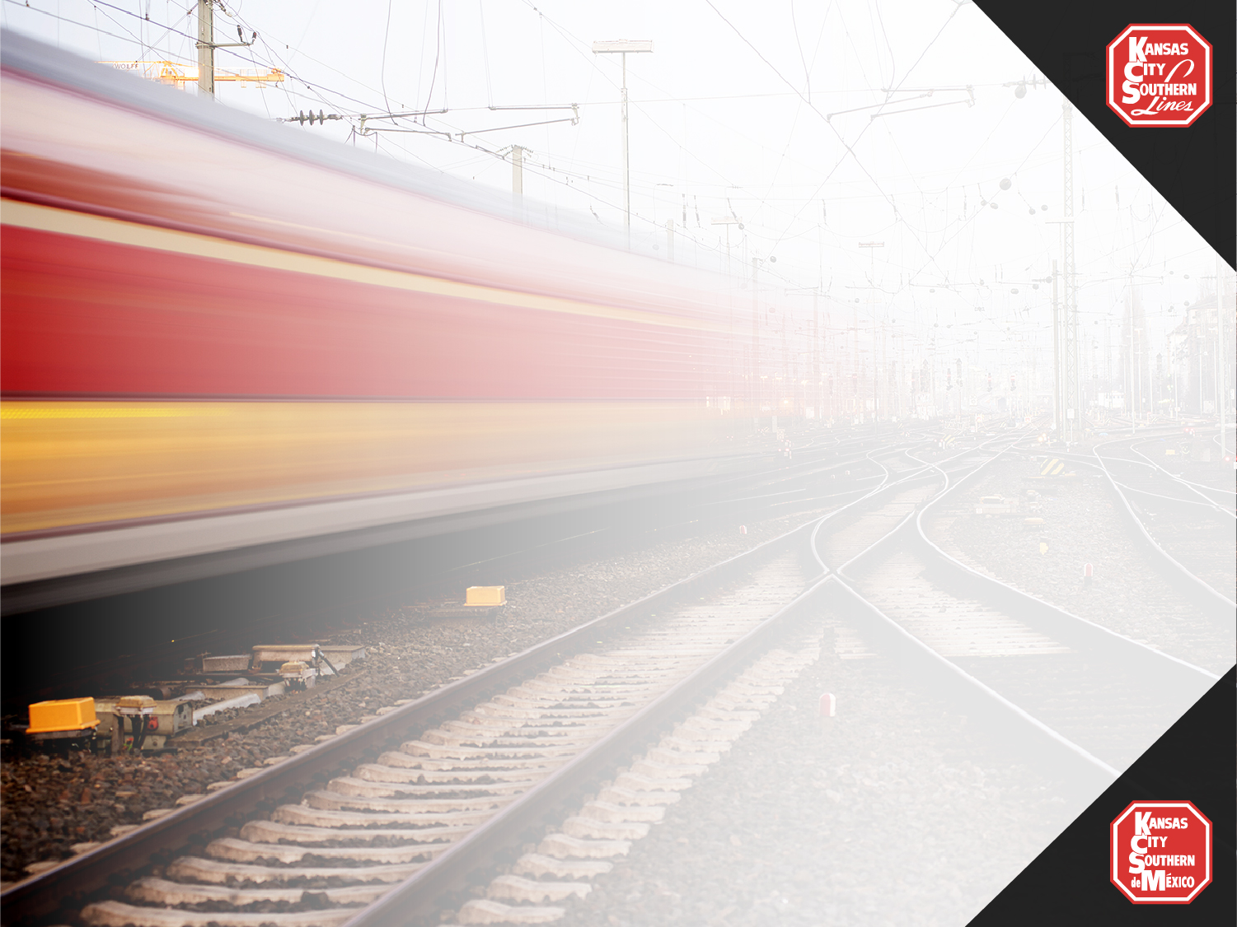
Security Points of Presence
1,068
593
Agents
Guard Points
117
Patrol Vehicles
5
K-9 Units
24x7
Security Desk
Notes:
The train is considered a very safe transport in Mexico and worldwide.
KCSM keeps a 99.98 % of security record.
The company invests important amounts of financial and human resources in the security of its net.
Each railway has a security model which includes filters, technology, guardians in dense settlements, hidden filters and monitoring using “security apps”.
The security in our railway system is been strengthen through:
Constant due diligence
Auditing of security filters
Combing technology with human capital
Security filtering combined with rail service design
Counter-intelligence program
Constant security analytics for prevention, detection and deterrence, legal team to support
Complaints
KCSM has adapted the security protocol; therefore security models adapt and modify to mitigate risks.
Cooperation and coordination schemes with authorities of the three levels of government have been established in order to create both, preventive and immediate attention measures in case of risks for the population, employees or the freight.

Slide 11
Safety
Procedure
Implemented
by KCSM
Notes:
Installation of security and protection systems
Modern network monitoring systems
24/7 security monitoring

Slide 12
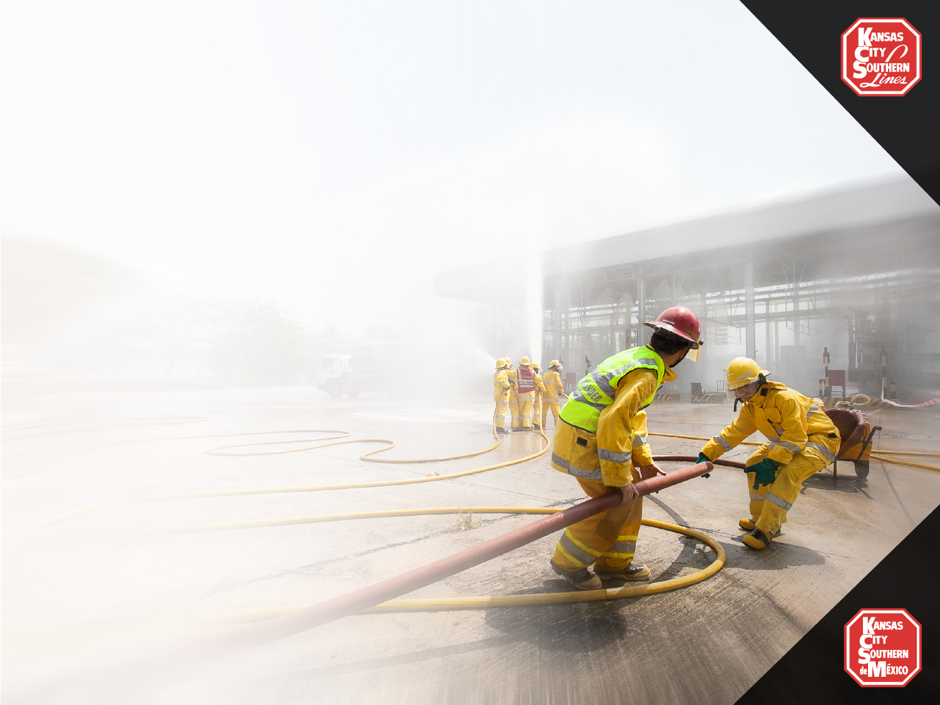
KCSM sponsored the fire fighting training course regarding wagons loaded with hydrocarbons.
Civil Protection and Firefighters personnel traveled to the "Brayton Fire Training Field" in Texas, USA and take the course.
Notes:
Working closely with local authorities, KCSM sponsored the fire fighting training course regarding wagons loaded with hydrocarbons.
Civil Protection and Firefighters personnel traveled to the "Brayton Fire Training Field" in Texas, USA and take the course.
It was carried out last year with an assistance of more than 20 students of Emergency Corps, which are located around the railroad tracks.
The training course for specialists in tank cars includes field exercises, transfer processes, flare and containment of product leakage.
It was carried out in August last year, with the training of 6 KCSM Services staff members.

Slide 13
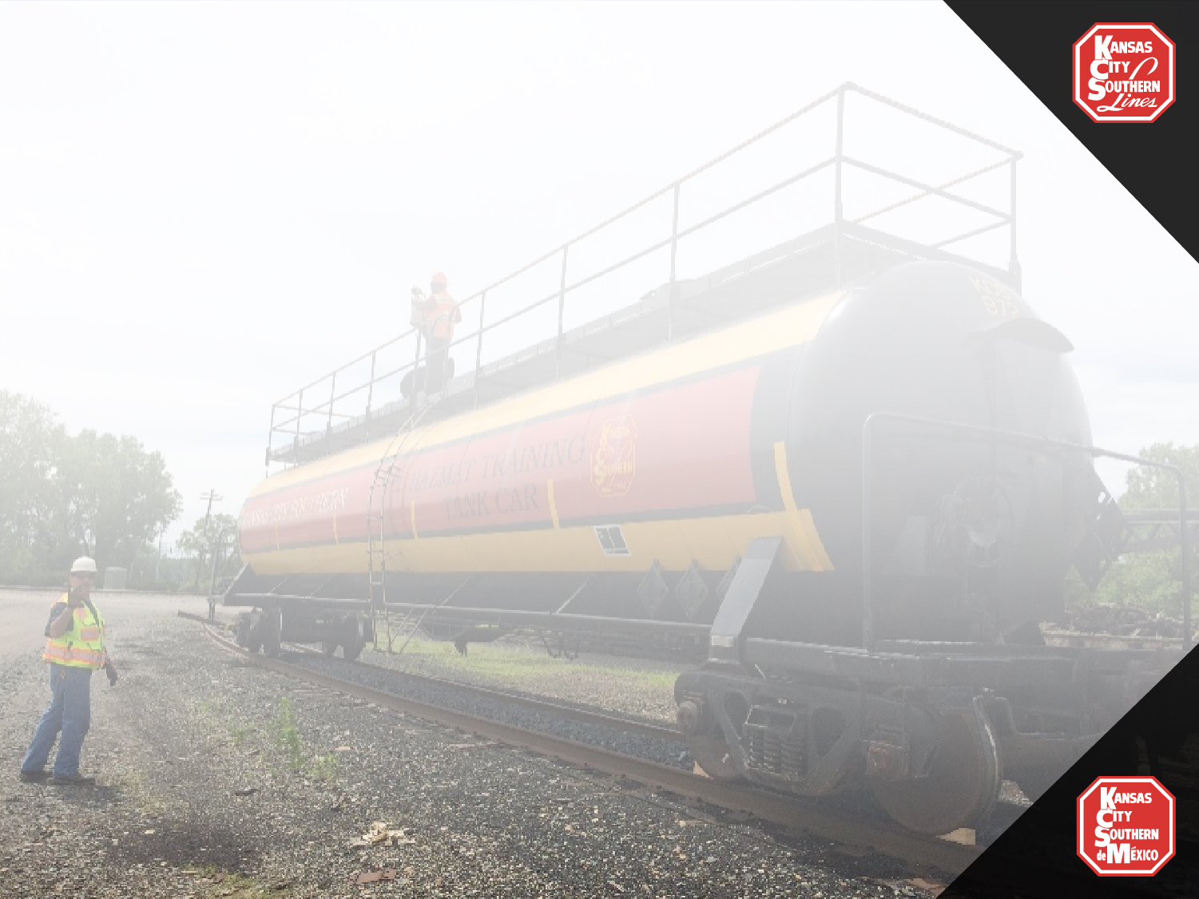
Safety
KCSM is continuously training in order to master the procedures regarding the hazardous materials incidents’ attention.
Notes:
KCSM has donated a school tank to the Training school for hazardous materials, in SLP in the central region of Mexico.
It agreed with the Security and Emergency Response Training Center (SERTC), to bring certified instructors to Mexico in order to give training courses inside the training school’s facilities.
In March 2018, personnel from KCSM, Fire, Civil Protection, and even from other railways, took this course.

Slide 14
Employees injuries
Notes:
Several actions have been implemented in order to prevent accidents:
Were bought new protective equipment and safety glasses with personalized graduation were bought.
In cooperation with the union representatives and the competent authorities were carried out a program of weeks of health in various terminals of the network which involved the workers’ families and children in a drawing contest that ended in a printed security calendar.

Slide 15
Safety
Efficiency
testing system
Training and
Regulations
Personal Protection Equipment
OPERATION TESTING SAFETY (OTS)
All supervisors conduct operational tests with the staff.
Monitoring system according to the regulation.
Monthly OTS approach.
INTERNAL TRANSPORTATION REGULATIONS
Internal Transportation Regulations.
Employees training every two years.
STAR
General Security Regulation.
Daily safety talks
Supervisors talk about safety before the beginning of every shift.
SPECIFIC PERSONAL PROTECTION EQUIPMENT
FOR EACH DEPARTMENT
8“ high boots.
Safety glasses.
Clothing with high visibility stripes
Notes:
Operation Testin Safety (OTS) - All supervisors conduct 15 safety observations to employees in order to give them feedback or congratulate them according to the observation made.
Internal Transportation Regulations (RIT) - It consist in the internal transport regulations, general orders, special instructions and safety regulations which establish the rules in order to operate the railroad efficiently and safely.
All employees who operate the railway (drivers, train safety workers, railway butlers) have a Federal Railroad License, granted by the Ministry of Communications and Transportation.

Slide 16
Safety
Safety routes
Monthly security tours in the yards.
Multi-disciplinary or crossed routes.
Risks identification.
Injuries’ prevention.
Security weeks
Family ‘s involvement in security issues.
Employees and family members training regarding impact issues.
Awareness on safety issues for a culture of preventive focus.
Alto Total Campaign
Civil Protection training
Training to the brigader team.
Simulations.
Working in collaboration with the Fire department and the Civil Protection.

Slide 17
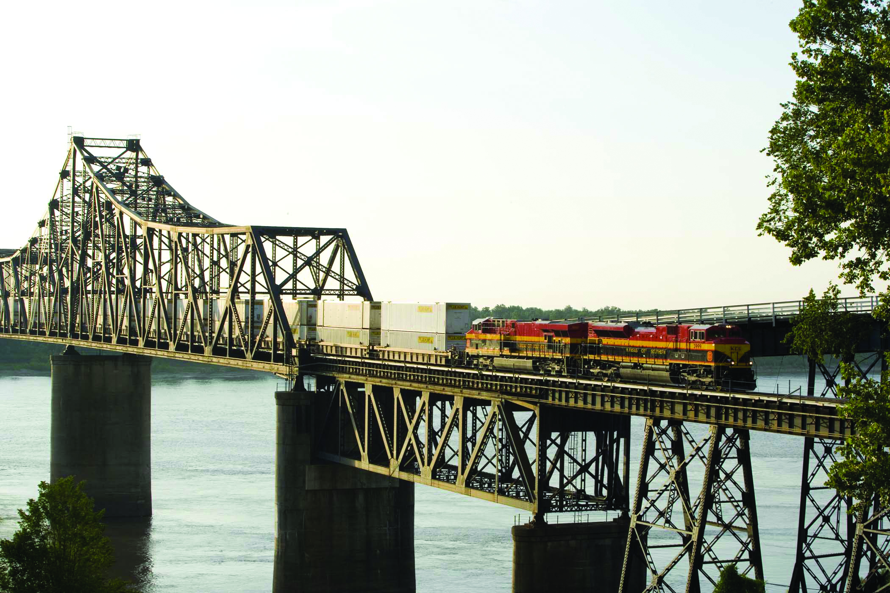
Thank you!

