Slide 1
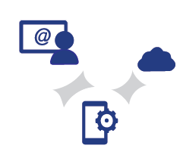
ITF-UNECE-UIC workshop on rail security DB SCHENKERsmartbox product / IoT
Schenker AG | I. Hellwig-Delaminsky | Essen | 2018-05-23

Slide 2
Introduction DB SCHENKERsmartbox product Timeline
2001
2003
2006
2011
2014
2015
2016
Initiation phase
Planning and Development of the DB SCHENKER smartbox project. Main target is the increase of safety of container transports.
Development phase
Up to now, first developments of the DB SCHENKER smartbox premium were made. Further developments are necessary to make the product smaller and lighter.
Year of foundation
Start of the DB SCHENKER smartbox project. Purchase of 10 containers for testing the Smartbox on selected routes.
From project to product
After investing several hundred thousand euros in development costs, the DB SCHENKER smartbox project released its first products on the market.
New product launches
Introduction of the products Air Real-time, Air Gateway, and Rail.
New product launches
Introduction of the products Domestic Lock and Domestic Package Tracker.
Economical success
Portfolio review & bench-marking for products and supplier.

Slide 3
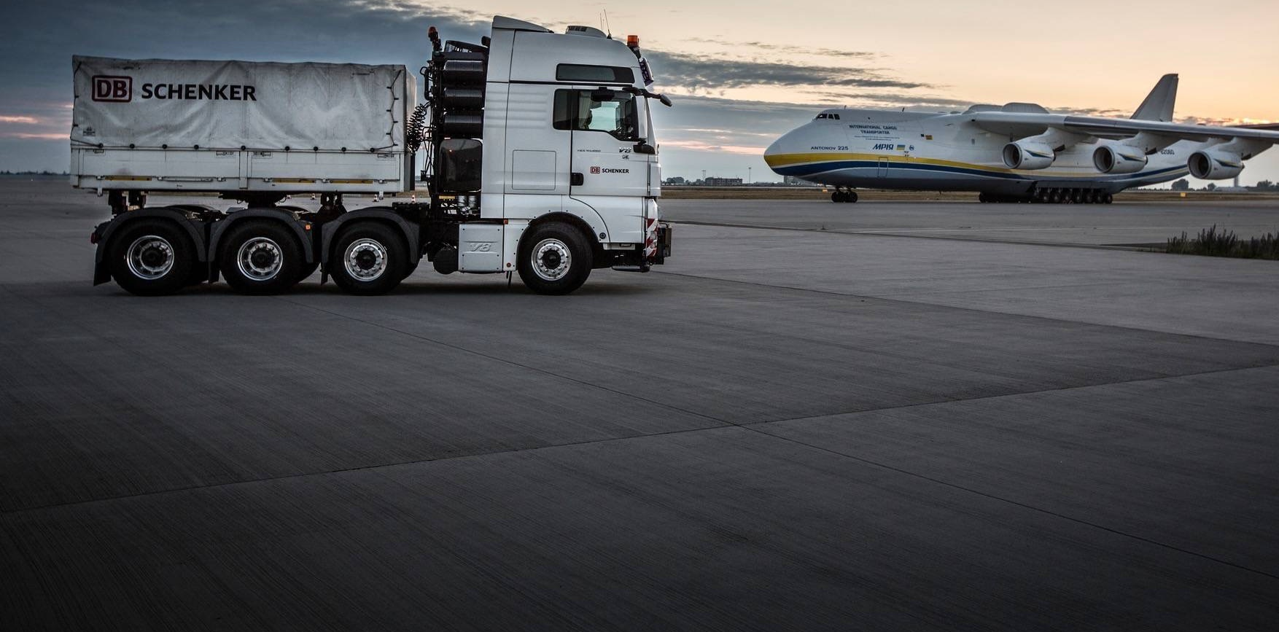
Introduction DB SCHENKERsmartbox product The SCHENKERsmartbox family provides monitoring solutions for all transport modes!
Premium
Air real time and gate way
Light
Domestic lock and package Tracker
Rail and Logistic
Easy 1&2 / Pharma
Individual
DB SCHENKERsmartbox family creates synergy effects due to a well-established network of cooperating partners. This is one of the key success factors which make DB SCHENKERsmartbox family unique within all modes of freight forwarding transportation.
With DB SCHENKERsmartbox family you will receive a detailed overview of your freight around the clock and worldwide. Since 2007 DB Schenker develops continuously new products which are based on the customers’ requirements.
In order to offer a worldwide service a well-established network of product representatives and innovative partners was built.

Slide 4
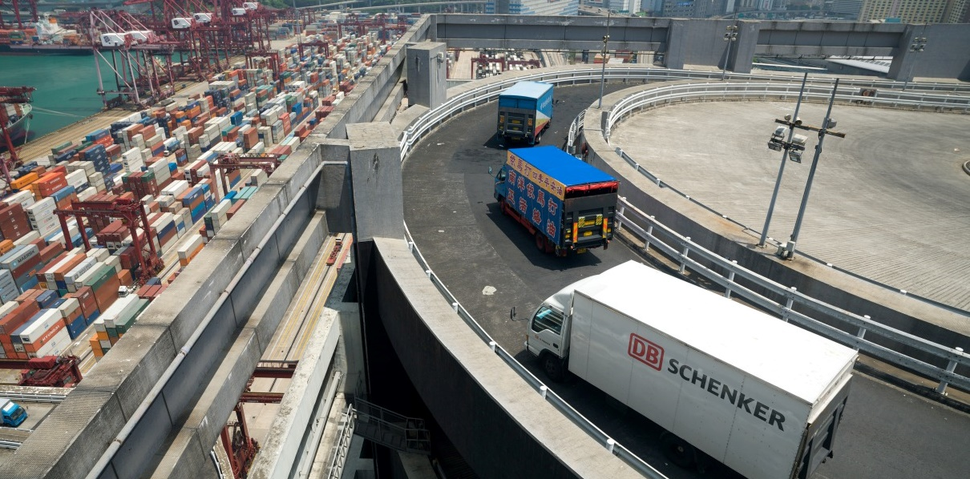
Introduction DB SCHENKERsmartbox product
DB SCHENKERsmartbox offers the following services and features to the customers
Logistics of device via air freight DB SCHENKERmarineparts, UPS and Ocean freight (worldwide network)
Customs & general consulting and Business Case analysis
1
2
Customized reports and statistics
Standard operation procedure (SOP)
3
4
Visibility System accessible via Customer Information System and through www.dbschenkersmartbox.com
security center monitoring solution (Security Center)
5
6

Slide 5
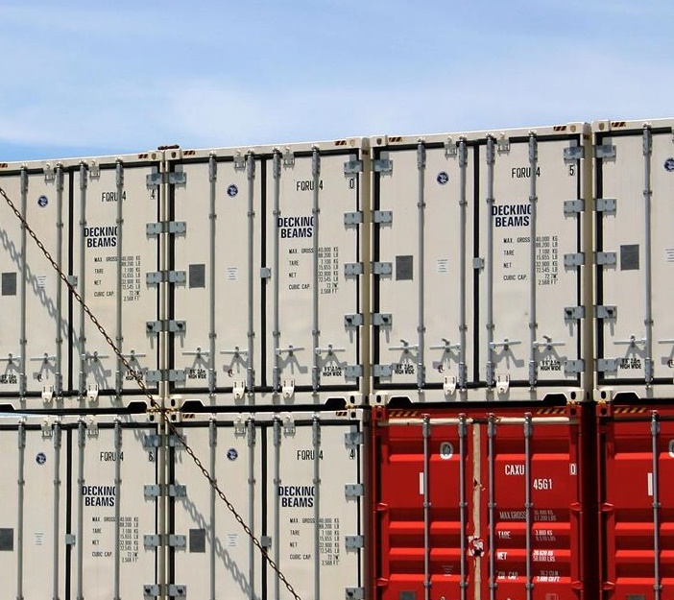
Introduction DB SCHENKERsmartbox product Case study – Electronics - China Rail transportation
For several customer products data like temperature and humidity in combination with real time monitoring is needed. Especially the impact e.g. on the lithium batteries needs to be observed while in transit
Several measurements are needed to be monitored in combination with real time GPS
The circumstances on the transport needs to be collected and evaluated for future transports to protect the goods and to change the supply chain
CHALLENGE
SOLUTION
By using the Smartbox device Premium, DB Schenker is able to monitor open door sensor for direct security calls if the door will be open outside of a Geo fence.
GPS coordinates,, Geo-fencing, G-Force Door alarms, Movement, Light, Vibration, Tilt and Intrusion detection are monitored 24/7 in real time
Data can be seen online or collected in a data file and analyzed afterwards
Product Name
Vertical
Region
DB SCHENKERsmartbox Rail
Electronics
APAC to worldwide

Slide 6
Introduction DB SCHENKERsmartbox product Case study – Military – Rail / Ocean transportation
Security transport monitoring and general thief protection of wagon used by Military of defense in Euro
The device needs to monitor several measurements to show that there is a potential theft
The needs to be monitored in real time while freight are transported and stored on freight delivery stations in and outside of military basis
CHALLENGE
SOLUTION
By using the device Premium, customer is able to monitor their freight while they are in transit
GPS coordinates,, Geo-fencing, G-Force Door alarms, Movement, Light, Vibration, Tilt and Intrusion detection are monitored 24/7 in real time
Data can be seen online or collected in a data file
The device was modified for the special needs (light sensor) to modify thief protection outside of door open identification
Product Name
Vertical
Region
INTERNAL USE ONLY
DB SCHENKERsmartbox Rail
Industrial
EUROPE / Worldwide

Slide 7
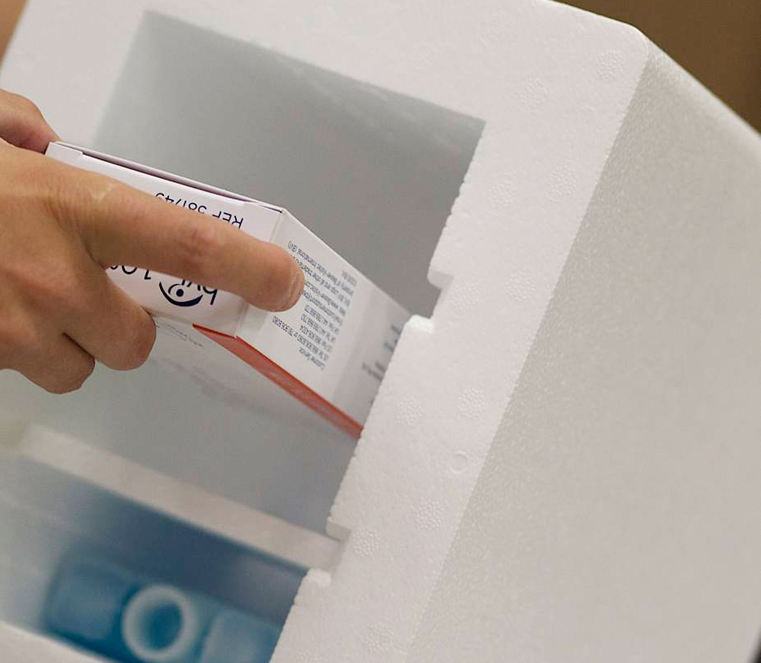
Introduction DB SCHENKERsmartbox product Case study – Healthcare – Rail / Ocean / Air transportation
CHALLENGE
For healthcare products particularly a fast, reliable transport and a permanent monitoring of the temperature is required. Furthermore it is required to thief protect the high value freight
Temperature and geographical location has to be monitored 24/7
Door open and a light inside indicator needs to be monitored continuously
SOLUTION
DB Schenker is monitoring the temperature of the Containers and Air cargo constantly to ensure a stable temperature
Use of Reefer Containers for Ocean and Smartbox premium
Smartbox Air gateway for Air cargo
For a more accurate measurement of temperature, in addition to the Smartbox another transmitter is centrally mounted within the container
Temperature and geographical location is monitored 24/7
If the measured temperature exceeds minus 5 degrees or plus 14 degrees a SMS alert is triggered towards Bosch Security
center
The responsible branch will be informed immediately to interact
Product Name
Company
Region
INTERNAL USE ONLY
DB SCHENKERsmartbox
Healthcare
Lux/Manheim – USA

Slide 8
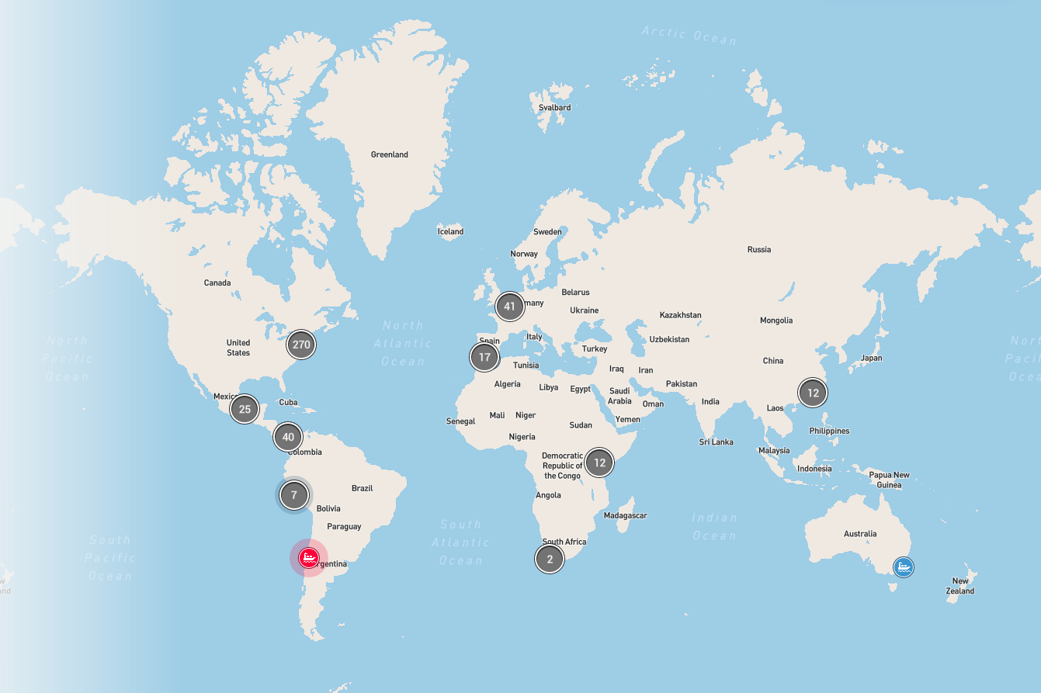
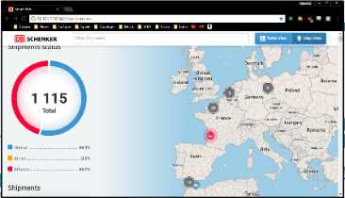
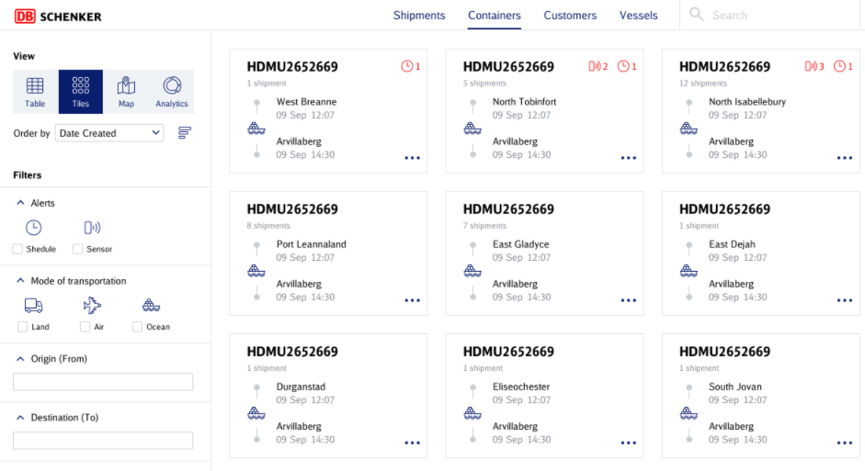
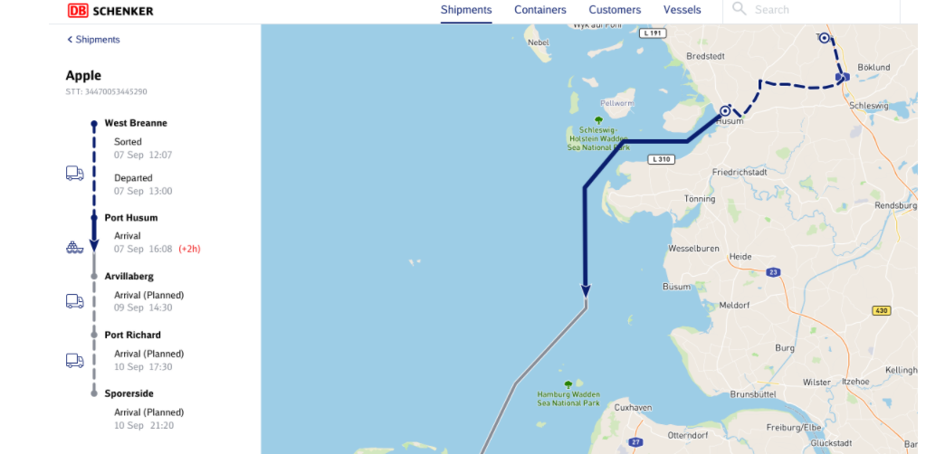
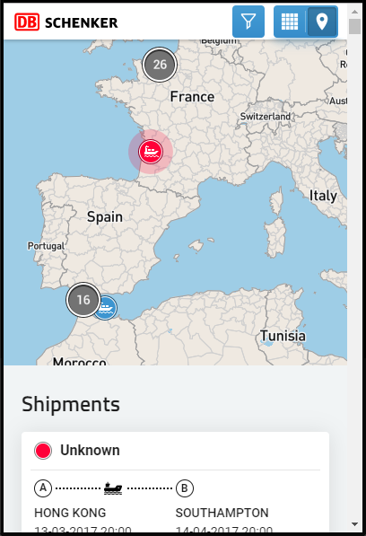
Introduction DB SCHENKERsmartbox product The Schenker IoT Platform – a geo information system designed to unify the digital appearance of our Smartbox Product family and to be used as the world wide security application.
Schenker IoT/ Telematics Platform
Manage Schenker SmartBoxes (IoT devices) and trade lanes with a map based visibility platform.
Customer

Slide 9
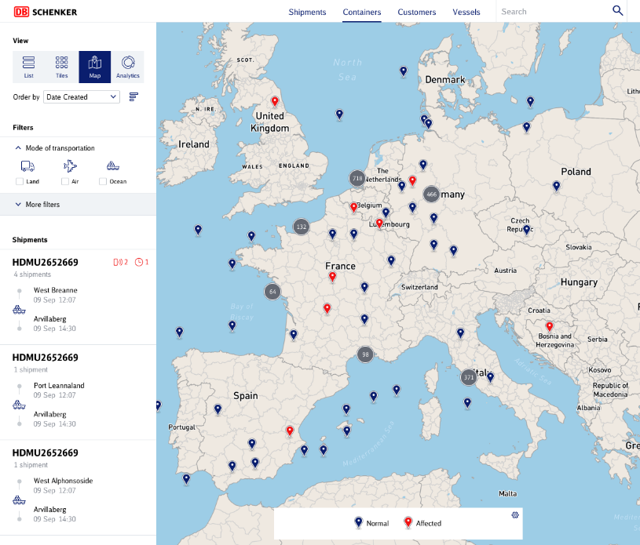
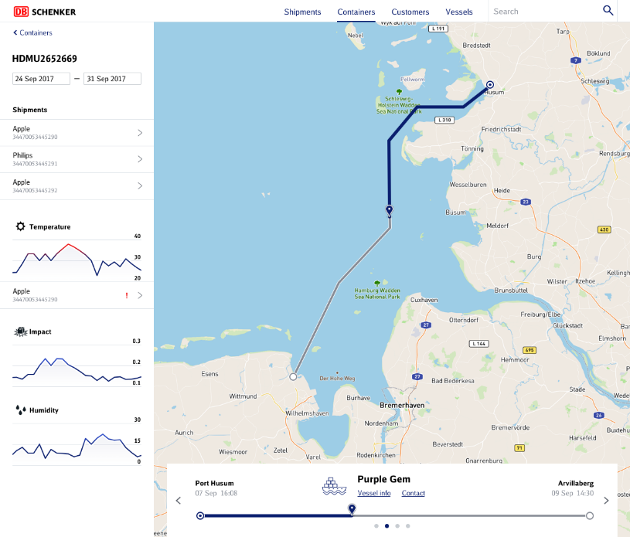
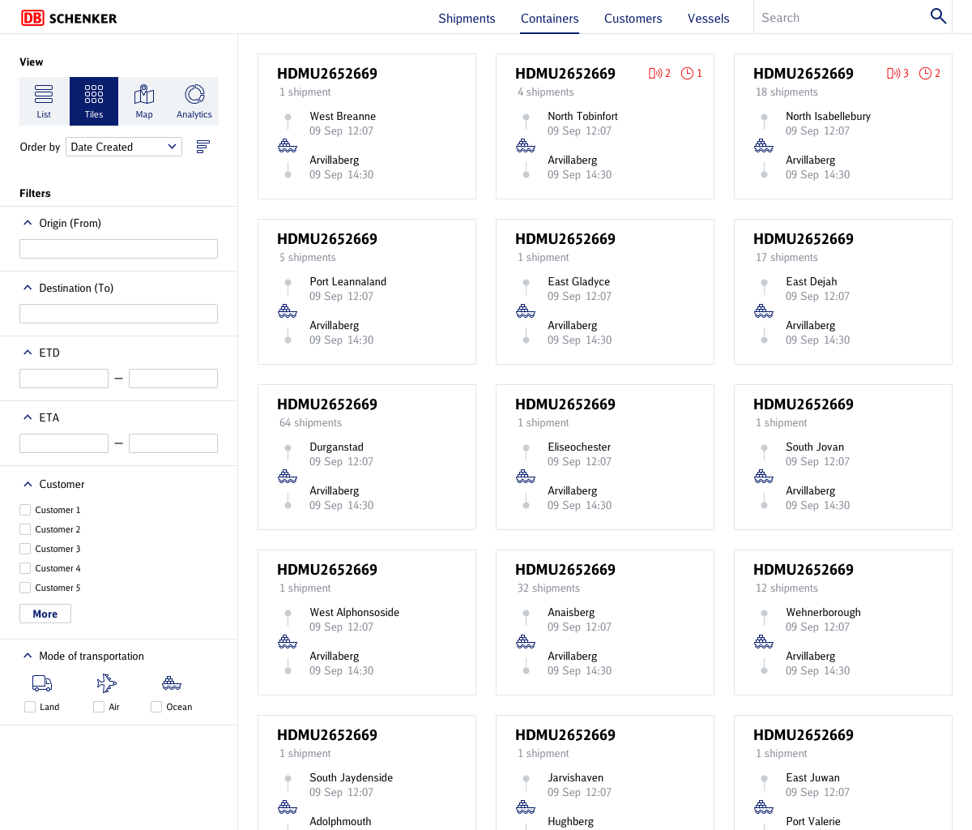
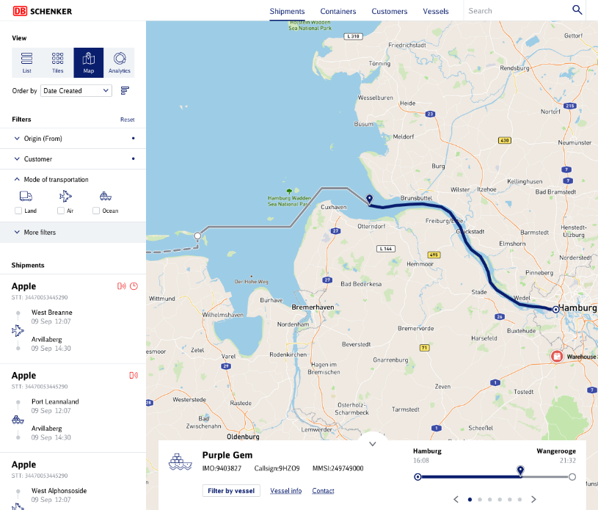
Introduction DB SCHENKERsmartbox product The Schenker IoT Platform – a geo information system designed to unify the digital appearance of our Smartbox Product family

Slide 10
Digital
Solutions
Thanks for your attention.

