Slide 1
UN-Regulation No. 80 Comparative study between static and dynamic test procedure Julian Ott
Submitted by the expert from Germany | Informal document GRSP-62-35 (62nd GRSP, 12-15 December 2017 agenda item 26(g))
November 2017

Slide 2
UN Regulation No. 80
Goal of UN Regulation No. 80:
the occupant is correctly retained by the seat in front of him (and/or by the use of a safety belt – dynamic only).
the seat and the seat anchorages are strong enough.
after an impact the occupant is not seriously injured

Slide 3
Are these tests equivalent?
UN-Regulation No. 80

Slide 4
UN-Regulation No. 80
The current UN-Regulation No. 80 allows to approve large passanger vehicle seats and their anchorage according to two different test procedures.
Appendix 1 (dynamic)
sled test with 50%ile Dummy (HII or HIII), 30-32km/h, 8-12g
Test 1 (without belt)
Test 2 (with belt)
Appendix 5 (static)
defined forces applied to the backrest at two locations
or
a_{x}
F₁
F₂
a_{x}

Slide 5
Testmatrix
Tests have been conducted
according to test procedure R80 Appendix 1 (dynamic) and Appendix 5 (static)
different seats
at different labs.
All seats are equipped with quick clamping systems
Seat | Test procedure | Belt | Test-No. | Remarks
A | Dynamic (Appendix 1) | unbelted | R-80_17_01
 |  | unbelted | R80-1-1-01
 |  | 2-point belt | R80-1-2-02
 |  | Seat only | R-80_17_02 | not part of R80
 |  | Seat only | R80-1-1-05 | not part of R80
 | Static (Appendix 5) | - | R-80-d-17_01
 |  | - | 179421190_002
B | Dynamic (Appendix 1) | unbelted | R80-1-1-03
 |  | unbelted | R80-1-1-04
 | Static (Appendix 5) | - | 179421190_001
C | Dynamic (Appendix 1) | unbelted | R-80_17_03
 | Static (Appendix 5) | - | R-80-d-17_02

Slide 6
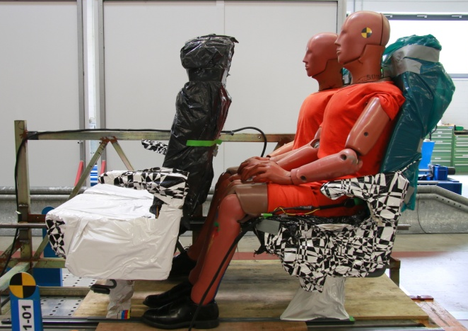
Results – Dynamic Test 1
R80-1-1-01 - Seat A
Tested according to R80 – Appendix 1, Test 1 (unbelted)
Observations:
Auxiliary seat slides 600mm (but still in seat track)
Test seat slides without any load of the dummies completely out of the seat track
→ seat mountings are not strong enough to hold the seat in place
→ Occupants are not restrained by the test seat
Dummy values are below the thresholds but serious injuries are likely
Pre-test
Post-test
Sliding distance of auxiliary seat

Slide 7
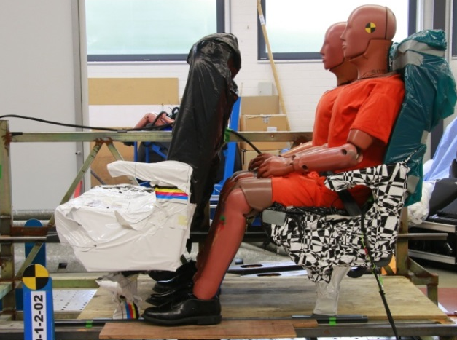
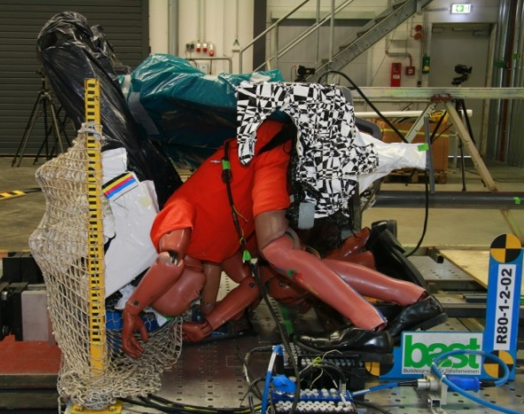
Results – Dynamic Test 2
R80-1-2-02 - Seat A
Tested according to R80 – Appendix 1, Test 2 (belted)
Observations:
Auxiliary seat detaches completely from the seat track
Test seat slides without any load of the dummies completely out of the seat track
→ seat mountings are not strong enough to hold the seat in place
→ Occupants are not restrained by the test seat
Dummy values are below the thresholds
but serious injuries are likely
Pre-test
Post-test -Dummies
Post-test - overview

Slide 8
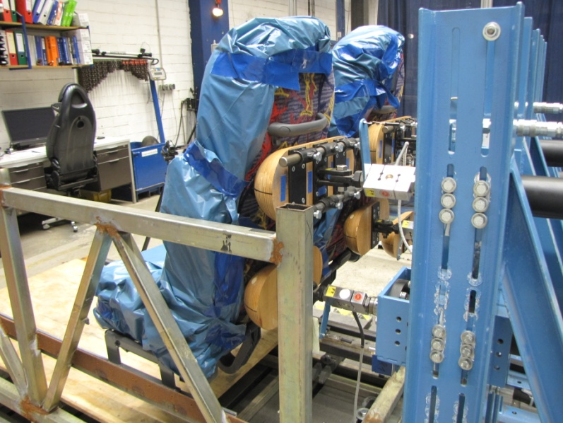
Results – Static Test
179421190_002 – Seat A
Tested according to R80 – Appendix 5
Observations:
Seat stays in place, no failure
The maximum displacement at F₁ is below the threshold of 400mm
The minimum displacement at F₁/ F₂ is above the threshold of 100/50mm




Slide 9
Conclusion
The statically (appendix 5) tested seats, when tested according to the dynamic test, collapsed in the dynamic tests
Goal of UN Regulation No. 80 is not achieved when tested statically
Proposal: delete static test according to Appendix 5

Slide 10
Outlook
In addition it has been observed that
the static test procedure:
does not consider dynamic effects like:
oscillation
inertia
mass and mass distribution of the seat
detaching of accessories
detaching/sliding/failure of clamp connection and locking
does only partially take into account the different installation situation of the seat (lateral and vertical offset of seats, etc.).
the dynamic test procedure:
Does not limit the sliding of the seat anchorage

Slide 11
Thank you for your attention!

Slide 12
Results - Summary
Seat | Test procedure | Belt | Test-No. | Resistance of seat/seat mountings | Occupants restraint | Occupant load
A | Dynamic (Appendix 1) | unbelted | R-80_17_01 | test seat slides ~240mm and detaches partly; auxiliary seat slides ~100mm^{*)} | excursion below threshold | values above threshold
 |  | unbelted | R80-1-1-01 | test seat slides out of seat track; auxiliary seat slides ~600mm | not restrained | values below threshold
 |  | 2-point belt | R80-1-2-02 | test seat slides out of seat track; auxiliary seat detaches | not restrained | values below threshold
 | Other | Seat only | R-80_17_02 | seat slides ~655mm | - | -
 |  | Seat only | R80-1-1-05 | seat slides ~665mm | - | -
 | Static (Appendix 5) | - | R-80-d-17_01 | seat slides ~20mm | correctly restrained | sufficient deformation
 |  | - | 179421190_002 | seat does not move | correctly restrained | sufficient deformation
B | Dynamic (Appendix 1) | unbelted | R80-1-1-03 | test seat slides ~39mm | Dummy excursion below threshold | values below threshold
 |  | unbelted | R80-1-1-04 | test seat slides ~16mm | excursion below threshold | values below threshold
 | Static (Appendix 5) | - | 179421190_001 | Seat does not move | correctly restrained | sufficient deformation
C | Dynamic (Appendix 1) | unbelted | R-80_17_03 | test seat slides (~340mm) | excursion below threshold | values below threshold
 | Static (Appendix 5) | - | R-80-d-17_02 | seat does not move | correctly restrained | sufficient deformation
^{*)} seat sliding influenced due to tape on seat track

