Slide 1
Transmitted by IWG SLR
Informal document GRE-78-35
(78th GRE, 24-27 October 2017,
agenda item 4)
Underlying Principles of Approval Marking for the LSD Regulation
A device type approved according to a lower level of series of amendments to this regulation may be installed on a new type of vehicle, provided that the change index related to each individual lamp, being part of this device, does not differ from that indicated in Table 2.
A new series of amendments shall have no impact on existing devices, type approved according to previous series of amendments to this regulation, provided that the change index related to each individual lamp, being part of this device, does not differ from that indicated in Table 2. In this case no impact means no modification or update of the type approval documents and markings on the device is required.

Slide 2
LSD Marking examples
Rear direction indicator lamp (variable)
Rear position lamp (variable)
2b
R2
AR
S2
Stop lamp (variable)
Reversing lamp (note: the letters A and R may be mingled)
168R04-22179
E 4
R-168 series 04.
Approval number 22179

Slide 3
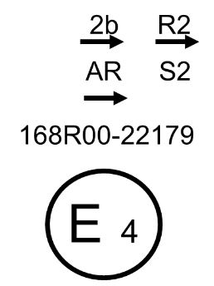
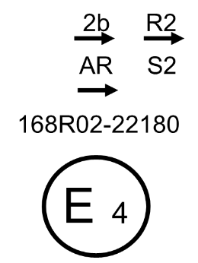
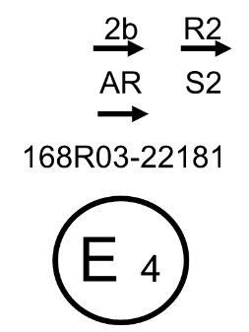
Underlying Principles of Approval Marking for the LSD Regulation
- Annex 8 -
2b
R2
The 05 Series of amendments is introduced by a general change that affects all the functions (lamps)
AR
S2
etc…
168R03-22181
E 4

Slide 4
LSD Marking examples – Extension of Approval
● Extension of direction indicator lamp according to series of amendment 04
● No extension (basic, series 03) for other function (lamps)
● Basic type approval,
series 03
2b
R2
R2
2b
AR
S2
AR
S2
168R03
168R03
168R04
E 4
E 4
22179
22179

Slide 5
Underlying Principles of Approval Marking for the LSD Regulation
- Annex 8 -
Extension of Approval

Slide 6
LSD Marking example – Without Change Index
Rear direction indicator lamp (variable)
Rear position lamp (variable)
2b
R2
AR
S2
Stop lamp (variable)
Reversing lamp (note: the letters A and R may be mingled)
168R04-22179
E 4
R-168 series 04.
Approval number 22179

Slide 7
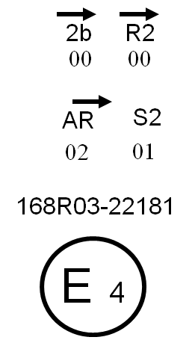
LSD Marking example – With Change Index
Rear direction indicator lamp (variable)
Rear position lamp (variable)
Change index
Change index
Reversing lamp (note: the letters A and R may be mingled)
Stop lamp (variable)
168R04-22179
Change index
Change index
R-168 series 04.
Approval number 22179

Slide 8
Further work for the SLR Group
Introduce a definition of “change index”
Amend the draft LSD, RID and RRD Regulations to incorporate this approach in the main body and annexes
Add a clear guidance in Annex 7 on how to apply the markings
Add a new Annex 8 and renumber the subsequent ones
Produce a corresponding draft proposal that would apply to the use of the UI
Introduce this (agreed) approach to the IWG-DETA on 09 Nov 2017 and to the IWVTA SG58 Meeting on 10 Nov 2017
Check the Draft Guidelines in Document SG58-22-10Rev1 and SG58-23-04 and prepare SLR input for the 10 Nov 2017 meeting

Slide 9
Alternative Solution
Current Marking
New marking
1A
01
2b
00
R2
02
HC
05
1A
01
2b
00
R2
02
HC
05
F2
03
AR
00
S2
00
K
04
F2
03
AR
00
S2
00
K
04
E 2
E 2
22179
22179
No change
“Old” Series of amendment replaced y “new” change index
SLR 1 : no fundamental change. Keep the current situation
To be precised in each 3 new REG in ‘Marking requirements’ paragraph : define clearly the sequence of marking, regarding to the general requirements form 58 agreements

