Slide 1
Informal document GRE-78-35- Rev.1
(78th GRE, 24-27 October 2017,
agenda item 4)
Note: the content of this Revision 1 is focussed on the part agreed by GRE. The part removed from the original version requires further development by IWG-SLR.
Transmitted by IWG SLR
Underlying Principles of Approval Marking for the LSD Regulation
A device type approved according to a lower level of series of amendments to this regulation may be installed on a new type of vehicle, provided that the change index related to each individual lamp, being part of this device, does not differ from that indicated in Table 2.
A new series of amendments shall have no impact on existing devices, type approved according to previous series of amendments to this regulation, provided that the change index related to each individual lamp, being part of this device, does not differ from that indicated in Table 2. In this case no impact means no modification or update of the type approval documents and markings on the device is required.

Slide 2
LSD Marking examples
Rear direction indicator lamp (variable)
Rear position lamp (variable)
2b
R2
AR
S2
Stop lamp (variable)
Reversing lamp (note: the letters A and R may be mingled)
168R04-22179
E 4
R-168 series 04.
Approval number 22179

Slide 3
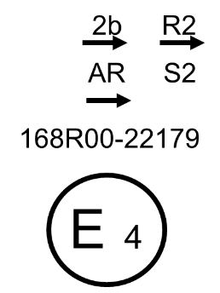
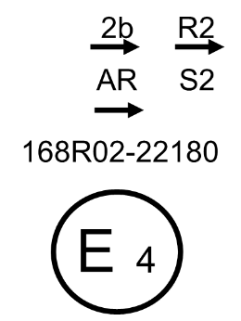
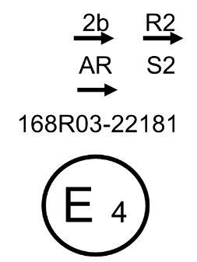
Underlying Principles of Approval Marking for the LSD Regulation
- Annex 8 -
2b
R2
The 05 Series of amendments is introduced by a general change that affects all the functions (lamps)
AR
S2
etc…
168R03-22181
E 4

Slide 4
Further work for the SLR Group
Introduce a definition of “change index”
Amend the draft LSD, RID and RRD Regulations to incorporate this approach in the main body and annexes
Add a clear guidance in Annex 7 on how to apply the markings
Add a new Annex 8 and renumber the subsequent ones
Develop a detailed approach to manage extensions to existing type approvals
Produce a corresponding draft proposal that would apply to the use of the UI
Introduce this (agreed) approach to the IWG-DETA on 09 Nov 2017 and to the IWVTA SG58 Meeting on 10 Nov 2017
Check the Draft Guidelines in Document SG58-22-10Rev1 and SG58-23-04 and prepare SLR input for the 10 Nov 2017 meeting

