Slide 1
Task Force on Electro-Magnetic Compatibility (TF EMC) Status report to GRE-78 Wednesday, 25. October 2017
Submitted by TF EMC
Informal document GRE-78-10-Rev.1
(78th GRE, 24-27 October 2017, agenda item 7 (a))

Slide 2
TF EMC Status Report
TF EMC had its 10th meeting on Wednesday, 18th October 2017
TF EMC will report on the work, which led to the “GRE/2017/12-Proposal for Supplement 2 to the 05 series of amendments to Regulation No. 10 (Electromagnetic compatibility) “ which was submitted by July 25th
TF EMC is asking for the adoption of this proposal including the final approval of two special modifications (vehicle radiated emission narrowband limit, suppression of clause 3.1.9) shown at GRE 77
TF EMC will ask for the approval of the informal document GRE-78-09_Rev1, supplied by TF EMC regarding Transitional Provisions
Furthermore, Spain prepared a proposal with a technical change concerning DC charging mode which is still under discussion and will be presented at GRE-79

Slide 3
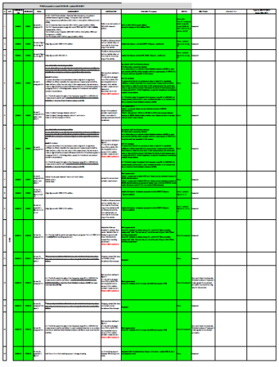
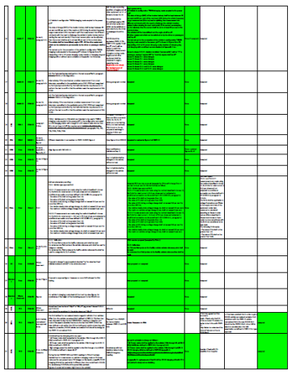
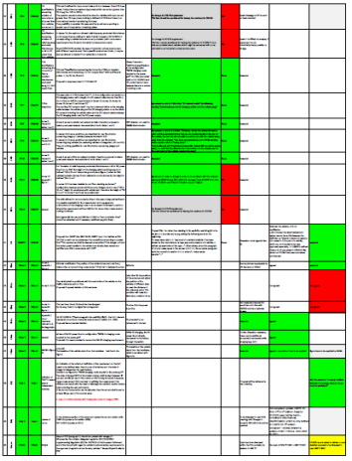
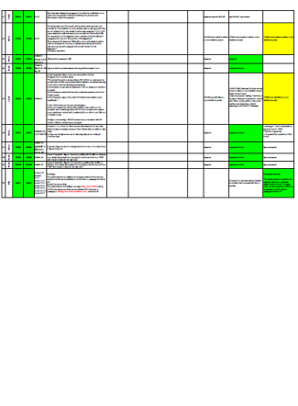
TF EMC Status Report – UN R10.05 Development
(Proposals from China, Italy, France, Japan, Spain, OICA and IMMA)
87 modification proposals were discussed
80 modifications were incorporated in the informal working draft supplement of UN R10.05.
5 of the proposals will be on the roadmap for a UN R10.06 version.
2 proposals were not accepted due to contradiction to international standards

Slide 4
TF EMC Status Report – UN R10.05 Development
(Modification overview)
Focus of the work on the current version of the UN R10 :
correction of technical and editorial errors, especially for the REESS test setups to be in line with CISPR and ISO standards; additionally all figures for Annex 11, 12, 14, 15 and 16 were updated
Correction of inconsistencies – developed by the implementation of REESS ESA contents in UN R10.05
Two major changes were identified by the TF EMC to be reported and asked to be accepted by the GRE -77:
Change of the UN R10.05 narrow band limit to be consistent with CISPR 12 (see details in Annex)
Suppression of clause 3.1.9

Slide 5
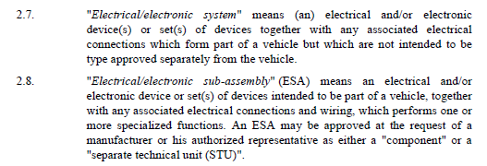
TF EMC Status Report – UN R10.05 Development
(Elimination of clause 3.1.9)
Justification
clause 3.1.9. of UN R10.05 might be interpreted not allowing to perform ESA type approval on REESS equipment, because it refers to E/E-Systems.
In fact this clause 3.1.9 has been added in UN R10.04 because there was NO description of REESS equipment ESA-test in UN R10.04.
When UN R10.05 has been issued to include specific REESS-equipment ESA test, this clause 3.1.9 should have been deleted, because it was in contradiction with the fact to have all this specific REESS equipment REESS ESA test available.

Slide 6
TF EMC Status Report – UN R10.05 Development
(Consistency of the description of Artificial networks with CISPR)
Background of the changes is to reach consistency in the description of artificial networks in UN R10.05 with all relevant CISPR and ISO standards.
a) AC Power mains shall be applied to the vehicle / ESA through 50 µH/50 Ω AN(s) AMN(s) as defined in CISPR 16-1-2 paragraph 4.3.
b) DC Power mains shall be applied to the vehicle / ESA through 5 µH/50 Ω HV-DC charging-AN(s) as defined in CISPR 25 Appendix 8.
c) High voltage power line shall be applied to the ESA through a 5 µH/50 Ω HV-AN(s) as defined in Appendix 8.
.

Slide 7
TF EMC Status Report – UN R10.05 Development (Necessary adoption of Transitional Provisons)
The EU indicated a missing expiration date for UN R10.04 within UN R10.05
Further discussions about the Transitional Provisons showed that TPs for UN R10.03 and UN R10.04 are still included in UN R10.05 (clauses 13.1 to 13.10)
Therefore the GRE TF EMC submitted an informal document GRE-78-09-Rev1 proposing :
To delete all clauses with TPs in relation with UN R10.03 and UN R10.04
To add missing TPs concerning UN R10.05 : “UN R10.04 expiration date“, UN R10.05 All Types date, vehicle type which are not equipped with a coupling system to charge the REESS.
To add specific TPs to differentiate between UN R10.05 and UN R10.05 Suppl. 2 because of major change (narrowband limit).
To change the relative periods of time into exact calendar dates, following the Rules of Revision 3 of 1958 Agreement.

Slide 8
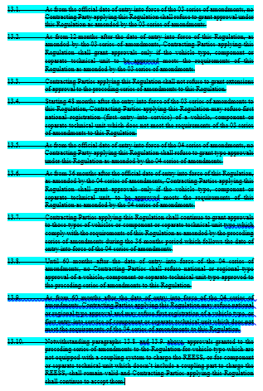
TF EMC Status Report – UN R10.05 Development (Necessary adoption of Transitional Provisons)
Suppression of clauses with TPs in relation with UN R10.03 and UN R10.04
Update of UN R10.05 TPs

Slide 9
TF EMC Status Report – UN R10.05 Development Spanish Proposal regarding DC charging mode
The needs for charging of heavy vehicles as trucks or busses in short time leads to high charging current
In the present version of UN R10.05 a test procedure is defined to test at a current level of 80% .
Laboratories are in trouble to fulfil the resulting requirements regarding the energy supply and test equipment. They also have to invest in continuously new equipment with increasing demands.
For the time being, the test requirements can not be fulfilled by most of the laboratories. So for each test, the technical service has to consult the national regulation authorities.
Therefore the TF EMC will prepare a proposal and a justification for an adoption of the test setup and requirements.

Slide 10
Thank you for your attention

Slide 11
Annex

Slide 12
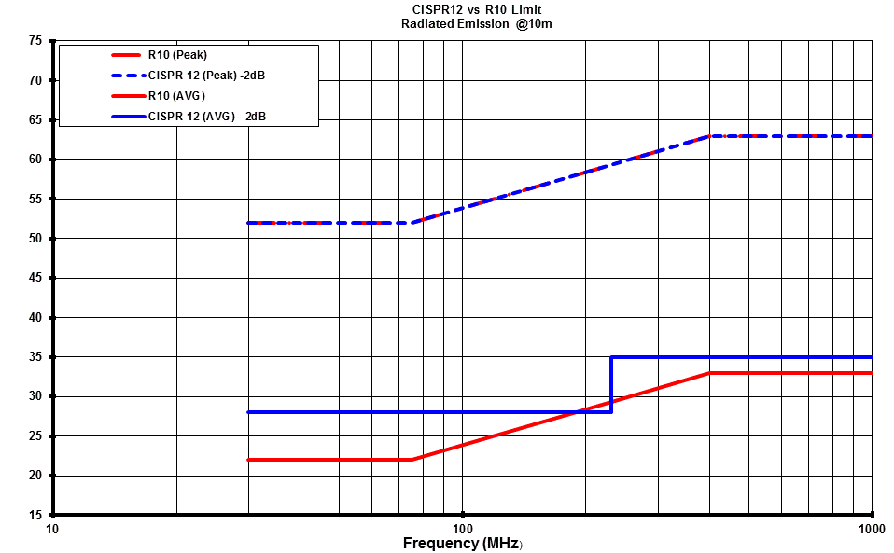
TF EMC Status Report – UN R10.05 Development (Change of the UN R10.05 narrow band limit consistent with CISPR 12)
It has been precised that in order to get a UN R10.05 vehicle narrowband emission limit consistent with the CISPR 12 vehicle narrowband limit, the new UN R10.05 limit should be the CISPR12-limit minus 2dB to take into consideration this 2dB more stringent requirement as defined in CISPR 12 for type approval.
For information: This figure shows also the consistence between the UN R10.05 and CISPR12 broadband peak limits.
The proposal for new UN R10-.05 narrowband limit is shown in blue, in comparison to the present UN R10.05 narrowband limit in red.

