Slide 1
Study on Euro 5 sound level limits of L-category vehicles
66th GRB meeting, 04.-06.09.2017
Transmitted by the expert from the European Commission
Informal document GRB-66-15
(66th GRB, 4-6 September 2017,
agenda item 10)
On behalf of the European Commission

Slide 2
GENERAL INFORMATION
Tender ID:
  Title: Study on Euro 5 sound level limits of L-category vehicles
  Tender No: 524/PP/GRO/IMA/16/1131/9316
  Contract No: SI2.736346 of the Consortium with the
  European Commission - DG-GROW
Consortium performing the work:
  EMISIA - Greece
  TNO - The Netherlands
  Ricardo Deutschland GmbH - Germany
  Heinz Steven Data Analysis and Consultancy (HSDAC) - Germany

Slide 3
Project objectives
      Investigate the potential for new sound limits of L-category vehicles at Euro 5 step and make a justified proposal, taking into account:
      Citizens’ needs and stakeholders interest
      (feedback gathering)
      Evolution of sound levels of road vehicles
      (actual vehicle testing)
      Technical and economic feasibility in medium term
      (cost-benefit analysis)
      Any new sound limits to be accompanied by an appropriate timeframe for their introduction

Slide 4
Project tasks and time plan
Task 1: Estimate of sound level limits for all L-categories (10.16 – 01.17)
a) Feedback gathering – stakeholder survey
b) Literature review
Task 2: Verification of sound level limits (01.17 – 04.17)
a) Actual vehicle testing – sound measurements
b) Processing of results
Task 3: Cost-benefit analysis (03.17 – 09.17)
a) Input data, scenarios, first results
b) Improvements, final CBA results
Task 4: Validation tests (03.17 – 06.17)
a) Additional vehicle testing – sound measurements
b) Noise Source Ranking (NSR)
Task 5: Proposal for limit values and reporting (07.17 – 10.17)
Final sound limits proposed by the study and recommendations
EMISIA, HSDAC
Completed
RICARDO
Completed
TNO
In progress – Input data, methodology
RICARDO
Completed
CONSORTIUM

Slide 5
Project deliverables
      1st Intermediate Report (June 2017) – approved by EC
      Contents: Detailed presentation of
        Method and outcome of Task 1 (stakeholder survey + literature review)
        Work and results from Tasks 2, 4 (vehicle testing)
        CBA methodology and input data (currently under work)
      Final report and recommendations (October 2017)
        Final results from the CBA, refinements and improvements
        Final proposal for the new sound limit values and recommendations

Slide 6
Summary of survey and lit. review
Approach:
  Technical questionnaire to stakeholders (manufacturers, authorities, concerned citizens associations, environmental organizations, etc.) to collect responses
  Objective to make first proposal estimate of new Euro 5 sound level limits
Main outcome:
  Potential room for improvements (lower sound limits) with technical measures
  Already vehicles type-approved with 2 dB or lower levels than limit
  2 dB(A) considered moderate feasible reduction [opinions range: 0 to >5 dB(A)]

Slide 7
Task 2, testing objectives
The objective of including testing of sound levels in the study:
  Establish current sound levels of state of the art vehicles
  Assess the contribution of various sources (vehicle components) to the sound level (noise source ranking with successive physical masking of the different sound sources)
  Investigate the current sound emissions control technology and the technical feasibility for improvement of sound level performance
Selection of vehicles:
  Recent homologation certificates (no more than 2-3 years)
  Type approval levels under or on the current limit
  Availability in suitable condition for testing within the current rental market
  Vehicles rented and tested unmodified (brand new vehicles or with low mileage)

Slide 8
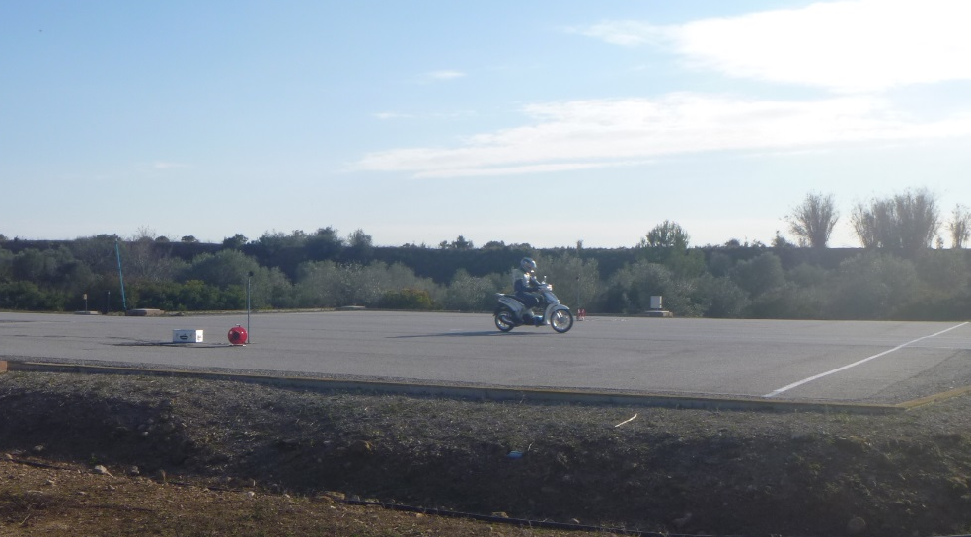
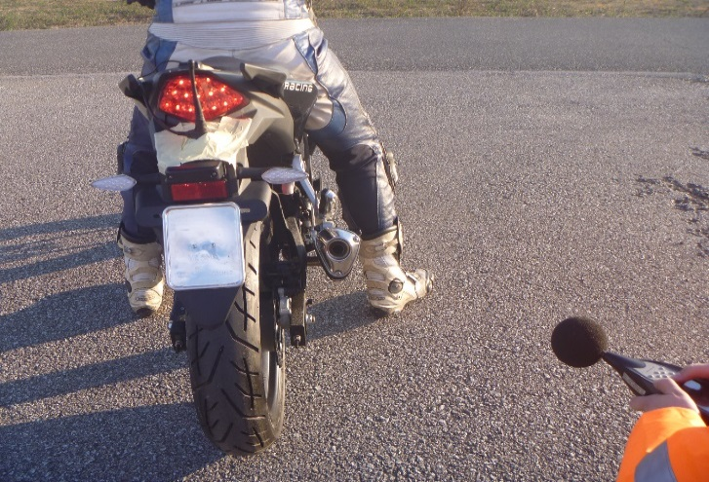
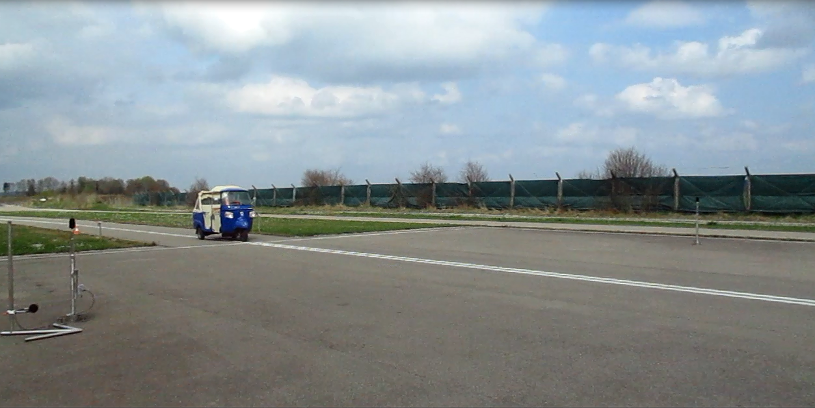
Vehicles Testing
Testing on homologated tracks in Spain and Germany
Vehicles tested according to UN Regulation 63, Regulation 41-04 and Regulation 9, depending on respective vehicle categories
Test in Motion
Stationary Test

Slide 9
Conclusions from measurements
Vehicles comply with their COP criteria
Vehicle-specific behaviour:
  All three mopeds 1 dB(A) below current limit,
  Two of the four L3e vehicles at or close to the current TA limit,
  Two of the four L3e vehicles and one L5e-B vehicle 4-5 dB(A) below current TA limit,
  The L5e-A vehicle at the current TA limit,
  The L6e-BP (mini-car) 14.5 dB(A) below current TA limit
  The L7e-B1 (ATV) at current COP limit
Reduction in sound limits will have different implications for different vehicle sub-categories
  Limit values for L5e-B and L6e-BP should be adjusted to the state of the art (4 or 8 dB reduction respectively would not require new technology measures)
  The feasibility of a similar reduction for L3e would be debatable.

Slide 10
Validation: Noise source Ranking (NSR)
Sound level is considered as the joint contribution of 4 different sub-systems: Exhaust, Intake, Engine, Driveline
Sub-systems covered for testing with heavy and effective acoustic damping material or muffled with additional “over-sized” infinite mufflers (for intake and exhaust)
These mufflers are not production representative but purposely reduce the exhaust and intake orifices sound emission
Each configuration is separately measured on pass-by measurement set up on both accelerated and cruise conditions
The comparison of all the various runs shows the contribution of the corresponding non-muffled subsystems

Slide 11
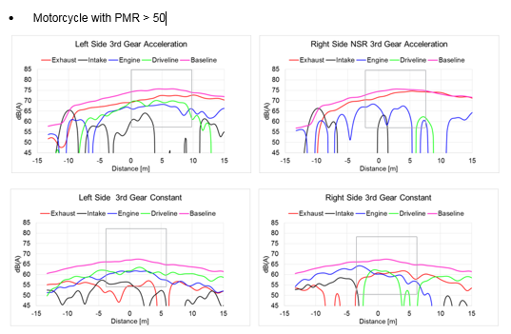
NsR Results Motorcycle 800cc PMR>50
Maximum pass-by area
Contributions of:
Exhaust
Intake
Engine
Driveline
Baseline sound level in original configuration, also equivalent to the total of all contributions
Exhaust dominant over transients, engine and driveline at constant speed

Slide 12
NSR testing Conclusions
Category | Test Concerns | Main contributors to sound levels | Technology to achieve lower levels
L1e-B, L2 | WOT | Exhaust main contributor, lower limit than other categories leaves less margin for reductions | Mostly exhaust but CVT as well
L3e, CVT | WOT, CRS | Exhaust and driveline are all important kp: power specific weighing of CRS/WOT | Exhaust sound attenuation, significant CVT attenuation necessary
L3e, manual | WOT, CRS | All components important CRS: intake, engine, driveline WOT: exhaust kp: power specific weighing of CRS/WOT | Vehicle specific but all four categories need to be considered.
L5e-A, L7e-B | WOT | No CRS contribution, hence exhaust most important | Exhaust sound attenuation Driveline in L7e-B
L5e-B, L6e-B, L7e-C | WOT | Vehicle specific, but definitely exhaust due to WOT test | Engine, exhaust, driveline: Better encapsulation possible

Slide 13
cost-benefit analysis (cba)
  The objective of performing CBA is to investigate the feasibility and relevance of possible new (lower) sound level limits for L-category vehicles
  The effectiveness of introducing lower limits depends on
    better enforcement = less excessive L-category vehicle noise due to illegal exhausts, tampering
    the relation between the limits and real world sound levels, especially the L_{WOT} levels on roads under acceleration (also: cycle bypassing for the test method)
    new (lower) sound limits of other vehicles gradually taking effect

Slide 14
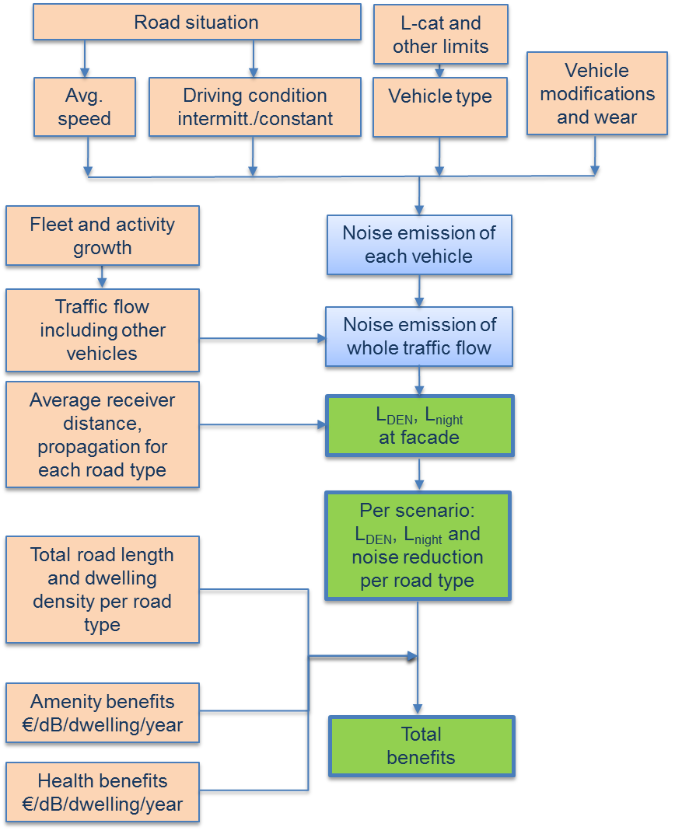
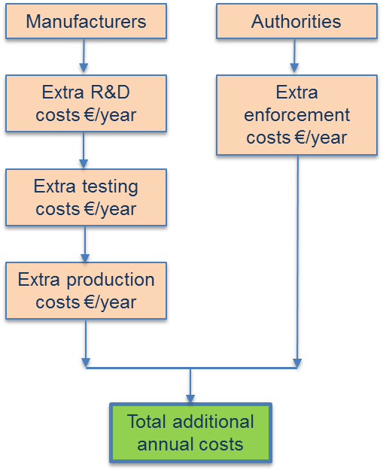
CBA methodology
Benefits Costs
Directive 2002/49/EC:
Long term average sound levels at the facade
L_{DEN}: Day Evening Night Level
weighted 12/4/8 h
L_{Night}: Night level, 8 h

Slide 15
benefits
Use of L_{DEN} (average) noise levels at the dwelling facade to assess noise reductions, which can be monetised
L_{DEN} level calculated with EU traffic noise model CNOSSOS, taking representative road types and sections into account
Valuation:
    Amenity (willingness to pay): € 29.90 / dB reduction / dwelling / annum
    based on EU paper 2002
    Health (only heart disease): € 17.60 / dB reduction / dwelling / annum
    based on TNO and UK estimates used for traffic noise
Alternative approach would be to use assessment of single events, L_{Amax} (currently under investigation)

Slide 16
Costs
Industry costs due to additional R&D, manufacturing and testing
(cost = price – tax – markup)
Enforcement costs for authorities and traffic police
Cost approach based on previous approach (i.e. L-Euro 5 emission study):
  Information received from industry
  Consortium assessment of technological needs to achieve lower limits

Slide 17
Benefit to cost ratio - net present value
Benefit to cost ratio =
Accumulated benefits over 20 year period
Accumulated costs over 20 year period
Net present value =
discounted value of benefits minus the discounted value of costs
Discount rate = 4% (takes future value into account)
Interest rate = 1% (takes growth and inflation into account)

Slide 18
CBA scenarios
Horizon: 2020 – 2040
1) Baseline scenario: no change to L-category limits
2) Reduced limits: on average -2 dB limit reduction
Exact limit change depends on L-subcategory considered
3) Ambitious scenario: on average -5 dB limit reduction
Exact limit change depends on L-subcategory considered
Scenario aims at showing max potential benefit if other conditions are met

Slide 19
Scenario conditions
Market growth (as in “L-cat Euro 5 effect study” project)
a) baseline: ‘business as usual’ after an initial sales rebound, shrinkage of mopeds sector, slow increase of motorcycles fleet
  b) high growth: increased number of registrations and fleet for motorcycles reflecting a vibrant economy, slower reduction of mopeds fleet
Traffic “background” noise levels
  a) baseline: current mean traffic noise levels despite tighter limits due to traffic growth
  b) reduction: average traffic noise levels reduced by 4 dB in 2040 due to lower limits for
  other vehicles, as in EU Regulation (EU) No 540/2014
Enforcement and ‘off-cycle’ sound levels
  a) baseline: moderate enforcement, use of automatically controlled exhaust flaps
  b) stringent: stringent enforcement, control of off-cycle sound levels

Slide 20
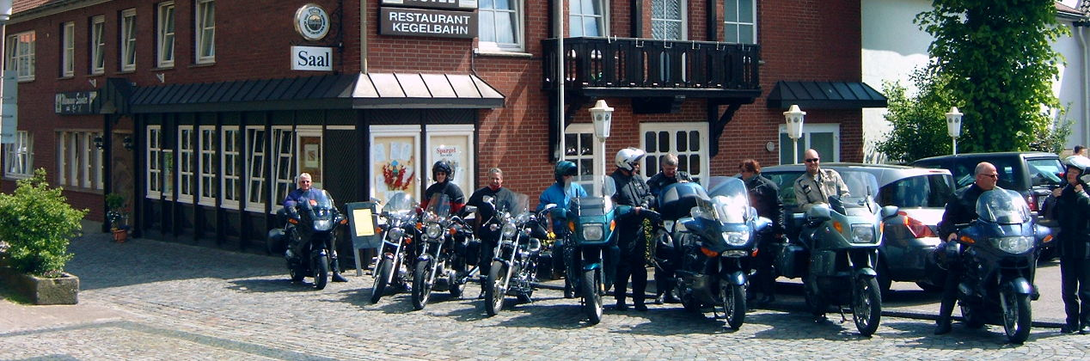
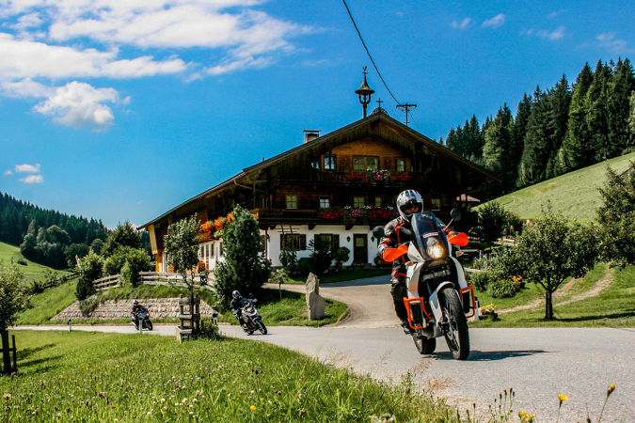
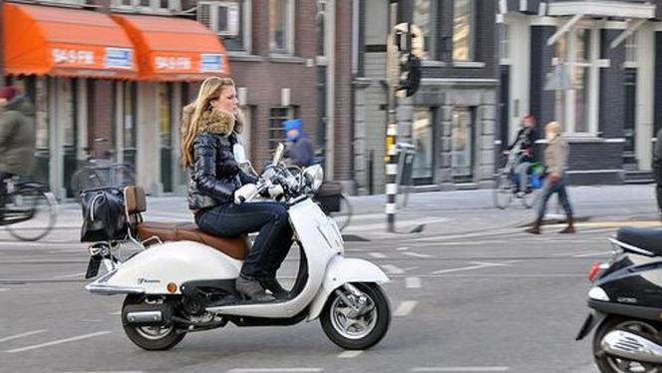
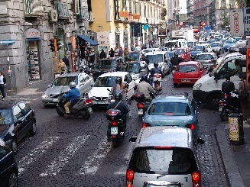
Situations in which L_{den} is reduced
Accelerating traffic only
Northern EU L_{DEN} effect:
Touring routes, mainly motorcycles
Residential roads, mainly mopeds
Main roads, mopeds and motorcycles
20% of the year (touring season, weekends+holidays)
Southern EU L_{DEN} effect:
Residential, main, arterial and rural roads
both mopeds and motorcycles
50% of the year (actual use)

Slide 21
Next steps
September – October 2017:
  Results and conclusions of CBA
  Limit values proposed and justification
  Discussion on boundary conditions for ASEP
  Final report

Slide 22
Thank you for your attention

