Slide 1
Study on Euro 5 sound level limits of L-category vehicles
65th GRB meeting
Transmitted by the expert from the European Commission
Informal document GRB-65-16
(65th GRB, 15-17 February 2017,
agenda item 10)
On behalf of the European Commission

Slide 2
GENERAL INFORMATION
Tender ID:
  Title: Study on Euro 5 sound level limits of L-category vehicles
  Tender No: 524/PP/GRO/IMA/16/1131/9316
  Contract No: SI2.736346 of the Consortium with the
  European Commission - DG-GROW
Consortium performing the work:
  EMISIA - Greece
  TNO - The Netherlands
  Ricardo Deutschland GmbH - Germany
  Heinz Steven Data Analysis and Consultancy (HSDAC) - Germany

Slide 3
background
      L-category vehicles continue to be source of complaints with respect to their (excessive) levels of sound emissions, often perceived as disturbing noise
      Excessive noise levels constitute a major nuisance for many European cities, contribute in quality of life degradation, and may be harmful for public health
      Recent advances in regulatory front (UN Regs. Nos. 9, 41, 63, 92 acceded - or to be acceded - by the EU Regulatory context) focused on improvements in the testing procedure and provisions for better market surveillance, enforcement, anti-tampering measures, and replacement silencers
      Current (Euro 4) sound level limits have been basically transferred from limits already applicable since the 1990’s (Directive 97/24/EC chapter 9) and remain (almost) unchanged for ~20 years

Slide 4
Project Objectives
      Investigate the potential for new sound limits of L-category vehicles at Euro 5 step and make a justified proposal, taking into account:
      the citizen’s needs and opinions of interested stakeholders
      (feedback gathering)
      the evolution of sound levels of approved vehicle types
      (actual vehicle testing)
      the technical and economic feasibility in the medium term range
      (cost-benefit analysis)
      The new sound limits will be accompanied by an appropriate application timeframe
      The ultimate objective is to protect the environment and human health, by providing an improved sound level range for L-category vehicles, and contribute in the reduction of the so-called ‘noise pollution’

Slide 5
Project tasks and time plan
Task 1: Estimate of sound level limits for all L-categories (Oct.’16 – Jan.’17)
a) Feedback gathering – stakeholder survey
b) Literature review
Task 2: Verification of sound level limits (Jan.’17 – Apr.’17)
a) Actual vehicle testing – sound measurements
b) Processing of results
Task 3: Cost-benefit analysis (Mar.’17 – Aug.’17)
a) Input data, scenarios, first results
b) Improvements, final CBA results
Task 4: Validation tests (Mar.’17 – Jun.’17)
a) Additional vehicle testing – sound measurements
b) Noise Source Ranking (NSR)
Task 5: Proposal for limit values and reporting (Jul.’17 – Oct.’17)
Final sound limits proposed by the study and recommendations

Slide 6
TASK 1: ESTIMATE OF SOUND LEVEL LIMITS
FOR ALL L-categories
INDICATIVE RESULTS AND FINDINGS FROM THE FEEDBACK GATHERING

Slide 7
Overview of the survey
Objectives
In-depth understanding of the wishes, demands, and requirements of stakeholders directly involved in the implementation of (possible) new sound limits (manufacturers, authorities, etc.)
Take into account the opinion of the recipients of possible benefits from improved sound limits (concerned citizens, municipalities, associations, environmental organizations, etc.)
Approach
Technical questionnaire sent to a large number of various stakeholder groups
Collection of responses, processing of questionnaires, analysis and main findings
Structure of questionnaire
Section 1: Technical issues related to sound limits
        Current status (Euro 4), improved (Euro 5) sound limits, absorbent fibrous materials, ASEP
Section 2: Contribution of L-category vehicle components to sound emissions
Section 3: Cost/benefit impact from the expected sound emissions reduction
        New vehicles, existing fleet

Slide 8
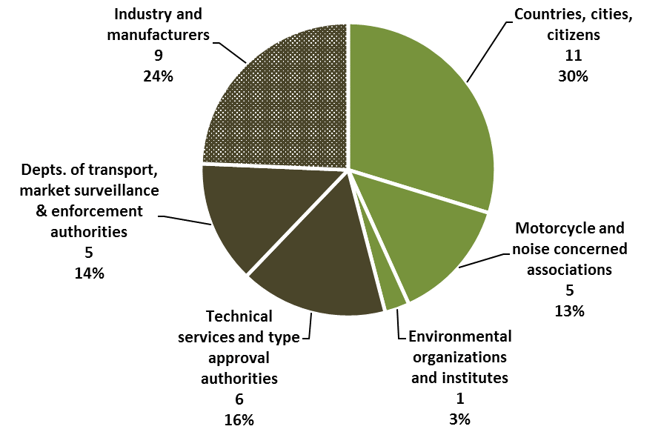
Positive responses – filled in questionnaires
Industrial stakeholders
‘Technical’ entities
Social partners
National authorities
      37 positive responses (satisfactory feedback, considering the technical nature of questionnaire)
      Most responses (54%) are from ‘technical’ entities; this enhances the validity of results regarding their technical content
      On the other hand, ‘social’ partners showed their interest despite the technical nature of questions (46% of responses); this shows the continuous interest and necessity to further decrease sound emissions

Slide 9
COMPLETED Questionnaires received from
      National responses (TSs, TAAs, transport departments, market surveillance, enforcement):
        DE (2), ES (2), NL, SE, IE, CH (2)
        Outside Europe: CN (2)
      Industry & manufacturers:
        ACEM, ATVEA
        From IT: Piaggio, ANCMA, Arrow, LeoVince, Termignoni, MIVV, Lafranconi Silenziatori
      Cities & organizations (environmental, noise concerned, motorcycle, consumer, other):
        Budapest, Madrid, Rotterdam (2)
        ANEC, FEMA, FIA
        From DE: UBA
            MOTORRADLAERM.DE - BUND für Umwelt und Naturschutz Deutschland
            Anwohnerinitiative gegen Verkehrslärm in Hattingen
            ALD (DE) - Arbeitsring Laerm der DEGA (Deutsche Gesellschaft für Akustik e.V.)
        Anonymous responses: DE (2), FR (2), NL
        1 individual response

Slide 10
Main conclusions from the survey
Social partners
The majority of social partners (~94%), especially non-bikers and environmental organizations, want a significant decrease in sound limits. However, this percentage is interpreted as a general requirement to reduce the excessive sound emissions (noise) produced by the inappropriate usage of vehicles and rider behaviour (i.e. illegal aftermarket exhaust, tampering, etc.).
Industrial stakeholders
Manufacturers have significant concerns about lowering sound limits, as this measure alone is not considered sufficient, if not combined with better enforcement of regulations, anti-tampering measures, and improvements in the test procedures. Furthermore, it entails the risk to drive even more customers to purchase illegal aftermarket systems.
National technical authorities
They express an intermediate position (in-between social partners and industry), suggesting a moderate reduction in sound limits, depending on the vehicle type and (possibly) excluding some categories. This reduction should be combined with specific technical improvements in the test procedure (ASEP) in order to be more representative of real-driving conditions.
Lowering the type approval sound limits is not the only problem that needs to be addressed

Slide 11
Technical feasibility for lower limits
      Current (Euro 4) sound limits remain (almost) unchanged for ~20 years
      Technical knowledge is available and existing technology is mature enough, so that Euro 4 limits are quite easily achievable for most of the L-categories
      Additional technology (possibly) required to achieve lower (Euro 5) limits:
        Bigger silencers (with potential impact on vehicle package and, perhaps, a problem for small vehicles)
        Better shielding and covering by silencing foam, new absorber material, modifications of the inlet and exhaust systems
        Better engine design and optimization for noise and vibration, optimization of combustion process, specific ECU software
      Concerns that specific vehicle categories (super-sport, off-road trial and enduro motorcycles, ATVs) may have additional technical difficulties
      Economic issues: very uncertain parameter
        Opinion 1: Additional technological improvements may increase the vehicle cost
        Opinion 2: Currently, a lot of money and effort is spent in sound design; no indication that designing for lower limits is necessarily more costly

Slide 12
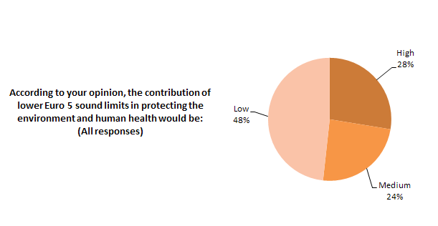
Environmental impact from lower limits
      All participants agree that there will be no environmental benefit, if lower limits will not be combined with:
        Better enforcement, effective market surveillance, road-side checks and periodical inspections, etc.
        Anti-tampering measures, i.e., making manipulations more difficult, forbidding certain illegal replacement silencers, etc. More environmentally friendly rider behaviour
        Improvements in the test procedures in order to be more representative of real-driving conditions, sound emissions outside ASEP area, incorporation of ASEP into type-approval procedure (not self-certification), etc.
      If the above items will not be in a package together with lower limits, the gap between real-world and type-approval sound emissions will not close

Slide 13
TASK 1: ESTIMATE OF SOUND LEVEL LIMITS
FOR ALL L-categories
LITERATURE REVIEW – RESULTS FROM THE Analysis of kba database

Slide 14
distribution of type approval sound levels
L1 vehicles
Euro 4 limit
● L1 ≤25km/h
Euro 4 limit
● L1 >25km/h
>25

Slide 15
distribution of type approval sound levels
L3, l5, l7 vehicles
Euro 4 limit
● L3 80< eng. cap. ≤175cm³ (EU Reg. 168/2013)
● L3 PMR >50 (UN Reg. 41.04)
Euro 4 limit
● L4, L5, L6, L7
● L3 >175cm³ (EU Reg. 168/2013)

Slide 16
UNDER TASKs 2 and 4: actual vehicle testing – sound measurements

Slide 17
Objectives – selection of vehicles
The objective of including testing of sound levels in the study:
  To establish current sound levels of state of the art vehicle
  Assess the contributions to the sound level of the different sources – vehicle components
Vehicles have been selected with achieved levels under or on the current limit and with recent homologation certificates (no more than 2-3 years)
Vehicles are tested in production configuration
In the validation tests (Task 4), a Noise Source Ranking (NSR) study (successive physical masking of the different sound level sources) is scheduled to identify and quantify the technical possibilities for sound level reduction on two different L3 vehicles (scooter, motorcycle) and one L7 vehicle (quadricycle)

Slide 18
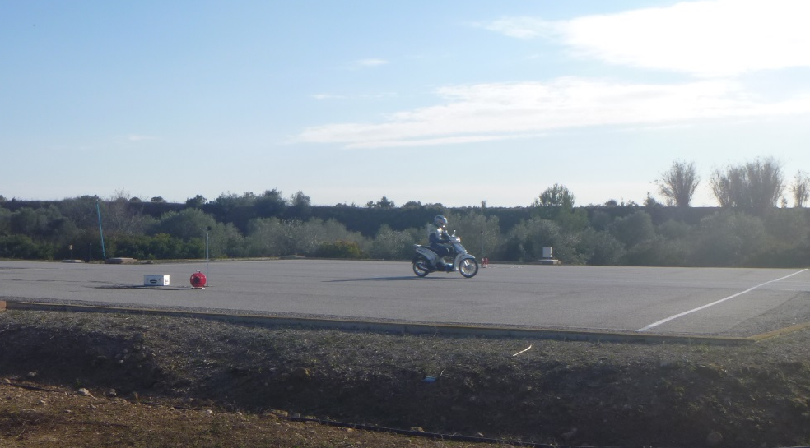
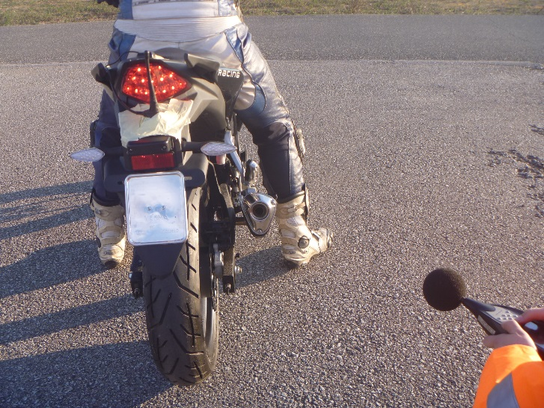
L1-vehicle Category testing
3 different vehicles tested according to UN R63
    L1eB-LS: Scooter 50cc (CVT) with physical restriction to 25km/h (MOFA)
    L1eB-HS: Scooter 50cc (not restricted)
    L1eB-HS: Manual 50cc
    Approval levels are in the process of verification
Acceleration Test
Standing Test

Slide 19
TASK 3: cost-benefit analysis plan FOR THE CBA model

Slide 20
Some key points on cba to be performed
      The main objective is to assess the technical and economic feasibility of lower (Euro 5) limits in the medium term range
      Input from Task 1 (feedback gathering and literature review) and Tasks 2 and 4 (actual vehicle testing – sound measurements) will be used
      Different scenarios will be examined (i.e. no change to limits, moderate reduction, ambitious limits), fleet projections (baseline, low/high market growth), urban/non-urban areas
      Focus on single or individual special noise events, e.g. noisy pass-by vehicles in villages and quiet rural areas, noisy events at night or during weekends/holidays
      CBA consistent with EU policy of sound emissions control at the source

Slide 21
Next steps – project milestones
      April 2017
      Processed results from vehicle testing
      CBA input data and methodology finalized
      June 2017
      All vehicle testing results finalized
      First results from CBA
      September 2017
      Final limit values proposed by the study and their justification

Slide 22
Thank you for your attention

