Slide 1
Some proposals of interpretations on UN R51.03 following GRB-64-15 - (France) Some proposals to improve efficiency of road vehicle noise regulations
Transmitted by the expert from France
Informal document GRB-65-12
(65th GRB, 15-17 February 2017,
agenda items 4 and 17)
Prepared by LF Pardo (France)

Slide 2
Transmission Set Up of the representative vehicle
“If the vehicle allows different transmission setups like automatic or manual gear selection and/or different software programs or modes (e.g. sporty, winter, adaptive) leading to valid accelerations, the vehicle manufacturer shall prove to the satisfaction of the Technical Service, that the vehicle is tested in the mode which achieves an acceleration being closest to a_{wot ref.}”
→ Could we consider that the mode which usually achieves an acceleration being closest to a_{wot ref} is locked-gear (using 1 gear with a _{wot ref} ± 5% or 2 gears).

Slide 3
Transmission Set Up of the representative vehicle
Could principle be extend to transmission variant in a vehicle type ?
→ For a vehicle-type which can equipped either with locked or with non-locked transmission, could we recommend that the vehicle shall be tested only in locked gear instead of both with locked and non-locked gear.
MT
Locked gear mode
AT
Non-locked gear mode

Slide 4
Transmission Set Up of the representative vehicle
“The vehicle transmission, gear, or gear ratio may be controlled by electronic or mechanical measures to avoid the activation of a kick-down function.
Therefore, it is permitted to establish and use electronic or mechanical devices, including alternate gear selector positions, to prevent a downshift to a gear ratio which is typically not used for the specified test condition in urban traffic.”
→ Could we precise the use of electronic device by manufacturer to test in alternate gear ?

Slide 5
Transmission Set Up of the representative vehicle
“The vehicle transmission, gear, or gear ratio may be controlled by electronic or mechanical measures to avoid the activation of a kick-down function.”
How to define Kick-down function ?
Gear shifting
x gear shifting or
gear shifting to a gear ratio which is typically not used for the specified test condition in urban traffic
Notch on pedal position close to end position
…
→ Could we precise kickdown function ?

Slide 6
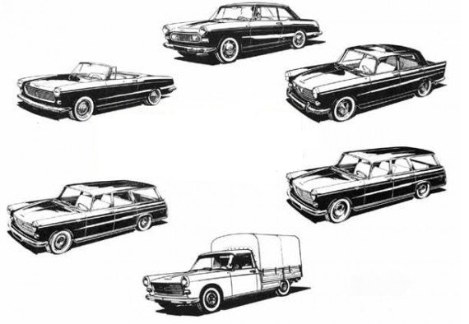
Mass of the representative vehicle
The test mass has to be measured with +/- 5% compared to target mass.
Mass is not part of the Vehicle Type definition. In that case the representative vehicle selected for testing could be for example, a 5 seats or 7 seats, with or without option, …
→ There is not only one mass in running order (target mass) but a range of mass in running order.

Slide 7
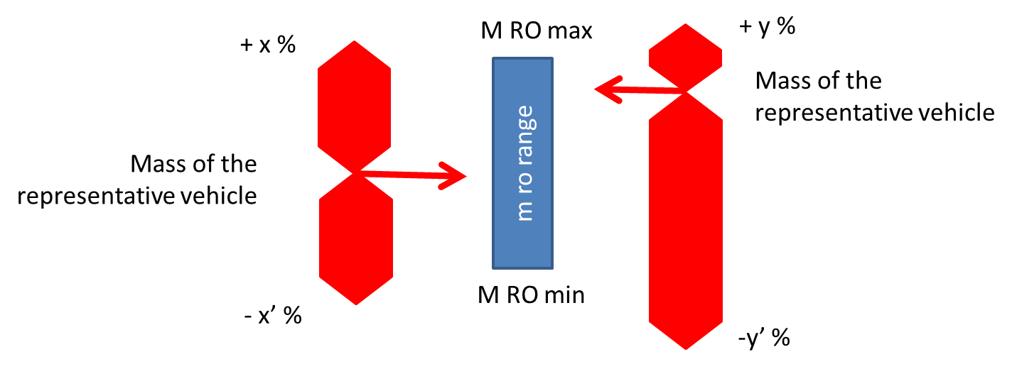
Mass of the representative vehicle
→ Could we consider range of m _{ro} ?
→ Could we precise how to select representative vehicle regarding range of m _{ro} ?
→ How to consider PMR, a _{wot ref}, a _{urban}, L _{urban} calculation… regarding m _{ro} range ?
e.g.

