Slide 1
INNOVATIVE POLICIES & INCENTIVES FOR INTERMODAL TRANSPORT
Kayıhan Ö. TURAN
UTIKAD
TURKEY
October 31 – November 1, 2016

Slide 2
UTIKAD
UTIKAD
Association of International Forwarding and Logistics Service Providers
National and International Transportation:
Road, Air, Sea, Rail and Combined Transportation
Logistics Services
Above 400 Members & 50,000 Direct Employment & 5 USD Billion Turnover
95 % of Air Transport
70 % of Road Transport
60 % of Sea Transport
20 % of Rail Transport
carried out by our members in Turkey

Slide 3
UTIKAD
‘’The Umbrella Organization for the Transportation and Logistics Industry’’
Presence & Organizations
Projects & Cooperations
Training & Publications
Social Responsibilities

Slide 4
NATIONAL & INTERNATIONAL PLATFORMS
VOICE OF INDUSTRY IN TURKEY
VOICE OF INDUSTRY IN THE WORLD

Slide 5
PRESENCE & ORGANIZATIONS
Voice of Industry Abroad with 6 Institutions
FIATA, CLECAT, UNECE, ECOLPAF, TRACECA, SEESARI
Founding Member of ECOLPAF & SEESARI
Working Groups of 7 Sectoral Divisions
Hosted 4 International Organizations
International Organizations By UTIKAD
1999
2002
2011
2014
Balkan Congress
FIATA World
Congress
10. Southeast European
Freight Forwarders
& Logistics Operators
Congress
FIATA World
Congress

Slide 6
FIATA WORLD CONGRESS 2014 ISTANBUL
From 95 Countries, 1039 Participants came together
15 Meetings
35 Speakers
1055 Networking Meetings
43 Exhibitors
Italy
Gana
India
U.S.A
Nigeria
U.A.E.
Taiwan
Ukraine
Malaysia
Belgium
MAIN SPONSOR
PLATIN SPONSOR
PLATIN SPONSOR
MAIN MEDIA SPONSOR
BRONZE SPONSOR
SILVER SPONSOR
YIFFYA SPONSOR
MEDIA SPONSORS

Slide 7
TRAINING & PUBLICATIONS
FIATA Diploma in Freight Forwarding / with 25 graduate end of 1st year June - 2016
Self Improvement and Vocational Trainings
Ahmet Kartal Annual Achievement Award
9 Educational Books & 2 Special Report
UTIKAD Library of 368 Books
Publications By UTIKAD

Slide 8
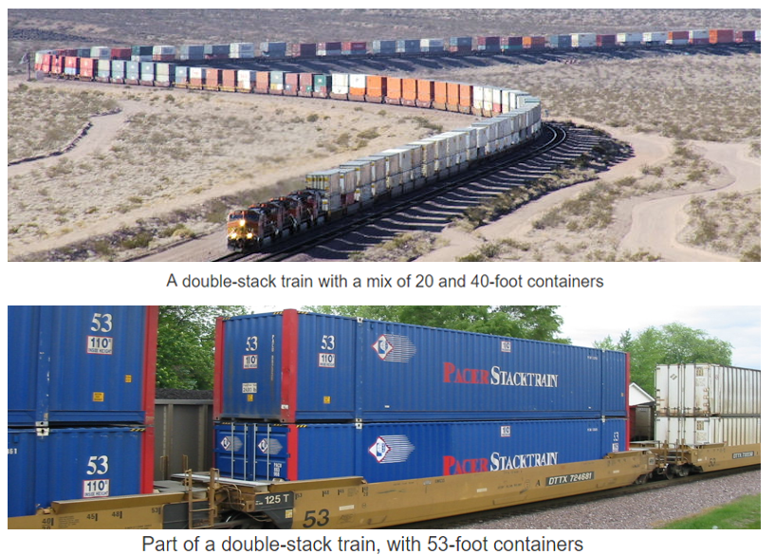
INNOVATIONS - I
ONE OF THE MAIN TARGET OF INTERMODALIZZATION IS TO MINIMIZE TOTAL LOGISTICS COSTS
TO DO SO, WE HAVE TO CARRY MORE ITUs ON RAIL WAGONS
SO WHY NOT TO CARRY 2 STACK CONTAINERS ON WAGON
ESPECIALLY ON ROUTES BETWEEN SEA PORTS & DRY PORTS / TERMINALS
USA SINCE 1984
AUSTRALIA, CHINA, INDIA,
PAKISTAN, PANAMA
S. ARABIA

Slide 9
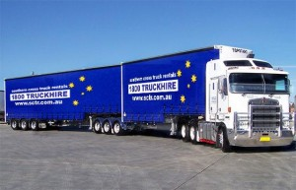
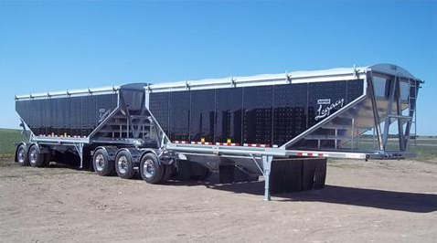
INNOVATIONS - II
ONE OF THE MAIN TARGET OF INTERMODAL TARGET IS TO MINIMIZE TOTAL LOGISTICS COSTS
TO DO SO, WE HAVE TO MINIMIZE INLAND HAULAGE COSTS FOR PRE/FINAL INLAND HAULAGE
SO WHY NOT TO CARRY 2 ITUs BY ONE TRUCK LIKE SEMI TRAILERS ON ROAD

Slide 10
INNOVATIONS - II
2 CONTAINERS BY ONE TRUCK

Slide 11
INNOVATIONS - II
1x20 CONTAINER + 1 SWAP BODY BY ONE TRUCK

Slide 12
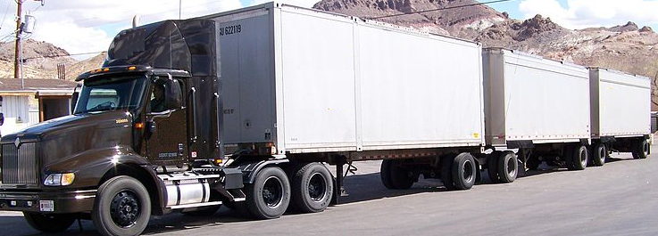
INNOVATIONS - II
3x30 CONTAINER BY ONE TRUCK

Slide 13
REGULATIONS
EACH COUNTRY SHOULD CHECK THE LIMITS OF LENGTH & TOTAL WEIGHT OF SUCH VEHICLES ON ROADS & DECIDE ACCESSABLE ROUTES
TECHNICAL STUDIES SHOULD BE DONE ON SUCH VEHICLES

Slide 14
INCENTIVES - I
1ST PROGRAME WAS «PACT» // 1997 – 2001
TOTAL BUDGET WAS € 5 MILLION
%30 OF PROJECTS WERE FUNDED

Slide 15
INCENTIVES - I
2ND PROGRAME WAS «MARCO POLO»
MP1 // 2003 – 2006 - €102
MP2 // 2007 - 2013 - €450
TOTAL BUDGET WAS € 552 MILLION

Slide 16
INCENTIVES - I
«MARCO POLO»
MP1 // 2003 – 2006
* 125 Projects over 500 companies received fund
%79 modal shift actions from road to other modes
%9 common learning actions
%8 catalyst actions
%2 traffic avoidance Projects
%2 motorways of sea projects

Slide 17
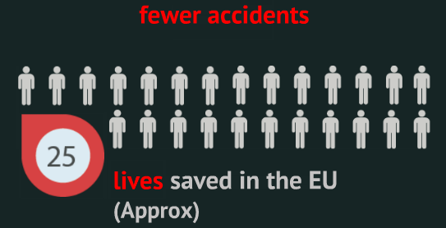
MP I
MAX 44.5 – MİN 8.4

Slide 18
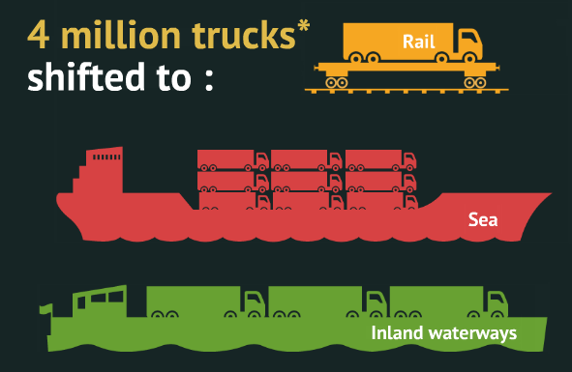
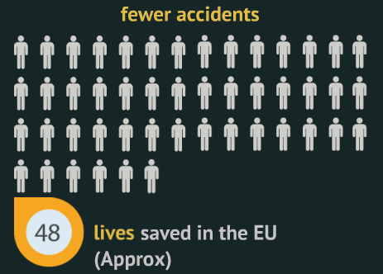
MP II // 2007 – 2011 5 YEARS RESULTS

Slide 19
INCENTIVES - I
FUNDED SAMPLE PROJECTS
2003 / ANTWERP PORT -> INLAND TERMINAL / € 1.73 MİLLİON
2004 / GERMANY -> HUNGARY / € 3.07 MILLION
2005 / FRANCE GOLBEY -> BARSELONA/TARRAGONA / € 1.79 MILLION
2006 / NETHERLAND -> HUNGARY / € 1.11 MILLION
2009 / NORWAY -> BENELUX / € 4.32 MILLION
2010 / PONEZIA -> ZEEBRUDGE / € 2.91 MILLION
2012 / ROTTERDAM -> WARSOWA / € 4.94 MILLION
2013 / NORWAY/DENMARK -> NORTH FRANCE / € 3.39 MILLION

Slide 20
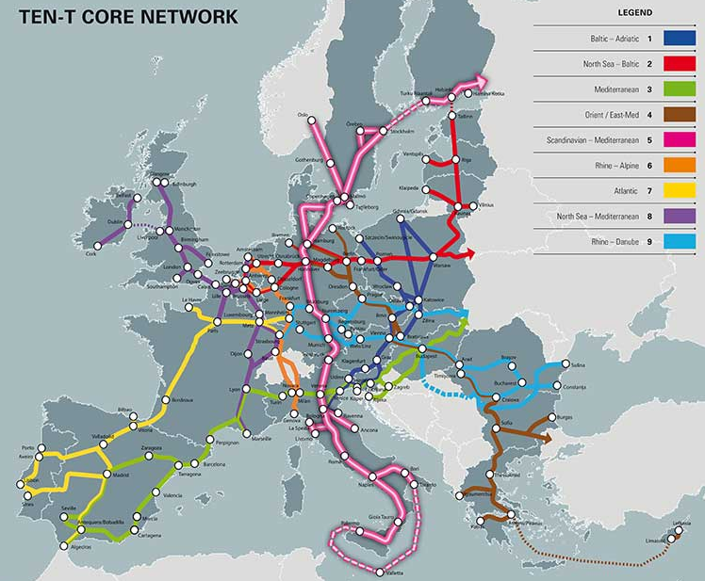
INCENTIVES – I – OTHER PROGRAMMES
A core transport network
on nine major corridors:
2 North–South corridors
3 East–West corridors
4 diagonal corridors
The core network is to
be completed by 2030

Slide 21
INCENTIVES – I – OTHER PROGRAMMES
The Projects of the TEN-T Programme cover all transport modes – air, rail, road and waterborne ( maritime / inland waterways ) plus logistics and intelligent transport systems and involve all EU Member States.
EU Funding for TEN-T
At EU level, two sets of funding instruments make financial support available to projects implementing the TEN-T:
1.Connecting Europe Facility
2.CohesionFund & European Regional Development Fund .

Slide 22
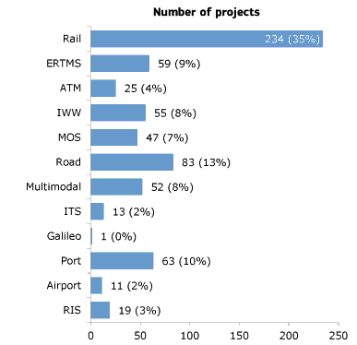
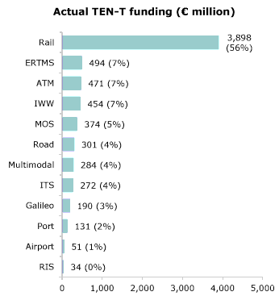
INCENTIVES – I – OTHER PROGRAMMES

Slide 23
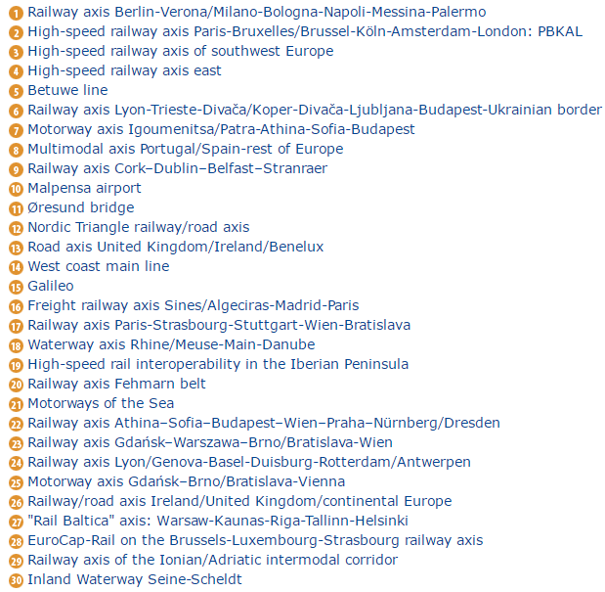
INCENTIVES – I – OTHER PROGRAMMES
From the start, the TEN-T
Guidelines included priority
Projects.
Those projects having
particular importance and
of a significant size.
They were extended at the
time of the EU’s 2004
enlargement to reflect
Europe’s changed
geographical space.
Priority projects are now 30
in number and occupy a central position in EU initiatives

Slide 24
INCENTIVES – I – OTHER PROGRAMMES
The Connecting Europe Facility (CEF) for Transport is the funding instrument to realise European transport infrastructure policy. It aims at supporting investments in building new transport infrastructure in Europe or rehabilitating and upgrading the existing one.
CEF Transport focuses on cross-border projects and projects aiming at removing bottlenecks or bridging missing links in various sections of the Core Network and on the Comprehensive Network (link), as well as for horizontal priorities such as traffic management systems.
CEF Transport also supports innovation in the transport system in order to improve the use of infrastructure, reduce the environmental impact of transport, enhance energy efficiency and increase safety.
Total budget for CEF Transport is €24.05 billion for period 2014-2020
2016 TRANSPORT CALLS & 16 OCT 16 & 7 FEB 17
TOTAL € 1.9 BILLION OF FUNDING

Slide 25
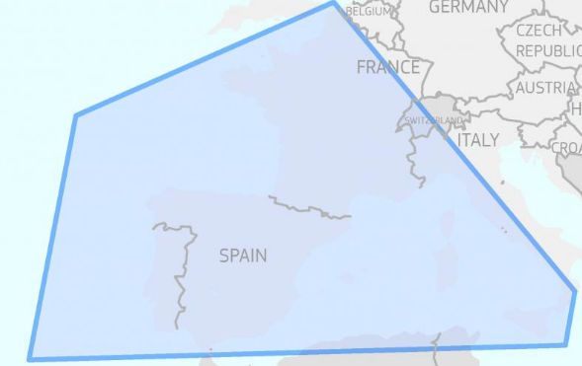
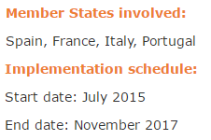
INCENTIVES – I – OTHER PROGRAMMES
MED ATLANTIC ECOBONUS
AIMING FOR MODAL SHIFT BY PROMOTING THE USE OF SEA-BASED ALTERNATIVE ROUTES & REDUCE ROAD CONGESTION
ECONOMIC INCENTIVE TO ROAD HAULIERS & SHIP OWNERS COVERING UPTO %30 OPS COST, NO LONGER THAN 3 YEARS

Slide 26
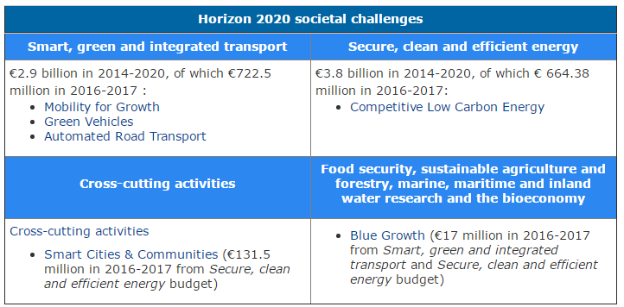
INCENTIVES – I – OTHER PROGRAMMES
HORIZON 2020

Slide 27
INCENTIVES - I
MAIN QUESTION ?
WHO RECEIVED THE FUNDS?
ROAD HAULIERS / SHIP OWNERS / RAIL OPERATORS
IMPORTANT QUESTION ?
DID PROJECTS WENT ON AFTER FUNDING
WAS OVER?

Slide 28
INCENTIVES - I
ANSWER TO THAT QUESTION IS IN
«Evaluation of the Marco Polo Programme, 2003-2010, Final Report
ITEM 1.32
Of 32 respondents to a survey question on the legacy of projects financed under the Marco Polo programme, 23 (i.e. 72 per cent) stated that the projects would continue (for Marco Polo II) and have continued (for Marco Polo I) following the end of the Grant Agreement of Marco Polo.

Slide 29
INCENTIVES - I
ITEM 4.72
Of those projects that will not continue (or have not continued) once Marco Polo funds are no longer available, the most common explanation was that the project was no longer financially viable. Other comments included that the service is of general interest and requires public support in the long run (response for one common learning action); that the project was terminated due to economic hardships in the industry; and that it is too early to tell at this stage whether or not the project will continue.
ITEM 4.73
The majority of respondents that stated that the project will (or did) continue further stated that the project would not change in nature when Marco Polo funds are no longer available. Ten of the 28 respondents to this question stated that the project will (or did) change in nature and the most common explanation was that a change in location of market means a change in the route.

Slide 30
INCENTIVES - II
THE FUTURE OF
INTERMODAL TRANSPORT
END USERS / NOT ONLY
SERVICE PROVIDERS
SO FUTURE IN THE HANDS OF SHIPPER & CONSIGNEE
FINALLY THESE 2 PARTIES SHOULD BE ATTRACTED
HOW ?
BY ECONOMICAL INCENTIVES IF THEY PREFER TO USE INTERMODAL TRANSPORT I / O ROAD TRANSPORT

Slide 31
Thank You
Kayıhan Ö. Turan
UTIKAD

