Slide 1
UNECE Intermodal Workshop & Logistics

Slide 2
UIRR - Overview

Slide 3
UIRR – 2015 figures

Slide 4
UIRR – 2015 figures

Slide 5
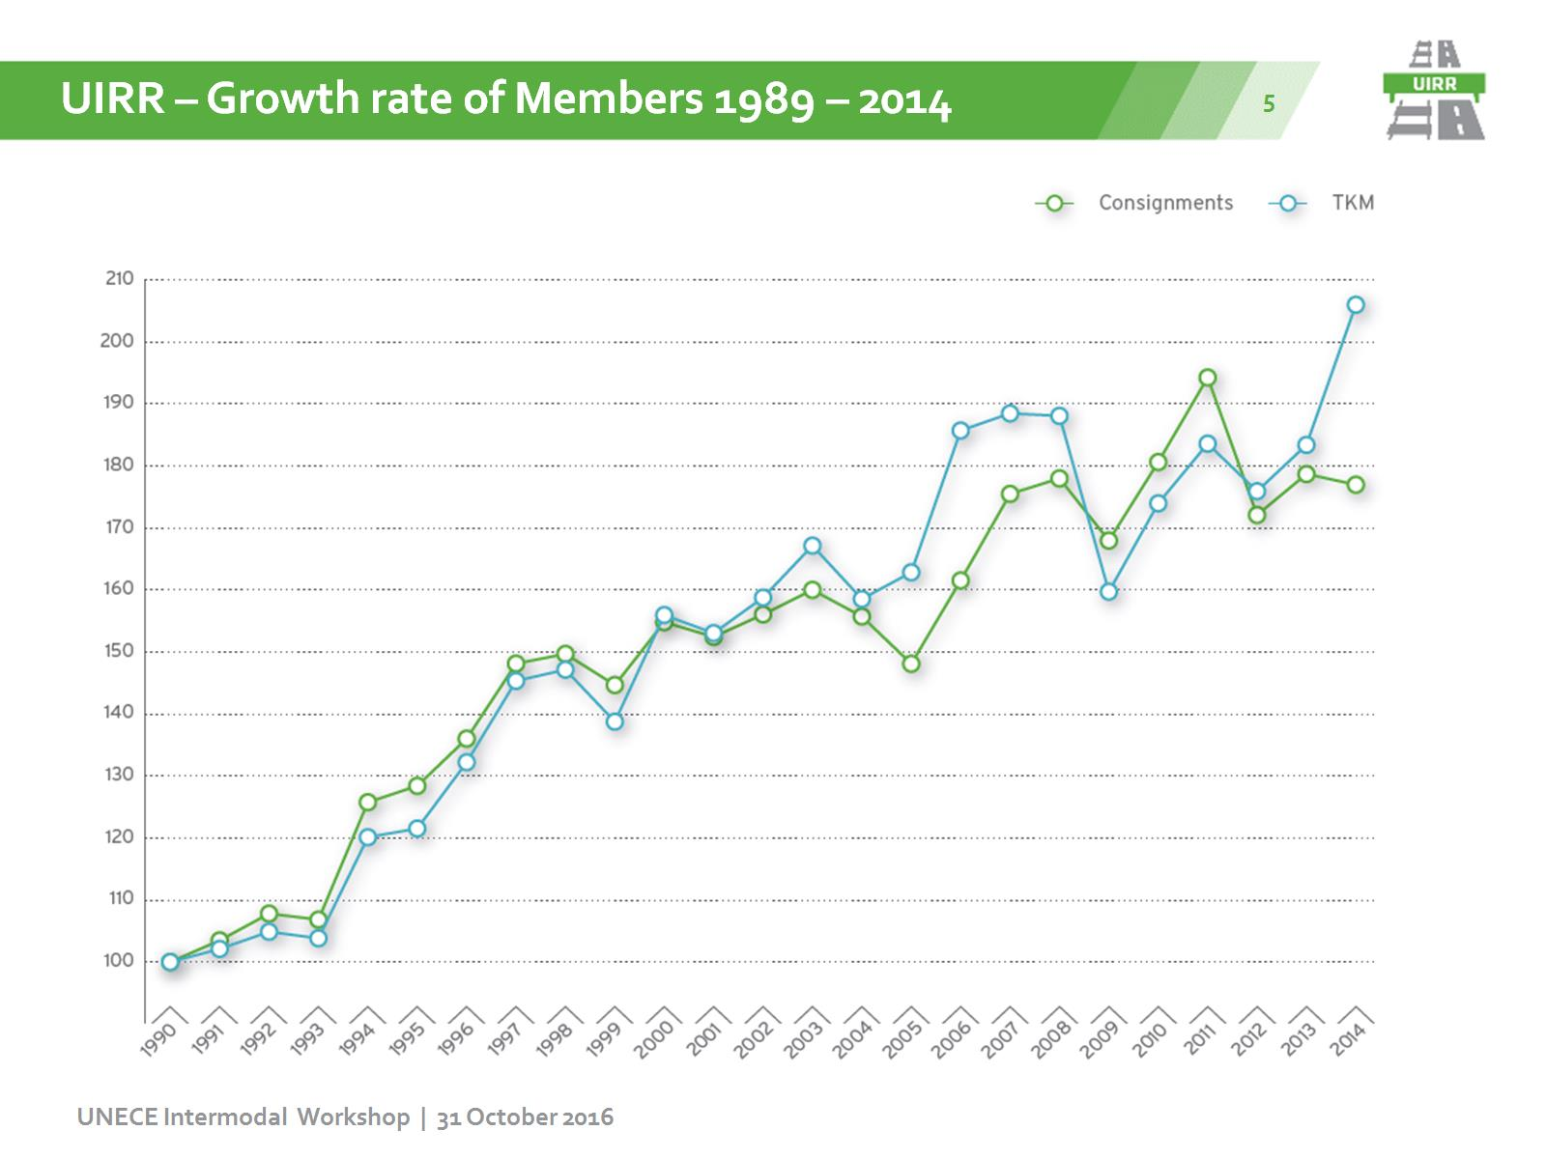

Slide 6
Railways: Fourth Railway Package

Slide 7
Railways: Rail Freight Corridors

Slide 8
Railways: Infrastructure development

Slide 9
Intermodal: The sector’s strategy

Slide 10
Intermodal: A need from the EU legislator 1/2

Slide 11
Intermodal: A need from the EU legislator 2/2

Slide 12
Road Legislation : clarity needed for intermodal operations

Slide 14
LAST MILE EU STUDY - Background & Objectives

Slide 15
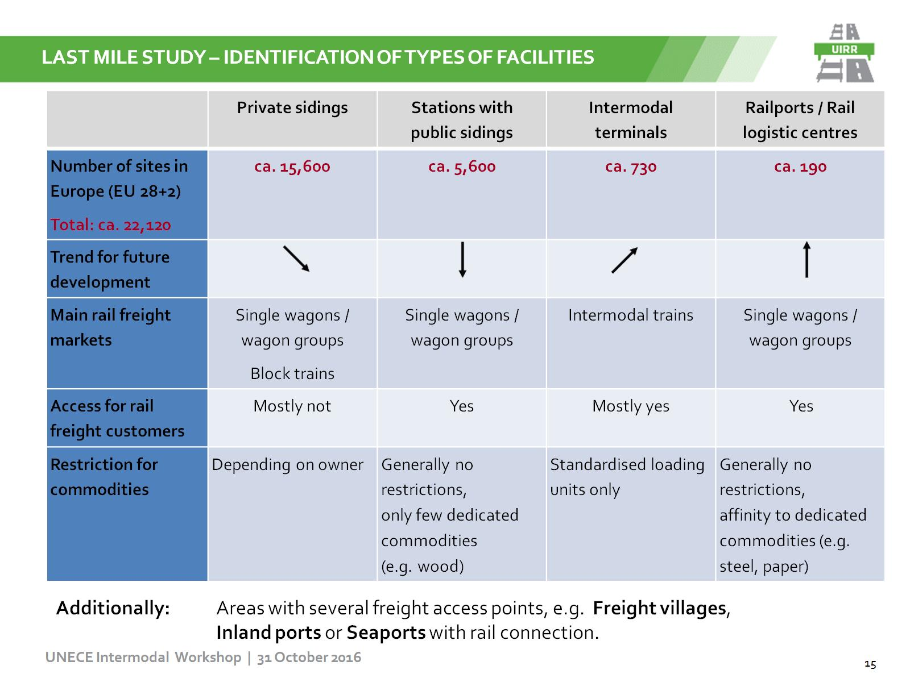
LAST MILE STUDY – IDENTIFICATION OF TYPES OF FACILITIES

Slide 16
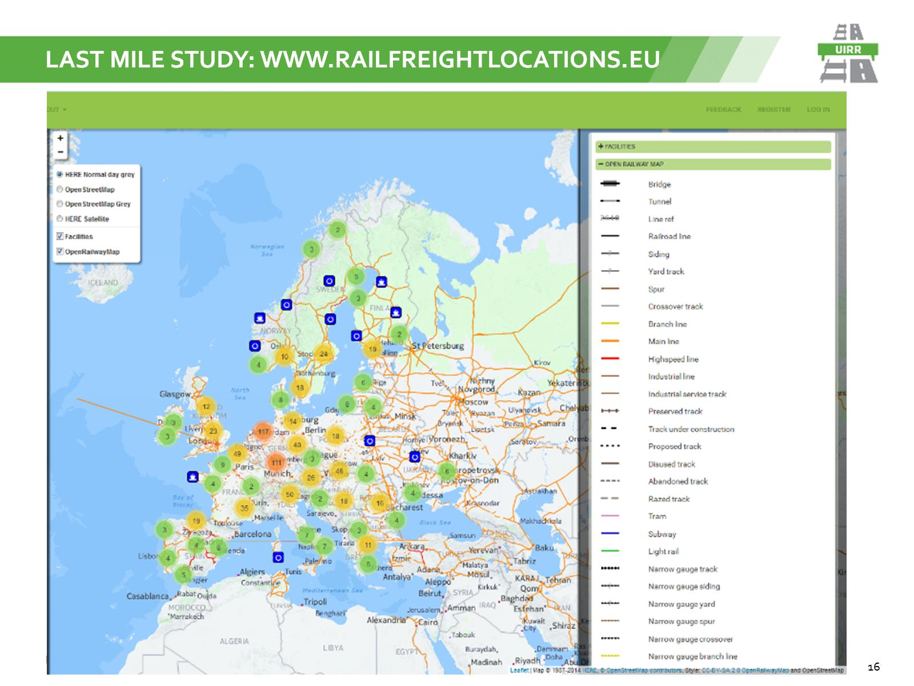
LAST MILE STUDY: WWW.Railfreightlocations.eu

Slide 17
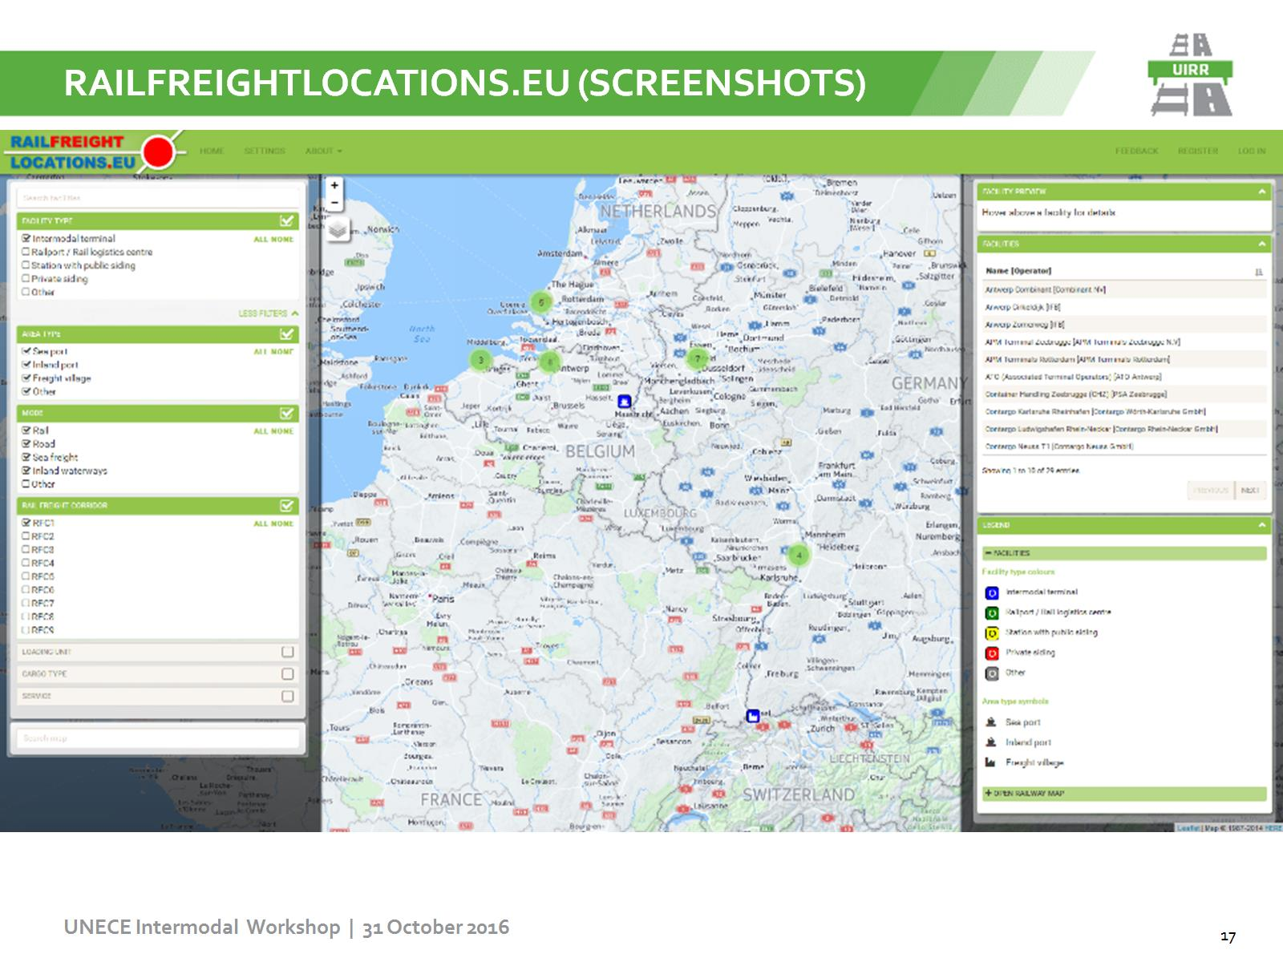
Railfreightlocations.eu (Screenshots)

Slide 18
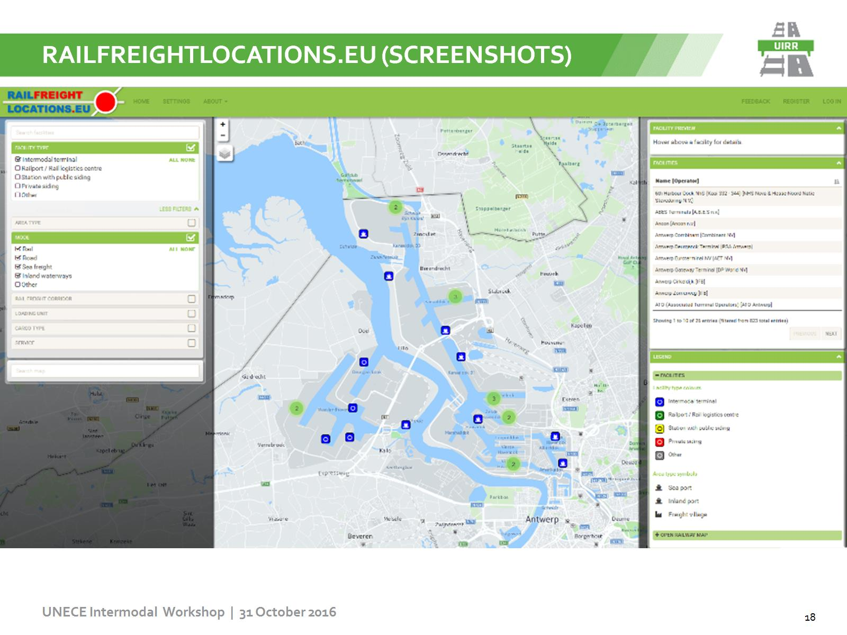
Railfreightlocations.eu (Screenshots)

Slide 19
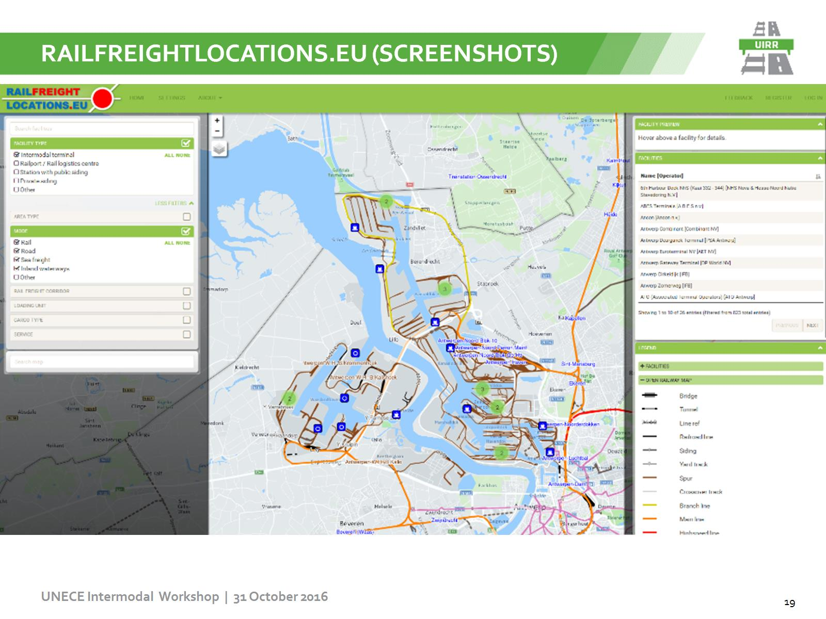
Railfreightlocations.eu (Screenshots)

Slide 20
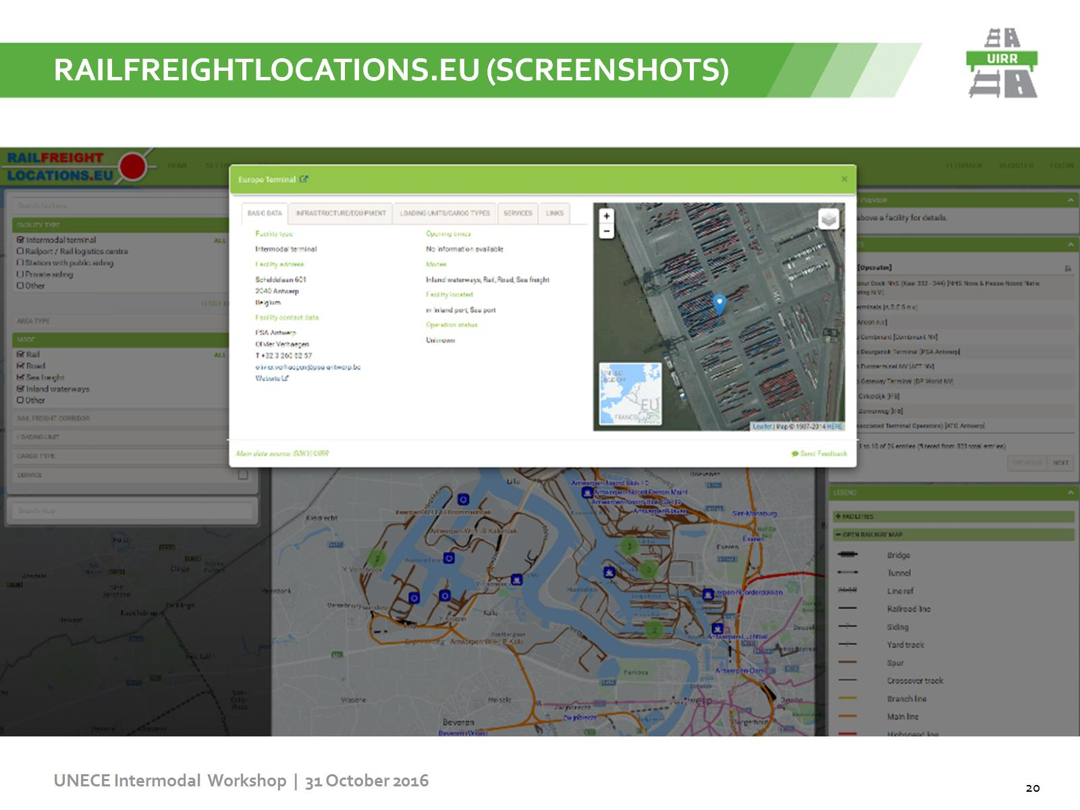
Railfreightlocations.eu (Screenshots)

Slide 21
LAST MILE STUDY: after…

Slide 22
Thank you

