Slide 1
Railway Infrastructure Financing and Public-Private Partnerships
November 2016

Slide 2
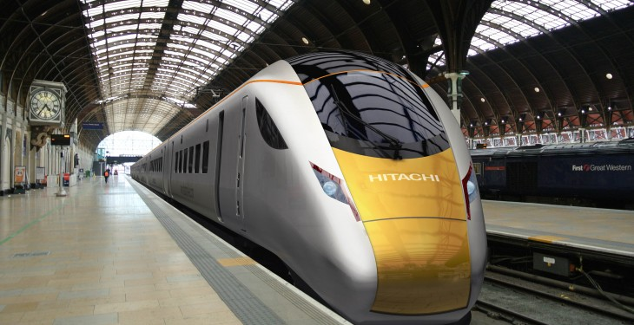
Railway Infrastructure Financing and Public-Private Partnerships
Railway Infrastructure Financing
Public-Private Partnerships
Sustainable Development Goals
SC2 Project

Slide 3
Railway Infrastructure Financing
Public sector
Government grant
Low cost of finance
Private sector
Market debt capacity
Higher cost of finance
Support from
EU – Connecting Europe Facility
The World Bank

Slide 4
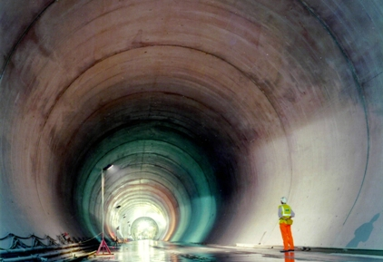
Public Private Partnerships
Structures
Traditional – DBFM
Construction Finance – DBF
O&M concession
Scope
High Speed lines
Infrastructure enhancements
Railway Station development
Rolling Stock procurement
Light Rail

Slide 5
Public Private Partnerships
Risks
Political risk
Construction risk
High capital cost
Demand risk (passenger revenues)
Availability of finance
Rewards
Whole Life costing
Spreading the cost

Slide 6
Public Private Partnerships
Issues
Suitable schemes
Market appetite
High cost
Long timeframe
Working Party on Transport Trends and Economics 27th Session
PPPs are not always the best solution for financing transport infrastructure and very careful steps should be taken and considered before proceeding with such an investment tool

Slide 7
Sustainable Development Goals
Adopted in September 2015 as a global mandate to end poverty, fight inequality and injustice, and tackle climate change
SDG9 – “build resilient infrastructure, promote exclusive and sustainable industrialisation and faster innovation”
SDG3 - good health and wellbeing
SDG8 - decent work and economic growth
SDG11 - sustainable cities and communities
SDG13 - climate action
SDG17 - partnerships for the goals

Slide 8
SC2 project
UNECE Standard on best practice for the management of Public Private Partnership (PPP) programmes in the rail sector
The aim of the project is to provide standards that will help achieve SDGs in the rail sector
The standards will:-
Analyse project types and examples
Review pros and cons of PPP programmes in the rail sector
Identify appropriate models to meet People First Objectives

Slide 9
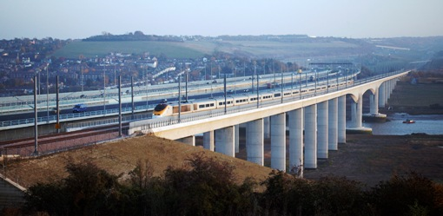
SC2 Project
Project team
Questionnaire
Sent to over 200 consultees from 25 nations
Reference projects
High Speed 1 (UK)
Southern Cross Railway station (Australia)
HSL South Europe Atlantic (France)
Intercity Express Programme (UK)

Slide 10
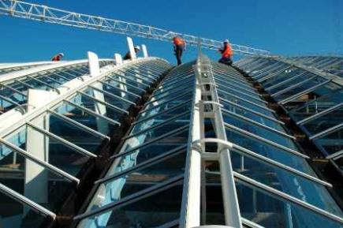
SC2 project
Outline of standard
Project selection
Business case assessment
Objective approval process
Output based specification
Market consultation
Financing
Market capacity
Economic framework for financial commitments
Availability of guarantees

Slide 11
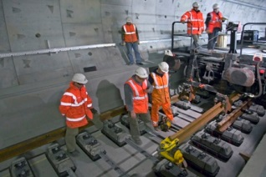
SC2 project
Outline of standard
Legal requirements
Standard documentation
Governance arrangements
Competitive procurement process
Transparent evaluation of tenders
Zero tolerance to corruption
Sector specific issues
Regulation
Patronage
Cost overruns

Slide 12
Contact
Jonathan Beckitt
Infrastructure and Project Finance Group
CMS Cameron McKenna LLP
Cannon Place 78 Cannon Street London EC4N 6AF
Tel: +44 20 7367 2113
jonathan.beckitt@cms-cmck.com

