Slide 1
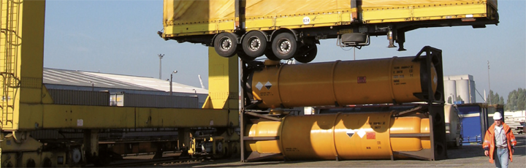
UNECE Intermodal Workshop
Intermodality leads to
Economic sustainability
Ralf-Charley SCHULTZE
President
geneva
1

Slide 2
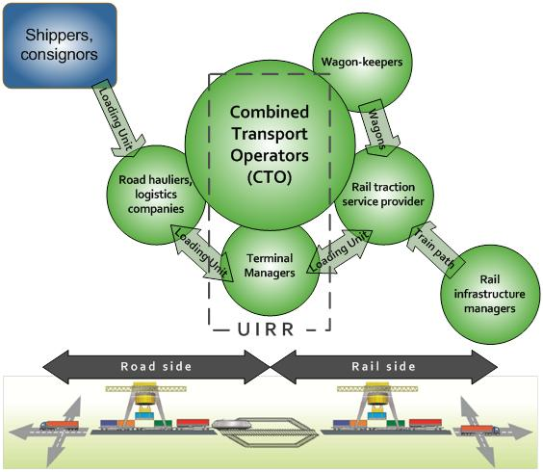
UIRR - Overview
Members: Combined Transport Operators and Terminal Managers, who enable the efficient insertion of rail into transport-chains
Logistics companies, road hauliers: customers as well as shareholders of UIRR Members
Performance: UIRR Members handled about 50% of European Combined Transport in 2014
Interest: fair regulatory conditions in
transport to enable competition on the
basis of technical merit and
competence/management excellence
UIRR: founded in 1970
- seat in Brussels since 1988

Slide 3
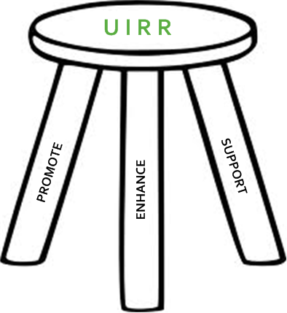
UIRR - Strategy
UIRR is an industry association which
PROMOTES the public understanding and appreciation of Road-Rail Combined Transport,
ENHANCES its development and the proliferation of industry best practice,
SUPPORTS the daily operation of European Combined Transport with a series of services

Slide 4

UIRR - Mission
Grow the pie
through fair competition on the basis of
technical merit, as an enabler of economic prosperity
the competence (professionalism) of those who organise CT
catalysed by UIRR as the industry association of the sector

Slide 5
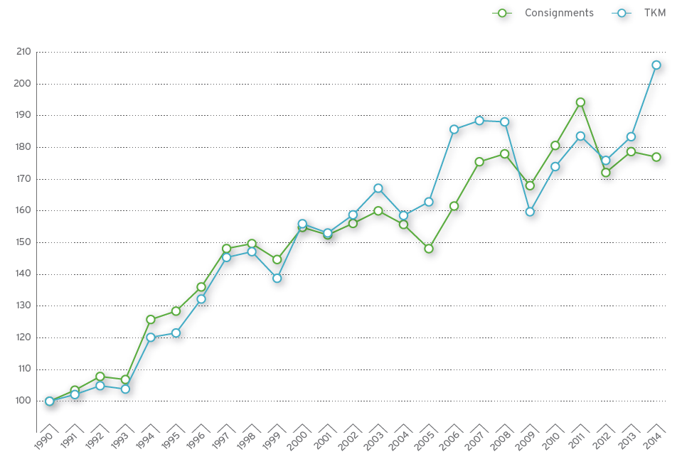
UIRR – Growth rate of Members 1989 – 2014
5

Slide 6
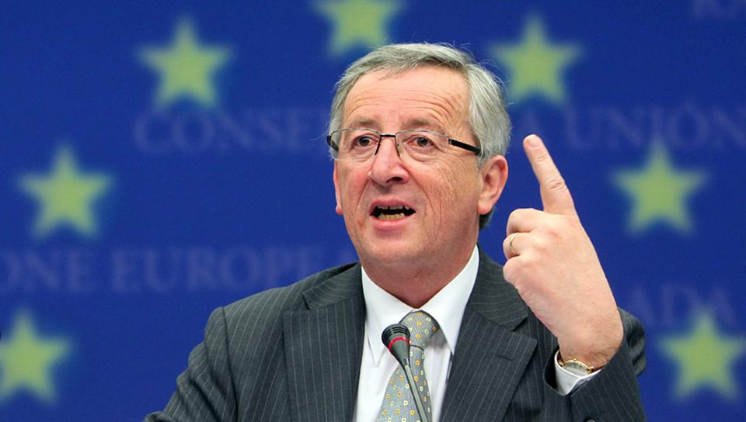
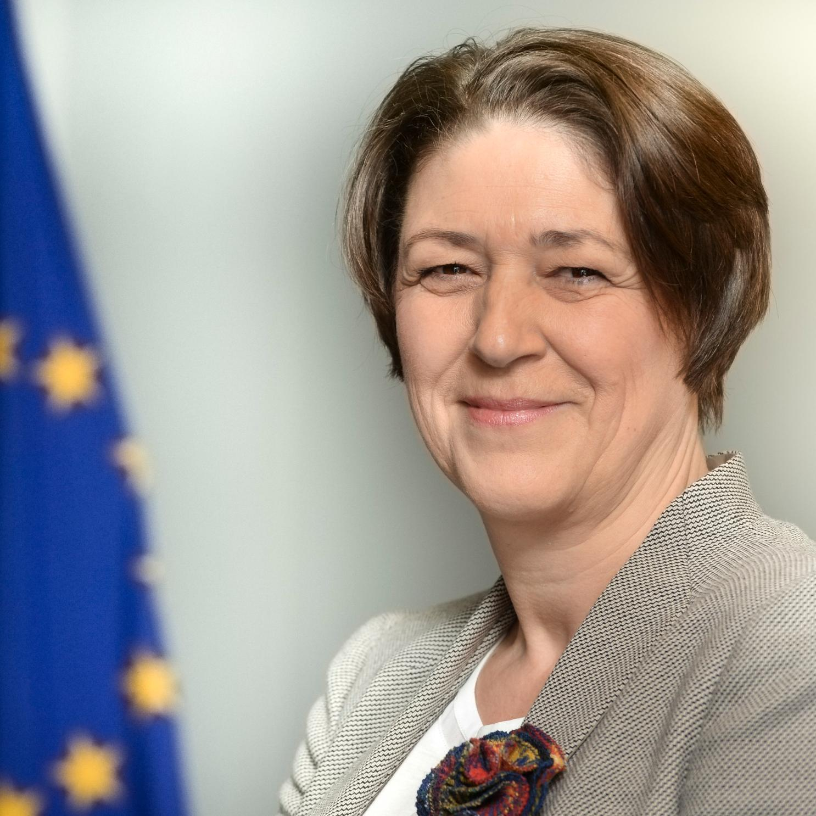
Mission letter of the new Transport Commissioner
6
”…the reduction of greenhouse gas emissions by the transport sector
contributes to the achievement of the overall EU target in this area.
This should be part of our overall effort to reinforce the sustainability of
our growth model.”

Slide 7
EU 2011 Transport White Paper
Shift 30% of long(er) distance road tonne-kilometres realised over distances of 300km or more by 2030 from trucks to sustainable modes of transport - (electric) rail, inland navigation and shortsea shipping - which ratio should increase to 50% by 2050*
* on the basis of 2010

Slide 8
The challenge at hand
8
The Beauty… (?)
and The Beast

Slide 9
The key to intermodality: switch to using the ”box”
9
Containerisation: the pre-requisite to unlock the benefits Combined Transport
HIGH VALUE
PERISHABLES
OVERSIZED
LIQUIDS
DANGEROUS GOODS
BULK
PALLETS

Slide 10
Unimodal vs. Intermodal transport
 | UNIMODAL FREIGHT TRANSPORT
 | Misses out on advantages: energy efficiency, labour productivity, superior safety and security, climate resilience, and oustanding environmental peformance.
INTERMODAL / COMBINED TRANSPORT
Efficiently inserts economically and ecologically sustainable modes of transport into long(er) distance transport-chains to maximise the benefits for every stakeholder.

Slide 11
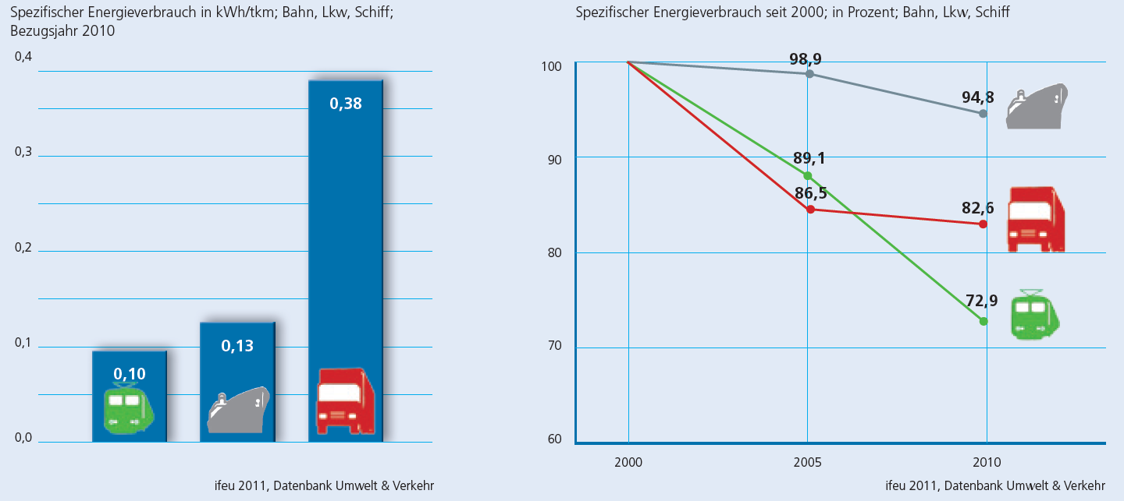
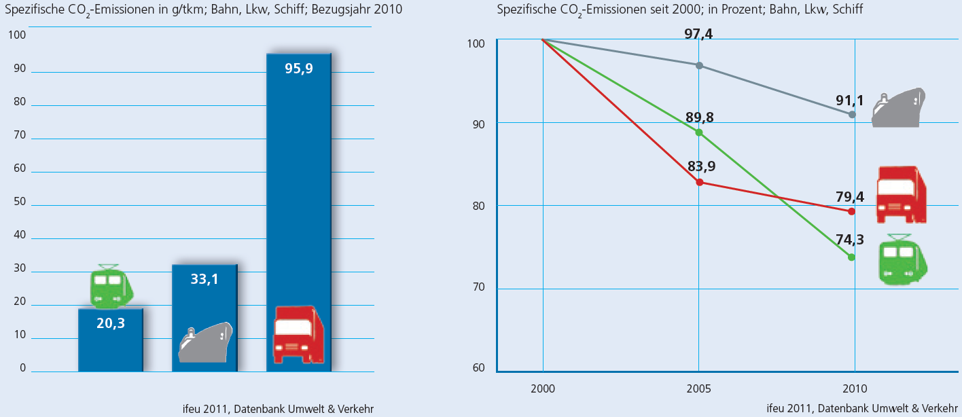
Primary energy need and CO2 performance of modes

Slide 12
Safety performance comparison
Safety category | Road | Rail
Fatalities in 2009¹ | 35 000 | 34
Accident occurrences: (i) road¹ and (ii) rail² | 1 200 000 | 1152
Accident occurrences: (i) HGVs, (ii) freight trains | 31 per 100M vkm² | 1,05 per 100M vkm³
Accident externality cost of (i) HGVs on motorways, and (ii) trains | €68 667 per 100M tkm⁴ | €238 per 100M tkm⁵
Road haulage is
30-times as accident prone as rail
¹ Source: EC EU transport in figures [2011]
² Source: Alan C McKinnon at 2nd IRU/EU Road Transport Conference: “31 per 100M vkm” [2012]
³ Source: ERA 2011 Rail Safety report figure (tkm) converted to (HGV) vkm @ 30t/vehicle rate [2011]
⁴ Source: CE Delft IMPACT Study (internalisation handbook) converted into tkm @ 30t/vehicle rate [2008]
⁵ Source: CE Delft IMPACT Study (internalisation handbook) converted into tkm @ 800t/train rate [2008]

Slide 13
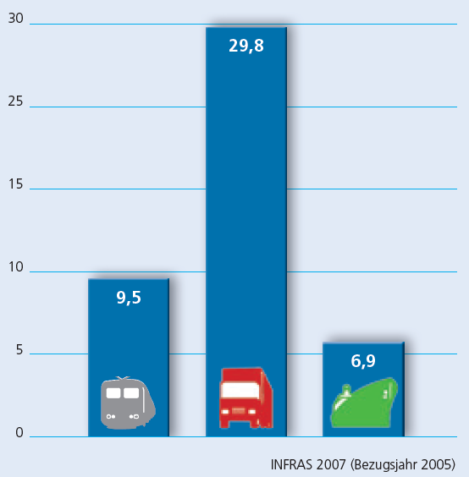
External costs of modes
External costs of rail: 33% of road
Ro-Ro and smaller vessels perform worse

Slide 14
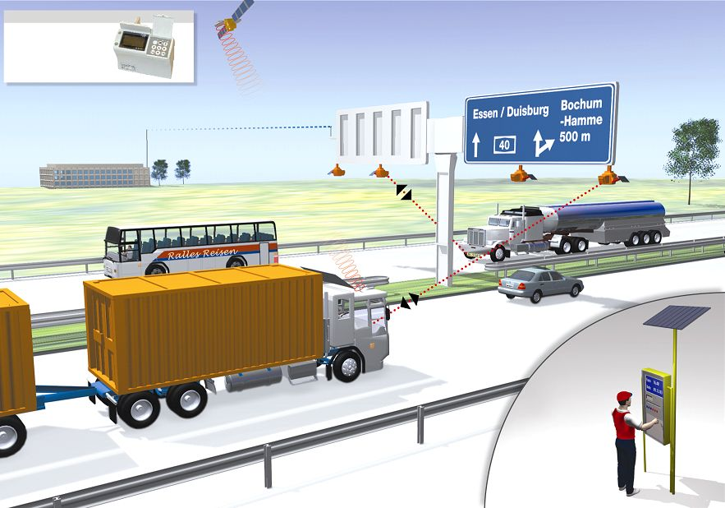

Distance-based eTolling on all roads

Slide 15
The relative competitive situation of modes
Two principles should be equally upheld:
user-pays
polluter-pays
The de-politicisation of transport - no more budget transfers - would be needed to make transport truly market based and competitive in a fair manner.

Slide 16
Competitiveness of the railway sector
16
Quality on rail
Traction
Wagons
Infrastructure
Train path
THE SOLUTION
The Fourth Railway Package: fair intramodal competition, homogeneous infrastructure management, technical harmonisation and reduced administrative burden
Rail Freight Corridor Regulation: seamless cross border travel, coordinated development and maintenance works, capacity planning and traffic management
The new TEN-T Guidelines and the Connecting Europe Facility: interoperable and homogeneous infrastructure, removal of capacity bottlenecks
Standardisation: CEN, ERA, UN ECE, OTIF, UIC, voluntary industry best practice recommendations
Implementing Acts and reporting: Commission guidance and enforcement of implementation concerning the European rules; as well as statistics collection and reporting

Slide 17
The Regulators’ Challenge
17
Relative competitive framework
- user to pay all costs: involved with accessing the public transport infrastructure; in case of roads it is land rent, operation (cleaning, rescue – emergency services, policing/traffic management), maintenance and construction
Internalisation
- congestion: value charging principle – congestion surcharge within road toll (scarcity surcharge)
- local pollution: noise, PM10, vibration, landscape destruction – within road toll
- accidents: loss to society due to loss of life or permanent injury – insurance surcharge
- GHG emission and oil dependency: climate change and ”wars for oil” – fuel excise duty
Within the railway sector
- end privileged relationships: traction service and other railway transportation providers should be allowed to fairly compete – irrespective of ownership / grouping with infrastructure manager
- rail infrastructure investments to be subject to strict cost-benefit-analysis: be based on business rationality – not only subject to political preference (vote maximisation)
For the intermodal sector
- harmonised regulatory framework throughout the EU: eliminate heterogeneity present in prevailing Member State level regulatory framework to help create a genuine single market

Slide 18
Regulatory framework for Combined Transport 1/2
18
The recast of Directive 92/106 to create a genuine single market in the EU
Framework legislation
- definitions and Pan-European rules for technical aspects such as codification, certification, registration, etc.
Temporary benefits
- to counterbalance the regulatory disadvantage for as long as it continues to prevail (proportionately to the status quo in each Member State)
Optimised infrastructure
- complementing the large CEF Transport projects with small scale development aid on a Member State level to eliminate infrastructure limitations faced by consignors if wishing to shift to intermodal/combined transport
continued…

Slide 19
Regulatory framework for Combined Transport 2/2
19
The recast of Directive 92/106 to create a genuine single market in the EU
Development plans
- encouraging the complex horizontal thinking required by intermodal/combined transport based logistics on a Member State level
Intermodality test
- systematic test of any policy or regulatory proposal as part of the impact assessment to check whether an intermodal/combined transport solution could not deliver the desired outcome more efficiently
Monitoring and reporting
- accurate measurement of intermodal/combined transport performance and regular feed-back to the decision-makers

Slide 20
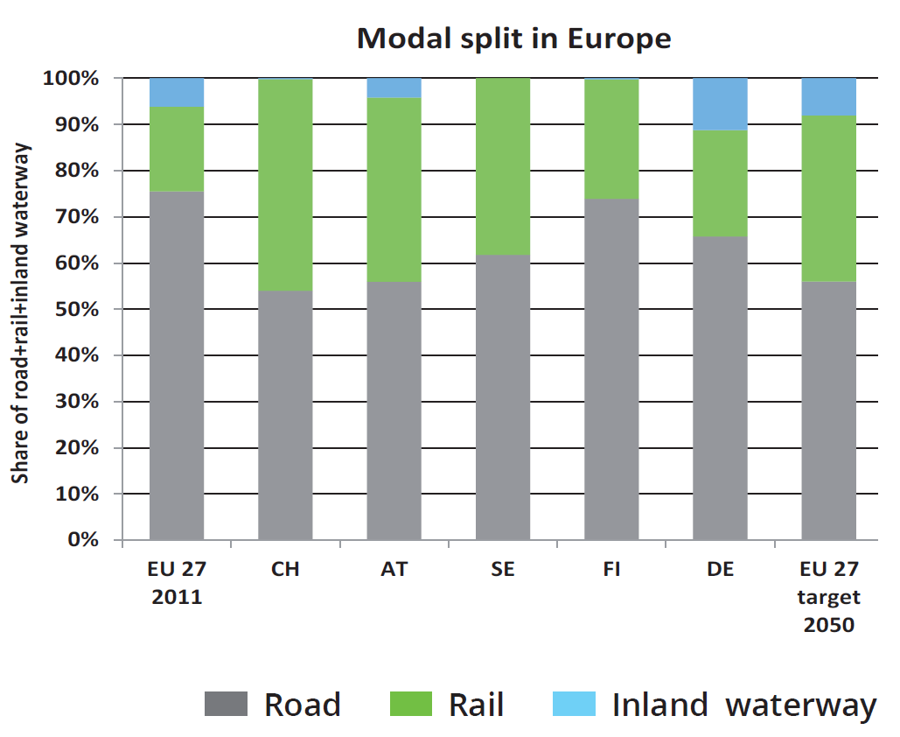
Modal split without SSS (coastal shipping)
=
Source: TRANSFORuM Project Report on Long Distance Freight, June 2015

Slide 21
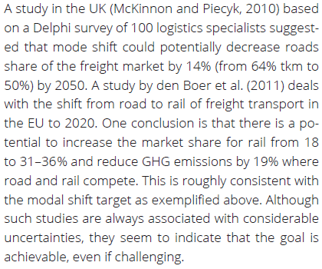
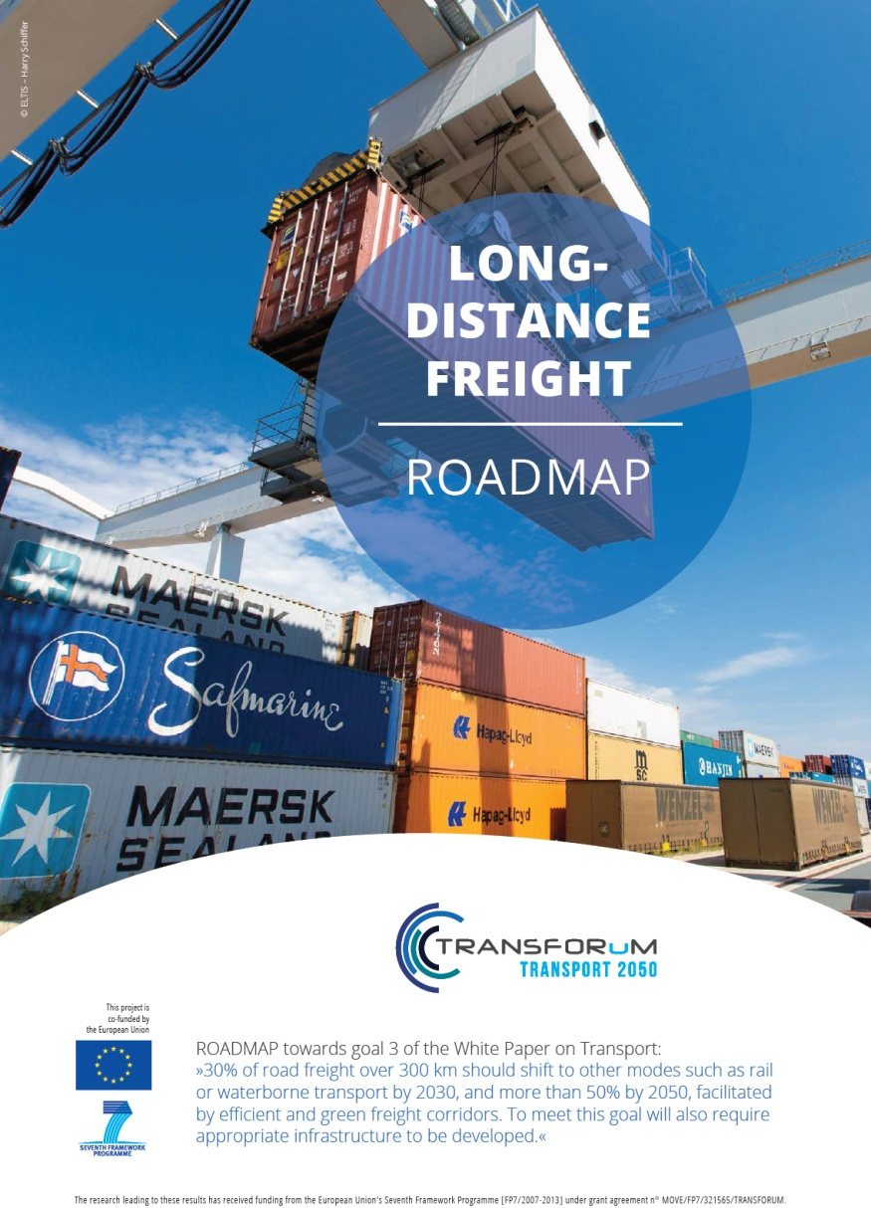
”Achievable, even if challenging”
Source: TRANSFORuM Project Report on Long Distance Freight, June 2015

Slide 22
The preference should be clear
The answer: Intermodal solutions
Energy efficiency
Accidents: injuries and fatalities
Congestion
Road degradation
PM10 emissions
CO₂ emissions
Labour productivity
Oil dependency

Slide 23
A Challenge to Logistics Professionals
 | Unimodal solution | Intermodality
Short-haul (positioning/distribution traffic) | trucks | trucks
Terminals | road logistics centres | intermodal terminals
Long-haul | road-only (megatrucks) | rail, SSS, IWW
Containerisation (using intermodal loading units) | not necessary | prerequisite
Consignors, logistics service providers | business as usual | creative, innovative thinking
INTERMODALITY = CREATIVE, INNOVATIVE THINKING IN TRANSPORT

Slide 24
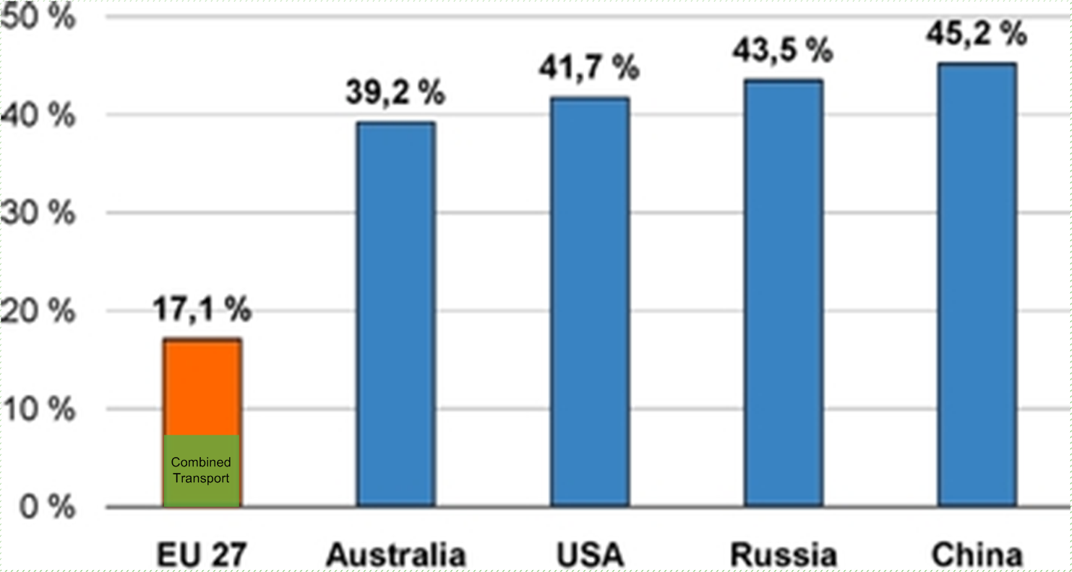
The outlook
THE RELATIVELY LOW SHARE OF RAIL FREIGHT IN EUROPE
PROMISES A CONSIDERABLE UPSIDE POTENTIAL FOR GROWTH

Slide 25
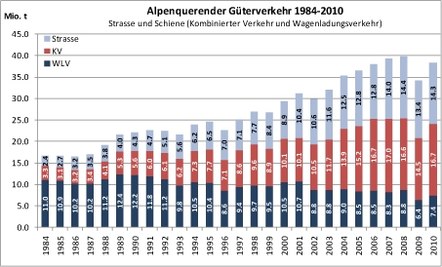
The future: Combined Transport can do the job
25
…if and where the framework conditions are right
Competition and transparency: level playing-field for the different modes
Recognition of freight: train path capacity allocation
Development of capacities: lines and terminals (infrastructure)
Quality and accountability
Transalpine traffic
through Switzerland
1984 – 2010

Slide 26
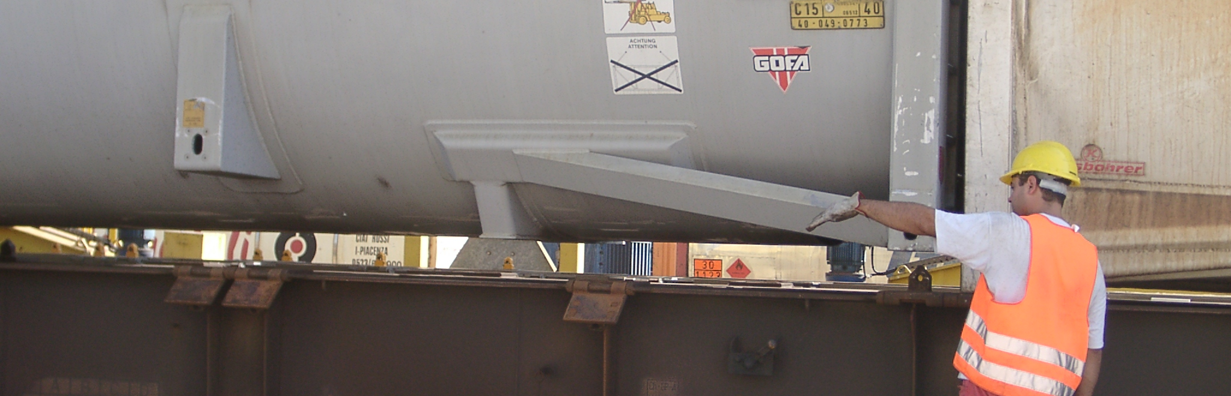
Thank you
For your attention
26

