Slide 1
Strategic Risk Management at the Swiss Federal Office of Transport
Hannes Meuli, Roman Slovák, FOT
Workshop on Rail Safety: Trends and Challanges, UNECE, Geneva, 24th November 2015
Notes:
AutorInnen-Namen eingeben: Registerkarte «Einfügen», «Kopf- und Fusszeile» den AutorInnen-Namen bei «Fusszeile» eingeben, «für alle übernehmen» klicken.
Hinzufügen von neuen Folien: Registerkarte «Start», «Neue Folie»; hier das entsprechende Layout auswählen.

Slide 2
Agenda
Federal Office of Transport (FOT)
Risk Assessment at FOT
Safety Monitoring
Statistics
Safety Performance Benchmark
Conclusions

Slide 3
Federal Office of Transport
National safety authority for public transport in Switzerland (railways, trams, busses, ships, cableways)
Main tasks:
Safety: Regulation, approvals, risk assessment, inspections
Financing
Commissioning of rail infrastructure extensions
The section of Safety-Risk Management is responsible for setting up the safety policy, definition of safety targets and establishing methods for safety monitoring
Notes:
Supervision volume of FOT:
Railway
IM, RU (80 undertakings) Wagon Keepers (150)
Undertakings with side tracks (1500)
Cableway (250)
Bus (100)
Navigation (20)

Slide 4
Policy FOT Safety Concept
The FOT uses a risk-oriented approach when assessing safety-related aspects
Basic principles:
Maintaining safety in public transport at least at current levels and on a par with leading countries
Accepting residual risk only when, to the best of our knowledge, such risk is justifiable and cannot be entirely eliminated through reasonable measures
Establishing the necessary conditions to allow the financial resources for safety measures to be used as effectively and economically as possible
www.bav.admin.ch

Slide 5
Risk Management at FOT
Federal Office of Transport FOT
Management Board FOT
Strategic Risk Management
Safety Monitoring
Swiss accident investigation board
Expert knowledge
Operative Risk Management
List of Risks
Incident database
Assessed Safety Risks
Audits, Inspections
Stakeholders of Swiss public transport (RU, IM, etc.)

Slide 6
Safety Monitoring
Safety indicators
Incident database
Evaluation of long term incident data
Target Evaluation
Safety targets
Assessed Safety Performance
Evaluation of short term incident data
Safety performance
Trend Identification

Slide 7
System of safety indicators
highest abstraction level for information to FOT management
annual assessment
5 TOP Safety Indicators
higher abstraction level, covering approx. 90% of total risk
21 FOT Safety Indicators
117 BASE Safety Indicators
indicators with relation to type, place, cause and severity of the occurrences

Slide 8
Safety Monitoring Results for the Management Board
Indicator | FWSI Ø 2009-12 | FWSI 2014 | Evalu-ation | 4-year trend | annual slope
TOP 1 all FWSI | 26.6 | 35.9 | 2 |  | 14.4%
TOP 2 FWSI in RU&IM responsibility | 4.8 | 4.8 | 1 |  | -3.3%
Indicator | Incidents Ø 2009-12 | Incidents 2014 | Evalu-ation | 4-year trend | annual slope
TOP 3 all incidents | 481.8 | 446 | 1 |  | 1.8%
TOP 4 incidents caused by human spurious action | 154.0 | 131 | 1 |  | 2.1%
TOP 5 incidents caused by technical defect | 53.0 | 38 | 1 |  | -2.6%

Slide 9
Data source Tool for collection of occurrence data
Web based database
About 5‘000 occurrences per year (railways ca. 4‘200)
Reporting includes
Basic data
Short description
Classification according to the kind (WHAT), location (WHERE), reason (WHY) and responsibility (WHO)
Consequences (Fatalities, serious/light injuries, damage to infrastructure/rolling stock/environment)
Supporting three national languages (de/fr/it)

Slide 10
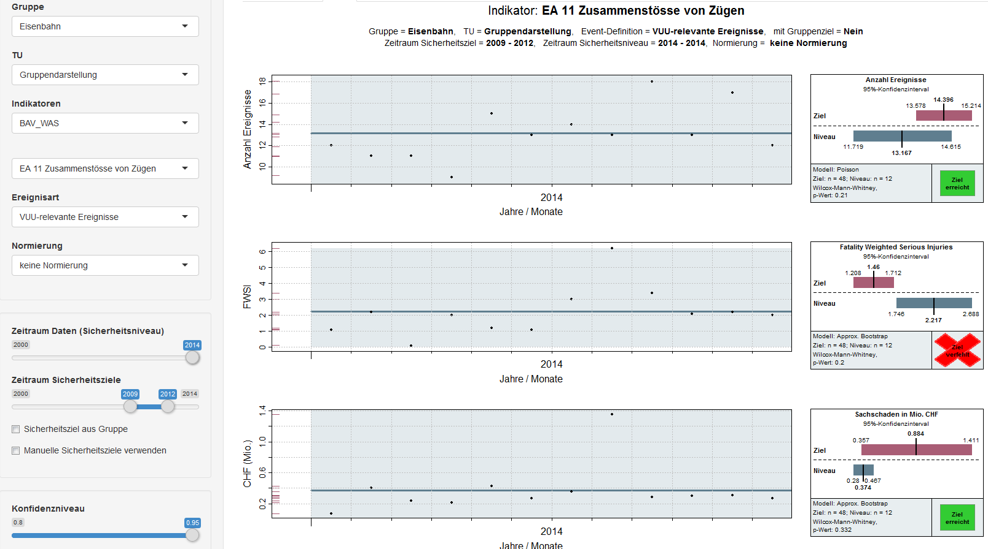
Supporting Tool for Safety Monitoring
Main features:
Evaluation of safety targets (all indicator levels)
Identification of significant trends and computing of annual slopes
Root-Cause analysis
Risk overviews

Slide 11
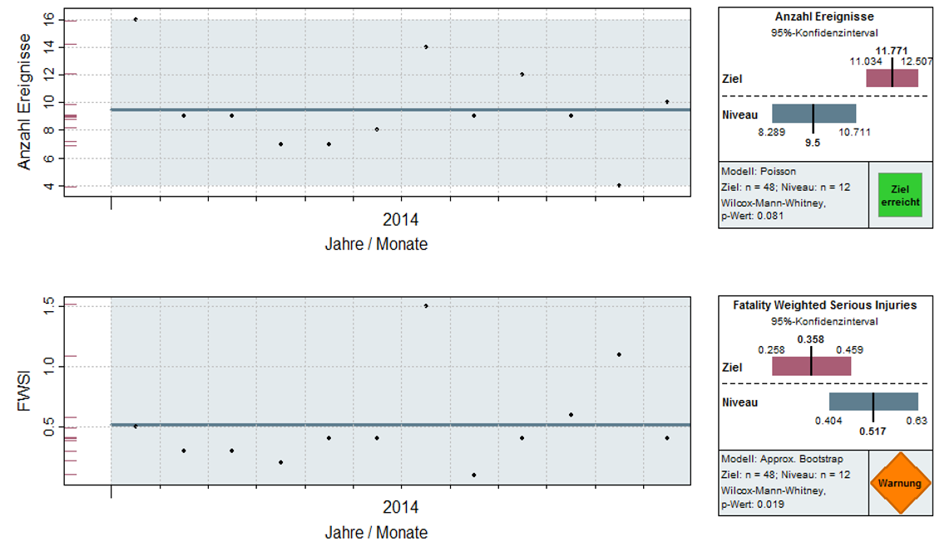
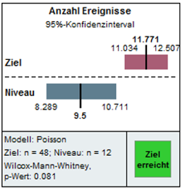
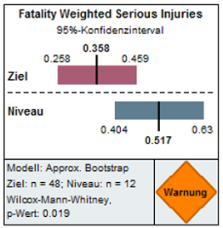
Safety target evaluation Example: Accidents to Persons
Occurrences
Jan Feb Mar Apr May Jun Jul Aug Sep Oct Nov Dec
2014
FWSI
Jan Feb Mar Apr May Jun Jul Aug Sep Oct Nov Dec
2014

Slide 12
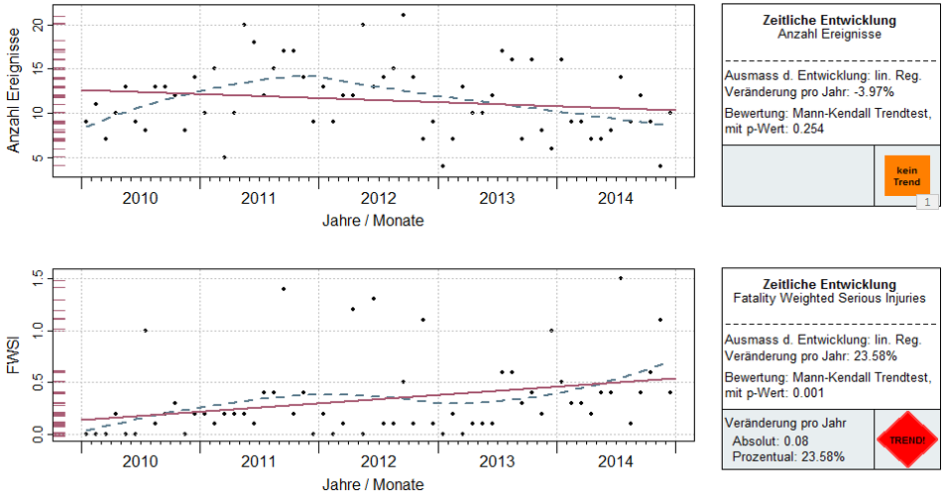
Trend identification Example: Accidents to Persons
Occurrences
Jan Feb Mar Apr May Jun Jul Aug Sep Oct Nov Dec
2014
FWSI
Jan Feb Mar Apr May Jun Jul Aug Sep Oct Nov Dec
2014

Slide 13
Safety Performance Benchmark
Basing on ERA-Indicators (CSI/CST)
Data published annually by the European Railway Agency (ERA)
Comparison with 17 EU-countries (with at least 20% of CH train-km)
Reference period: three years
Comparison of 13 Indicators
Ranking of countries
per indicator
per sum of indicator’s rankings

Slide 14
Indicators of the Benchmark
 | Indicator | Scaling base
1 | Total Number of all accidents | train km
2 | Number of Collisions of trains | train km
3 | Number of Derailments of trains | train km
4 | Number of Level-crossing accidents | train km
5 | Number of Accidents to persons | train km
6 | Number of Fires in rolling stock | train km
7 | Passengers FWSI | passenger train km
8 | Passengers FWSI | passenger km
9 | Employees FWSI | train km
10 | Level crossing users FWSI | train km
11 | Other persons FWSI | train km
12 | Unauthorised persons FWSI | train km
13 | Total number of persons FWSI | train km
FWSI – Sum of Fatalities and Weighted Serious Injuries (1F = 10 SI)

Slide 15
Results of the Benchmark: CH-rank per indicator
Indicator | CH-rank 2009/11 | CH-rank 2010/12 | CH-rank 2011/13
All accidents | 5 | 4 | 3
Collisions of trains | 13 | 10 | 13
Derailments of trains | 1 | 2 | 3
Level-crossing accidents | 2 | 2 | 2
Accidents to persons | 7 | 8 | 7
Fires in rolling stock | 7 | 13 | 10
All persons FWSI | 3 | 2 | 3
Passengers FWSI per PTKm | 8 | 5 | 9
Passengers FWSI per PKm | 9 | 6 | 10
Employees FWSI | 6 | 8 | 11
Level crossing users FWSI | 1 | 2 | 2
Other persons FWSI | 11 | 11 | 15
Unauthorised persons FWSI | 3 | 3 | 4
Sum of indicator’s rankings CH 76 76 92

Slide 16
Results of the Benchmark: ranking per sum of indicator’s rankings
Country | Rank 2009/11 | Rank 2010/12 | Rank 2011/13
United Kingdom | 1 | 1 | 1
Finland | 7 | 3 | 2
Netherlands | 3 | 4 | 3
Switzerland | 4 | 2 | 4
Denmark | 2 | 5 | 5
Norway | 8 | 10 | 6
Italy | 12 | 7 | 7
Germany | 6 | 8 | 8
Sweden | 10 | 12 | 9
Spain | 5 | 6 | 10
Austria | 11 | 11 | 11
France | 9 | 9 | 12
Belgium | 17 | 15 | 13
Czech republic | 14 | 14 | 14
Romania | 15 | 16 | 15
Hungary | 13 | 13 | 16
Slovakia | 18 | 17 | 17
Poland | 15 | 18 | 18

Slide 17
Conclusions
Safety Monitoring provides a base for taking risk-oriented decisions to
Management Board
Experts
Helps to inform the government on achievement of the safety targets:
Safety at least at current level
Safety on a par with leading countries
No over-interpretation! Judgements on national level only, when data statistically significant
Benchmark:
No detailed occurrence data -> limited possibility for statistical analyses
Comparing needs scaling: Traffic-Volume (Train-km) or Traffic-Density (Train-km/Track-km)?

