Slide 1
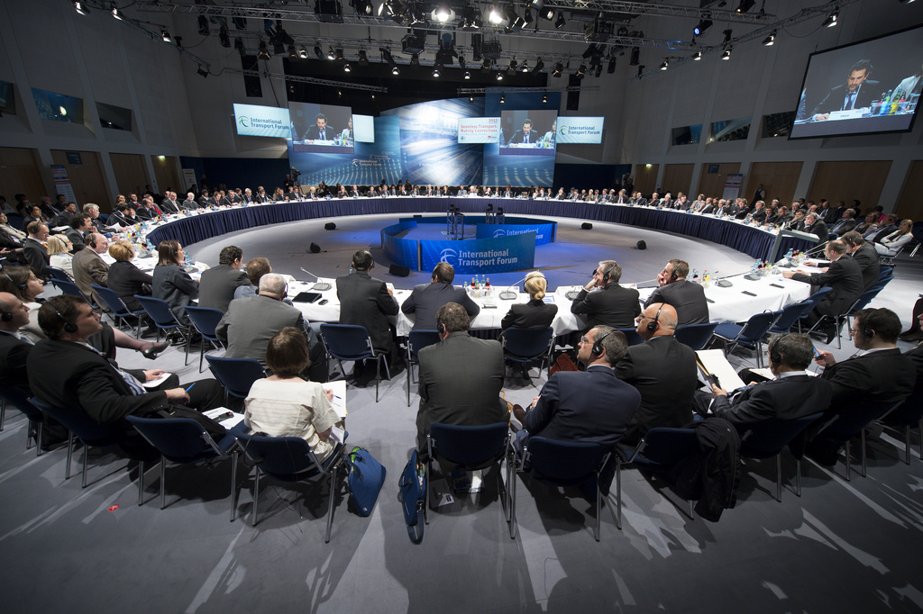
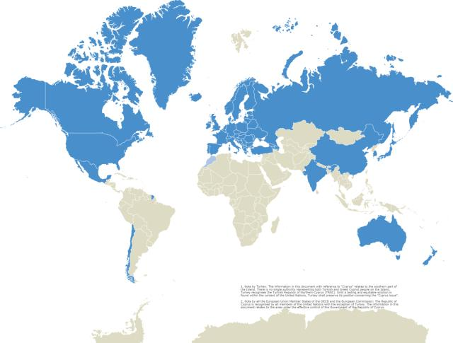
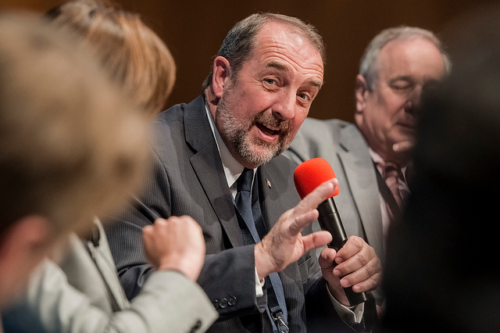
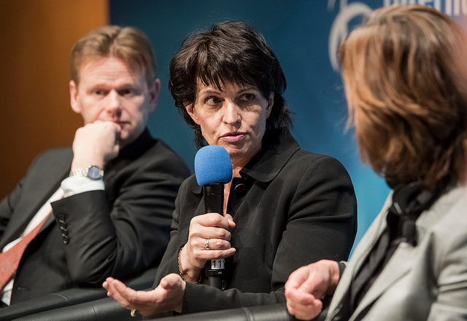
The International Transport Forum at the OECD
Think Tank | Annual Summit | Intergovernmental Organisation

Slide 2
Intergovernmental Organisation
57 member countries (23 non-OECD)
Administratively integrated with OECD
Only transport body with a mandate for all modes

Slide 4
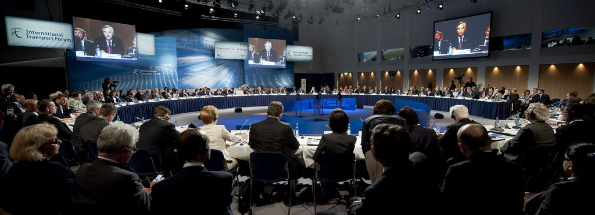
The Annual Summit
Held every May in Leipzig, Germany, on a strategic theme
Ministers are joined by business leaders, civil society, international organisations, research community
Outputs help advance and guide transport policy for 21st Century
Notes:
The Summit of the International Transport Forum is the world's leading transport policy event. Every year, it brings together transport ministers from 57 member countries with business leaders, top researchers, and key sector representatives for debate and networking. 2016: Green and inclusive transport
In focus: Green transport, inclusive mobility Transport plays a central role in the pursuit of prosperity that is both economically and environmentally sustainable, and where the benefits are more evenly shared across society. The 2016 Summit will consider why green and inclusive transport is important for economic growth, and how low-carbon transport will help the transition to a green growth economy. It will also explore the changes needed to make transport more inclusive and to provide better, broader access to services, jobs, and other opportunities. How you can get involved The 2016 Summit provides a unique opportunity to involve your organisation in this critical debate. Raise your organisation's profile, showcase your products, services, research and other initiatives and benefit from unparalleled access to a high-level audience and international media. Contact us to discuss the many ways to get involved and to identify relevant opportunities for your organisation.

Slide 5
Think Tank
Policy research, analysis, statistics and outlook
Roundtables: Accessibility, Regulatory Change
Corporate Partnership Board and Common Interest Groups
Renewed focus on railways
lorenzo.casullo@oecd.org
Notes:
Common Interest Groups with member countries and interested organisations

